Slide 1
Realtime Rendering
CS 481/681 Computer Graphics Rendering

Slide 2
Overview
Reyes Architecture
Shade Trees

Slide 3
Reyes Architecture
Cook, Carpenter, Catmull 1987
Pixar Renderman
An Architecture
Micropolygons
Visibility
Programmable Shaders
Motivation: Speed
Rendering a 2 hour movie in one year
3 minutes per frame

Slide 4
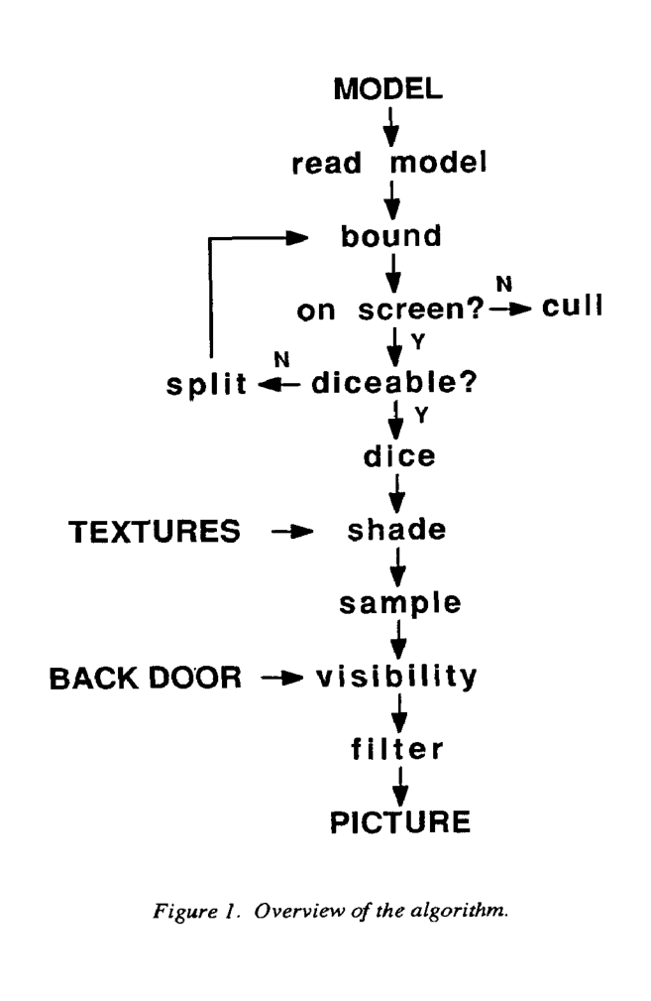
Reyes Flowchart
Reyes Architecture

Slide 5
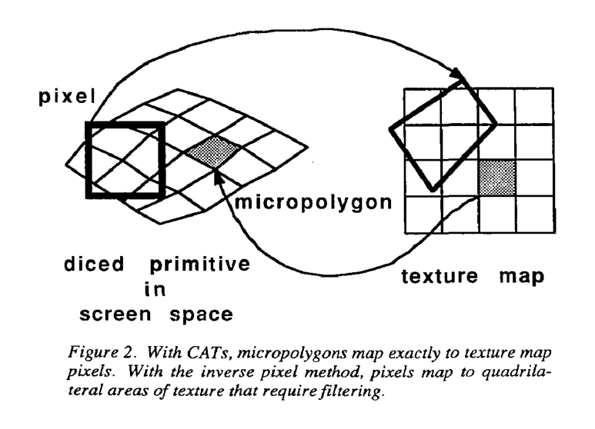
Reyes Texture Maps

Slide 6
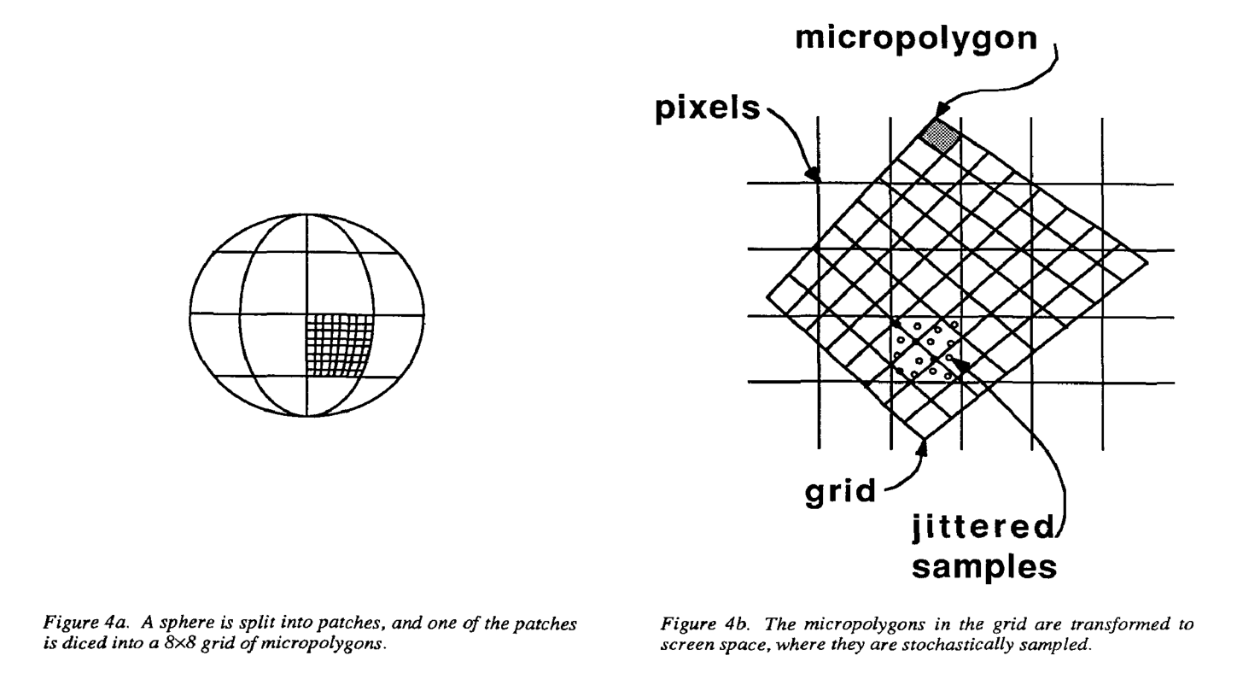
Reyes Micropolygons

Slide 7
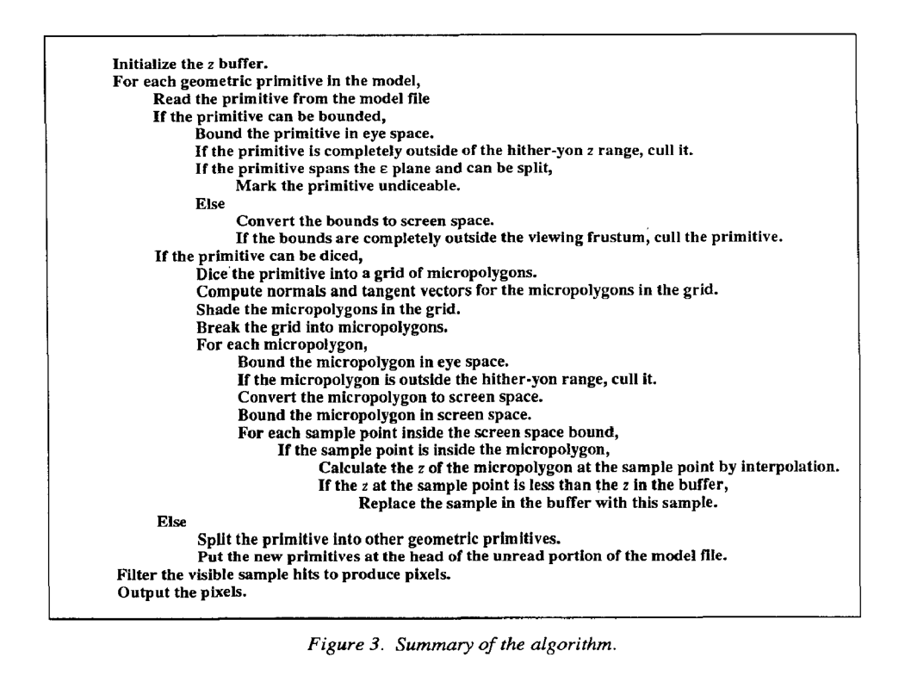
Reyes Algorithm

Slide 8
Shade Trees
Cook 1984

Slide 9
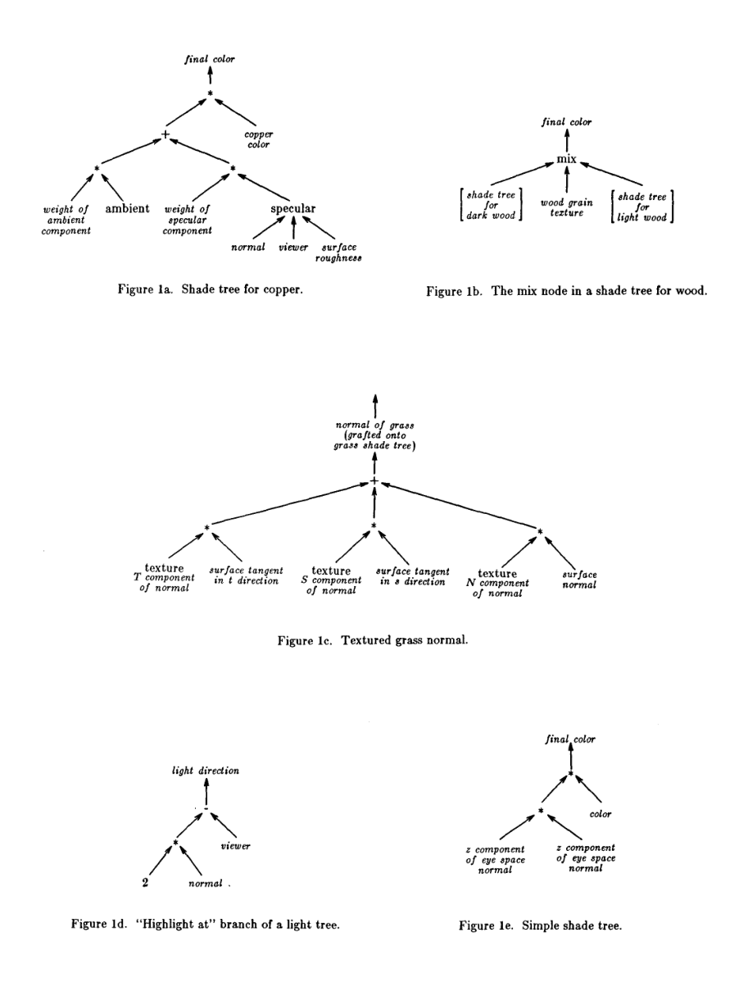
Shade Trees

Slide 10
Questions
What are advantages / disadvantages?
What are micropolygons?
Why use shaders?

Slide 11
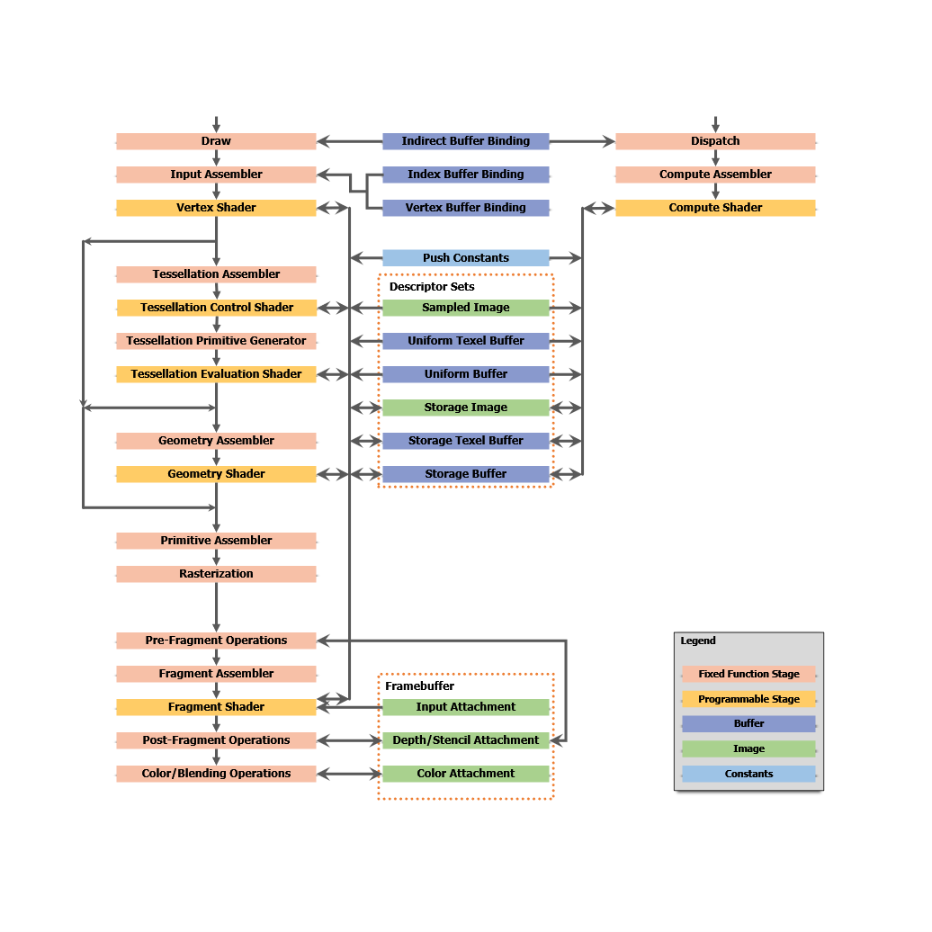
Comparison
Vulkan Pipeline

