Slide 1
Enhancing Wrist Fracture Detection with YOLO
Presented by :
Jaydutt Desai (25PGAI0017)
Nisarg Patel (25PGAI0104)
Rahil Bhensdadia (25PGAI0001)
Guided By : Prof. Sudipta Roy

Slide 2
Introduction
Background
Wrist fractures—especially distal radius and ulna fractures—are common among children, adolescents, and young adults during puberty. Timely diagnosis is critical for proper treatment and long‐term outcomes.
Early methods used sliding window approaches and handcrafted features (e.g., LBP and Haar-like features), which later evolved into region-based (two-stage) and single-stage detection frameworks. The emergence of deep learning, especially models like YOLO (You Only Look Once), has opened a path for faster and potentially more accurate detection in medical imaging contexts.
Problem Statement
The paper identifies a pressing clinical issue: the accurate and rapid detection of wrist abnormalities (with a strong focus on fractures) in paediatric X-ray images. Given that misinterpretations in X-ray readings can be as high as 26%, and considering the limited availability of expert radiologists—especially in regions with increasing imaging studies—there is an urgent need for automated systems that can reliably flag fractures and other wrist abnormalities. Moreover, although two-stage detection methods have been popular, their computational overhead and limited exploration of single-stage detectors leave room for improvement.
Research Goal
To assess the effectiveness of state-of-the-art YOLO single-stage detectors (YOLOv5, YOLOv6, YOLOv7, and YOLOv8) for detecting wrist fractures using the GRAZPEDWRI-DX dataset—a large, comprehensively annotated paediatric wrist X-ray collection.

Slide 3
Existing Methods & Challenges
Existing Methods:
Two-stage Detection Methods: Approaches such as Faster R-CNN have been extensively used for fracture detection. Studies using VGG16 backbones, Inception-ResNet, and other variants have demonstrated high precision on relatively small datasets.
Sliding Window and Cascade Classifiers: Early efforts in object detection employed sliding window techniques combined with handcrafted features (e.g., LBP, Haar-like features) that were computationally expensive.
Early Single-stage Detectors: Although there has been limited work with single-stage detectors (e.g., YOLOv2, YOLOv4), the majority of the research has relied on two-stage approaches for detecting wrist abnormalities.
Challenges:
Diagnostic Accuracy: High error rates (up to 26% in some studies) in interpreting emergency X-rays underline the risk of misdiagnosis.
Data Scarcity and Annotation: Many studies have been limited by the size of available datasets, making robust model training difficult.
Computational Efficiency: Two-stage methods, while accurate, often come with increased computational costs and slower inference times.
Variant Performance: There is uncertainty over whether compound-scaled variants within the YOLO family improve detection performance across different classes of wrist abnormalities

Slide 4
Proposed Solution
Evaluation of single-stage object detection models
Implementing and Comparing Multiple YOLO Versions: Testing YOLOv5, YOLOv6, YOLOv7, and YOLOv8 along with various compound-scaled variants of each to assess improvements in performance.
Benchmarking Against a Two-stage Detector: Using Faster R-CNN as a baseline to quantify the performance gains of single-stage detectors.
Using a Large Annotated Dataset: Leveraging the GRAZPEDWRI-DX dataset, which contains over 10,000 wrist radiography studies, to validate the models under realistic clinical conditions.
Evaluating Multiple Metrics: Focusing on sensitivity and mAP to provide a robust assessment of fracture detection efficacy.

Slide 5
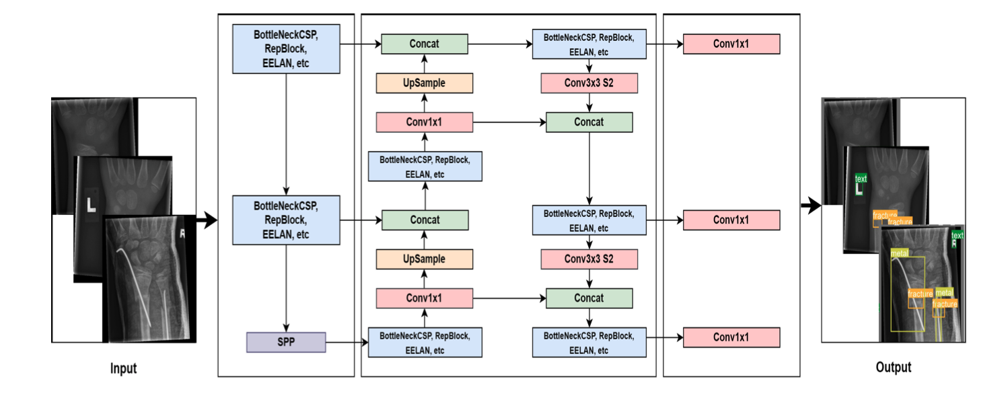
Architecture Overview
YOLOv5: Utilizes a three-part structure comprising a backbone (CSPDarknet for feature extraction), a neck (PANet for feature aggregation), and a head (for predicting bounding boxes, objectness scores, and class probabilities). It comes in five variants (“n”, “s”, “m”, “l”, “x”) that differ in depth and complexity.
YOLOv6: Introduces an anchor-free design with a reparametrized backbone (EfficientRep) and a decoupled head (Rep-PAN) to optimize both accuracy and computation.
YOLOv7: Implements E-ELAN for improved gradient flow, and applies novel model scaling techniques.
YOLOv8: While details are built on previous advances, this version is tailored further for performance, with experiments showing high sensitivity and precision in fracture detection. Faster R-CNN: Used as the comparative two-stage model, known for its two-pass approach (region proposal followed by classification/refinement).

Slide 6
Results
Dataset Utilization: The comprehensive GRAZPEDWRI-DX dataset is central to the experiments, providing a robust foundation for model evaluation.
Performance Metrics:
YOLOv8m achieved a fracture detection sensitivity of 0.92 and an mAP of 0.95.
YOLOv6m demonstrated the highest sensitivity across all classes at 0.83.
For multi-class detection on the dataset, YOLOv8x recorded the highest mAP of 0.77.
Comparative Insights:
The single-stage YOLO models outperformed the two-stage Faster R-CNN in terms of speed and accuracy.
The results also underscore the benefits of compound scaling in enhancing model performance for medical imaging tasks.

Slide 7
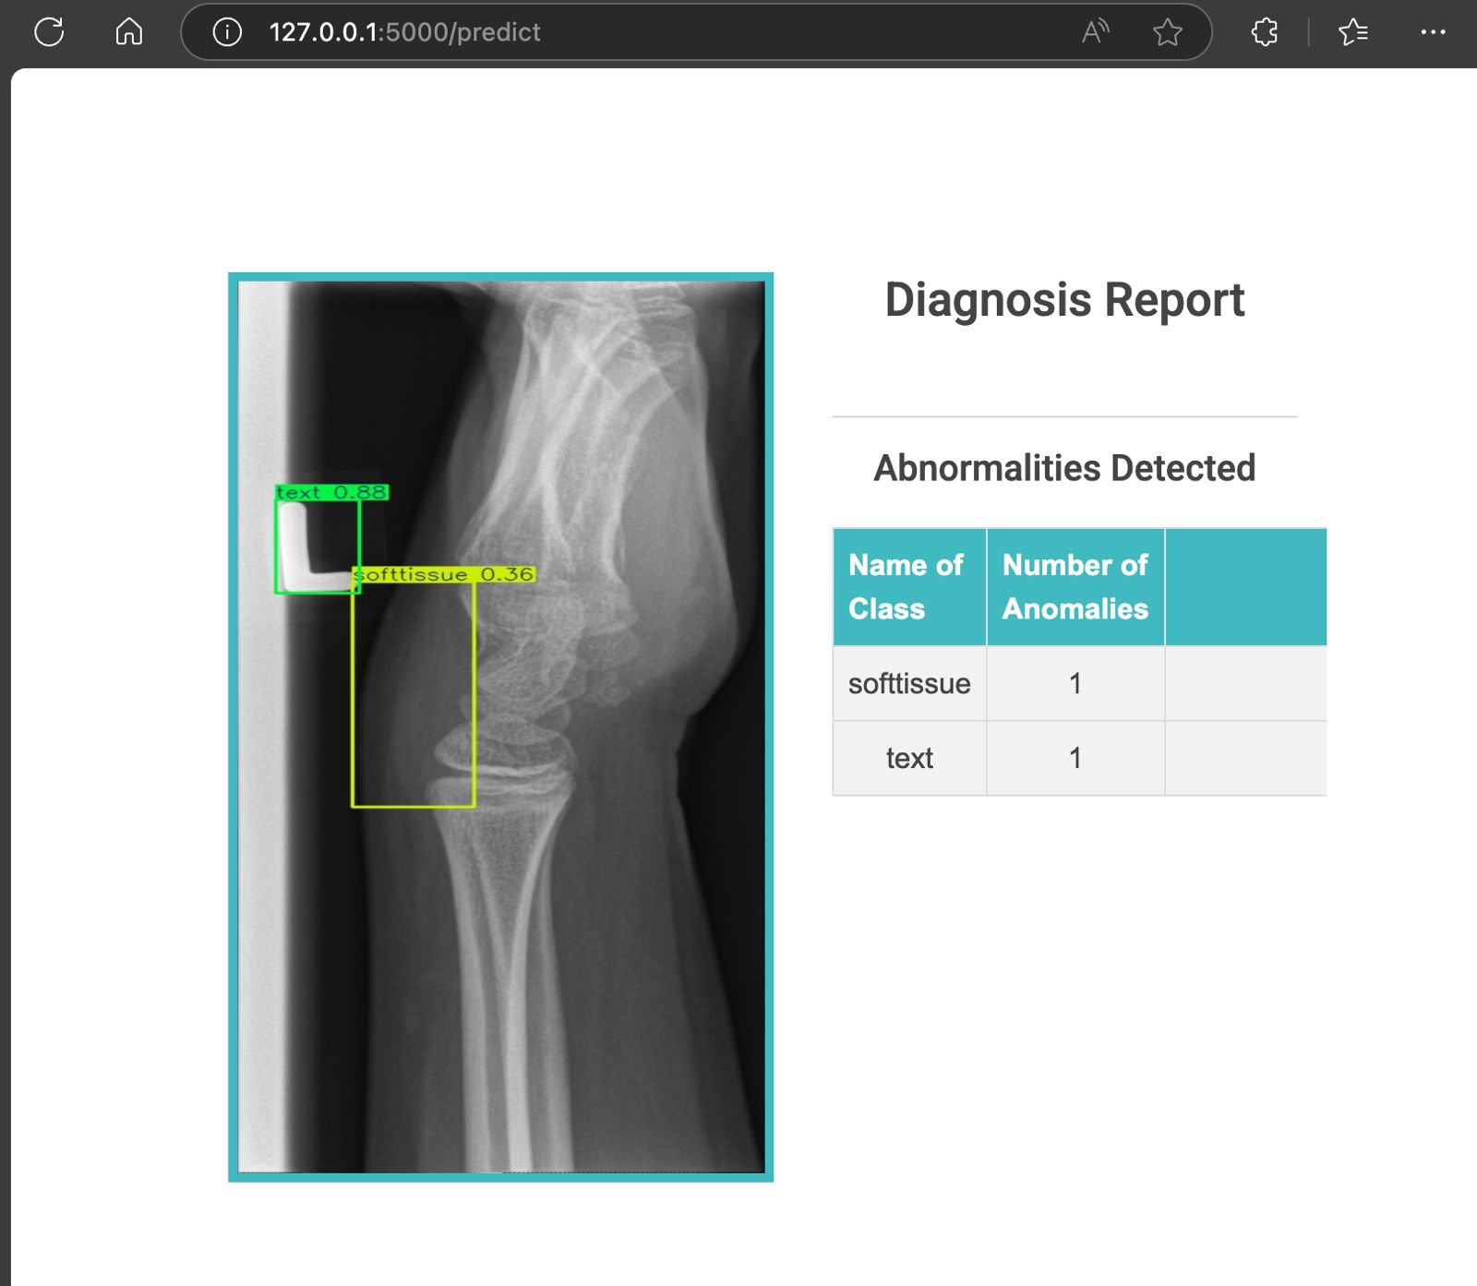

Slide 8
Conclusion & Future Work
Clinical Integration: Validating the models in real-world clinical settings to assess their practical utility and potential integration with existing radiology workflows.
Dataset Expansion: Extending the approach to include a wider variety of wrist abnormalities and possibly other types of fractures.
Robustness Studies: Investigating the generalization capabilities of the proposed models across different imaging modalities and patient populations.

Slide 9
Thank You

