Slide 1

RAJESH BHEDA CONSULTING
Prodigi
Plan
lines · dates · targets
Capture
hourly · QC · batch · cutting
Plan the making.
Capture the making.
Know the making.
Know
same-day production truth
Product presentation
01 / 17

Slide 2

THE PROBLEM
The factory knows
the plan.
It cannot see
the making.
What was actually produced yesterday?
Where is the WIP right now?
What left — and what came back?
Will this order ship on time?
PRODIGI
02 / 17

Slide 3
WHY THE GAP EXISTS
The systems exist.
Production is still disconnected.
ERP owns the money. PLM owns development. The floor still owns spreadsheets.
ERP
PLM
Excel & paper
Orders · finance
Payroll · materials
Tech packs · BOM
Development
The actual
production floor
THE GAP
Prodigi is that layer. It plans the making, captures the making, and feeds the ERP — it never replaces it.
Nobody owns production
as a system.
PRODIGI
03 / 17

Slide 4
THE CONSEQUENCE
Planned, produced and shipped
are three different numbers.
Management reconciles them after the fact. The floor cannot steer with them in the moment.
PLANNED
PRODUCED
SHIPPED
the order
≠
the floor
≠
the carton
counted separately
counted separately
counted separately
Until these three share one spine, on-time shipment is an argument — not a fact.
PRODIGI
04 / 17

Slide 5
INTRODUCING PRODIGI
Prodigi is the
production layer
for the garment
factory.
Plan
Colorways onto lines and dates. One route. A real target.
Capture
Hourly, QC, batch or cutting — as the operation works.
It feeds the ERP.
It never replaces it.
Know
Day, style and factory views from the same actuals.
PRODIGI
05 / 17

Slide 6
THE SYSTEM
Plan goes to the floor.
The floor comes back as insight.
01
02
03
04
05
Configure
Plan
Capture
Handover
Report
departments
flows · users
lines · dates
routing
output
+ people
WIP
movement
day · style
dashboard
Nothing important sits outside this loop.
That is what makes Prodigi a system
rather than a set of tools.
PRODIGI
06 / 17

Slide 7
ONE ORDER
Follow one order through the factory.
One record. One route. One trail of actuals.
Order
Cut
Print
Sew
Pack
Ship
sizes live
lay & qty
outsourced
hourly / QC
handed on
fulfilled
At cutting
At sewing
At handover
At shipment
What was actually cut?
What was produced — and how fast?
What left? What arrived?
Will it go out on time?
PRODIGI
07 / 17

Slide 8
PLAN
The plan becomes
work on the line.
Who makes what, where, and when — with a target the floor can be measured against.
LINE PLAN
D1
D2
D3
D4
D5
D6
Cutting
1
Route locked to the order
Sewing L1
Applied once, then frozen. History never rewrites itself.
Sewing L2
2
Colorways on lines and dates
Every colour allocated to a resource across a real calendar.
Finishing
3
Targets from SAM and people
Packing
Planned, then compared against what was actually made.
PRODIGI
08 / 17

Slide 9
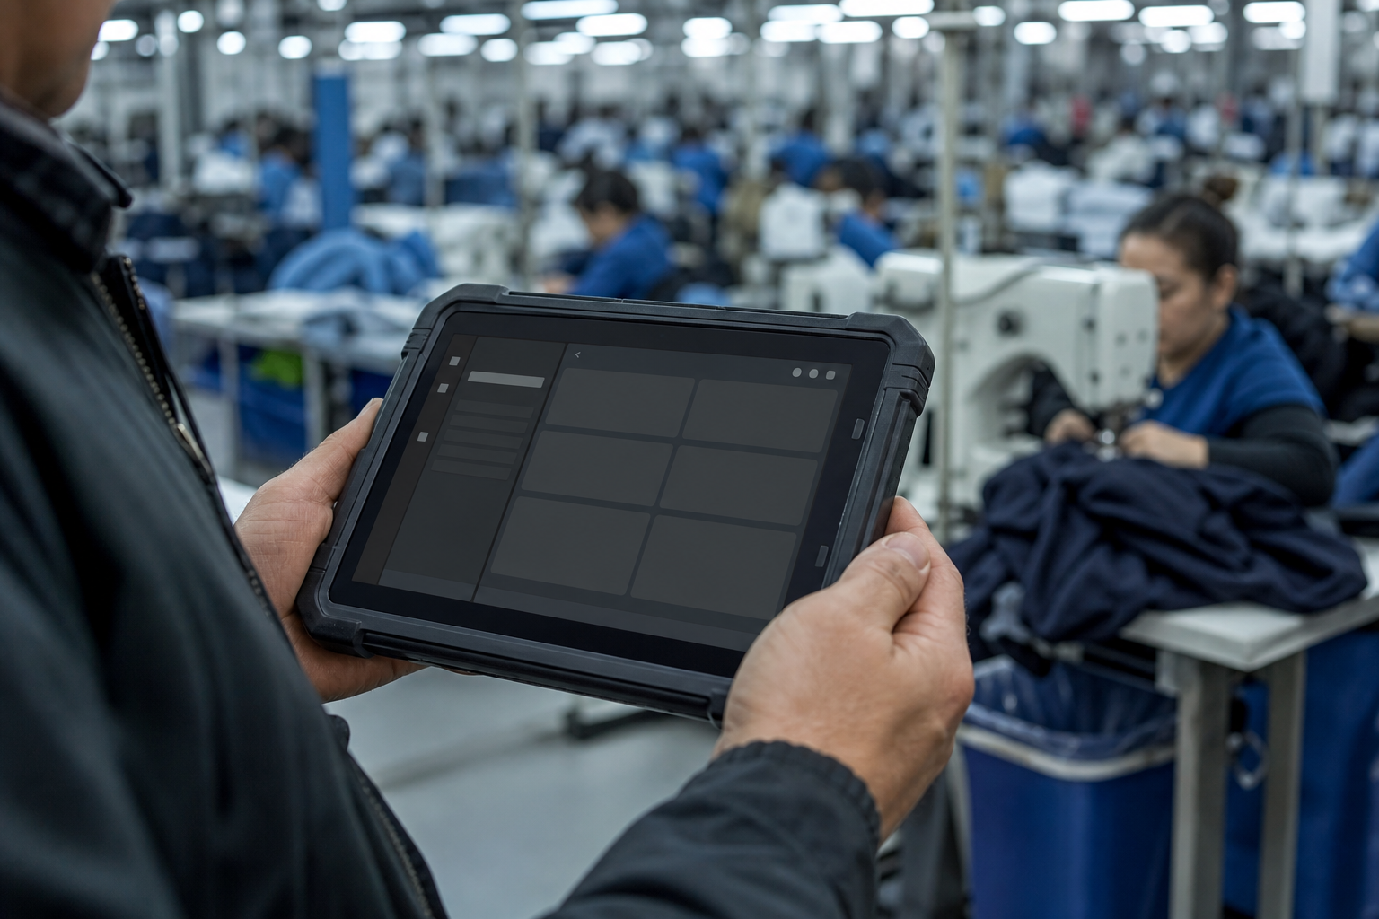
RUN
The floor sees only
the work assigned
to it.
PIN login. Today's allocations. Not the entire factory.
Operator
Production tiles for the operations they are granted.
Supervisor
Handover and workforce — the line, not a catalogue.
QA / terminal
Shipment and rejection. Closes the order.
Composed from the person, the department, and the factory's entitlements.
09 / 17

Slide 10
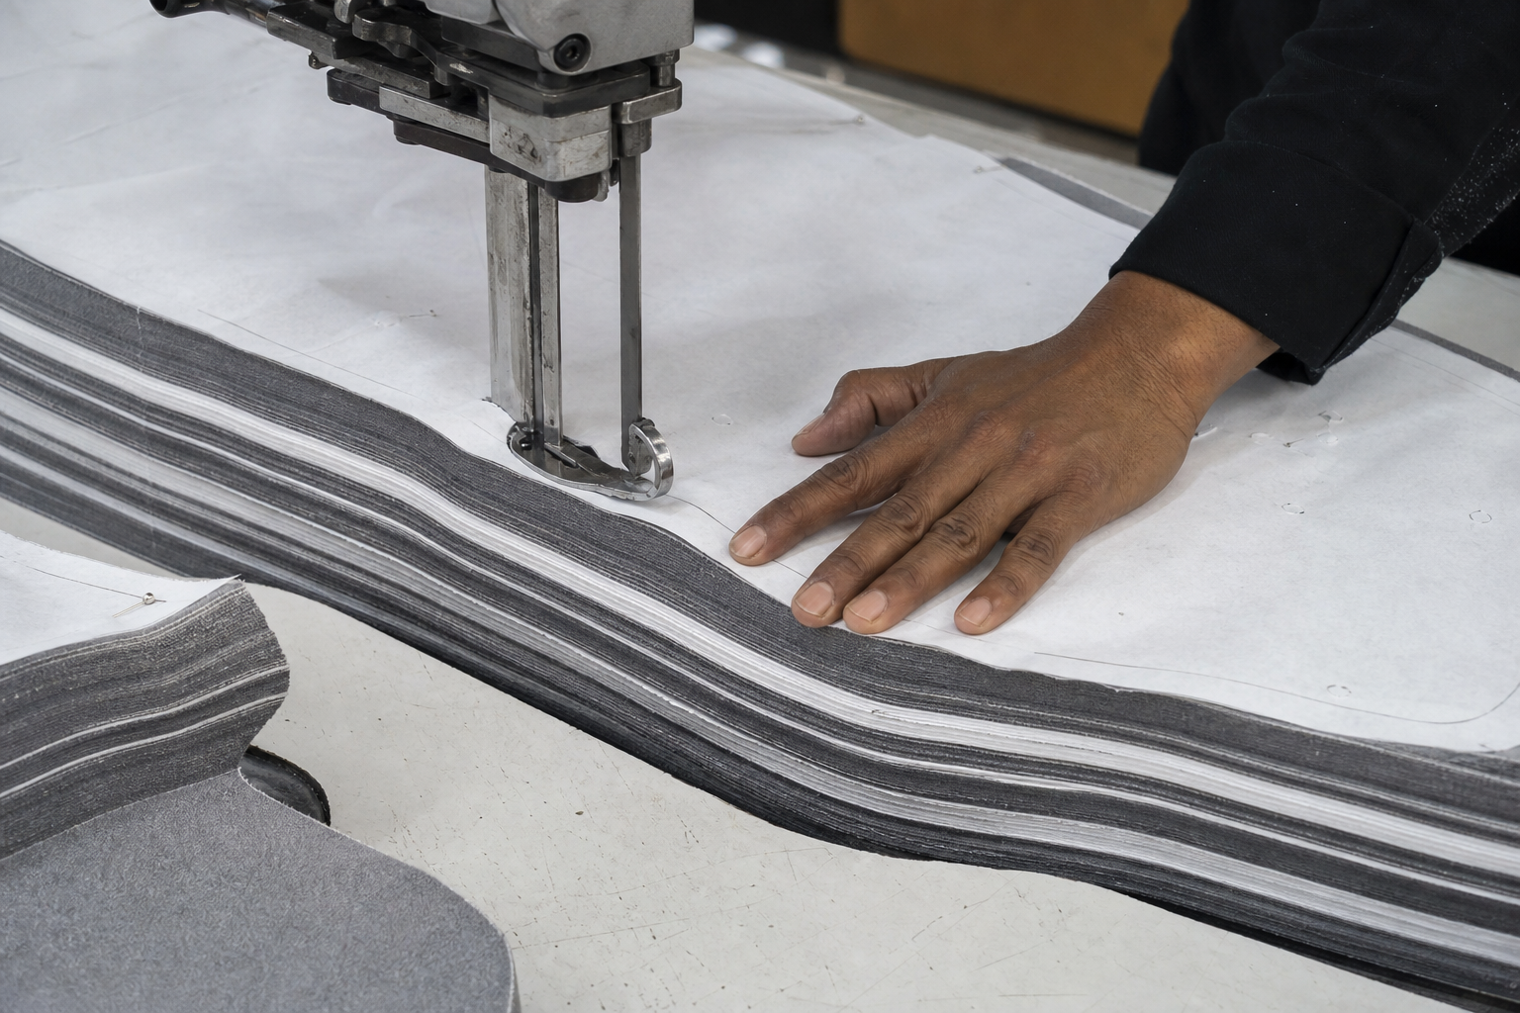
CAPTURE
Capture production the way
the operation actually works.
Hourly
QC
Batch
Cutting
Sewing, finishing, packing.
Size-wise, hour by hour.
Piece-wise pass, fail, rework.
Defects caught at source.
Washing, curing, ovens.
One count per batch.
Lay, plies, size quantities.
Where the count is born.
One truth at a time
Efficiency needs people
Output or QC — never both at once on the same department and order.
Headcount is logged on the same allocation as the output.
PRODIGI
10 / 17

Slide 11

HANDOVER
Every movement of WIP
leaves a digital trail.
Pieces cannot appear downstream unless the previous department handed them over.
Pending
Sent. Awaiting receipt.
Received
Counts match.
Disputed
What arrived differs.
Closed
Loss owned, remarked, resolved.
ON THE CHALLAN
From → to · order & colour · qty by size · who, and when
11 / 17

Slide 12
OUTSOURCE
Outsourced work never
disappears from the picture.
Printing, washing, embroidery — still on the order, still reconcilable.
In-house
Vendor
Return
Next step
Raises the out-challan
Work happens off-site
Return-challan comes back
Receives into the flow
Both legs are challans. The pieces never leave the system — even while they leave the building.
PRODIGI
12 / 17

Slide 13
MEASURE
Production becomes management
insight on the same day.
DAY · TIME
STYLE · ORDER
How did the factory run?
How is this order moving?
Department output for any date range
Production matrix across the route
Handovers sent, received, disputed
Daily output trend per department
Efficiency from output and workforce
Cut-to-ship and fulfillment
The morning review, already compiled
The handover journey, end to end
Same actuals. Two lenses. No overnight batch.
PRODIGI
13 / 17

Slide 14
ACT
The factory can see the risk
before the order is late.
Output
Efficiency
Floor WIP
Active orders
Order → Ship
against the plan
output vs people & time
pieces on the floor now
in production
shipped vs ordered
Then the list that actually matters
Every number on this screen traces back
to a tap on the floor.
Orders with balance still to ship — drill into the day, the style, or the floor.
PRODIGI
14 / 17

Slide 15
TRUST
The numbers can be trusted because
the factory cannot skip the truth.
01
One truth at a time
A department cannot count the same work as hourly output and as QC.
02
You cannot produce what has not arrived
Downstream capture waits on handover. Cutting is where the count is born.
03
Every gap has an owner
A disputed challan closes as acknowledged loss, not a quiet correction.
04
History does not rewrite
The route is locked onto the order the moment planning applies it.
05
Efficiency needs people
Headcount is captured against the same allocation as the output.
Each factory's data is isolated · floor PINs are stored hashed · new factories are provisioned by RBC, never self-signup
PRODIGI
15 / 17

Slide 16
WHAT CHANGES
One production spine.
Not a stack of spreadsheets.
BEFORE
WITH PRODIGI
Plan in Excel, output in notebooks
Plan and actuals on the same order
WIP as a guess
WIP as received, sent, in transit
Outsource as a phone call
Outsource as a two-leg trace
Efficiency as an opinion
Efficiency only when people are logged
The morning meeting as compilation
The day report already compiled
Visibility, accountability and traceability — the value is operational, not a promised percentage.
PRODIGI
16 / 17

Slide 17
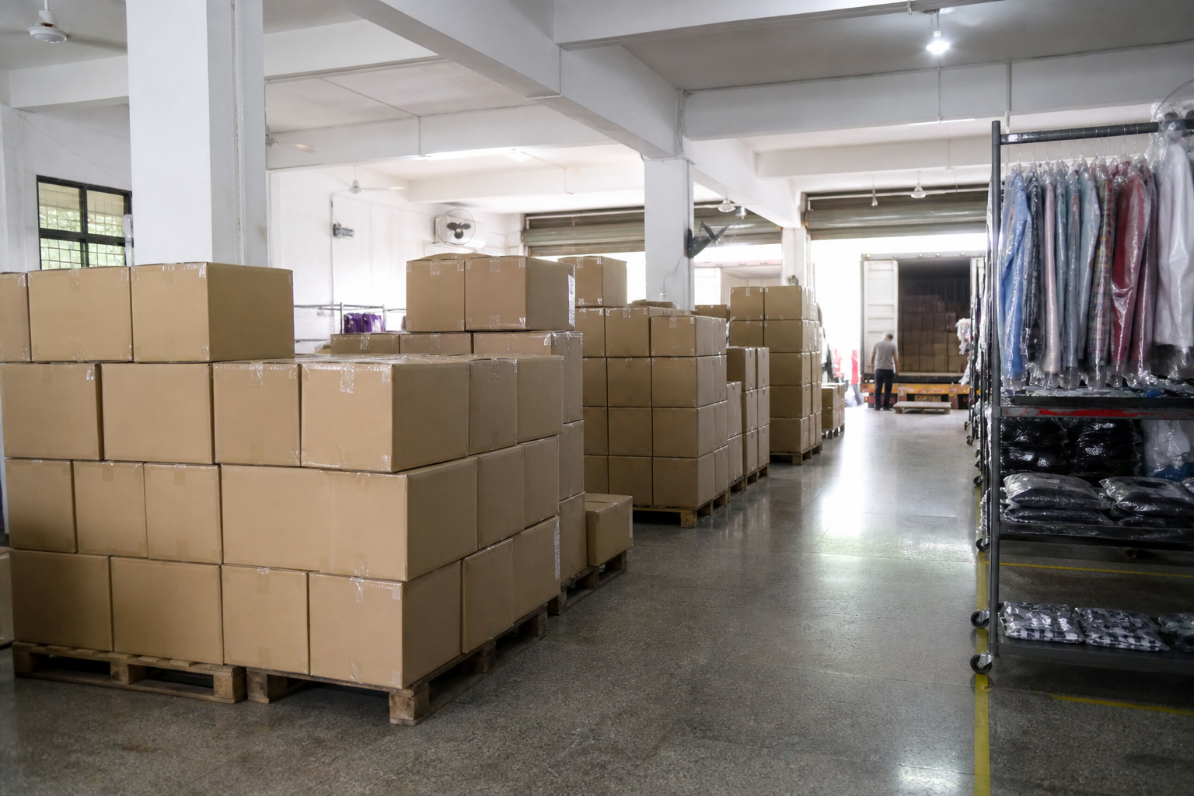
WHERE PRODIGI IS GOING
Own your production.
Plan it, capture it, measure it — in one system
built for how garments are actually made.
The operating system for garment production.
Inventory, costing and finance stay out of scope. Prodigi feeds them — never duplicates them.
NOW
NEXT
LATER
CONTACT
Configure · plan · capture
handover · report
Company layer · finer desktop
roles · stronger audit trail
Buyer WIP view · supplier
portal · machine capture
rbc@rajeshbheda.com
www.rajeshbheda.com
PRODIGI
17 / 17

