Slide 1
CONTINUOUS INTEGRATION - PHYSICAL ANDROID

Slide 2
TA AUTOMATION: THEN
Find the .apk
Install the .apk
Entire automation code needed on local machine
Trigger test suite

Slide 3
AND NOW
.apk generates
Pull the latest .apk - on demand
Copy to local machine
Install the .apk on tablet
No need of automation code on local machine
Execution on Physical device

Slide 4
Is this Traditional CI ?
CI
Ideally
Acts as a gatekeeper
At TA (for now)
On Demand
Physical devices

Slide 5
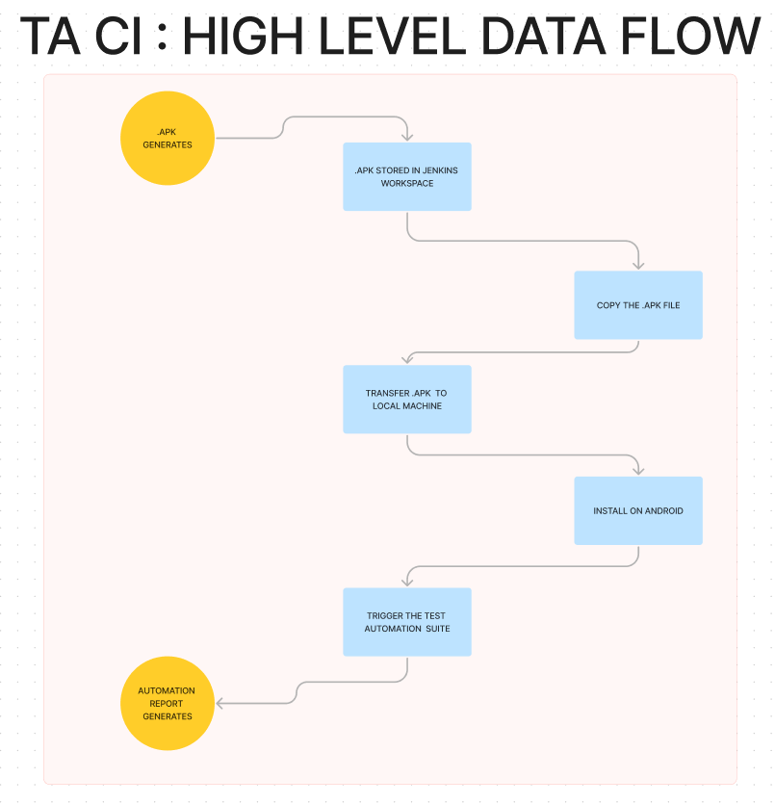
.

Slide 6
IMPLEMENTATION
Three Jenkins Instances
Dev
QA
Local
Five Jobs in total
Three Freestyle
Two Pipeline
Tech Stack
Groovy Scripts
Jenkins API
Jenkins Plugins: Parameterised Remote Trigger, Pipeline Syntax
Bitbucket API
Bitbucket Pipelines

Slide 7
DEV JENKINS
One Job
Generates the .apk
QA JENKINS
Three Jobs
Pull the Latest .apk from Dev Jenkins
Copy the .apk and trigger local Jenkins
Trigger Automation suite.
LOCAL JENKINS
One Job
Copy the .apk to laptop and install on android

Slide 8
DEV JENKINS DETAIL
View
dev8-android
Job
teacherapp-frontend
Artifacts
Lead .apk
Propel .apk
Pinnacle .apk
URL
https://dev-jenkins.leadschool.in/

Slide 9
QA JENKINS DETAIL
View
TeacherApp_CI
Job
Curl_Test_TA_CI
Pull-TA-Build-From-Dev-Jenkins
Trigger_TA_TestSuite
Artifacts
Lead .apk
URL
https://scaling-jenkins.leadschool.in/

Slide 10
LOCAL JENKINS DETAIL
Job
Copy from Server To Local
Artifacts
Lead .apk
URL
https://localhost:8080/

Slide 11
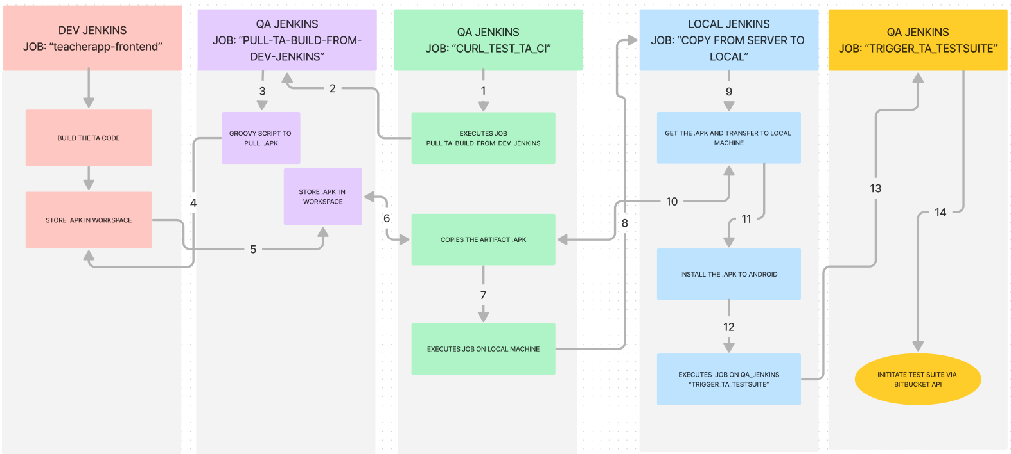

Slide 12
Connecting from Remote Jenkins to Local Jenkins
Why (Problem Statement): We need to transfer .apk from remote to local machine.
What (To be done): We need a way to connect from remote jenkins to our local machine.
How (A Solution to implement): ngrok : Establishes a tunnel from remote Jenkins server to Local Machine. Install ngrok and generate a public IP of your local machine, so that your local host is accessible from the remote Jenkins server.
Installation and set up ngrok:

Slide 13
Pulling the latest .apk by scanning all successful builds from latest to earliest
Defining Environment Variables
Listing the .apk from successful builds
Downloading the latest .apk
Storing it in workspace

Slide 14
Defining Environment Variables
environment {
jenkinsUrl = 'SPECIFY DEV JENKINS URL WHERE .APK RESIDES.'
devInstance_CredentialsId = 'CREDENTIALS FOR ACCESSING DEV JENKINS'
jobName = 'SPECIFY THE JOB NAME THAT GENERATES .APK JOB EXISTS WITHIN DEV JENKINS'
viewName = 'SPECIFY THE DEV JENKINS VIEW NAME WHERE THE JOB IS LISTED'
qacreds = credentials('SPECIFY CREDENTIALS FOR QA JENKINS INSTANCE')
buildNumbers = '[ ]'
}

Slide 15
Listing all .apks from Successful Dev Jenkins Build
stage('List Artifacts') {
steps {
script {
def apiUrl = "${jenkinsUrl}/job/${jobName}/api/json?tree=builds[number,result]"
response = httpRequest(url: apiUrl, authentication: devInstance_CredentialsId)
if (response.status == 200) {
def jsonResponse = new JsonSlurper().parseText(response.content)
def successfulBuilds = jsonResponse.builds.findAll {
it.result == 'SUCCESS'
}
buildNumbers = successfulBuilds.collect {
it.number
}
echo "Successful Build Numbers: ${buildNumbers.join(', ')}"
} else {
echo "Failed to fetch data from Jenkins API. Response code: ${response.status}"
echo "Response content: ${response.content}"
}
}
}
}

Slide 16
Triggering bitbucket pipelines

