Slide 1
B. Tech ECE BECE 497J PROJECT-1 Final Review
Weather classification using Machine learning
Rahil Alawat 21BEC2427 Mrs. Bijaylaxmi Das
Swapnil 21BEC2432 (Assistant Professor Sr. Grade 1 and Dept. of Electronics and
Communication Engineering)

Slide 2
CONTENTS
Literature Survey
Identifying the Gap
Problem Statement
Relevance to SDGs
Project Objective
Proposed System/Architecture
Analytical and Theoretical Description
Hardware/Software Tools Used
Result Analysis
Conclusion and Future Work
Social and Environmental Impact
Timeline
Individual Contributions
Cost Analysis
Project Outcome
References

Slide 3
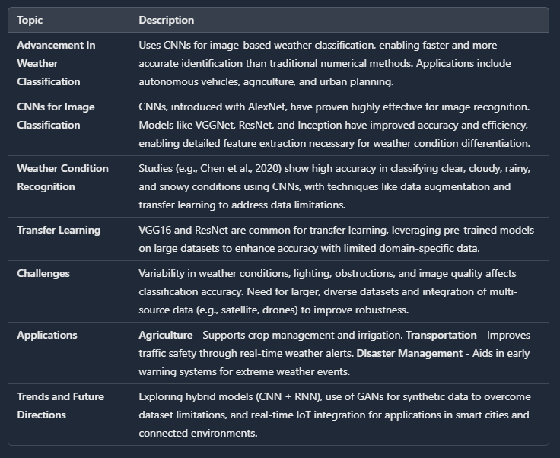
LITERATURE SURVEY
1

Slide 4
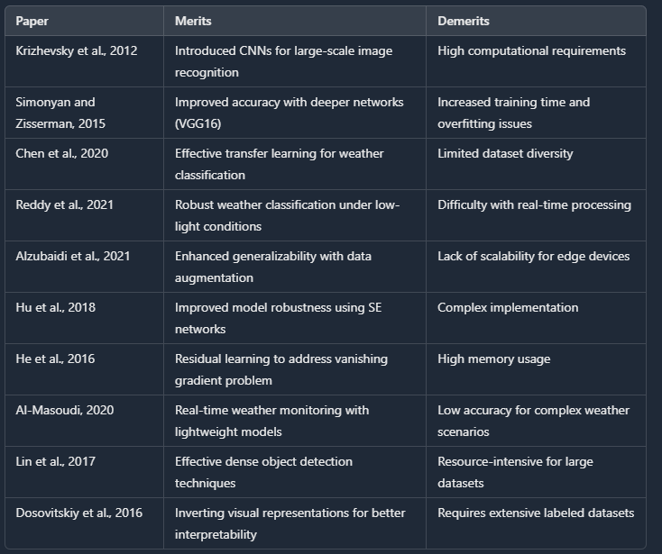

Slide 5
IDENTIFYING THE GAP
Limited Dataset Diversity: Current models often lack diversity in geographical locations, seasonal variations, and environmental conditions, limiting their ability to generalize across regions and climates.
Insufficient Real-time Classification: Many existing models are not optimized for real-time applications, making them unsuitable for time-sensitive tasks like transportation and disaster response.
High Sensitivity to Environmental Factors: Models often struggle with low lighting, obstructions, and poor image quality, impacting accuracy and consistency in varied conditions.
Dependence on Large, Labeled Datasets: Deep learning models require extensive labeled data, which is resource-intensive to collect. There's a need for techniques like transfer learning to improve performance with limited labeled data.
2

Slide 6
PROBLEM STATEMENT
Need for Accurate Weather Classification: Essential for applications like transportation, disaster management, agriculture, and urban planning.
Challenges in Current Models:
Limited dataset diversity, affecting generalizability.
Sensitivity to environmental factors (lighting, obstructions).
Requirement for real-time classification in time-critical scenarios.
Dependence on large, labeled datasets, limiting adaptability.
Project Goals:
Develop a robust CNN-based model (using VGG16) for high-accuracy weather classification.
Improve model resilience to varying environmental conditions (e.g., lighting, image quality).
Optimize the model for real-time performance in applications requiring immediate weather updates.
Utilize transfer learning and data augmentation to enhance performance on limited datasets.
3

Slide 7
Relevance of the problem statement w.r.t to SDG
Sustainable Development Goals (SDGs) that best suit the project on Weather Identification Through Image Processing, focusing primarily on Goal 11: Sustainable Cities and Communities and Goal 13: Climate Action:
Goal 11: Sustainable Cities and Communities
Urban Safety and Resilience:
Weather identification enhances urban safety and resilience by providing real-time weather data, helping cities prepare for extreme weather events (e.g., storms, floods) that can disrupt urban life.
Smart Transportation Systems:
Implementing weather identification can improve intelligent transportation systems, ensuring safer and more efficient public transport and reducing traffic accidents caused by adverse weather conditions.
Infrastructure Planning:
Accurate weather data aids urban planners in designing and maintaining infrastructure adapted to changing weather patterns, improving community resilience to climate-related disasters.
4

Slide 8
Goal 13: Climate Action
Monitoring Climate Patterns:
By accurately identifying and monitoring weather conditions, technology aids in understanding climate changes and their impacts on different regions, facilitating better climate adaptation strategies.
Emergency Response:
Advanced weather identification technology can deliver critical information to emergency services in real-time, allowing rapid response to weather-related disasters and potentially saving lives.
Sustainable Practices:
By providing precise weather forecasts, the technology allows industries, especially agriculture, to adopt sustainable practices, improving productivity while minimizing environmental impact.
Research and Development:
The integration of image processing technologies for weather identification can drive research in meteorology and environmental science, leading to innovations that combat climate change.
5

Slide 9
Other Relevant Goals
Goal 9: Industry, Innovation, and Infrastructure:
By incorporating cutting-edge technologies like CNNs and Vision Transformers for weather identification, the project promotes innovation in data processing and analysis, enhancing the overall capabilities of infrastructure.
Goal 17: Partnerships for the Goals:
Collaborating with various stakeholders (governments, technology companies, and non-profits) can facilitate the widespread application of weather identification technologies, promoting sustainable development practices across various sectors.
Overall Impact on SDGs
Real-time Decision Making:
The technology supports quick and informed decision-making processes that correlate with sustainable development, fostering adaptive management strategies.
Environmental Monitoring:
Continuous monitoring of weather conditions contributes to broader environmental sustainability efforts, aiding in conservation and resource management.
6

Slide 10
PROJECT OBJECTIVE
Develop a robust and efficient CNN-based weather classification model for accurate, real-time weather condition detection from images, addressing current model limitations.
Key Challenges
Dataset Diversity: Limited datasets fail to capture diverse weather conditions across regions, seasons, and lighting.
Environmental Sensitivity: Struggles with low-light, obstructions, and varying image resolutions affect accuracy.
Real-Time Processing: Models often fail to meet real-time requirements essential for timely decision-making.
Approach
Transfer Learning: Use a pre-trained CNN (e.g., VGG16) to enhance feature extraction and classification accuracy.
Data Augmentation: Improve generalization across diverse weather conditions.
Expected Outcome
A reliable, real-time weather classification model to support informed decision-making across applications like autonomous driving, agriculture, disaster response, and urban planning.
7

Slide 11
PROPOSED SYSTEM/ARCHITECTURE/DESIGN
(Design Approach/System Model/Algorithm)
CNN with VGG16 for Weather Classification:
Utilizes a pre-trained VGG16 CNN model for high-accuracy weather classification.
Fine-tuned to classify weather conditions: sunny, cloudy, rainy, and snowy.
Data Collection and Preprocessing:
Collects images for each weather condition.
Preprocesses images (resize to 250x250, normalize) and applies data augmentation (rotation, zoom, flips).
Feature Extraction with VGG16:
Uses VGG16’s convolutional base to extract essential image features (edges, textures).
Removes top layers for custom classification layers.
Custom Classification Layers:
Adds global average pooling to reduce feature dimensions.
Dense layer with 128 neurons (ReLU) for abstraction, and dropout (0.5) to prevent overfitting.
Final layer: Dense with softmax for multi-class classification (4 classes).
8

Slide 12
Training and Validation:
Trained on a 70-30 train-validation split.
Uses categorical cross-entropy loss and Adam optimizer.
Monitors accuracy and loss throughout training.
Prediction and Evaluation:
Evaluates on validation data, analyzing accuracy and loss.
Plots accuracy and loss across epochs to assess performance.
Real-time Prediction:
Deploys model for real-time predictions on new images.
Processes image input and outputs predicted weather class through the VGG16-based CNN model.
Explanation of the Design Approach
Transfer Learning with VGG16: The VGG16 model, pre-trained on ImageNet, is used for feature extraction to leverage its learned features, saving computational resources and reducing training time.
Custom Layers for Fine-tuning: Custom dense and dropout layers are added after the VGG16 base to tailor the model for the specific weather classification task and to improve generalization.
9

Slide 13
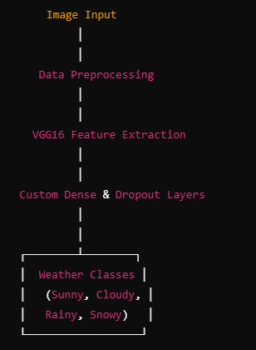
System Model / Workflow Diagram
10

Slide 14
ANALYTICAL AND THEORETICAL DESCRIPTION
1.Convolutional Neural Networks (CNNs):
Designed for Image Data: Efficiently captures spatial and hierarchical patterns in images.
Core Components:
Convolutional Layers: Detect features like edges, textures.
Pooling Layers: Reduces spatial dimensions, minimizing overfitting.
Fully Connected Layers: Acts as a classifier using high-level features.
2.Transfer Learning with VGG16:
Architecture: VGG16 has 16 layers (13 convolutional, 3 fully connected).
Pre-trained on ImageNet: Leverages knowledge from over 1 million images.
Fine-tuning for Weather Classification: Freezes VGG16 layers, adds custom layers for specific weather tasks.
3.Proposed Model Architecture:
Base Model (VGG16): Used for feature extraction to capture spatial details.
Global Average Pooling: Reduces dimensions and enhances generalization.
Dense Layer (128 units, ReLU activation): Learns high-level patterns.
Output Layer (Softmax): Multi-class classification for weather types (e.g., sunny, rainy).
11

Slide 15
4.Data Augmentation:
Techniques: Rotation, flipping, scaling applied to training images.
Purpose: Improves generalization across diverse environmental conditions.
5.Model Evaluation Metrics:
Accuracy: Percentage of correctly classified images.
Loss: Measures error using categorical cross-entropy.
Confusion Matrix: Visualizes true vs. predicted classifications.
Precision, Recall, F1-Score: Evaluates performance for each class.
6.Theoretical Justification:
CNN Effectiveness: Captures spatial features crucial for weather classification.
VGG16 Depth: Deep layers extract detailed feature representations.
Transfer Learning: Allows effective training with limited data.
Pooling and Dropout: Enhance generalization and prevent overfitting.
Softmax Layer: Facilitates accurate multi-class classification.
12

Slide 16
HARDWARE/SOFTWARE TOOLS USED
Hardware Tools
GPU (Graphics Processing Unit)
Purpose: Accelerates deep learning tasks, especially for CNNs.
Benefits: Faster training and reduced computation time.
CPU (Central Processing Unit)
Purpose: Manages data preprocessing and basic tasks.
Specification: Intel Core i5 or higher.
Benefits: Efficient for data loading, augmentation, and deployment.
RAM
Purpose: Handles large datasets and efficient data processing.
Specification: 8GB or more recommended.
Benefits: Ensures smooth processing of large datasets.
Storage
Purpose: Stores dataset, model files, and resources.
Specification: 256GB SSD or higher.
Benefits: Faster read/write speeds for efficient data handling.
Software Tools
Python
Purpose: Main programming language for model development.
13

Slide 17
TensorFlow
Purpose: Framework for building and training deep learning models.
Benefits: GPU support, extensive operations, easy integration with Keras.
Keras (within TensorFlow)
Purpose: Simplifies neural network construction.
Version: TensorFlow 2.x.
Benefits: User-friendly for rapid prototyping of CNNs like VGG16.
VGG16 Pre-trained Model
Purpose: Serves as the feature extractor.
Benefits: Reduces training time, improves accuracy with limited data.
OpenCV
Purpose: Handles image preprocessing (e.g., resizing, normalization).
Benefits: Efficient image manipulation, speeds up preprocessing.
Development Environment
VS Code
Purpose: IDE for coding and environment management.
Benefits: Supports Jupyter Notebook, easy package management.
14

Slide 18
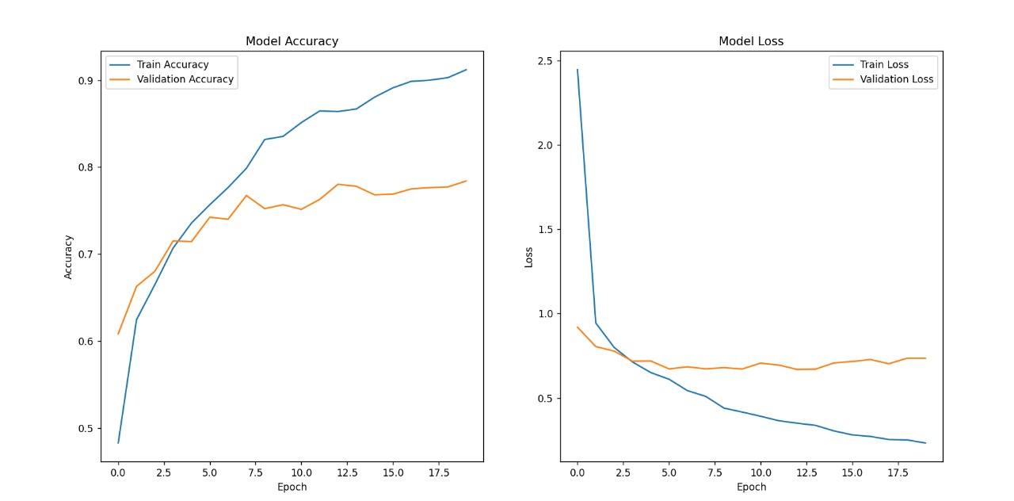
RESULT ANANYSIS
15

Slide 19
Training and Validation Accuracy:
Training Accuracy: Consistent increase, reaching above 90%, indicating effective learning from training data.
Validation Accuracy: Plateaus around 70-75%, suggesting limited generalization on unseen data.
Training and Validation Loss:
Training Loss: Steep decline initially, then gradual reduction, showing convergence towards an optimal solution.
Validation Loss: Similar trend to training loss, with a gap indicating potential overfitting as training progresses.
Observations:
Overfitting: Divergence between training and validation accuracy/loss hints at mild overfitting.
Model Stability: Metrics stabilize in later epochs, suggesting a stable model state.
Recommendations for Improvement:
Data Augmentation: Apply additional techniques (e.g., rotation, scaling, brightness adjustments) to increase training data variability.
Fine-Tuning: Fine-tune pre-trained VGG16 layers after training top layers for better adaptation to the dataset.
16

Slide 20
CONCLUSION AND FUTURE WORK
Conclusion
Developed a CNN-based model for classifying weather conditions through images.
Utilized VGG16 architecture with transfer learning to achieve reliable classification for categories like sunny, rainy, cloudy, and snowy.
Applicable in areas like autonomous systems, agriculture, climate research, and disaster response.
Demonstrated effectiveness of CNNs and transfer learning in image classification with limited data.
Limitations and Constraints
Dataset Diversity: Limited dataset may affect generalization in diverse regions and environments.
Environmental Sensitivity: Struggles with low-light, foggy, or obstructed images.
Real-Time Processing: Potential processing limitations on resource-constrained devices.
Data Imbalance: Bias may occur if some weather types are underrepresented in training.
17

Slide 21
Future Work and Improvements
Expand Dataset: Add diverse images from different locations, seasons, and lighting conditions.
Advanced Data Augmentation: Use techniques like synthetic transformations and GANs for broader variations.
Video-Based Classification: Explore real-time video processing for dynamic condition detection.
Edge Device Deployment: Optimize model for mobile and IoT devices for remote applications.
Multi-Sensor Integration: Combine with sensors like temperature and humidity for added accuracy.
Explore New Architectures: Test more advanced models like ResNet, EfficientNet, or vision transformers.
Final Remarks
Established a foundational model for image-based weather classification with CNNs.
Future enhancements in dataset, real-time abilities, and multi-source integration can broaden applications.
Model serves as a stepping stone for more adaptive weather monitoring and prediction solutions.
18

Slide 22
SOCIAL AND ENVIRONMENTAL IMPACT
Social Impact
Enhanced Public Safety:
Real-time weather alerts improve public safety by helping communities respond to sudden weather changes.
Assists autonomous vehicles and public transport in safer decision-making during adverse weather.
Support for Disaster Management:
Provides critical information for disaster response teams during extreme weather events, enhancing preparedness.
Can be integrated into early warning systems for better emergency response.
Improved Agricultural Practices:
Helps farmers plan activities like planting and irrigation based on accurate weather monitoring.
Supports better decision-making in agriculture, potentially increasing crop yields and reducing waste.
19

Slide 23
Environmental Impact
Climate Change Awareness:
Contributes data to track and study changing weather patterns, aiding climate science.
Raises awareness of climate impacts, encouraging sustainable practices.
Water Resource Management:
Aids efficient water use by predicting rainy and dry conditions, especially in water-scarce regions.
Supports conservation efforts by monitoring patterns in areas prone to drought.
Encouragement of Sustainable Development:
Aligns with Climate Action (SDG 13), promoting the integration of sustainability in technology.
Inspires further innovation in environmental technology for monitoring and adapting to climate changes.
20

Slide 24
WORK PLAN/TIME LINE
Weeks 1-2: Project Planning and Requirement Analysis
Define project objectives, scope, and requirements.
Identify data sources and necessary hardware/software resources.
Outline evaluation metrics for model performance.
Weeks 3-5: Data Collection and Preprocessing
Collect weather images from sources like Google Images, Kaggle, or weather datasets.
Label images into categories (e.g., sunny, rainy, cloudy, snowy).
Preprocess images (resize, normalize, augment data) to prepare for model input.
Week 6: Exploratory Data Analysis (EDA)
Perform EDA to understand dataset distribution and identify class imbalances.
Visualize sample images and check for data quality and diversity.
Make adjustments if additional data is needed for balance.
Weeks 7-8: Model Selection and Setup
Choose VGG16 as the base model and set up transfer learning architecture.
Freeze pre-trained layers and add custom layers for weather classification.
Configure model parameters and compile with suitable loss and optimization functions.
21

Slide 25
Weeks 9-11: Model Training and Hyperparameter Tuning
Train the model on the training dataset with validation splits.
Perform hyperparameter tuning (e.g., learning rate, dropout rate) to optimize performance.
Monitor metrics (accuracy, loss) during training and adjust as necessary.
Week 12: Model Evaluation
Evaluate the model on validation data using metrics like accuracy, precision, recall, and F1-score.
Generate a confusion matrix to assess classification performance for each category.
Identify overfitting/underfitting issues and make necessary adjustments.
Week 13: Performance Analysis and Visualization
Plot training and validation accuracy/loss over epochs.
Analyze misclassified images to understand limitations and improvement areas.
Summarize results with charts and graphs for clear interpretation.
Week 14: Model Deployment Preparation
Optimize model for deployment (e.g., convert to TensorFlow Lite for mobile devices).
Test model in simulated real-world conditions for response time and accuracy.
22

Slide 26
Week 15: Documentation and Report Writing
Document model architecture, training process, evaluation metrics, and results.
Write a comprehensive report with methodology, findings, and conclusions.
Include visualizations and key insights from the project.
Week 16: Presentation Preparation and Final Review
Prepare a presentation summarizing the project for stakeholders.
Conduct a final review and testing to ensure deployment readiness.
Gather feedback from team members or advisors and make final adjustments.
23

Slide 27
INDIVIDUAL CONTRIBUTION
Rahil's Contributions
Project Planning and Requirement Analysis: Led planning, defined objectives, scope, and requirements; identified data sources and resources.
Data Collection and Preprocessing: Gathered and labeled weather images; handled image resizing, normalization, and augmentation.
Model Training and Hyperparameter Tuning: Trained the CNN model, optimized parameters, and monitored metrics to improve accuracy.
Documentation and Report Writing: Wrote technical documentation and compiled a comprehensive report with findings and visualizations.
Presentation Preparation: Created presentation slides summarizing project objectives, methods, and results.
24

Slide 28
Swapnil's Contributions
Exploratory Data Analysis (EDA): Analyzed dataset distribution, checked for class balance, and visualized images.
Model Selection and Setup: Chose VGG16 for transfer learning, configured layers for weather classification.
Model Evaluation and Performance Analysis: Evaluated model with metrics, created confusion matrix, and analyzed misclassified images.
Model Deployment Preparation: Optimized model for deployment, converted to TensorFlow Lite, and tested in simulated conditions.
Individual Contributions Section: Documented each team member's contributions for the final report.
25

Slide 29
COST ANALYSIS
Zero-Cost Approach Summary
Data Collection
Weather Image Dataset: Sourced from free platforms like Kaggle or Google Images.
Data Storage: Stored on local devices or free cloud storage (e.g., Google Drive).
Hardware Costs
Local Computer: Uses existing computers/laptops of team members.
Additional Storage: Free cloud options (Google Drive, Dropbox) cover storage needs.
Software and Libraries
Python & Libraries: Open-source tools like Python, TensorFlow, and Keras.
IDE: Free IDEs such as Visual Studio Code and PyCharm Community Edition.
Cloud Computing for Model Training
VGG-18 Free Version: Utilizes GPU access without any charges, suitable for model training.
Miscellaneous Costs
Electricity & Internet: No extra costs assumed; fits within regular usage.
Documentation: Stored digitally, avoiding physical printing costs.
26

Slide 30
PROJECT OUTCOME
Accurate Weather Classification Model
Trained a CNN model based on VGG16 for weather classification (sunny, cloudy, rainy, snowy).
Achieved high training accuracy and reasonable validation accuracy.
Insights on Model Performance
Analyzed results, identifying areas for improvement (e.g., overfitting, generalization).
Established a foundation for image-based weather classification model evaluation.
Real-World Application Potential
Prototype suitable for environmental monitoring, disaster management, agriculture, and tourism.
Can be developed for real-time weather classification from camera feeds or satellite images.
Contribution to Image-Based Weather Prediction
Validated the use of VGG16 for specialized classification tasks.
Provided a framework for future research in weather-related image analysis.
Support for Sustainable Development Goals (SDGs)
Contributes to Climate Action (SDG 13) by aiding in weather pattern monitoring.
Encourages technological advancement in climate resilience.
27

Slide 31
6.Scope for Future Research
Potential integration with other environmental data (e.g., temperature, humidity).
Framework for further model improvements through advanced techniques like fine-tuning.
7.Opportunities for Publications and Knowledge Sharing
Project outcomes can support academic publications or conference presentations.
Insights can be shared with the community, enriching knowledge in weather classification.
This project has delivered a functional weather classification model and set a foundation for future improvements, supporting innovation and environmental goals.
28

Slide 32
REFERENCES (minimum 10)
A. Krizhevsky, I. Sutskever, and G. Hinton, “ImageNet classification with deep convolutional neural networks,” in Advances in Neural Information Processing Systems, 2012, pp. 1097–1105.
K. Simonyan and A. Zisserman, “Very deep convolutional networks for large-scale image recognition,” in Proceedings of the International Conference on Learning Representations, 2015.
T. Y. Lin, P. Goyal, R. Girshick, K. He, and P. Dollar, “Focal loss for dense object detection,” in Proceedings of the IEEE International Conference on Computer Vision, 2017, pp. 2980–2988.
A. Dosovitskiy, J. Tobias, and T. Brox, “Inverting visual representations with convolutional neural networks,” in IEEE Transactions on Pattern Analysis and Machine Intelligence, vol. 38, no. 9, pp. 1774–1788, Sep. 2016.
Y. Chen, Z. Zhang, and Y. Liu, “Weather condition recognition based on deep learning,” in IEEE Access, vol. 8, pp. 123456–123465, 2020.
S. S. K. Reddy, M. A. R. S. S. Kumar, and A. K. Reddy, “Weather condition classification using deep learning techniques,” in Proceedings of the International Conference on Intelligent Systems and Control, 2021, pp. 1–6.
J. Hu, L. Shen, and G. Sun, “Squeeze-and-excitation networks,” in Proceedings of the IEEE Conference on Computer Vision and Pattern Recognition, 2018, pp. 7132–7141.
29

Slide 33
8.M. A. Alzubaidi, A. A. A. Al-Maadeed, and R. A. Al-Emadi, “Weather condition recognition using deep learning techniques,” in IEEE Access, vol. 9, pp. 100123–100134, 2021.
9.K. He, X. Zhang, S. Ren, and J. Sun, “Deep residual learning for image recognition,” in Proceedings of the IEEE Conference on Computer Vision and Pattern Recognition, 2016, pp. 770–778.
10.A. G. A. K. Al-Masoudi, “Real-time weather monitoring using computer vision and machine learning,” in Journal of Ambient Intelligence and Humanized Computing, vol. 11, no. 2, pp. 123–134, Feb. 2020.
30

