Slide 1

Access vs Salesforce: Database Solutions
Prepared By: SEVEN SOLUTIONS: RAHEEL AHSAN

Slide 3
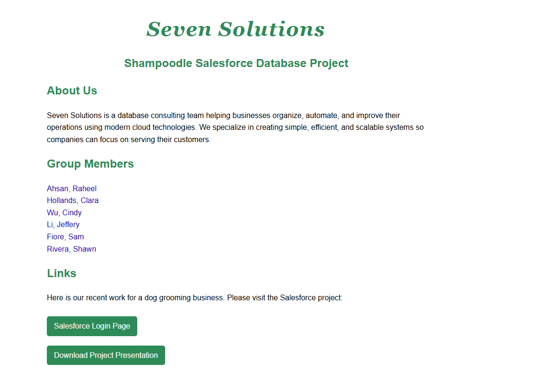

Slide 4
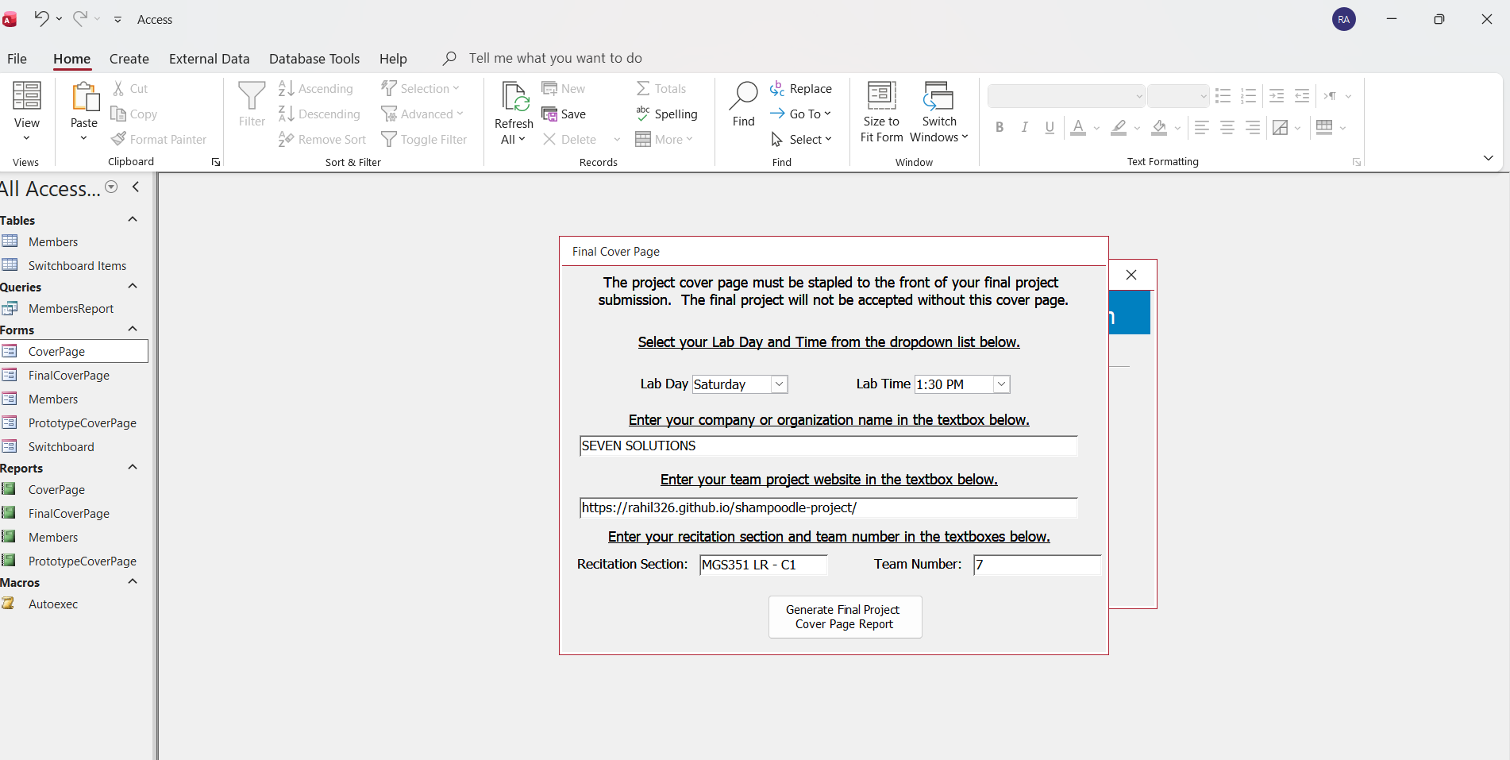
FINAL COVER PAGE _TEAM INFORMATION DATABASE- https://rahil326.github.io/shampoodle-project/

Slide 5
MICROSOFT ACCESS [ DESKTOP DATABASE]
PROS | CONS
Easy to set up : tables, forms, queries, and reports all in one place | Not scalable: Performance slows down with large datasets or multiple users.
Good for local storage: Everything is on your computer — no internet required. | Limited collaboration: Difficult for multiple users to access simultaneously; requires shared network or splitting database.
Rapid prototyping: You can quickly create forms, queries, and reports. | Not web-based: Cannot easily access via browser or mobile apps.
Simple data entry: User-friendly forms for inputting data. | Limited security: Only basic user-level security; not suitable for sensitive business data.
Cost-effective: Often included in Office 365 or cheaper than enterprise solutions. | Manual integration: Hard to connect with other systems automatically.

Slide 6
SALESFORCE (CLOUD CRM / DATABASE)
PROS | CONS
Cloud-based:& Accessible anywhere, anytime, via browser or mobile. Multi-user collaboration: Multiple users can access, update, and share data simultaneously. | Learning curve: Slightly more complex than Access; needs understanding of objects, fields, report types, and relationshipS.
Built-in reporting & dashboards: Real-time visualization of data (charts, metrics, tables). | Internet required: Cannot work offline easily (except with some mobile caching).
Security & permissions: Granular control over who can view/edit data (profiles, roles, sharing rules). | Cost: Salesforce licenses can be expensive for full access.
Automation & workflow: Can automate notifications, emails, and approvals. | Setup overhead: Initial setup requires planning for objects, relationships, and permissions.
Integration-ready: Scalable: Handles large datasets and enterprise-level usage | Internet Dependent: Requires Internet all the time.

Slide 7
FUTURE ENHANCEMENTS FOR THE SHAMPOODLE SALESFORCE APP
In the future, the Shampoodle Salesforce app can be enhanced to make appointment and service management more efficient and automated. For example, it could include automated notifications for upcoming appointments to customers, or reminders for groomers about their daily schedule. Service recommendations based on a dog’s breed, age, or grooming history could also be added to help customers select the right services.
Additionally, integrating mobile access would allow groomers to update appointments, record completed services, or add notes directly on the go. The dashboards can be enhanced to provide analytics insights, such as identifying peak service times, revenue per groomer, or tracking the most popular services. These enhancements would make the Salesforce app a more interactive, smart, and practical tool for managing Shampoodle’s Dog grooming operations.

Slide 8
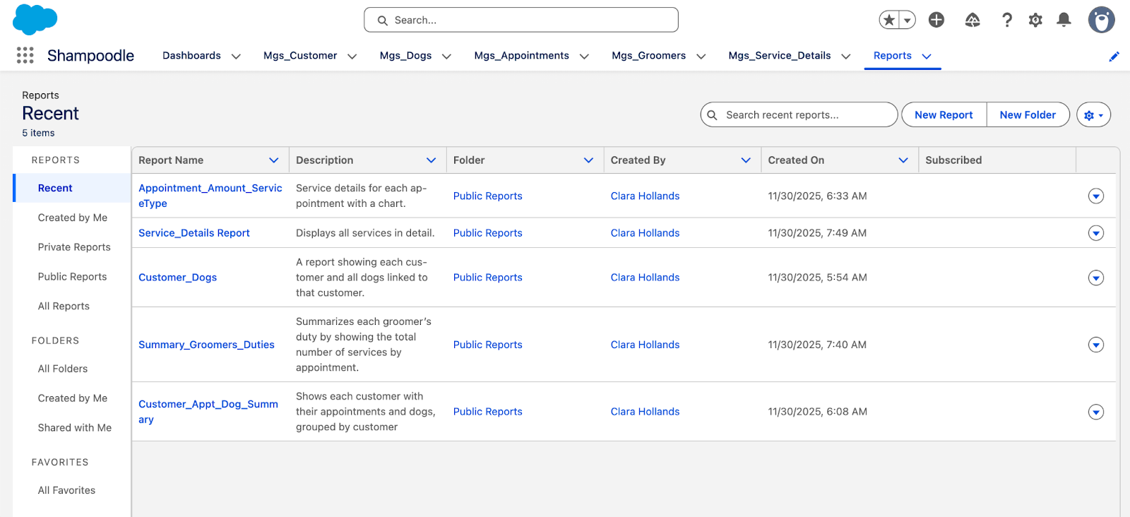
OVERVIEW OF REPORTS

Slide 9
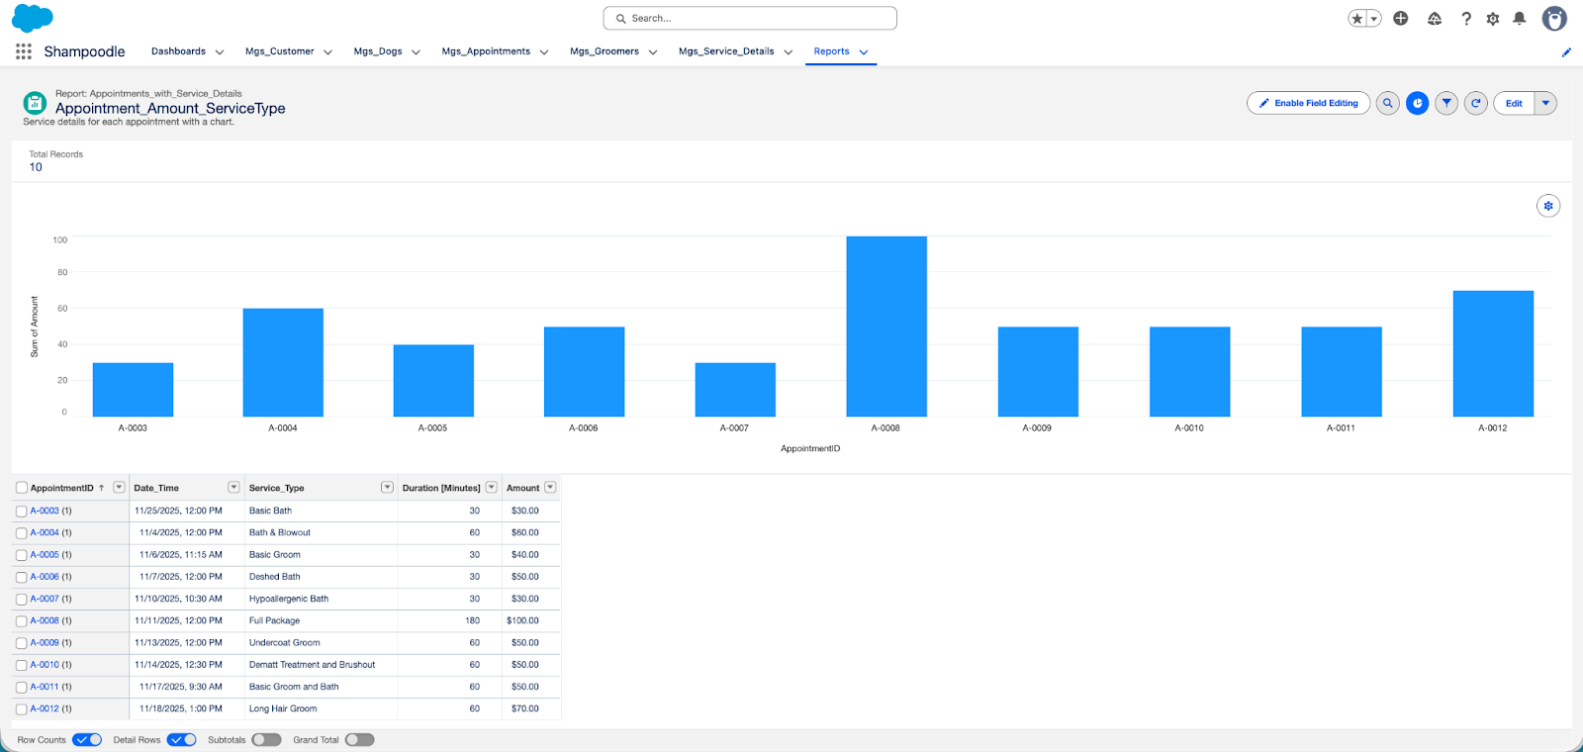
SCREENSHOTS OF REPORTS WITH DESCRIPTION , HOW THEY CAN SUPPORT BUSINESS
Appointment_Amount_ServiceType - report

Slide 10
Appointment_Amount_ServiceType
This report provides a detailed view of each appointment, showing the service type and the amount charged, along with a chart visualization. Businesses can use it to analyze revenue distribution across different services, identify trends in service demand, and make informed decisions on pricing, promotions, or expanding popular services. It also helps management quickly spot high-performing services and revenue opportunities.

Slide 11
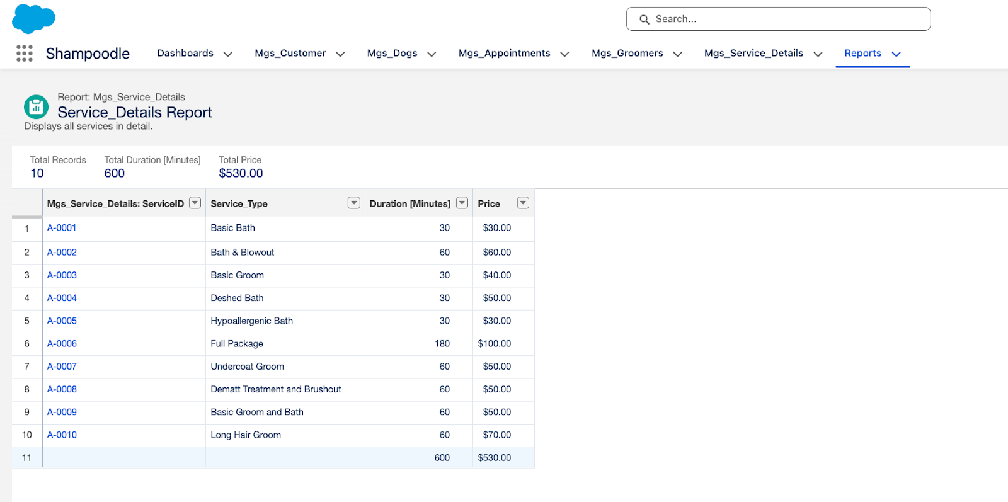
Service_Details-Report

Slide 12
The Service_Details Report lists all services provided in detail, making it valuable for auditing and ensuring accurate billing. It allows staff and management to monitor the services offered, identify underutilized or high-demand services, and make decisions about adjusting offerings

Slide 13
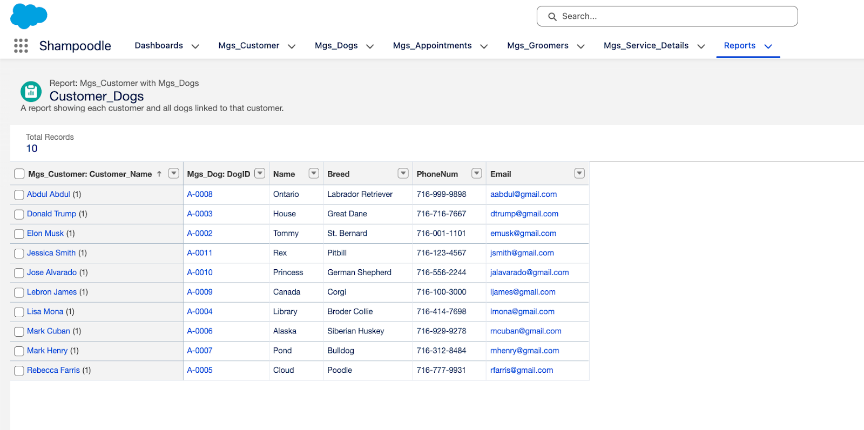
Customer_Dogs-Report

Slide 14
The Customer_Dogs report shows each customer along with all dogs associated with them. It helps staff quickly access pet details before appointments, improving service accuracy and personalization. From a business perspective, it is useful for tracking customer loyalty, managing repeat visits, and planning targeted marketing campaigns such as reminders for vaccinations, grooming, or special offers.

Slide 15
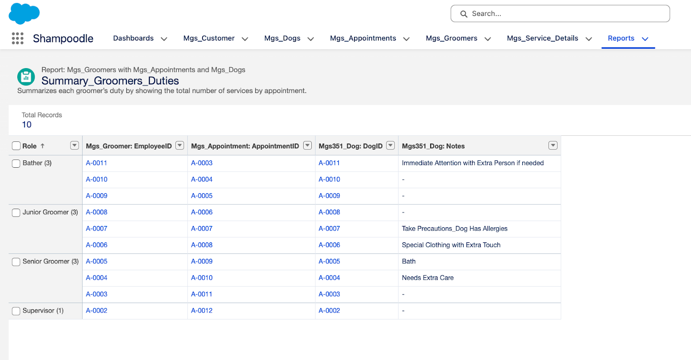
Summary_Groomers_Duties-Report

Slide 16
This report summarizes each groomer’s duties by showing the total number of services performed per appointment. Businesses can use it to monitor staff workload, balance appointments efficiently, and evaluate performance. It also aids in scheduling decisions, ensuring no groomer is over- or under-utilized, and helps management recognize high-performing employees or areas needing support.

Slide 17
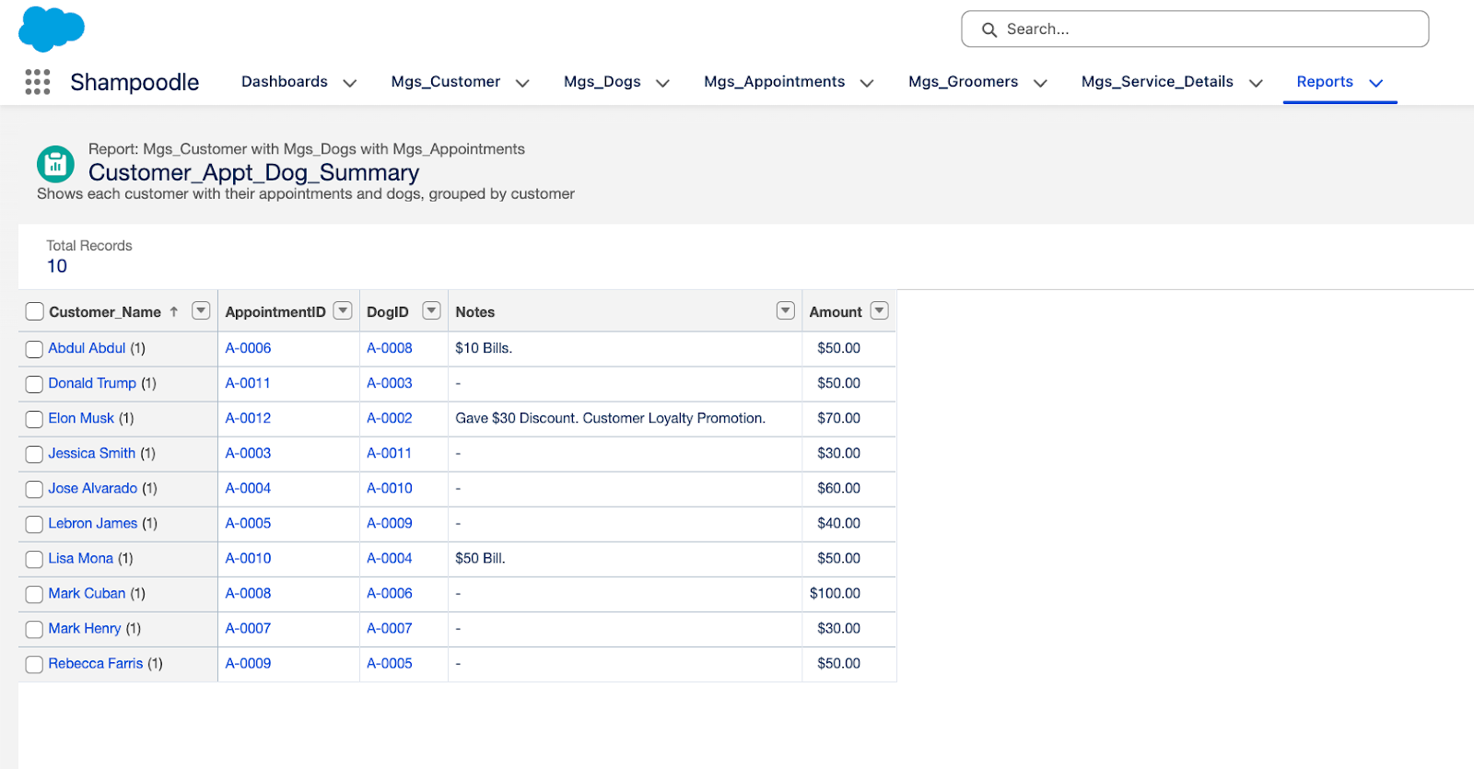
Customer_Appt_Dog_Summary-Report

Slide 18
The Customer_Appt_Dog_Summary report groups data by customer, showing all appointments and pets linked to each customer. This enables businesses to understand customer engagement, identify frequent clients, and anticipate service needs. It supports loyalty programs, targeted marketing, and improved customer experience by allowing staff to prepare in advance and personalize services for each customer.

Slide 19
Seven Solution Website _https://rahil326.github.io/shampoodle-project/

