Slide 1


Cafe Self Ordering Kiosk
User-Friendly Ordering System

Slide 2

Prepared By
Name : Maiyani Rahil Nareshbhai
Enroll : 23002170110078
Roll No. : 10
Branch : CE

Slide 3
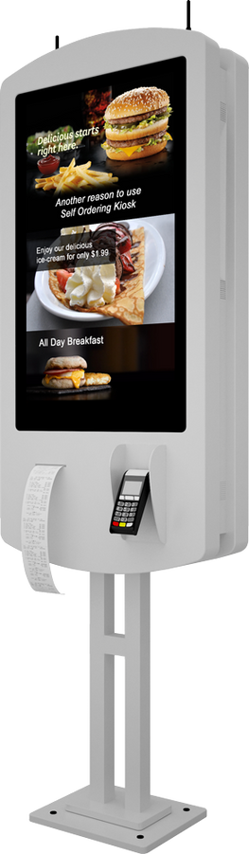
Project Overview & Objectives
Full-stack café kiosk system using MERN stack.
Reduce manual ordering, improve efficiency, and enhance customer loyalty.
Backend handles user data, orders, and reward system securely.
Modular design supporting admin, user, and guest roles.

Slide 4
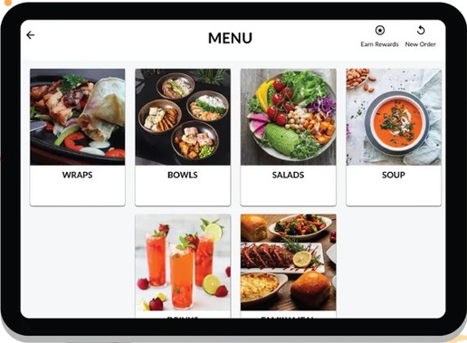
Key Features
Secure login/logout with authentication flow.
Menu with categorization (Hot/Cold Coffees, Snacks, Desserts) with images and prices.
Cart with live total calculation and checkout.
AdminPanel for Order management

Slide 5
Code Highlights
Frontend built with functional React components and hooks
Axios used for communication with backend API.
JWT-based authentication and middleware.
Mongoose schemas for structured user and item data.

Slide 6
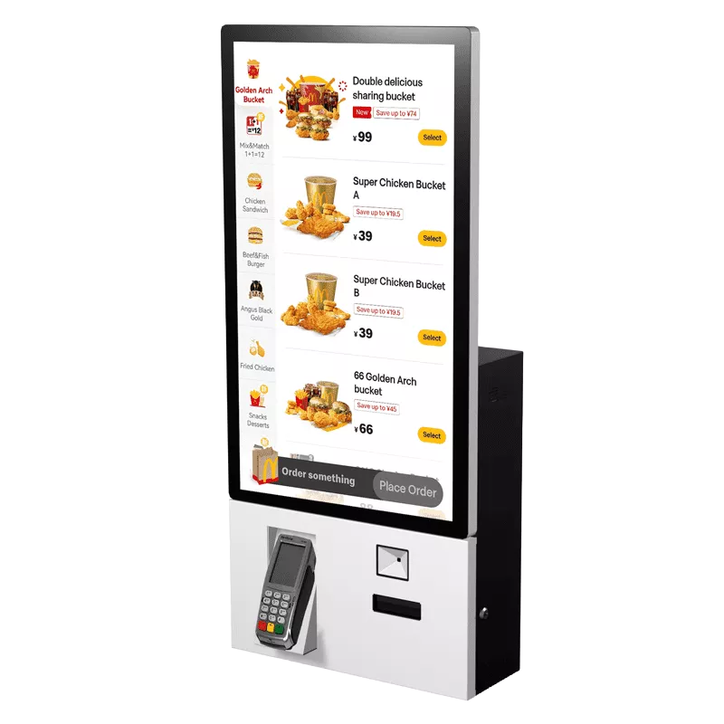
Future Scope
Personalized menu suggestions.
Multilingual support for diverse customers.
Payment gateway
QR-code based loyalty and mobile integration.
Dashboard analytics for admin

Slide 7
Thank You

