Slide 1

Credit Risk Assessment: Predicting Loan Default Using Machine Learning
DAT 402 - Project 2
Rahila Jafari
April 2026

Slide 2

Introduction & Problem Statement
Introduction
Loan approval is a critical decision for banks
High-risk borrowers may fail to repay loans (loan default)
Loan defaults cause significant financial losses
Problem
Traditional methods rely on credit scores and judgment
Limited ability to accurately predict default risk
Project Focus
Predict loan default using machine learning
Compare Logistic Regression, Decision Tree, Random Forest

Slide 3
Dataset & Data Preparation
Dataset
Credit risk dataset (Kaggle)
32,574 loan applications
12 features describing borrower profiles
Target: Loan Status (Default / No Default)
Data Preparation
Filled missing values
Removed unrealistic values
Encoded categorical variables
Scaled features
Split data (80% train / 20% test)
Key Features
Demographics: age, income, home ownership, employment length
Loan Details: loan amount, interest rate, loan intent, loan grade
Credit History: prior default, credit history length
Financial Ratio: loan percent of income

Slide 4

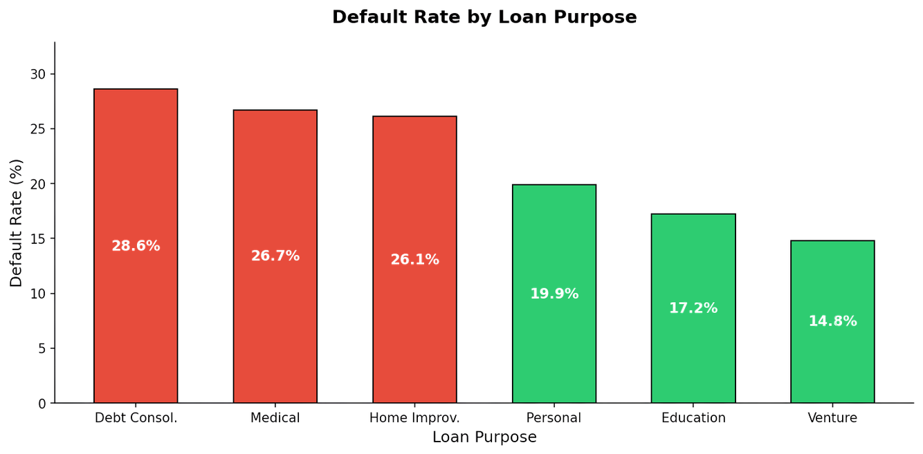
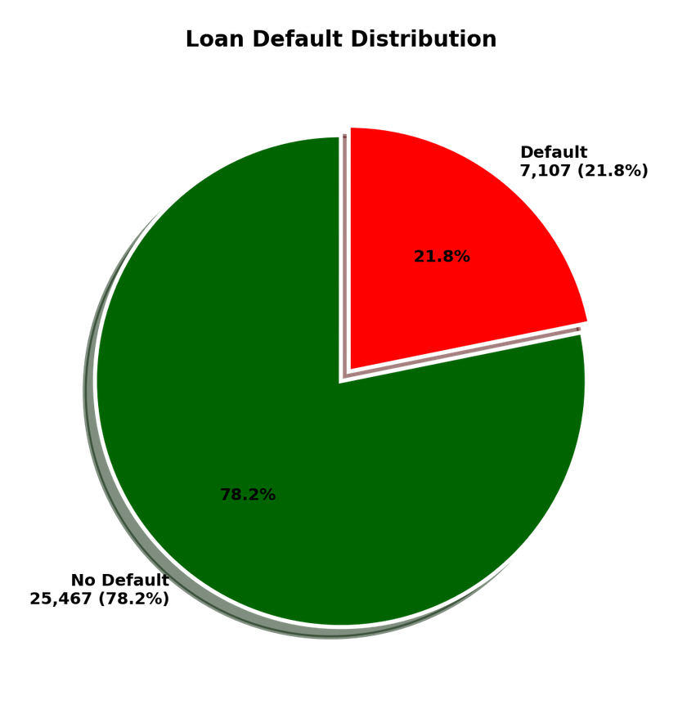
Loan Default Overview & Purpose Analysis

Slide 5
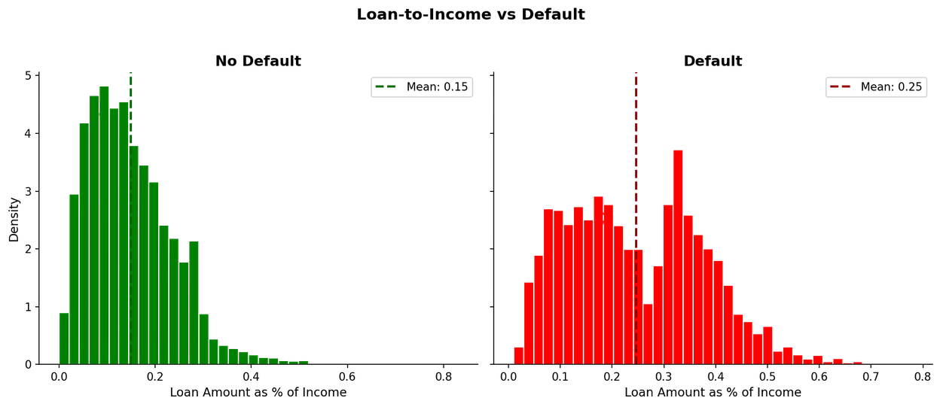
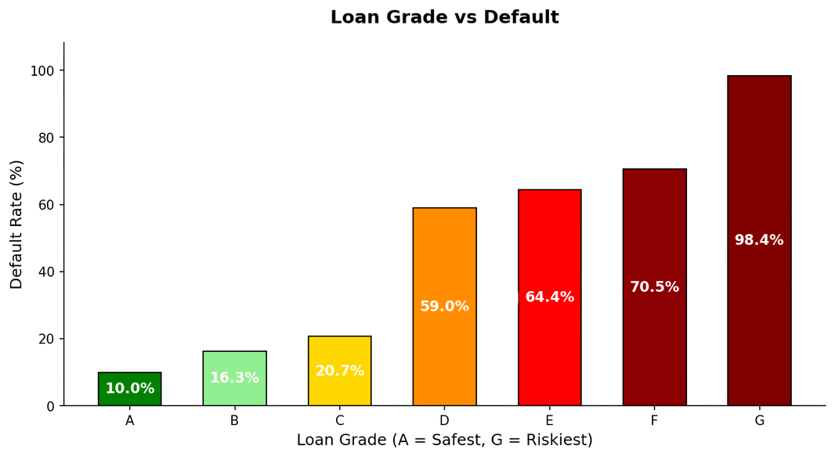
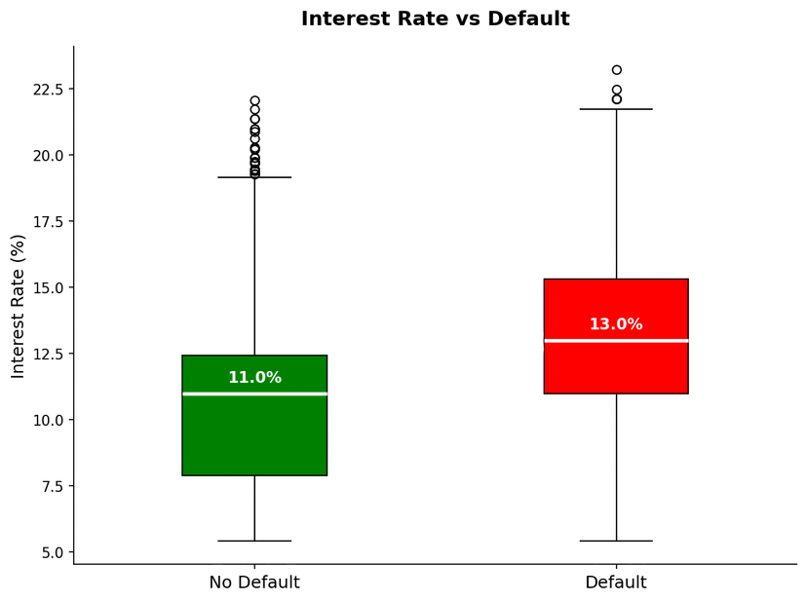
Key Financial Risk Factors
Grade G borrowers' default at 98.4%
Defaulters borrow 25% of income vs 15% for non-defaulters
Defaulters pay 13% interest vs 11% for non-defaulters

Slide 6
Models Used
Logistic Regression
Decision Tree
Random Forest
Simple and widely used classification model
Predicts probability of default
Accuracy: 85% | AUC: 0.85
Splits data into groups based on feature values
Easy to interpret and understand
Accuracy: 91% | AUC: 0.90
Combines 100 decision trees for better accuracy
Uses bagging to reduce overfitting
Accuracy: 93% | AUC: 0.94 -Best Model

Slide 7
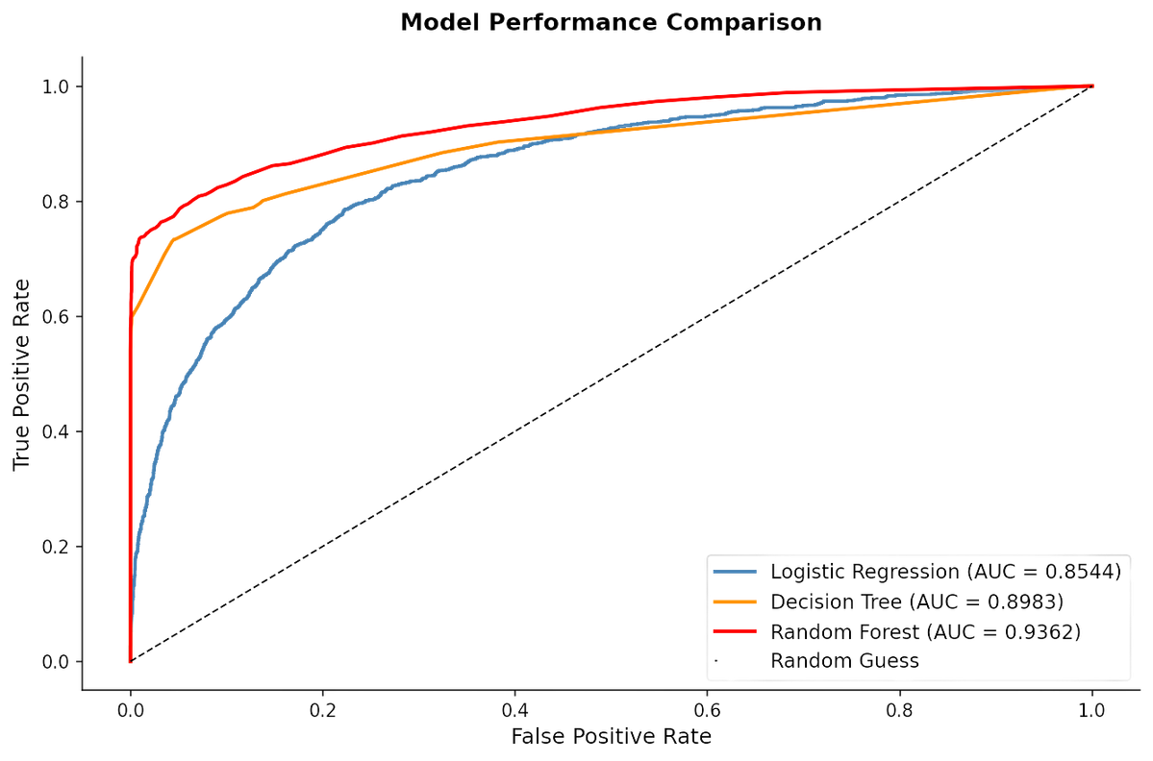
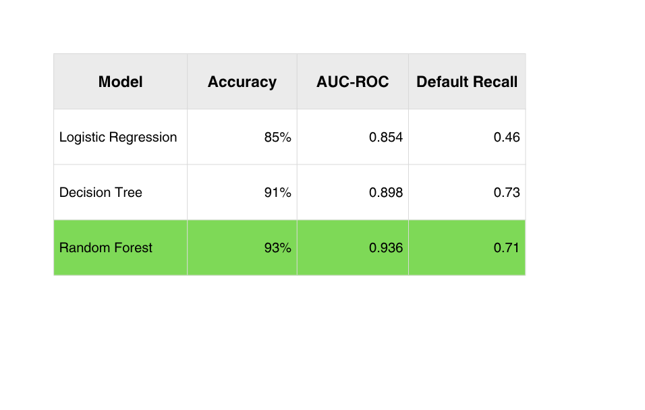
Model Results & Comparison

Slide 8
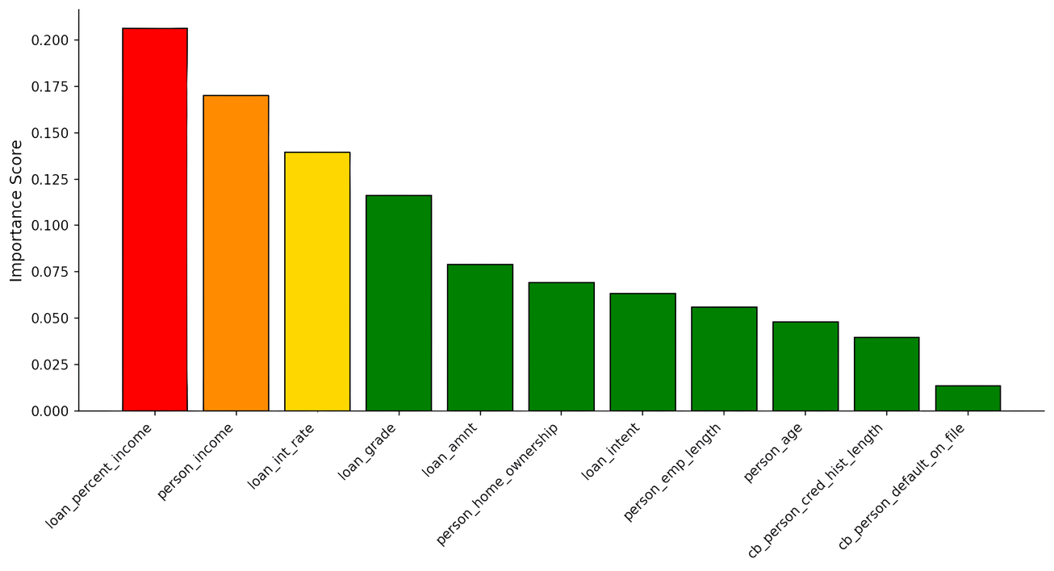
What Drives Loan Default?
Loan-to-income ratio is the strongest predictor of default
Lower income is associated with higher default risk
Higher interest rates are linked to more defaults

Slide 9
Conclusion
Achieved 93% accuracy in loan default prediction
Random Forest performed best among the three models
Key predictors: loan-to-income ratio, income, and interest rate
This model can help banks identify high-risk applicants before approval
This approach improves lending decisions and reduces financial risk.

Slide 10
References
Credit Risk Dataset: Kaggle (Lao Tse)
Scikit-learn Documentation
Pandas, NumPy, Matplotlib, Seaborn
Thank You

