Slide 1
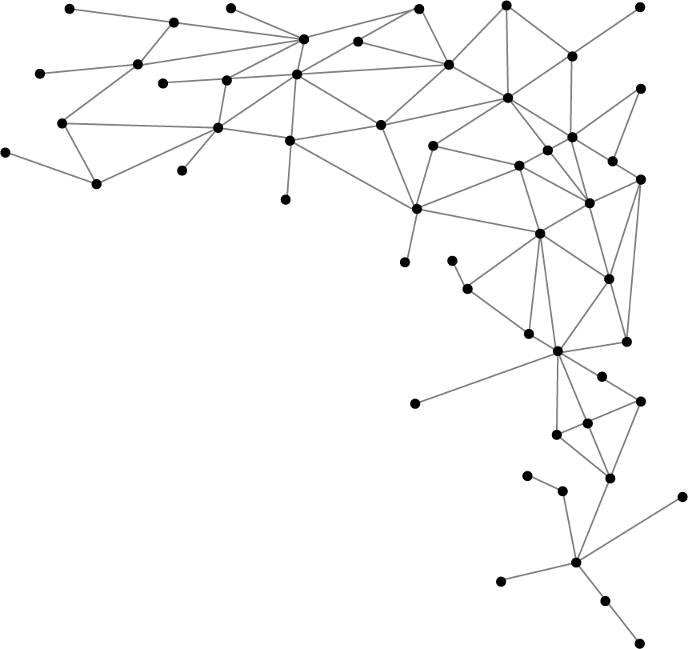




Machine Learning
I am Saif Hassan
Lecturer (CS@SIBAU)
@saifhassandr
@saifhassandr

Slide 2
Agenda
Nearest Neighbor (k-NN)
Linear Regression
Reading HW

Slide 3
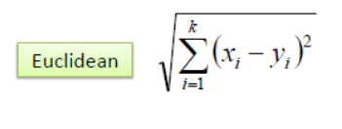
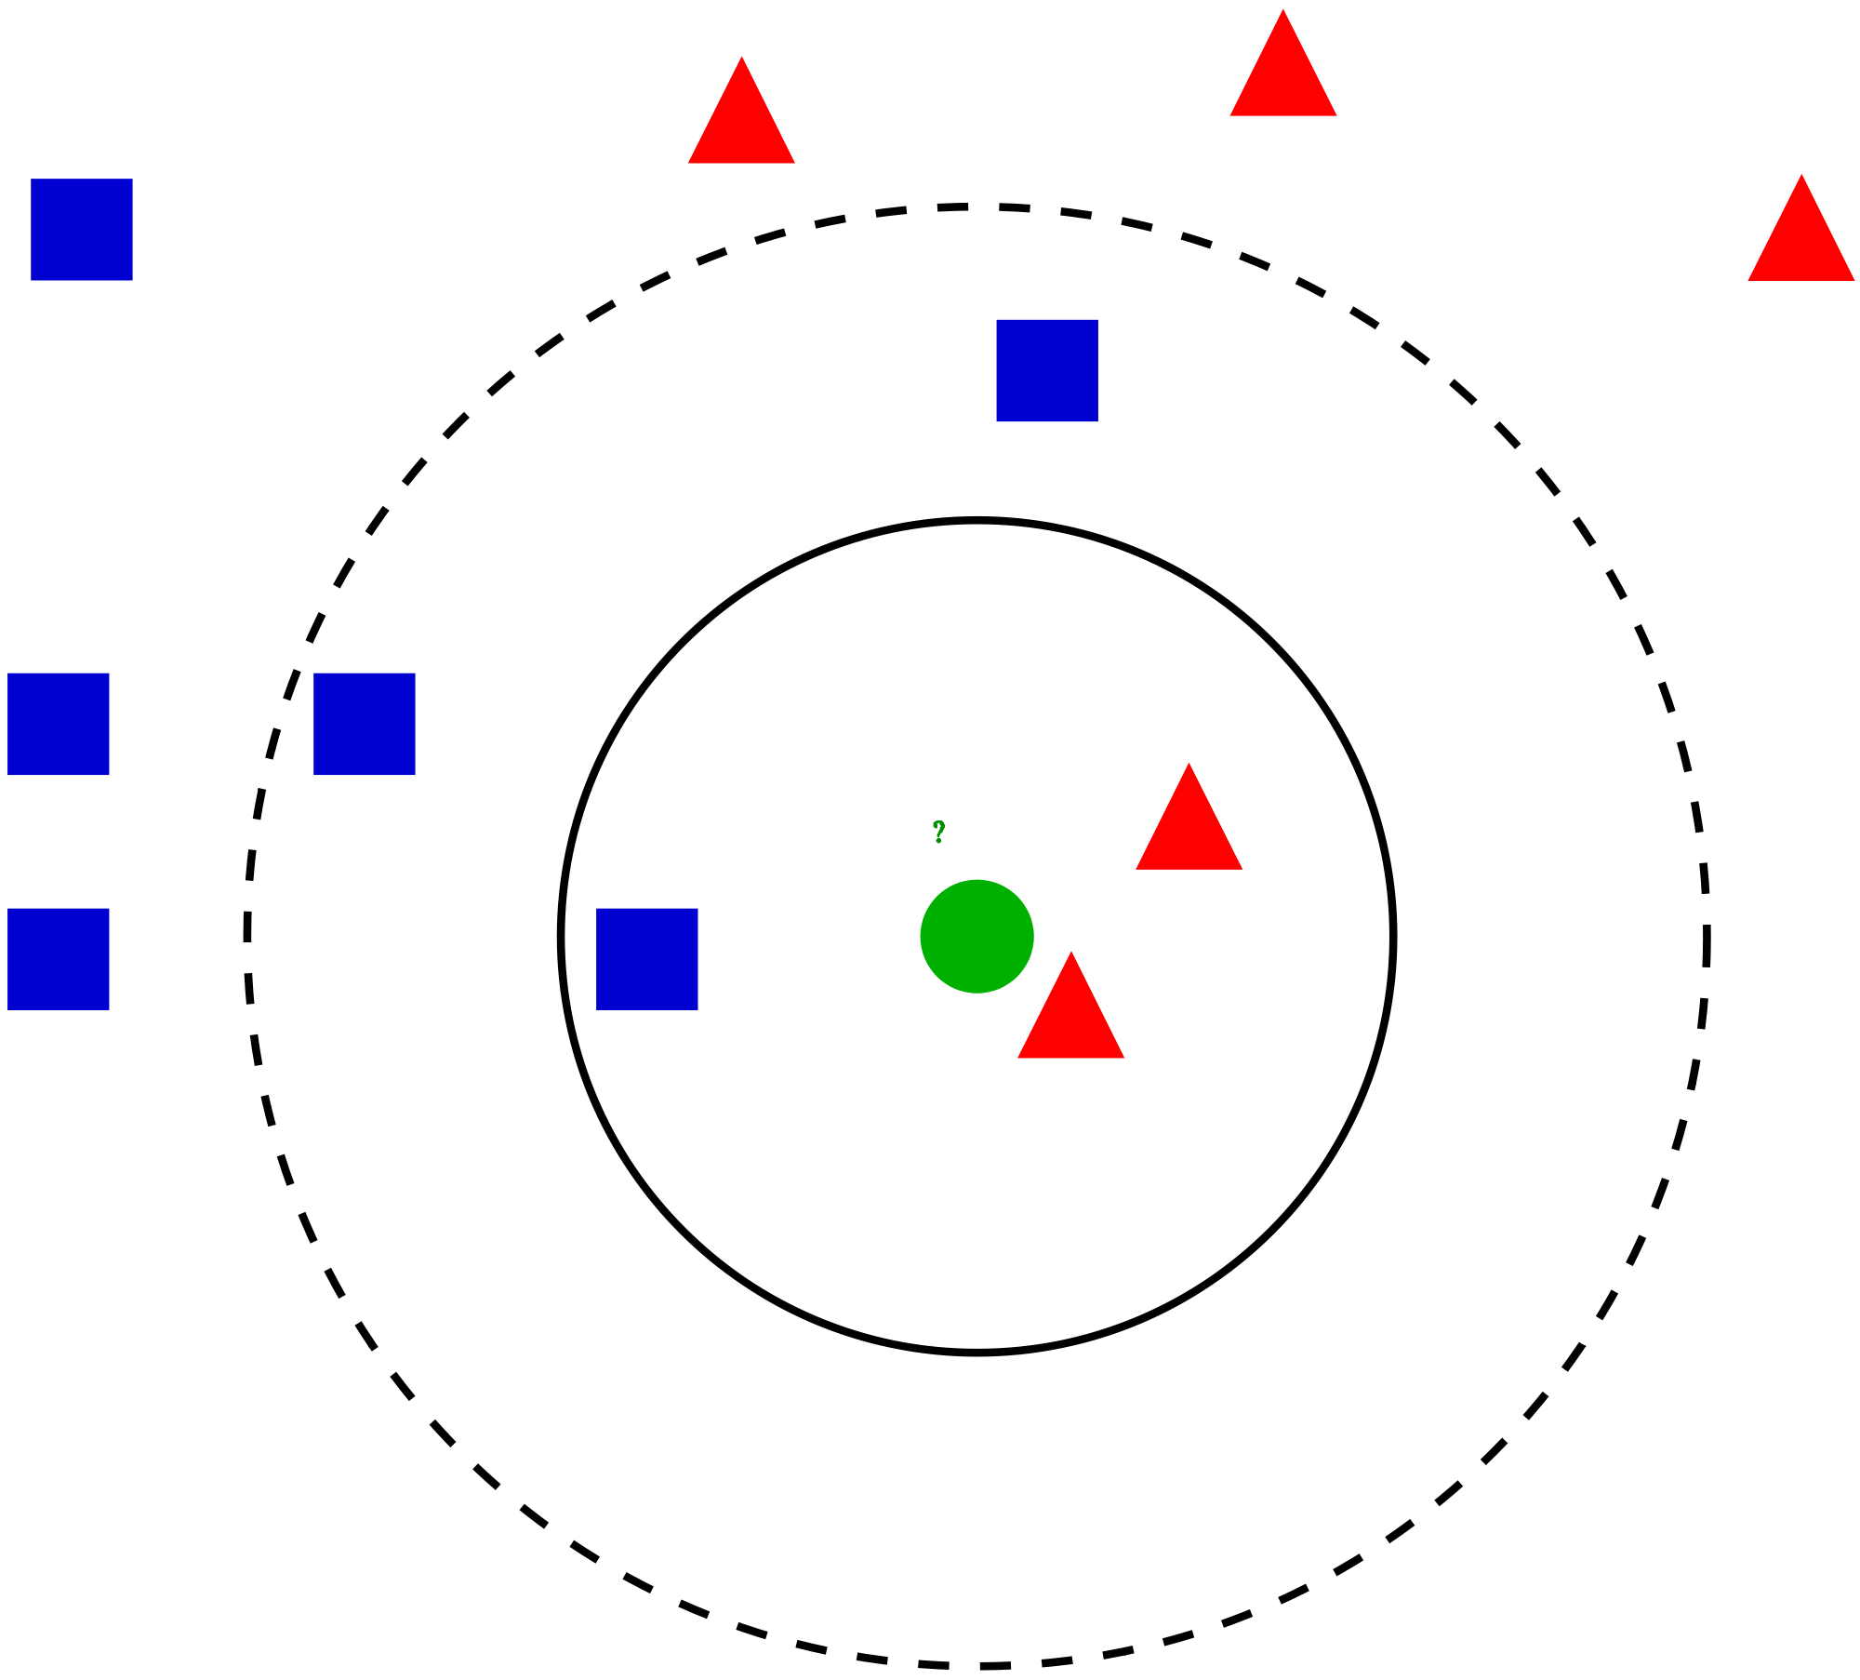
Nearest Neighbor
Overview of kNN
What is k in kNN?
How to choose k value?
Notes:
Idea of similarity, distance, closeness
Cosine vs. Euclidean
Euclidean for low dimensions
Cosine for high dimensions
How to choose k value?
Large k = biased to majority of labels
Small k = fast but unstable decision
So experiments and then choose, and data scientist mostly choose odd value
Pros and cons
Pros (training time less, easy)
Cons (testing time much, computation high, storage high, curse of dimensionality (PCA))
Questions
What if more than two classes?
What if more than two features?
How do u plot multi dimensional data?

Slide 4
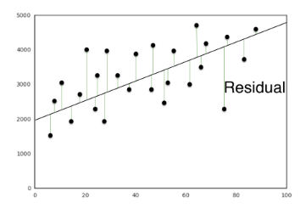
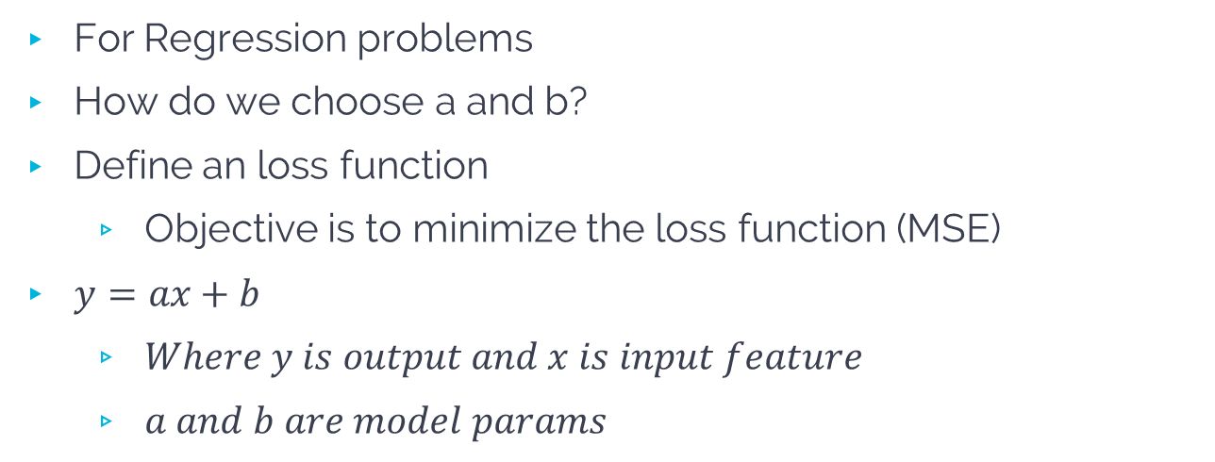
Linear Regression
For Regression problems
How do we choose a and b?
Define an loss function
Objective is to minimize the loss function (MSE)
$y=ax+b$
$Where y is output and x is input feature$
$a and b are model params$
Notes:
Linear regression in higher models:
Y = a1x1 + a2x2 + b

Slide 5
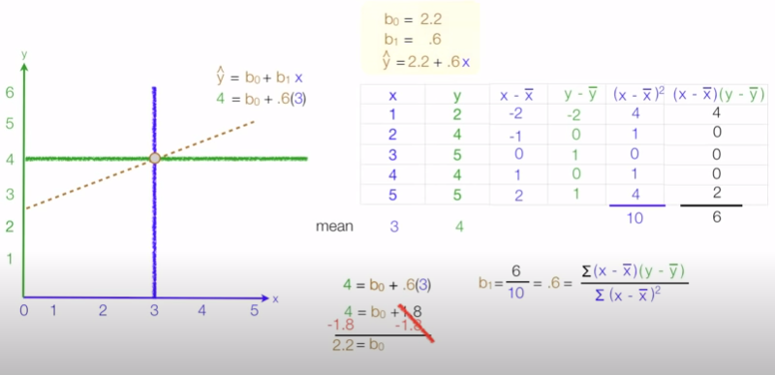

Slide 6
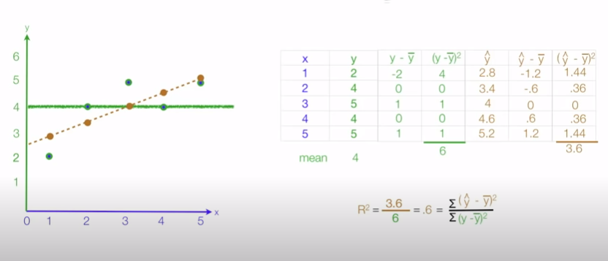
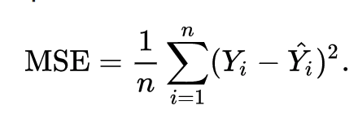

Slide 7
Questions
What if more than two classes?
What if more than two features?
How do u plot multi dimensional data?

Slide 8
THANKS!
@saifhassan
Any questions?
Leave comments below.

