Slide 1
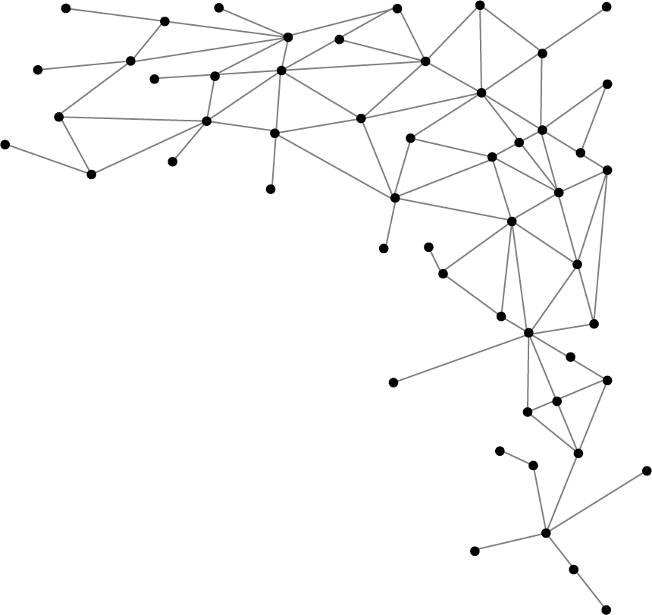




Machine Learning
I am Saif Hassan
Lecturer (CS@SIBAU)
@saifhassandr
@saifhassandr

Slide 2
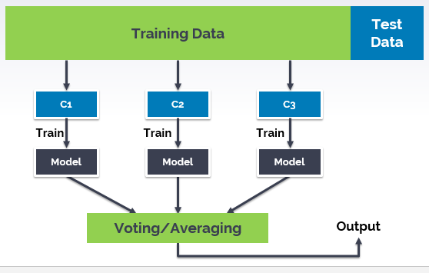
Ensemble Learners

Slide 3
Ensemble Learners Ensemble (French) means Together/assemble

Slide 4
Ensemble Learners using multiple methods to obtain better predictive models

Slide 5
Data
Training Data
Test Data
kNN
SVM
Decision Tree
Train
Train
Train
Model
Model
Model
Voting
Output

Slide 6
Ensemble Methods
Bootstrap aggregation (Bagging)
Boosting

Slide 7
Bagging – Ensemble Method
Train multiple models of same learning algorithm on subsets of dataset by choosing randomly points with replacement.

Slide 8
Bagging
Training Data
Test Data
Repetition allowed
n samples
n samples
n samples
Train
Train
Train
Same ML classifier
Model
Model
Model
Homogenous Weak Learners
Voting
Output

Slide 9
Boosting – Ensemble Methods Focus on wrong predictions

Slide 10
Boosting
Training Data
Test Data
Model
Train
n samples
Train
Data points with Wrong Predictions
Train
n samples
Model
+
And so on …
Test on
training data
Data points with Wrong Predictions

Slide 11
THANKS!
@saifhassandr
Any questions?
Leave comments below.

