Slide 1
Mutual Friend Recommender
Group Members:- 1. Rahil Kothari
2. Jitesh Sidhani
3.Harshit Sahani

Slide 2
Problem Statement
Social media platforms aim to increase user engagement by suggesting new friends.
Existing users already have direct friends, but identifying relevant new connections is a challenge.
This project addresses the problem using Breadth-First Search (BFS) to recommend meaningful connections.

Slide 3
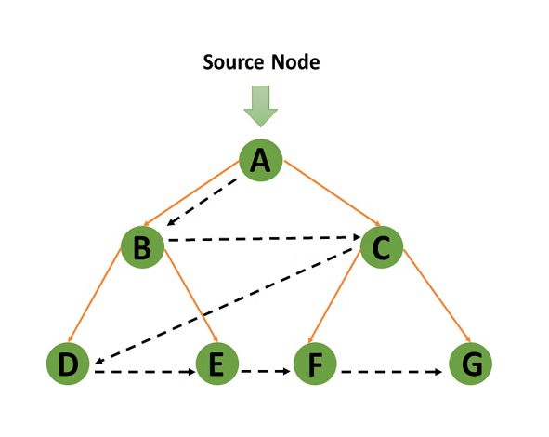
Graph Representation
Nodes: Users
Edges: Friendships
First Degree connections
(Direct Friends)
Second-degree connections

Slide 4
Why BFS?
BFS explores friends layer by layer, making it ideal for discovering mutual and second-degree connections.
It helps find relevant friend suggestions quickly by focusing on users who are closely connected in the social graph.
DFS goes deep into one path first, which can skip nearby (2nd-degree) connections important for friend suggestions.

Slide 5
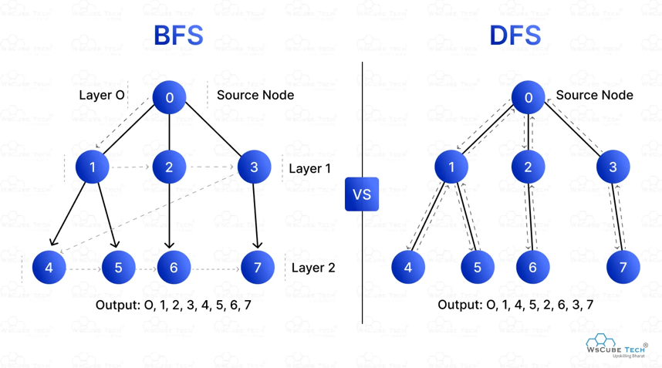

Slide 6
BFS Algorithm Logic
1. Start from user (e.g., 'A')
2. Use a queue to explore connections level-wise
3. Track visited users
4. For level 2 users, suggest if not already a friend

Slide 7
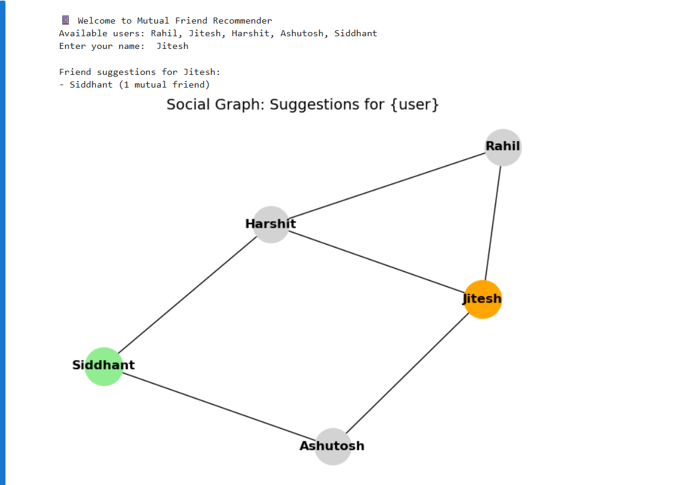
Example Output

Slide 8
Benefits and Limitations
✅ Benefits:
Simple and efficient
Works well for unweighted social graphs
Easy to implement and scalable for large networks
⚠️ Limitations:
Doesn’t consider interests or activity
May suggest irrelevant friends in dense networks
Ignores edge weights or strength of relationships

Slide 9
Conclusion
BFS can effectively suggest friends based on social proximity.
Useful in platforms like Facebook, LinkedIn.
Can be enhanced with mutual friend count, filters, and weights.

Slide 10
ANY QUESTIONS?

