Slide 1

Simple Calculator

Slide 2
Objective: Design a simple calculator using variables operators and functions in python.
This calculator provides options to perform addition, subtraction, multiplication, and division. It uses a while loop to keep the calculator running until the user chooses to exit. It also includes error handling for division by zero and invalid input.

Slide 3
Concepts Involved:
Data Types
Operators
Functions
Conditional Statements

Slide 4
Code:
def add(x, y):
return x + y
def subtract(x, y):
return x - y
def multiply(x, y):
return x * y
def divide(x, y):
return x / y
print("Select operation:")
print("1. Add")
print("2. Subtract")
print("3. Multiply")
print("4. Divide")
choice = input("Enter choice (1/2/3/4): ")
num1 = float(input("Enter first number: "))
num2 = float(input("Enter second number: "))
choice = input("Enter choice (1/2/3/4): ")
num1 = float(input("Enter first number: "))
num2 = float(input("Enter second number: "))
if choice == '1':
print("Result:", add(num1, num2))
elif choice == '2':
print("Result:", subtract(num1, num2))
elif choice == '3':
print("Result:", multiply(num1, num2))
elif choice == '4':
if num2 == 0:
print("Error! Division by zero is not allowed.")
else:
print("Result:", divide(num1, num2))
else:
print("Invalid input")

Slide 5
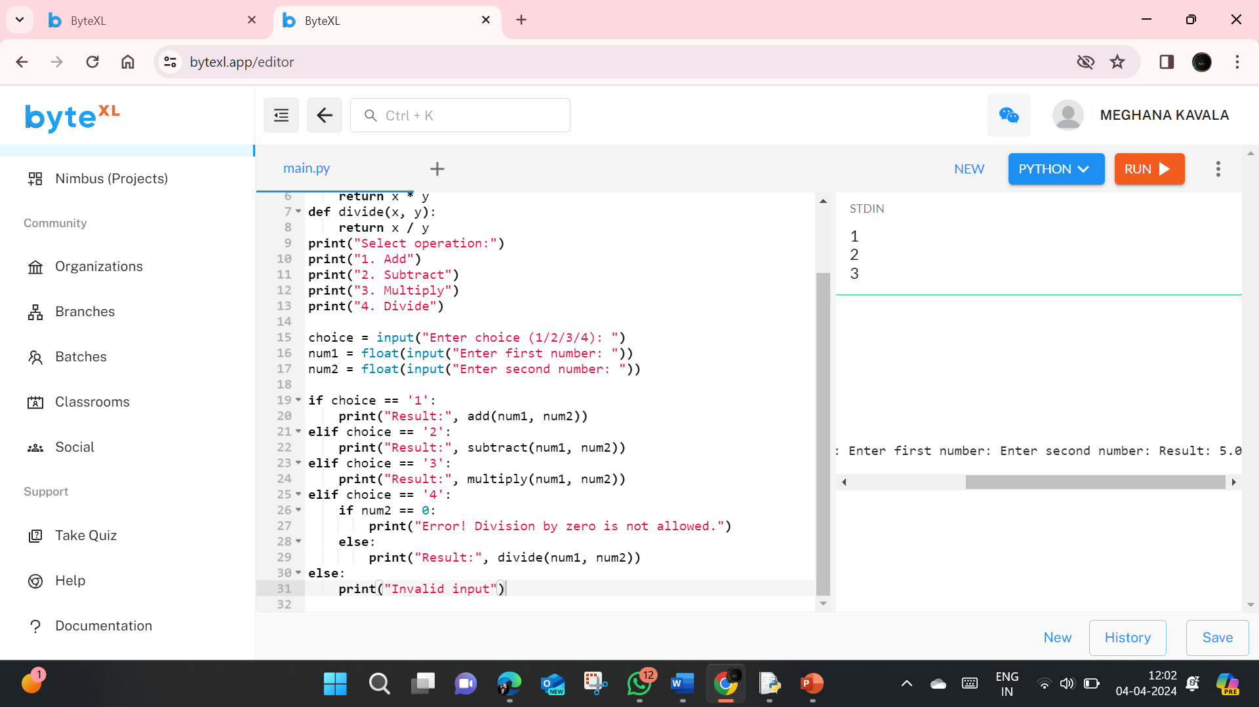
Output:

Slide 6
Outcome:
Students will come to know the application of learned concepts.
How to fix errors in the code.
Curiosity to make project through the learned concepts.

Slide 7
Future Scope of the Project
Graphical User Interface (GUI): You can enhance the calculator by creating a graphical user interface using libraries like Tkinter. This will provide a more user-friendly experience.
Scientific Calculator: Integrate advanced mathematical functions such as trigonometric, logarithmic, and exponential functions to transform the basic calculator into a scientific calculator.
History Feature: Implement a history feature that stores previous calculations, allowing users to review or reuse them.

Slide 8
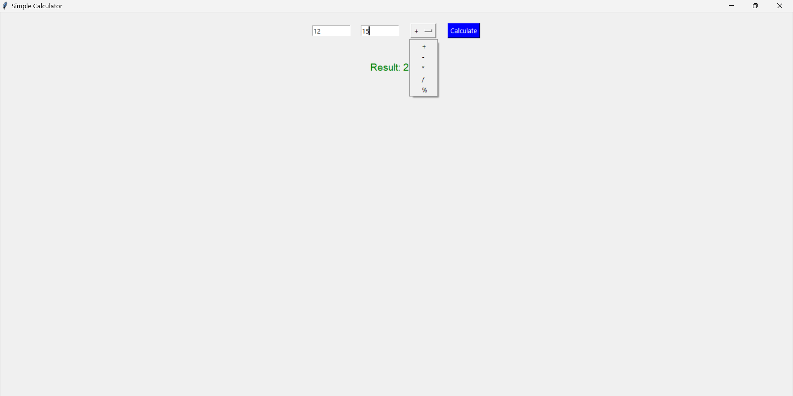
Using Tkinter

