Slide 1

-- Online Marketing Site

Slide 2
Statement :
Design a project for an online marketing site.
Condition : The Electronics and Clothing subclasses inherit from Product and add their specific attributes while overriding the display_product method to display their details.

Slide 3
Objective :
The primary objective of this project is to design an online marketing site that showcases a variety of products. This project aims to teach students the principles of object-oriented programming, inheritance, and polymorphism in the context of Python programming.
Students will gain hands-on experience in designing classes, creating subclasses, and overriding methods to implement specific functionalities.

Slide 4
Concepts Involved :
Classes and Objects
Inheritance
Polymorphism
Encapsulation

Slide 5
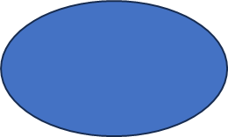
Start
Product
Product_id,name,
price
__init__(),
display_product()
Clothing
Electronics
Brand,
warranty
__init__(),display_product()
size,
color
__init__(),display_product()

Slide 6
Outcomes :
Understanding of Inheritance and Polymorphism
Object-Oriented Design Skills
Hands-on Programming Experience
Problem-Solving and Logical Thinking

Slide 7
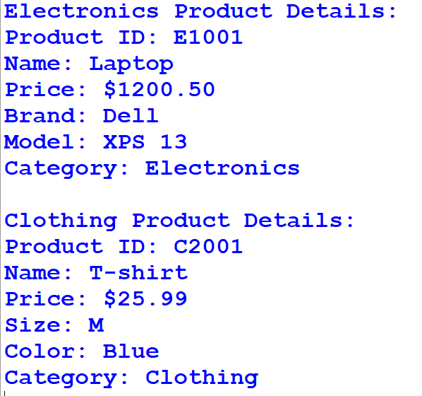
Output :

Slide 8
Future Scope Of The Project
Enhanced GUI: Improve the GUI by adding more interactive elements like images, dropdown menus for selecting categories or sorting products, and input fields for user reviews and ratings.
Database Integration: Implement a database to store and retrieve product information, allowing dynamic updates and real-time data display on the GUI.
Shopping Cart: Add a shopping cart feature where users can add products from different categories, view their cart, and proceed to checkout.

Slide 9
Futures Added
Tkinter Integration: The Tkinter library is used to create a simple GUI window for the online marketing site.
Display Product Details: Labels are used to display product details in the GUI window. Two buttons, "Electronics" and "Clothing," are provided to switch between product categories and display the corresponding product details using the display_electronics and display_clothing functions.

Slide 10
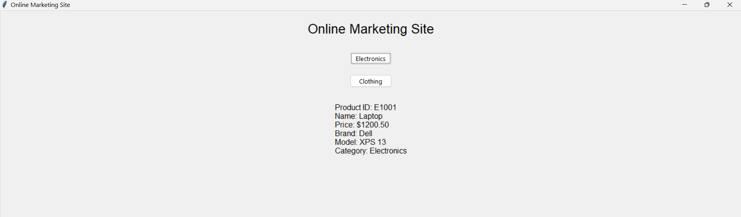
Output Using Tkinter :

