Slide 1

-- Task Management Application

Slide 2
Objective : Develop a task management application to organize tasks and deadlines.
The objective of a Task Management Application project is to develop a software tool that helps users organize, track, and manage their tasks effectively. The application serves as a centralized platform for users to create, prioritize, update, and monitor their tasks, ensuring that they stay on top of their responsibilities and deadlines.

Slide 3
Concepts Involved :
Vraiables and Data Types
Operators
Functions
Conditional Statements
Lists

Slide 4
Outcomes :
Technical Skills Development
Creativity and Innovation
Practical Application of Concepts
Problem-Solving and Critical Thinking

Slide 5
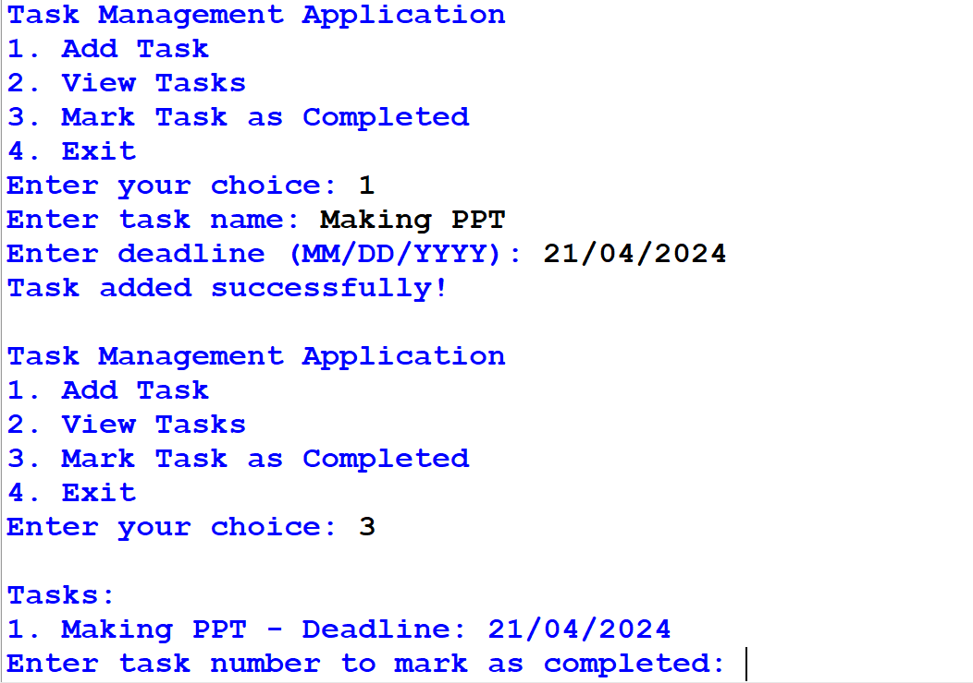
Output :

Slide 6
Future Scope Of The Project :
GUI Integration: Replace the command-line interface with a Tkinter-based graphical user interface (GUI) to provide a more user-friendly and visually appealing experience.
Task List Display: Implement a scrollable list or table to display tasks and deadlines in the GUI, allowing users to easily view and manage their tasks.
Add Task Form: Create a form in the GUI with input fields for entering task details (task name and deadline) and a button to add the task to the list.

Slide 7
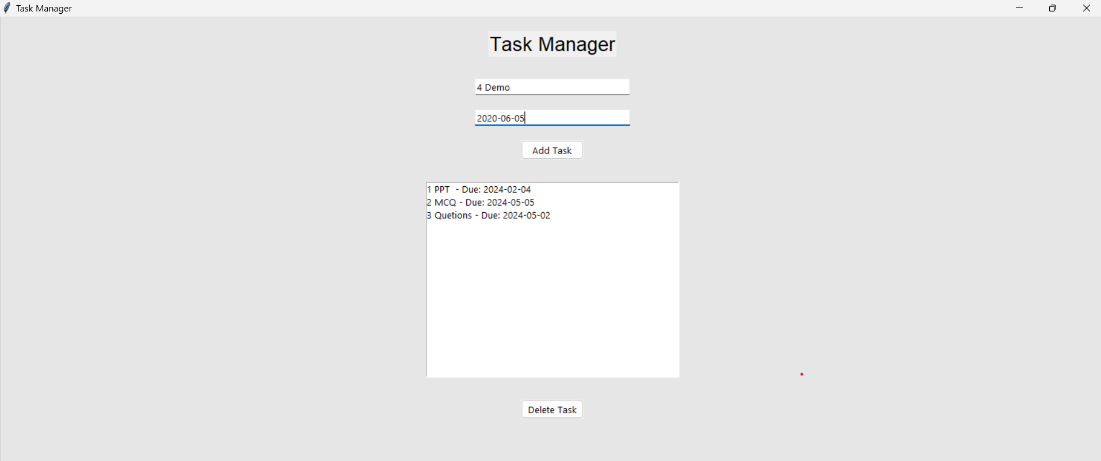
Output By Using Tkinter

