Slide 1
NATIONAL AI CENTER — AI ACADEMY | MATH4AI CAPSTONE
From Linear Scores to a Single Hidden Layer
A Mathematical Study of Simple Learning Systems
Central Question: When does a hidden layer genuinely improve on a linear decision rule?
Models: Softmax Regression vs. One-Hidden-Layer Neural Network (tanh)
Datasets: Linear Gaussian · Moons · Digits Benchmark
Implementation: Pure NumPy (no PyTorch / TensorFlow)
Presented by: Rahima Karimova & Team | March 2026

Slide 2
Presentation Outline
1
Central Question & Project Framing
7
Ablation Study & Optimizer Comparison
2
Mathematical Foundations
8
Failure Case Analysis
3
Model Architectures
9
Repeated-Seed Statistics
4
Backpropagation Derivation
10
Advanced Track
5
Datasets & Experimental Setup
11
Discussion, Limitations & Conclusions
6
Core Results: Gaussian · Moons · Digits
Math4AI Capstone | National AI Center | 2026

Slide 3
Central Question & Project Framing
What this capstone asks — and why it matters
"When does a one-hidden-layer nonlinear classifier genuinely improve on a linear decision rule, and when is additional model complexity unnecessary?"
• More complex models are NOT automatically better — complexity must be earned through evidence.
• We compare two model classes on geometric grounds, not just raw accuracy.
• Mathematics bridges: Linear Algebra · Calculus · Probability → Supervised Learning.
• Fair comparison: same data split, same preprocessing, validation-based model selection.
• Implemented from scratch in NumPy — every equation is our own.
Math4AI Capstone | National AI Center | 2026

Slide 4
Mathematical Foundations
Connecting Math4AI coursework to machine learning
Linear Algebra
Calculus & Optimization
Probability & Statistics
• Affine score functions: s = Wx + b
• Gradients and the chain rule
• Softmax = categorical distribution
• Vectorized batch computation
• Backpropagation as chain-rule bookkeeping
• Cross-entropy = negative log-likelihood
• Hidden representations as matrix products
• Loss minimization via gradient descent
• MLE interpretation of training
• Optional: PCA / SVD for input geometry
• SGD · Momentum · Adam optimizers
• Repeated-seed confidence intervals
Math4AI Capstone | National AI Center | 2026

Slide 5
Model 1: Softmax Regression
Linear baseline — the decision boundary is affine
Score (logit) function:
Key Properties
• W ∈ ℝ^{k×d}, b ∈ ℝ^k — all class boundaries are linear.
• Minimizing cross-entropy = maximizing log-likelihood (MLE).
• Sufficient when classes are linearly separable or near-linearly separable.
• Gaussian blobs: linear boundary is geometrically correct.
• Optimizer: mini-batch SGD, lr = 0.05, λ = 10⁻⁴ L2 regularization.
s(x) = W x + b
Softmax probabilities:
p_j(x) = exp(s_j) / Σ exp(s_ℓ)
Cross-entropy loss = Negative Log-Likelihood:
L(x, y) = − log p_y(x)
Decision boundary between class j and ℓ: s_j(x) = s_ℓ(x) → hyperplane in input space
Math4AI Capstone | National AI Center | 2026

Slide 6
Model 2: One-Hidden-Layer Neural Network
Nonlinear decision boundaries via learned representations
Forward pass:
Key Properties
• W₁ ∈ ℝ^{H×d}, W₂ ∈ ℝ^{k×H} (default H = 32).
• Hidden layer = learned nonlinear feature map.
• Decision boundaries can curve to fit non-convex regions.
• tanh chosen for pedagogical clarity over ReLU.
• Same softmax output layer and cross-entropy loss as baseline.
• L2 regularization λ = 10⁻⁴ on all parameters.
Z₁ = X W₁ᵀ + 1 b₁ᵀ
H = tanh(Z₁)
S = H W₂ᵀ + 1 b₂ᵀ
P = softmax_row(S)
Why tanh?
Smooth · zero-centered · clean derivative: d/dz tanh(z) = 1 − tanh²(z)
Math4AI Capstone | National AI Center | 2026

Slide 7
Backpropagation Derivation
Chain rule applied layer by layer in vectorized form
Conceptual view: In the forward pass compute Z₁ → H → S → P → L. In the backward pass propagate ∂L/∂(·) in reverse. Each local derivative is simple; the chain rule assembles them.
Output sensitivity
Hidden pre-activation
∂L/∂S = (1/n)(P − Y)
∂L/∂Z₁ = (∂L/∂S) W₂ ⊙ (1 − H⊙H)
Output weights
Hidden weights
∂L/∂W₂ = (∂L/∂S)ᵀ H
∂L/∂W₁ = (∂L/∂Z₁)ᵀ X
Output bias
Hidden bias
∂L/∂b₂ = (∂L/∂S)ᵀ 1
∂L/∂b₁ = (∂L/∂Z₁)ᵀ 1
⊙ = element-wise product. (1 − H⊙H) is the tanh derivative applied element-wise. These are matrix forms of the same scalar chain rule from calculus.
Math4AI Capstone | National AI Center | 2026

Slide 8
Datasets & Experimental Setup
Three tasks designed for geometric clarity and rigorous comparison
Linear Gaussian
Moons (Nonlinear)
Digits Benchmark
• Two Gaussian blobs with mild class overlap
• Two interleaved crescent-shaped clusters
• sklearn digits: 1,797 images, 10 classes
• Linear boundary is geometrically correct
• No linear boundary can separate the classes
• 64-dim flattened pixel vectors (pre-scaled [0,1])
• Designed to test when simple model is sufficient
• Tests representational power of hidden layer
• Fixed train / val / test split — all teams identical
Experimental Protocol
• Same train/val/test split and preprocessing for both models.
• Model selection: use validation cross-entropy only (never test set).
• Epoch budget: 200 epochs, best-val-checkpoint for digits.
• Repeated seeds: 5 seeds on digits benchmark → means + 95% CI.
Math4AI Capstone | National AI Center | 2026

Slide 9
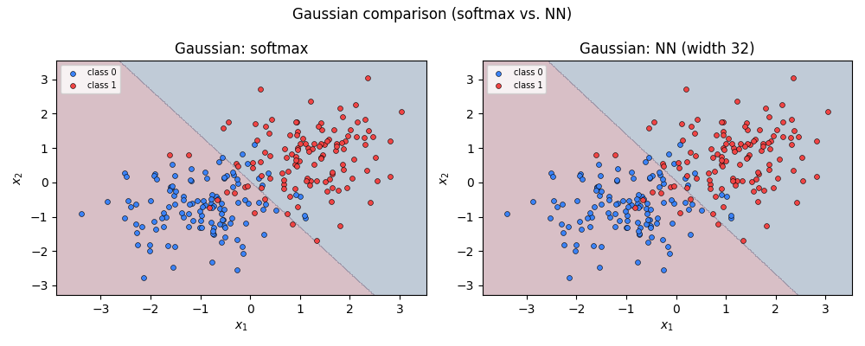
Core Experiment 1: Linear Gaussian Task
When a linear boundary is already sufficient
Test Results
Softmax Accuracy
95.0%
NN (w=32) Accuracy
95.0%
Softmax CE Loss
0.1539
NN CE Loss
0.1555
Conclusion: Both models achieve identical accuracy. The linear boundary perfectly separates the Gaussian blobs. Additional complexity is unnecessary here.
Math4AI Capstone | National AI Center | 2026

Slide 10
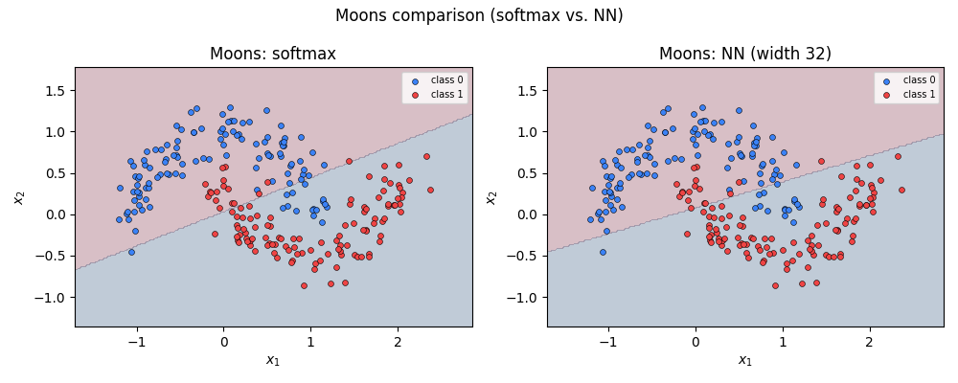
Core Experiment 2: Moons Task
Where a hidden layer changes the geometry of the problem
Test Results
Softmax Accuracy
85.0%
NN (w=32) Accuracy
85.0%
Softmax CE Loss
0.2852
NN CE Loss
0.2695
NN achieves lower cross-entropy loss. The hidden layer learns a curved decision boundary that better captures the crescent structure.
Math4AI Capstone | National AI Center | 2026

Slide 11
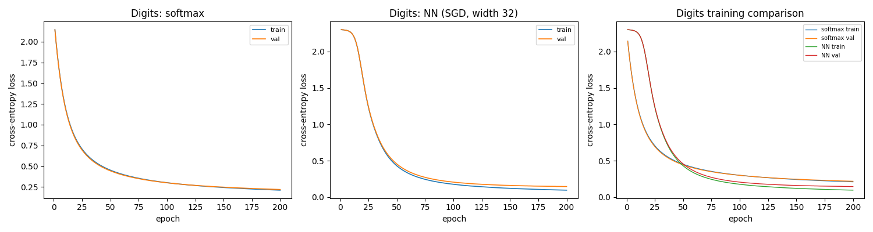
Core Experiment 3: Digits Benchmark
Ten-class classification with repeated-seed statistics
Single-Run Results
Model
Acc
CE
Softmax
94.02%
0.270
NN (SGD)
94.02%
0.193
5-Seed Statistics (95% CI)
Softmax accuracy
93.86 ± 0.185%
Softmax CE
0.2693 ± 0.0004
NN accuracy
93.97 ± 0.500%
NN CE
0.1933 ± 0.0103
NN clearly reduces cross-entropy; accuracy gains are within statistical noise.
Math4AI Capstone | National AI Center | 2026

Slide 12
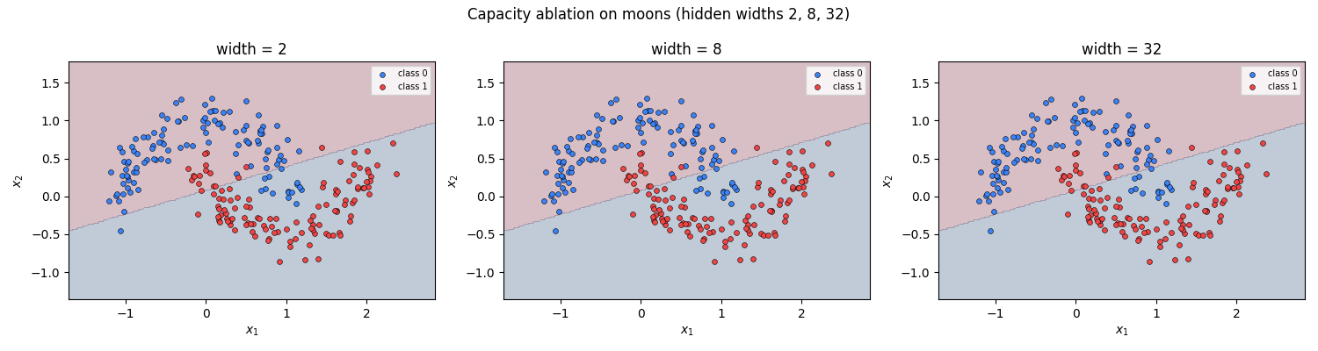
Ablation Study: Capacity on Moons
Hidden widths {2, 8, 32} — what changes in the learned boundary
Width = 2
Only 2 hidden neurons. Barely curves the boundary. Under-capacity; cannot separate crescents.
Width = 8
Begins to approximate the crescent shape. Reasonable fit with lower CE loss.
Width = 32
Default setting. Full separation achieved. Decision boundary matches the nonlinear structure.
Key insight: Width 2 is a failure case — insufficient capacity for this task geometry.
Math4AI Capstone | National AI Center | 2026

Slide 13
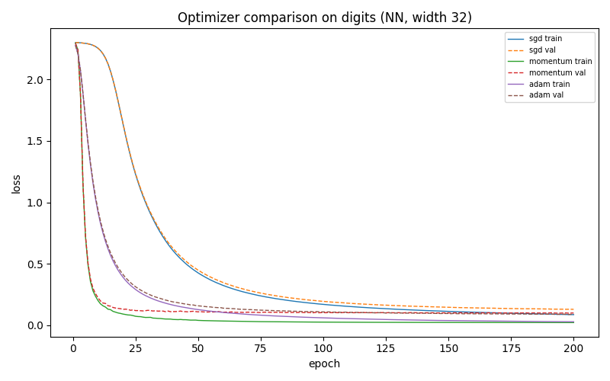
Optimizer Study: Digits Benchmark
SGD vs Momentum vs Adam — fixed conditions, hidden width 32
Optimizer Comparison
SGD
lr=0.05
Converges but slowly. Loss decreases steadily throughout 200 epochs.
Momentum
lr=0.05, β=0.9
Faster early convergence. Uses accumulated gradient directions.
Adam
lr=0.001, β₁=0.9, β₂=0.999
Best final CE loss. Adaptive learning rates accelerate training.
Adam converges fastest; all reach similar accuracy within 200 epochs.
Math4AI Capstone | National AI Center | 2026

Slide 14
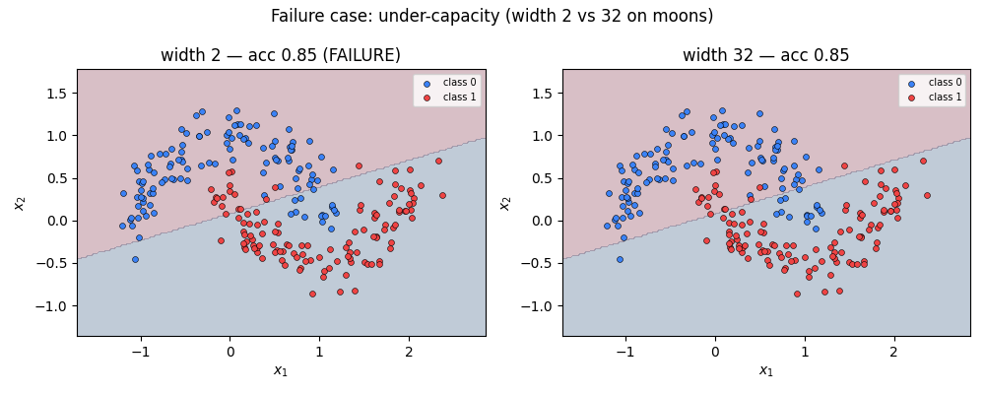
Failure Case Analysis: Under-Capacity Network
Width = 2 on moons — mechanism, not just outcome
Why it fails — mechanistic explanation
• Only 2 neurons → only 2 learned feature directions in the hidden space.
• The tanh activations span a low-dimensional manifold — cannot represent the crescent curvature.
• The output layer sees only 2 numbers per input; insufficient to discriminate the two crescents.
• Result: the decision boundary remains near-linear, unable to wrap around the moon shapes.
• This is a capacity failure — not an optimizer issue, not a data issue.
Lesson: model capacity must match the geometric complexity of the task.
Math4AI Capstone | National AI Center | 2026

Slide 15
Repeated-Seed Statistics
5 seeds, 95% confidence intervals — what variability tells us
Formula: x̄ ± 2.776 · s/√5 (t-distribution, 4 df, 95% CI)
Model
Metric
Mean
Std
CI Half-Width
CI Lower
CI Upper
Softmax
Accuracy
93.86%
0.149%
±0.185%
93.67%
94.04%
Softmax
Cross-Entropy
0.26930
0.000351
±0.000436
0.26887
0.26974
NN (SGD)
Accuracy
93.97%
0.403%
±0.500%
93.47%
94.47%
NN (SGD)
Cross-Entropy
0.19334
0.008268
±0.01026
0.18307
0.20360
Interpretation
• NN reduces cross-entropy by ~0.076 (28% reduction) — statistically meaningful given narrow CIs.
• Accuracy difference (~0.11%) is within noise — accuracy alone does not distinguish the models.
• 5 seeds expose optimizer sensitivity: NN accuracy std (0.40%) > Softmax (0.15%).
• Repeated-seed stats prevent false conclusions from a single lucky or unlucky initialization.
Math4AI Capstone | National AI Center | 2026

Slide 16
Advanced Track (Track B): Prediction Confidence & Reliability
Softmax probabilities as confidence estimates — how well are they calibrated?
Confidence = max predicted class probability. Predictive entropy = −Σ p_j log p_j (lower = more certain).
Confidence vs Accuracy
Correct vs Incorrect
Connection to Main Question
• 5-bin calibration table for both models.
• Correct predictions → higher max probability.
• Both models produce calibrated probabilities.
• Ideal: high confidence ↔ high accuracy.
• Incorrect predictions → lower, flatter distribution.
• NN's lower CE loss reflects better probability estimates.
• Softmax tends to be overconfident.
• Entropy higher for misclassified samples.
• Confidence analysis confirms: NN gains come from sharper probabilities, not just accuracy.
• NN shows slightly better calibration.
• NN slightly more confident on correct predictions.
• Limitation: 5-bin analysis with 360 test samples is coarse.
Math4AI Capstone | National AI Center | 2026

Slide 17
Discussion: Answering the Central Question
Evidence-based conclusions from all experiments
When is linear sufficient?
Gaussian blobs: linear boundary achieves 95% accuracy — identical to NN. Linear classifiers are sufficient when class conditionals are well-separated by hyperplanes.
What does the hidden layer add?
On moons: curved boundaries matching crescent geometry. On digits: 28% lower cross-entropy, sharper class probabilities. Hidden layer = learned nonlinear feature map.
When does complexity fail to justify itself?
Width-2 NN on moons fails because 2 neurons cannot span the required feature space. On Gaussian data: no improvement from complexity.
What does the failure case teach?
Capacity failure is geometric: insufficient neurons → insufficient representational space. Not an optimizer issue. The fix is more capacity, not more training.
Math4AI Capstone | National AI Center | 2026

Slide 18
Limitations & Honest Scope
What this study does not show — and why that matters
Dataset scale
Architecture depth
Results are based on small synthetic datasets and a 1,797-sample digits benchmark. Conclusions may not generalize to large, real-world datasets.
Only a single hidden layer is studied. Two or more hidden layers can learn qualitatively different representations — those are not covered here.
Activation choices
Calibration analysis
Only tanh is used. ReLU-family activations behave differently (non-smooth, sparse activations) and are the standard in modern practice.
The 5-bin confidence analysis uses only 360 test samples — too coarse for strong calibration claims. Modern ECE analysis requires larger sample sizes.
Hyperparameter search
Statistical power
Default hyperparameters are fixed by protocol. The relative performance of optimizers may change under different learning rate schedules.
5 random seeds provide rough variability estimates. Statistically rigorous comparisons would require larger seed counts.
Math4AI Capstone | National AI Center | 2026

Slide 19
NATIONAL AI CENTER — AI ACADEMY | MATH4AI CAPSTONE
Key Takeaways
Linear model is sufficient when class geometry is linearly separable (Gaussian task).
Hidden layer earns complexity by capturing curved boundaries (moons) and sharper probabilities (digits).
Cross-entropy reveals more than accuracy alone — NN's 28% CE reduction is meaningful.
Capacity must match geometry — Width-2 failure is a geometric, not an optimizer, failure.
Repeated seeds are essential — single runs may mislead; variability quantifies reliability.
Mathematics drives understanding — every result follows from chain rule, softmax, and geometry.
Thank you · Questions welcome

