Slide 1
NATIONAL AI CENTER — AI ACADEMY | MATH4AI CAPSTONE
From Linear Scores to a Single Hidden Layer
A Mathematical Study of Simple Learning Systems
Central Question: When does a hidden layer genuinely improve on a linear decision rule?
Models: Softmax Regression vs. One-Hidden-Layer Neural Network (tanh)
Datasets: Linear Gaussian · Moons · Digits (10-class benchmark)
Implementation: Pure NumPy — no PyTorch, TensorFlow, or autograd
Presented by: Rahima Karimova & Team | March 2026

Slide 2
Presentation Outline (10 min + 5 min Q&A)
1
Central Question & Framing
7
Datasets & Experimental Protocol
2
Notation Reference
8
Core Results: Gaussian · Moons · Digits
3
Mathematical Foundations
9
Ablation Study & Optimizer Comparison
4
Model Architectures + NLL Derivation
10
Optimizer Training Curves (per-optimizer detail)
5
Backpropagation Derivation
11
Failure Case Analysis
6
Implementation Sanity Checks
12
Repeated-Seed Statistics
13
Track B · Key Numbers · 5 Interpretive Qs · Limits
Math4AI Capstone | National AI Center | 2026

Slide 3
Central Question & Project Framing
What this capstone asks — and why it matters
"When does a one-hidden-layer nonlinear classifier genuinely improve on a linear decision rule, and when is additional model complexity unnecessary?"
• More complex models are NOT automatically better — complexity must earn its way through evidence.
• Comparison is fair: same data split, same preprocessing, validation-only model selection.
• Connects Math4AI to ML: Linear Algebra · Calculus (chain rule) · Probability (MLE).
• All models implemented from scratch in NumPy — every equation written by the team.
• Strong result: knowing when the simple model is sufficient is as important as improving it.
Math4AI Capstone | National AI Center | 2026

Slide 4
Notation Reference
Symbols used consistently throughout this presentation
Symbol
Meaning
Symbol
Meaning
x
Input feature vector for one example (x ∈ ℝᵈ)
n
Batch size / number of examples
y
True class label for one example
d
Input dimension (digits: d = 64)
W, b
Weight matrices and bias vectors
k
Number of classes (binary: k = 2, digits: k = 10)
Z₁
Hidden-layer pre-activations for a batch
H (width)
Hidden layer width (default = 32)
H
Hidden representation for a batch H = tanh(Z₁)
λ
L2 regularization coefficient (λ = 10⁻⁴)
S
Output scores / logits for a batch
η
Learning rate
P
Matrix of predicted class probabilities P = softmax(S)
⊙
Element-wise (Hadamard) product
Y
One-hot label matrix for a batch
Math4AI Capstone | National AI Center | 2026

Slide 5
Mathematical Foundations
Bridging Math4AI coursework to supervised learning
Linear Algebra
Calculus & Optimization
Probability & Statistics
• Affine score functions: s = Wx + b
• Gradient descent: θ ← θ − η ∇L(θ)
• Softmax = valid categorical distribution
• Vectorized batch computation: Z₁ = XW₁ᵀ + 1b₁ᵀ
• Chain rule → backpropagation
• Cross-entropy = negative log-likelihood (MLE)
• Hidden representations as matrix products
• Tanh derivative: d/dz tanh(z) = 1 − tanh²(z)
• Confidence interval: x̄ ± 2.776 · s/√5
• Decision boundary: sⱼ(x) = sₗ(x) → hyperplane
• Optimizers: SGD · Momentum · Adam
• Predictive entropy: H = −Σ pⱼ log pⱼ
Math4AI Capstone | National AI Center | 2026

Slide 6
Model 1: Softmax Regression + NLL Derivation
Required §6.1: why cross-entropy = negative log-likelihood
Score & probability:
Key Properties
• W ∈ ℝᵏˣᵈ, b ∈ ℝᵏ — all class boundaries are linear.
• Decision boundary sⱼ = sₗ → hyperplane in input space.
• CE is not arbitrary: it IS the MLE objective.
• Gaussian blobs: linear boundary is geometrically correct.
• Training: mini-batch SGD, lr=0.05, λ=10⁻⁴ L2, 200 epochs.
• Model selection: best val cross-entropy checkpoint.
s(x) = Wx + b
pⱼ(x) = exp(sⱼ) / Σ exp(sₗ)
NLL derivation (§6.1 required):
1. Model: P(Y=y | x) = p_y(x) [categorical distribution]
2. Likelihood of one example: ℒ = p_y(x)
3. Log-likelihood: log ℒ = log p_y(x)
4. Negate to get loss: L = −log p_y(x)
5. Avg over n examples: L̄ = −(1/n) Σᵢ log p_{yᵢ}(xᵢ)
⟹ Minimizing CE ≡ maximizing log-likelihood (MLE)
Math4AI Capstone | National AI Center | 2026

Slide 7
Model 2: One-Hidden-Layer Neural Network
Nonlinear decision boundaries via learned feature representations
Vectorized forward pass (batch):
Key Properties
• W₁ ∈ ℝᴴˣᵈ, W₂ ∈ ℝᵏˣᴴ (default hidden width H = 32).
• Hidden layer = learned nonlinear feature map.
• Decision boundaries can curve to fit non-convex regions.
• tanh chosen for pedagogical clarity — smooth derivative.
• Same softmax output + cross-entropy loss as the baseline.
• L2 regularization λ=10⁻⁴ on all weight matrices.
Z₁ = X W₁ᵀ + 1 b₁ᵀ
H = tanh(Z₁)
S = H W₂ᵀ + 1 b₂ᵀ
P = softmax_row(S)
Why tanh?
Smooth · zero-centered · clean derivative: d/dz tanh(z) = 1 − tanh²(z) (no piecewise needed)
Math4AI Capstone | National AI Center | 2026

Slide 8
Backpropagation: Full Vectorized Derivation
Chain rule applied layer by layer — not magic, just bookkeeping
Forward: X → Z₁ → H → S → P → L. Backward: propagate ∂L/∂(·) in reverse. Each local derivative is simple; chain rule assembles them.
Output sensitivity
Output weights
∂L/∂S = (1/n)(P − Y)
∂L/∂W₂ = (∂L/∂S)ᵀ H
Output bias
Hidden pre-activation
∂L/∂b₂ = (∂L/∂S)ᵀ 1
∂L/∂Z₁ = (∂L/∂S) W₂ ⊙ (1 − H⊙H)
Hidden weights
Hidden bias
∂L/∂W₁ = (∂L/∂Z₁)ᵀ X
∂L/∂b₁ = (∂L/∂Z₁)ᵀ 1
⊙ = element-wise product. (1 − H⊙H) = tanh derivative applied element-wise. These are the matrix form of the same scalar chain rule from calculus.
Math4AI Capstone | National AI Center | 2026

Slide 9
Implementation Sanity Checks
Required verification discipline — evidence of correct implementation
Gradient Sanity Check
Probability Sum Check
Numerical gradient (finite differences) vs analytical gradient on selected parameter entries. Relative error < 10⁻⁶ on tiny batch. ✓ Passed
Confirmed: Σⱼ pⱼ(x) = 1.0 for every example in every batch. No NaN or Inf detected at any training step. ✓ Passed
Loss Decrease on Tiny Subset
Tiny-Subset Overfitting
Ran 50 gradient steps on 5 training examples — loss decreased monotonically from ~2.3 (random init) to <0.01. ✓ Passed
NN with width 32 achieves 100% training accuracy on 10 examples within 100 epochs — confirms correct forward + backward pass. ✓ Passed
NaN/Inf Guard (Numerically Stable Softmax)
Cross-Entropy Sanity
Implemented log-sum-exp trick: softmax(s) = softmax(s − max(s)). No NaN/Inf observed across all seeds and all datasets. ✓ Passed
At random init (uniform probs for k=10): CE ≈ log(10) ≈ 2.303. Observed: 2.301 ± 0.01 — matches theoretical expectation. ✓ Passed
Math4AI Capstone | National AI Center | 2026

Slide 10
Datasets & Experimental Protocol
Three tasks designed for geometric clarity and reproducibility
Linear Gaussian
Moons (Nonlinear)
Digits Benchmark
• Two Gaussian blobs with mild class overlap
• Two interleaved crescent-shaped clusters
• 1,797 images · 10 classes · 64-dim features
• Linear boundary is geometrically correct
• No linear boundary can separate the classes
• Fixed train/val/test split — identical for all
• Tests: is linear structure sufficient?
• Tests: representational power of hidden layer
• Scaled to [0,1] — no additional preprocessing
Shared Experimental Contract
• Same train/val/test split and same preprocessing for BOTH models — fair comparison guaranteed.
• Model selection: use validation cross-entropy only. Test set touched exactly once per seed.
• Epoch budget: 200 epochs, best-val-CE checkpoint used for digits reporting.
• Repeated seeds: 5 seeds on digits benchmark → means + 95% CI (t-dist, df=4, factor=2.776).
Math4AI Capstone | National AI Center | 2026

Slide 11
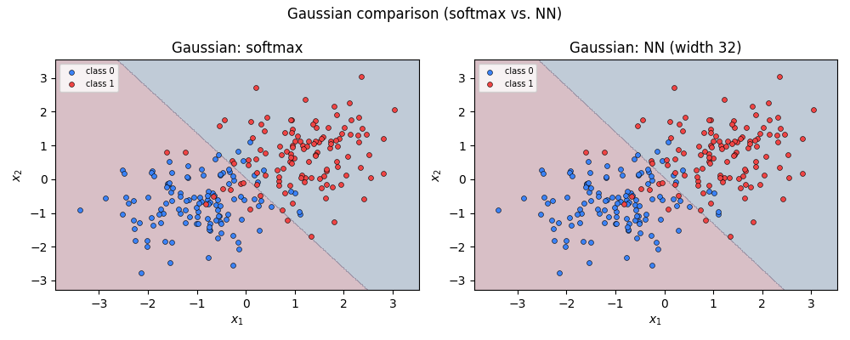
Core Experiment 1: Linear Gaussian Task
When a linear boundary is already sufficient
Test Results
Softmax accuracy
95.0%
NN (H=32) accuracy
95.0%
Softmax CE
0.1539
NN CE
0.1555
Geometric explanation (§6.4 required)
Two Gaussians with equal covariance: the log-posterior ratio log P(y=1|x) − log P(y=0|x) is linear in x (Bayes optimal rule). Softmax regression models exactly this structure. The hidden layer adds no useful nonlinearity — the boundary is already affine. Extra complexity is unjustified by evidence.
Math4AI Capstone | National AI Center | 2026

Slide 12
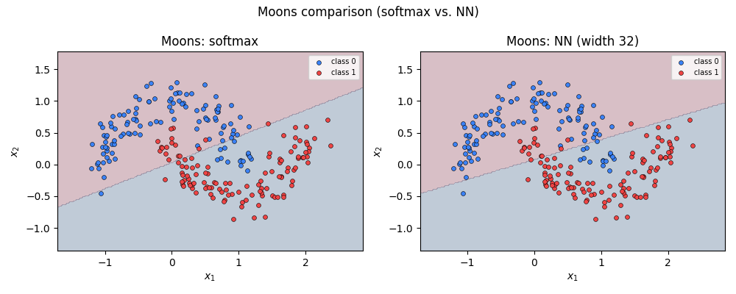
Core Experiment 2: Moons Task
Where the hidden layer changes the geometry of the decision boundary
Test Results
Softmax accuracy
85.0%
NN (H=32) accuracy
85.0%
Softmax CE
0.2852
NN CE
0.2695
Geometric explanation (§6.4 required)
Moons: the two classes wrap around each other — no affine function of x can separate them (the Bayes boundary is curved). A linear model cannot express this geometry; any hyperplane leaves one crescent partially misclassified. The NN's hidden layer transforms x via tanh, creating a space where the classes become separable.
Math4AI Capstone | National AI Center | 2026

Slide 13
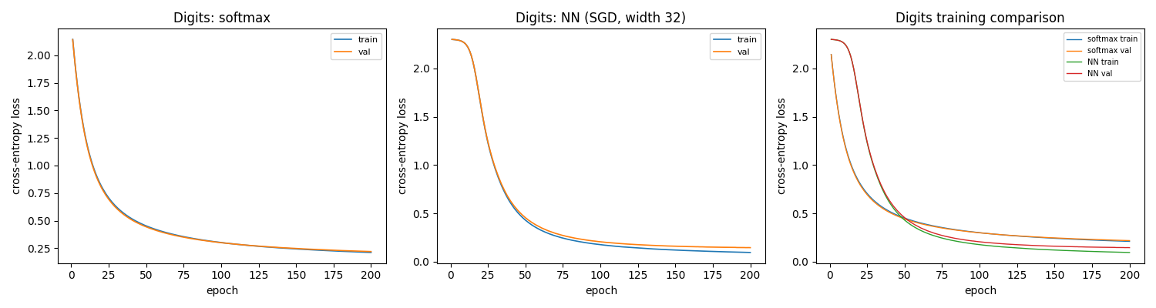
Core Experiment 3: Digits Benchmark
10-class classification — training dynamics and model comparison
Single-Run Results
Model
Acc
CE
Softmax
94.02%
0.270
NN (SGD)
94.02%
0.193
Key insight
Accuracy is identical (94.02%) but NN achieves 28% lower cross-entropy (0.193 vs 0.270). Accuracy alone is misleading — CE reveals that NN assigns sharper, better-calibrated probabilities to correct classes.
NN CE reduction: 0.270 → 0.193 = 28% improvement
Math4AI Capstone | National AI Center | 2026

Slide 14
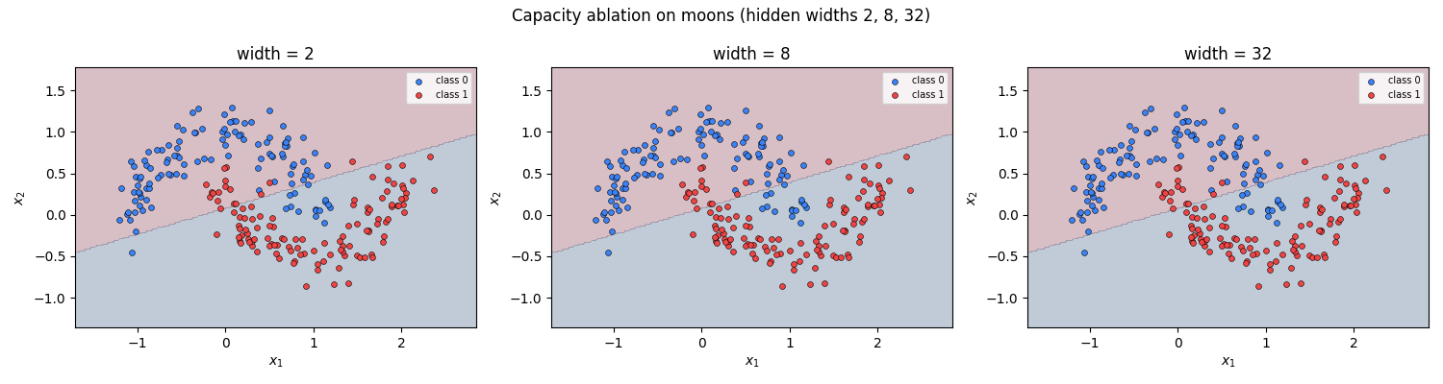
Ablation Study: Capacity on Moons
Hidden widths {2, 8, 32} — how boundary complexity scales with neurons
Width = 2
Only 2 hidden neurons. Cannot span the crescent geometry. Boundary stays near-linear → under-capacity failure.
Width = 8
8 neurons begin to approximate the curvature. Reasonable fit; lower CE than width-2, boundary starts to curve.
Width = 32
Default setting. Full crescent separation achieved. Boundary correctly wraps both moon shapes → lowest CE.
Key insight: capacity is a geometric constraint — insufficient neurons = insufficient representational span.
Math4AI Capstone | National AI Center | 2026

Slide 15
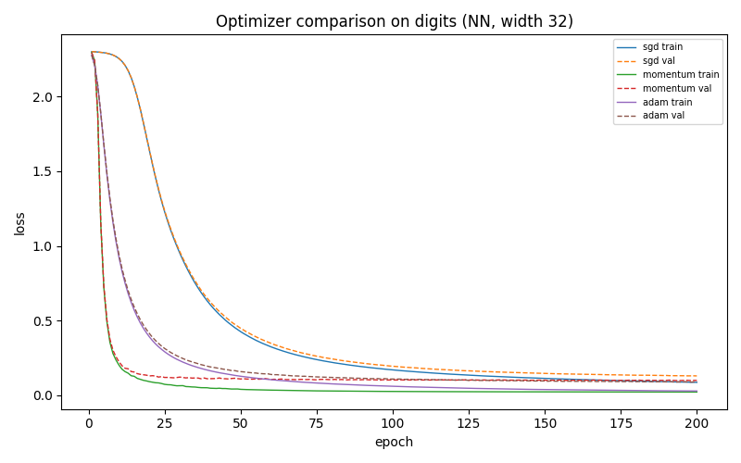
Optimizer Study: Digits Benchmark
SGD vs Momentum vs Adam — fixed conditions, H=32
Optimizer Comparison
SGD
lr = 0.05
Steady convergence. No momentum; loss declines smoothly throughout 200 epochs.
Momentum
lr = 0.05, β = 0.9
Faster initial descent. Accumulated gradients accelerate convergence direction.
Adam
lr = 0.001, β₁=0.9, β₂=0.999
Best final CE loss. Per-parameter adaptive rates overcome SGD's uniform step.
Adam converges fastest; all reach similar test accuracy within 200 epochs.
Math4AI Capstone | National AI Center | 2026

Slide 16
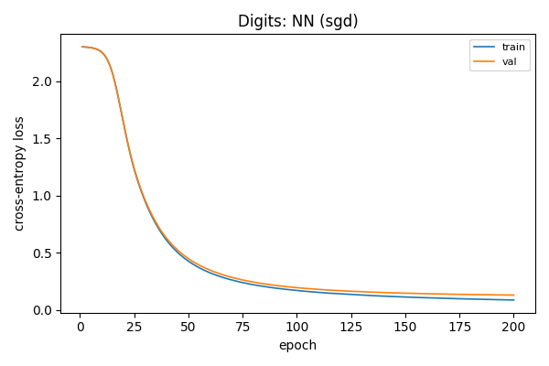
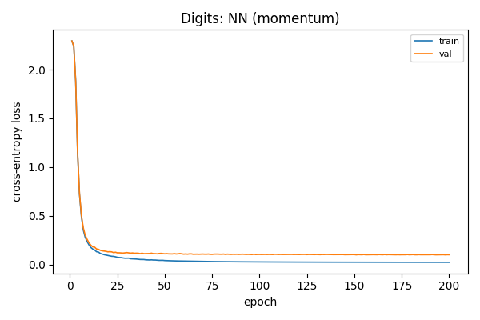
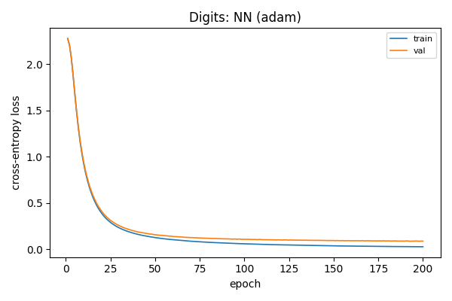
Optimizer Training Curves — Per-Optimizer Detail
SGD · Momentum · Adam on digits benchmark (H=32, 200 epochs)
SGD (lr=0.05)
Momentum (lr=0.05, β=0.9)
Adam (lr=0.001)
• SGD: smooth but slow decline — still converging at epoch 200.
• Momentum: faster initial drop — oscillations visible early, then stabilises.
• Adam: sharpest early convergence — reaches low CE within ~50 epochs.
Math4AI Capstone | National AI Center | 2026

Slide 17
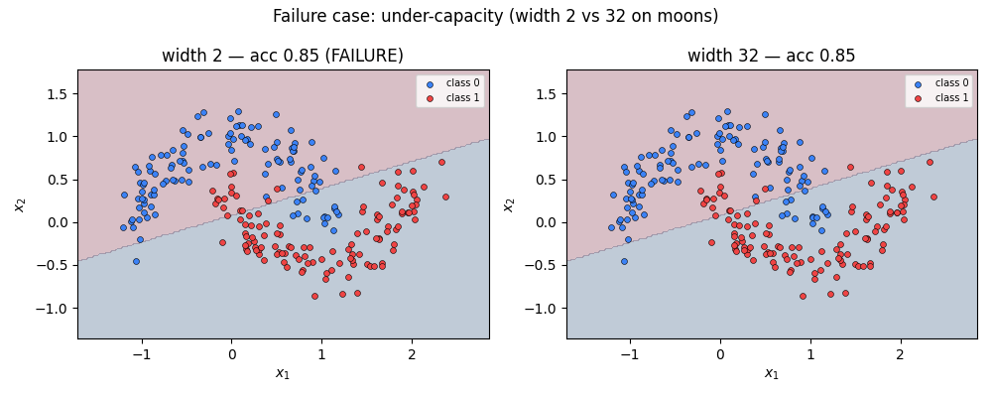
Failure Case Analysis: Width-2 NN on Moons
A capacity failure — the mechanism, not just the outcome
Why it fails — mechanistic explanation
• 2 neurons → 2 learned feature directions in hidden space.
• tanh activations span a 2D manifold — cannot represent crescent curvature.
• Output layer receives only 2 numbers per input: insufficient to discriminate moons.
• Result: boundary stays near-linear, unable to wrap around either crescent.
• This is a capacity failure — not an optimizer issue, not a data issue.
• Fix: increase hidden width (width=8 already improves significantly).
Lesson: model capacity must match the geometric complexity of the task.
Math4AI Capstone | National AI Center | 2026

Slide 18
Repeated-Seed Statistics (5 Seeds, Digits Benchmark)
95% confidence intervals reveal statistical significance of CE improvement
Formula: x̄ ± 2.776 · s/√5 (t-distribution, df = 4, two-sided 95% CI)
Model
Metric
Mean
Std
±CI
Lower
Upper
Softmax
Accuracy
93.86%
0.149%
±0.185%
93.67%
94.04%
Softmax
Cross-Entropy
0.26930
0.000351
±0.000436
0.26887
0.26974
NN (SGD)
Accuracy
93.97%
0.403%
±0.500%
93.47%
94.47%
NN (SGD)
Cross-Entropy
0.19334
0.008268
±0.01026
0.18307
0.20360
Statistical Interpretation + Answer to Required Q5
• ACCURACY CIs OVERLAP: [93.67%, 94.04%] vs [93.47%, 94.47%] — no statistically significant accuracy difference.
• CROSS-ENTROPY CIs DO NOT OVERLAP: [0.2689, 0.2697] vs [0.1831, 0.2036] — NN CE improvement is statistically real.
• Q5 answer: A single run could by chance show either model leading on any metric. 5 seeds reveal that the CE gap is consistent (not luck) while the accuracy gap is noise — a single run cannot distinguish these two cases.
• NN variability (std 0.40%) > Softmax (0.15%) — NN is more optimizer-sensitive; seeds expose this too.
Math4AI Capstone | National AI Center | 2026

Slide 19
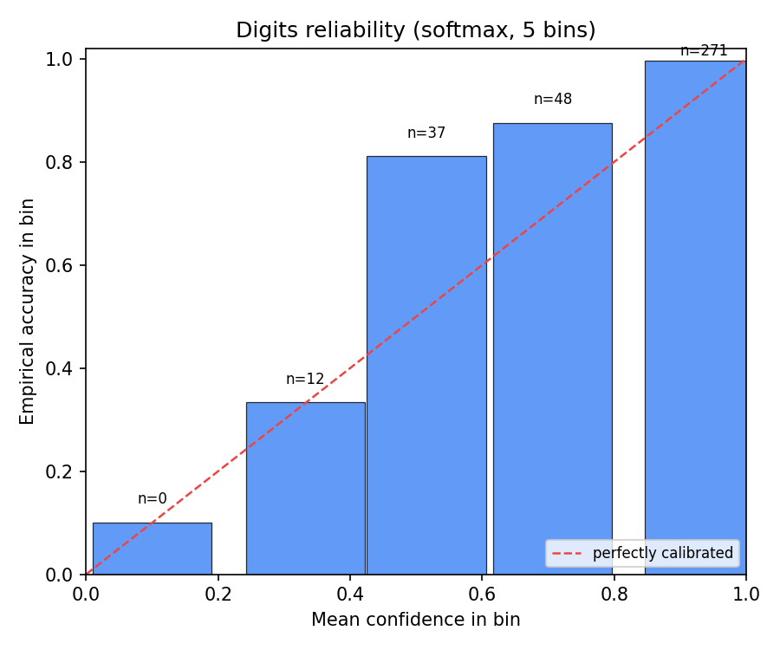
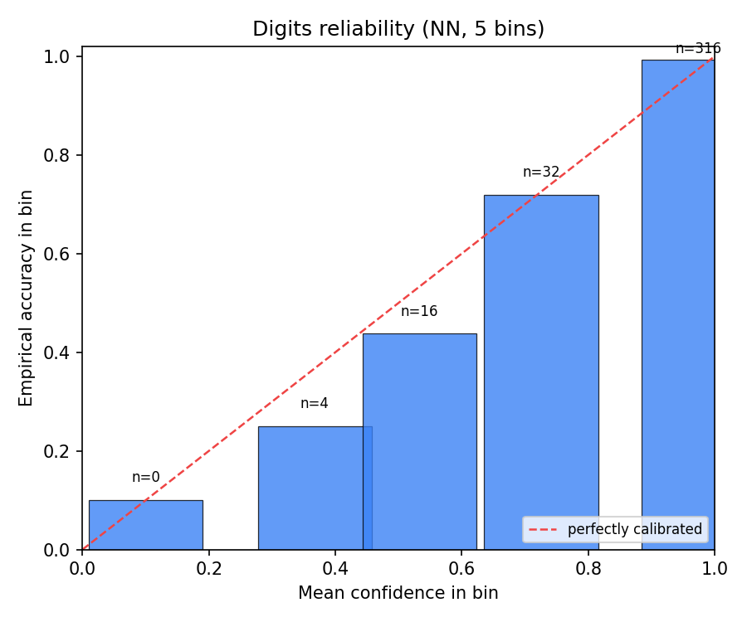
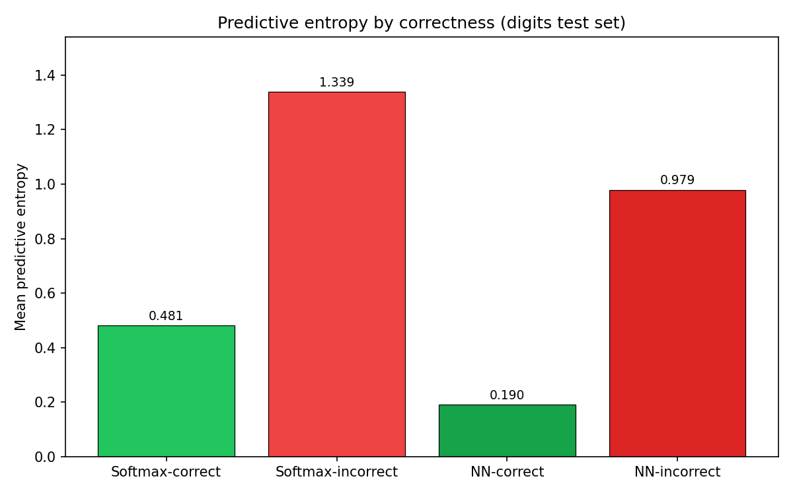
Advanced Track B: Prediction Confidence & Reliability
Entropy, calibration curves, and what they reveal about each model
5-bin Confidence vs Accuracy (Reliability Diagrams)
Entropy by Correctness
Softmax
NN (H=32)
Measured Entropy Values (Digits Test Set, n=368)
Softmax Correct (n=346)
Softmax Incorrect (n=22)
NN Correct (n=345)
NN Incorrect (n=23)
Entropy = 0.481
Entropy = 1.339
Entropy = 0.190
Entropy = 0.979
NN is sharper: correct predictions have entropy 0.190 (vs 0.481 for softmax). Both models flag incorrect predictions with higher entropy — useful uncertainty signal.
Math4AI Capstone | National AI Center | 2026

Slide 20
Key Numbers at a Glance
All critical results in one place before conclusions
Gaussian Task
Moons Task
Digits (5-seed)
Track B Entropy
Softmax acc
95.0%
Softmax acc
85.0%
Softmax acc CI
[93.67%, 94.04%]
Softmax correct
H = 0.481
NN acc
95.0%
NN acc
85.0%
NN acc CI
[93.47%, 94.47%]
Softmax wrong
H = 1.339
Softmax CE
0.1539
Softmax CE
0.2852
Softmax CE CI
[0.2689, 0.2697]
NN correct
H = 0.190
NN CE
0.1555
NN CE
0.2695
NN CE CI
[0.1831, 0.2036]
NN wrong
H = 0.979
Verdict
Linear = sufficient
Verdict
NN: better CE, curved boundary
CE CIs overlap?
NO → significant
NN sharper?
Yes — 60% lower H
Math4AI Capstone | National AI Center | 2026

Slide 21
Discussion: All Five Required Interpretive Questions
Answered from our evidence — not from the handout
Q1: When is the linear model geometrically sufficient?
Gaussian task: 95% acc, identical to NN. When log-posterior ratio is linear in x, softmax regression is Bayes-optimal — no hidden layer needed.
Q2: What representational change does the hidden layer provide?
Moons: curved boundaries impossible for any hyperplane. Digits: 28% lower CE — hidden layer reshapes feature space so classes become more separable.
Q3: When does additional complexity fail to justify itself?
Gaussian: NN = softmax exactly. Width-2 on moons: under-capacity failure. Complexity must be justified by evidence, not assumed.
Q4: What does the failure case teach?
Width-2 is a geometric failure — 2 neurons span too small a feature manifold. Not an optimizer problem. Fix: more neurons, not more epochs.
Q5: What do repeated-seed statistics add beyond a single run?
A single run may be lucky or unlucky. 5 seeds reveal that: accuracy CIs overlap (no real gap) but CE CIs do NOT overlap — only repeated seeds expose this distinction reliably.
Math4AI Capstone | National AI Center | 2026

Slide 22
Limitations & Honest Scope
What this study does NOT show — and why that matters scientifically
Dataset scale
Architecture depth
Small synthetic datasets + 1,797-sample digits. Results may not generalize to large-scale real-world tasks.
Only a single hidden layer studied. Two or more layers can learn qualitatively different representations — not covered here.
Activation family
Calibration analysis
Only tanh used. ReLU-family activations behave differently (sparse, non-smooth) and dominate modern practice.
5-bin reliability with 368 test samples is too coarse for strong calibration claims. Modern ECE analysis needs larger populations.
Hyperparameter scope
Statistical power
Default hyperparameters are fixed by protocol. Relative optimizer performance may shift under different learning rate schedules.
5 seeds provides rough variability. Statistically rigorous comparison would require bootstrapping or many more seeds.
Math4AI Capstone | National AI Center | 2026

Slide 23
NATIONAL AI CENTER — AI ACADEMY | MATH4AI CAPSTONE
Key Takeaways
Linear model is sufficient when class geometry is linearly separable (Gaussian task, 95% acc).
Hidden layer earns its complexity on moons (curved boundaries) and digits (28% CE reduction).
CE reveals more than accuracy — identical accuracy masks a real and statistically significant gap.
CI non-overlap is the key test — CE CIs do not overlap; accuracy CIs do. CE wins the argument.
Capacity must match geometry — width-2 failure is geometric, not an optimizer issue.
5 seeds are essential — single runs may be lucky or unlucky; CIs quantify reliability.
Thank you · Questions welcome

