Slide 1
Doctor Appointments Booking System
Abdur Rahim
Id:1219475
Batch Id:ESAD-J2EE/APCL-A/33/02

Slide 2
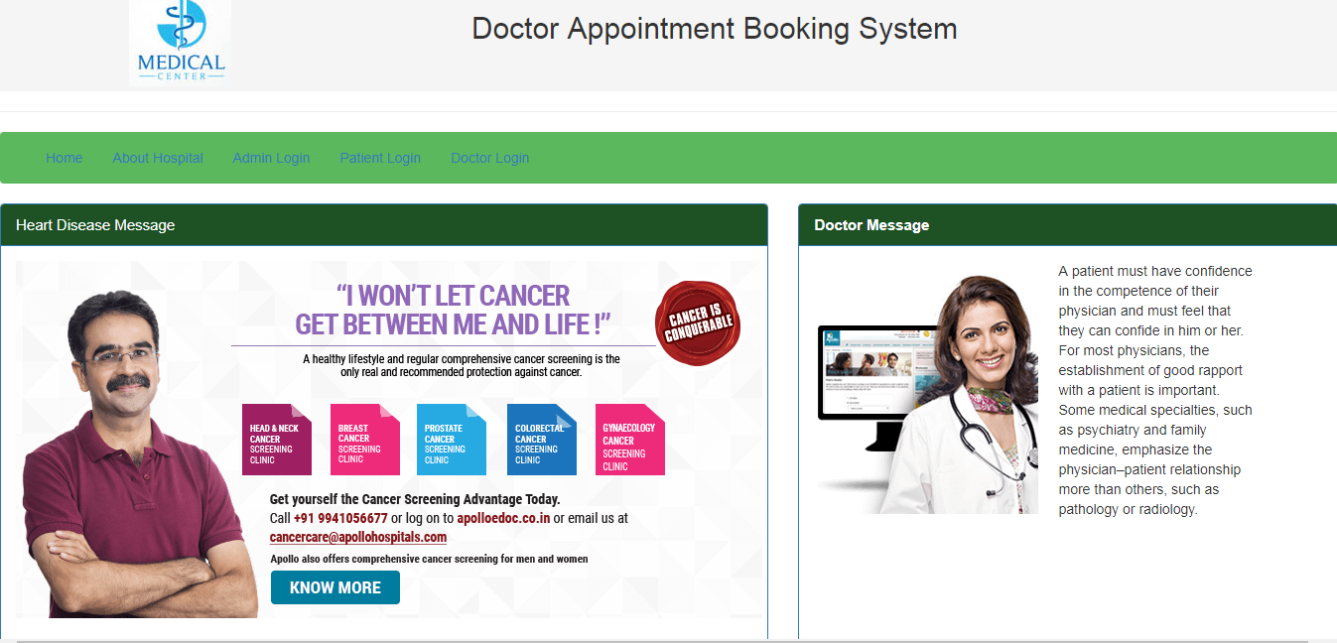
Main page

Slide 3
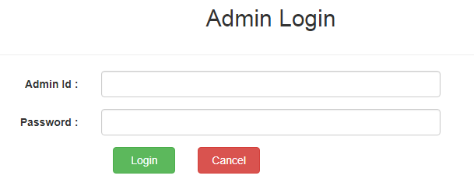
Admin login

Slide 4
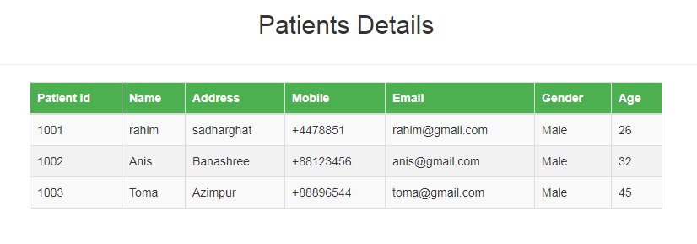
View patients details

Slide 5
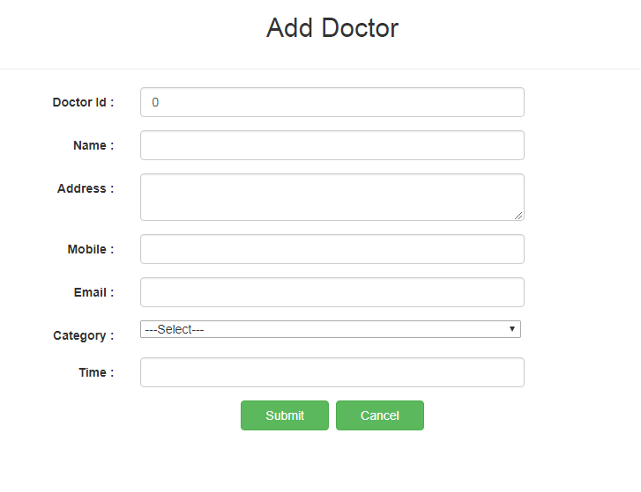
Add doctor

Slide 6
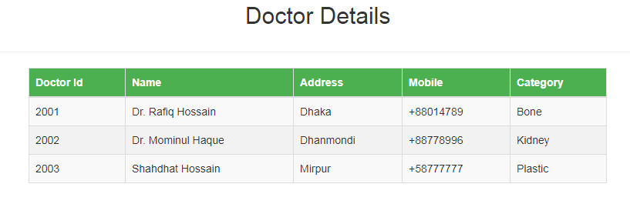
View doctor

Slide 7
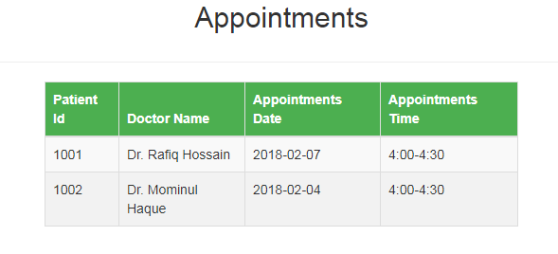
View appointments

Slide 8
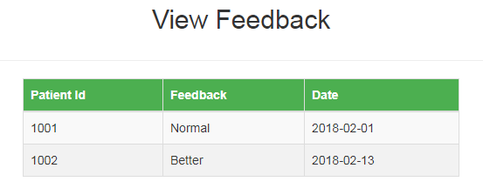
View feedback

Slide 9
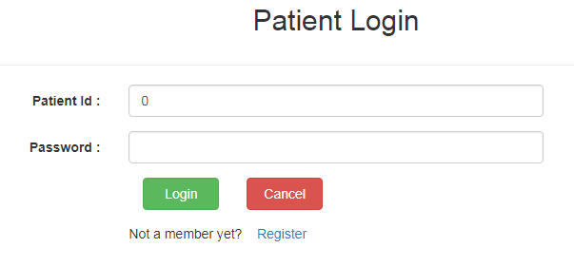
Patient login

Slide 10
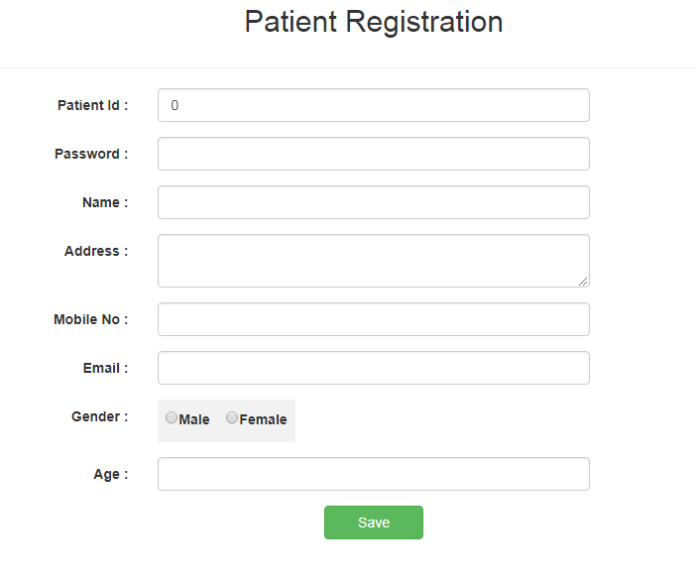
Patient registration

Slide 11
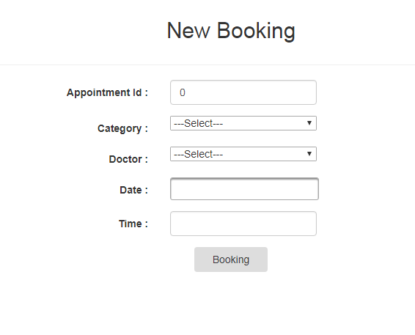
Book appointments

Slide 12
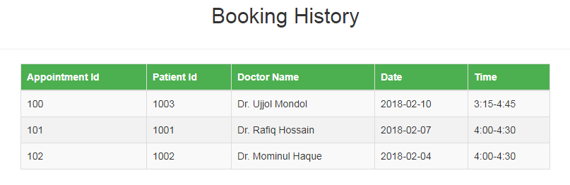
View booking

Slide 13
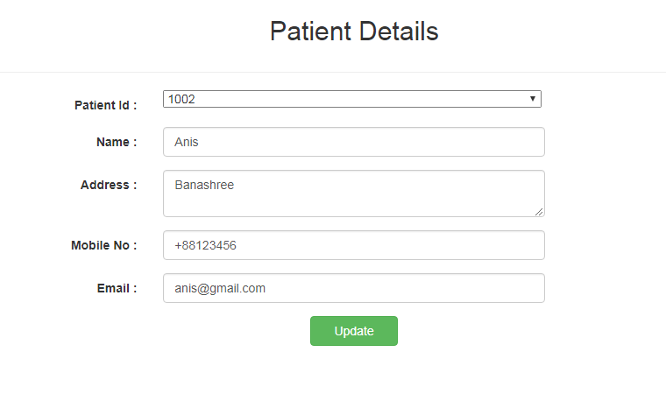
Patient information updated

Slide 14
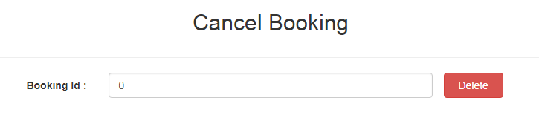
Booking cancel

Slide 15
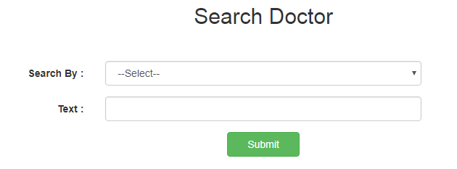
Search doctor

Slide 16
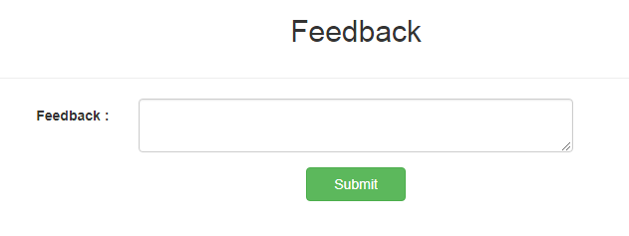
Patient feedback

Slide 17
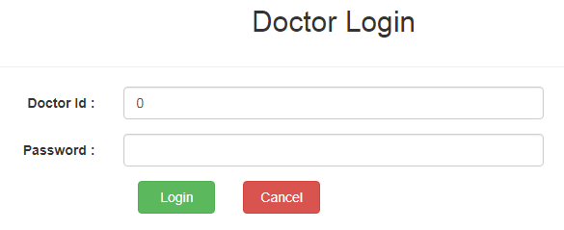
Doctor login

Slide 18
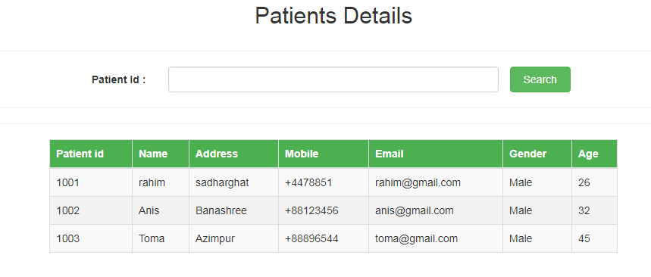
Patients details by id

Slide 19
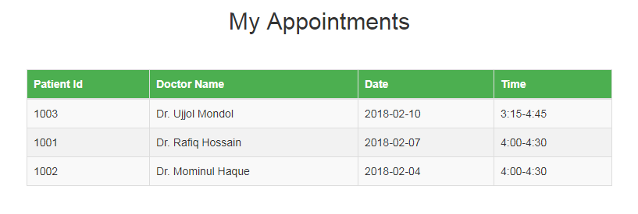
My appointments

Slide 20
The end

