Slide 1
TITLE: GROCERY SHOPPING WEBSITE APPLICATION

Slide 2
TEAM MEMBERS:
NIVASH. M (211521205101)
NITHYANANDHAN.K (211521205100)
RISHI.V(211521205120)
RAHIN MON(211521205116)

Slide 3
ABSTRACT:
A grocery shopping web application allows users to browse, select, and purchase groceries online with ease. The platform features a user-friendly interface for searching products, adding items to a cart, and checking out securely. It includes personalized recommendations, filtering options, and the ability to schedule deliveries or pickups. Additionally, users can track orders, manage shopping lists, and explore offers and discounts, enhancing convenience and efficiency for everyday grocery needs

Slide 4
INTRODUCTION:
A grocery shopping web application is a digital platform that allows users to browse, select, and purchase groceries online. Users can search for items by category, brand, or keyword, and add products to a virtual shopping cart. These applications often feature filters for dietary preferences, price ranges, and availability. With secure payment gateways, users can pay for their orders and choose delivery or pickup options. The app may also offer personalized recommendations, subscription services for recurring orders, and loyalty programs for frequent shoppers, enhancing convenience and streamlining the grocery shopping experience

Slide 5
PROPOSED SYSTEM:
1. Project Overview: The proposed grocery shopping web application will provide users with an online platform to browse, search, and purchase groceries from local stores
2. Core Features: User Registration and Login: Allow users to sign up using email or social media accounts. Provide login and password recovery functionality. Product Catalog: Display a list of products categorized by types (vegetables, fruits, dairy, snacks, etc.).
3. Admin Features: Inventory Management: Store owners can manage inventory, add/remove products, and set prices.
4. Technological Stack: Frontend: HTML5, CSS3, JavaScript (React.js or Vue.js for dynamic UI). Backend: Node.js with Express.js or Python (Django/Flask) for handling API requests.

Slide 6
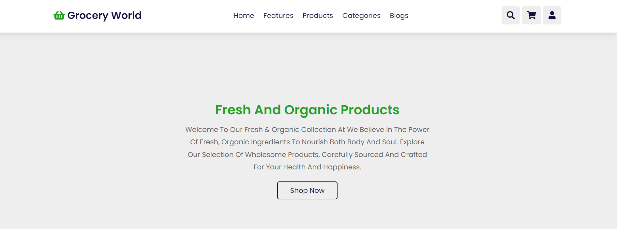
screenshots: Home page

Slide 7
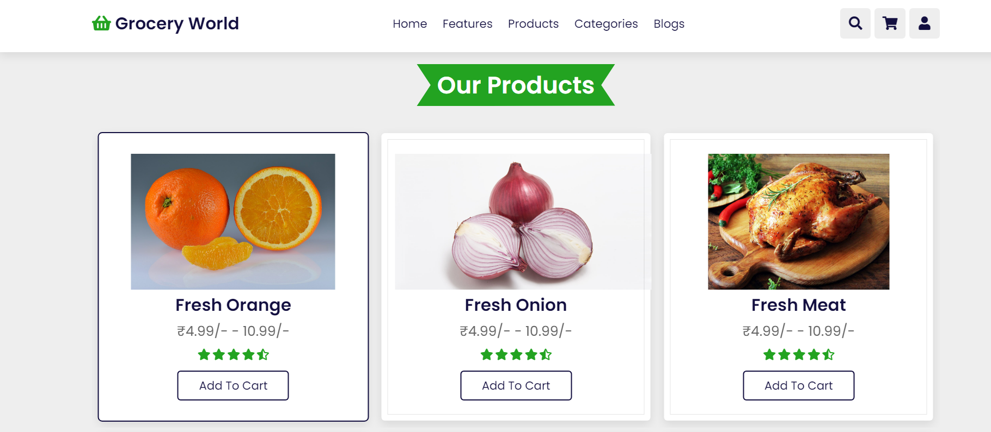
Products:

Slide 8
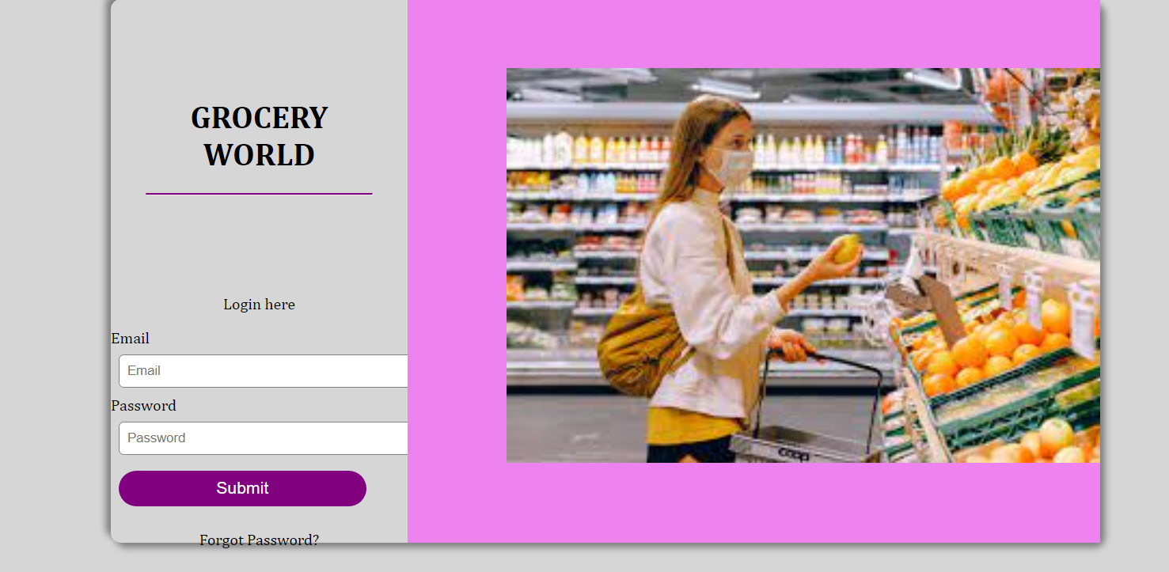
Login page:

Slide 9
CONCLUSION:
In conclusion, a grocery shopping web application simplifies the shopping experience by offering users the convenience of browsing, selecting, and purchasing items online. It enhances customer satisfaction through features such as personalized recommendations, secure payment options, and efficient delivery tracking. Additionally, it enables businesses to streamline their operations, improve customer retention, and expand their market reach. Overall, a well-designed grocery shopping web application bridges the gap between consumers and retailers, providing a seamless and time-saving shopping solution.

Slide 10
THANK YOU

