Slide 1
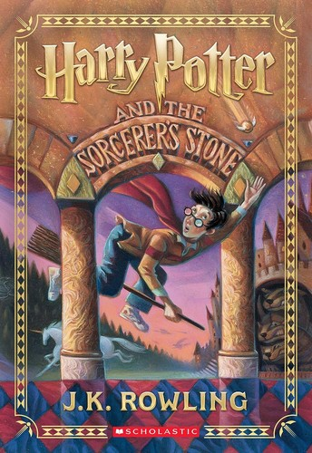
NEHRU ARTS AND SCIENCE COLLEGE
(Autonomous)
Harry Potter and the Philosopher's Stone
Book Review – 2
Communicative English Practical – II
Candidate Name: Sudhan KS
Roll Number: 24UGCI035
Department: Commerce
Course Code: 24U2ENG404
Course Name: Communicative English Practical – II

Slide 2
NEHRU ARTS AND SCIENCE COLLEGE
(Autonomous)
Book Details & Introduction
Name of the Book:
Harry Potter and the Philosopher's Stone
Author: J.K. Rowling
Year of Publication: 1997
Introduction
This beloved fantasy novel introduces readers to Harry Potter, an orphan boy who discovers on his eleventh birthday that he is a wizard. The book opens the door to a magical world filled with wonder, friendship, courage, and adventure. It marks the beginning of one of the most successful book series in history and has captivated millions of readers of all ages across the globe.
2

Slide 3
NEHRU ARTS AND SCIENCE COLLEGE
(Autonomous)
Summary of the Story
Harry Potter grows up not knowing he is a wizard, raised by his cold and unkind relatives — the Dursleys. On his eleventh birthday, he receives a letter of admission to Hogwarts School of Witchcraft and Wizardry. At Hogwarts, Harry makes loyal friends — Ron Weasley and Hermione Granger — and begins to uncover the truth about his mysterious past and the fate of his parents. Harry learns that a powerful hidden object called the Philosopher's Stone, which grants immortality, is hidden in the school. He and his friends face dangerous challenges to protect it from the dark wizard Lord Voldemort, who seeks to return to power.
3

Slide 4
NEHRU ARTS AND SCIENCE COLLEGE
(Autonomous)
Themes & Message
Themes & Message in Harry Potter and the Philosopher's Stone: • Friendship & Loyalty — Harry, Ron, and Hermione show that true friendship means standing together even in the face of danger. • Good vs. Evil — The battle between Harry and Voldemort represents the timeless struggle between good and evil. • Courage — Harry repeatedly acts bravely despite fear, teaching readers that courage is not the absence of fear but acting in spite of it. • Love & Sacrifice — Harry's mother's love is portrayed as the most powerful magic of all — stronger than any dark spell.
4

Slide 5
NEHRU ARTS AND SCIENCE COLLEGE
(Autonomous)
My Opinion
Harry Potter and the Philosopher's Stone is a magical and unforgettable reading experience. J.K. Rowling has created a vivid and imaginative world that feels completely real, filled with fascinating characters, creative settings, and a plot that keeps readers eagerly turning every page. What makes this book truly special is its heart — the themes of friendship, bravery, and love resonate deeply with readers of all ages. This is not just a story for children — it is a story about what it means to be human: to face fear, to choose good over evil, and to find your place in the world. I highly recommend this timeless classic to every reader.
5

Slide 6
NEHRU ARTS AND SCIENCE COLLEGE
(Autonomous)
Thank You
Communicative English Practical – II

