Slide 1

Job Title Matching
Rahkakavee Baskaran
Department of Economics
December 16, 2021

Slide 2
Table of Contents
Research task
Related work and research gap
Method
First results and discussion

Slide 3
Research Task
Improve the classification of job titles of German job postings with the Taxonomy KldB 2010 with different vectorization techniques based on the challenges of short text classification.

Slide 4
Related Work – Challenges
Domain-specific
some work for the English-speaking job market
traditional (Zhu et al 2017) vs. Deep Learning Methods (Neculoiu et al 2016)
framing as classification task (Wang et al. 2019) vs. framing as a string representation approach of similar job titles (Decorte et al. 2021)
Multiclass
decomposition into multiple binary problems vs. naturally handling
no clear answer so far
different approaches like SVM(Guo and Wang 2015) or Convolutional Neural Networks (Farooq etc. al 2017)
Short Text

Slide 5
Related Work – Challenges
Domain-specific
some work for the English-speaking job market
traditional (Zhu et al 2017) vs. Deep Learning Methods (Neculoiu et al 2016)
framing as classification task (Wang et al. 2019) vs. framing as a string representation approach of similar job titles (Decorte et al. 2021)
Multiclass
decomposition into multiple binary problems vs. naturally handling
no clear answer so far
different approaches like SVM(Guo and Wang 2015) or Convolutional Neural Networks (Farooq etc. al 2017)
Short Text

Slide 6
Related Work – Short Text Classification
job titles have often not more than 50 characters
sparseness
few word co-occurrence
missing shared context
noisiness
ambiguity
Notes:
Wang et al 2017b achieve better performance with sparse vectors while Chen et al. (2019) argues for dense vectors

Slide 7
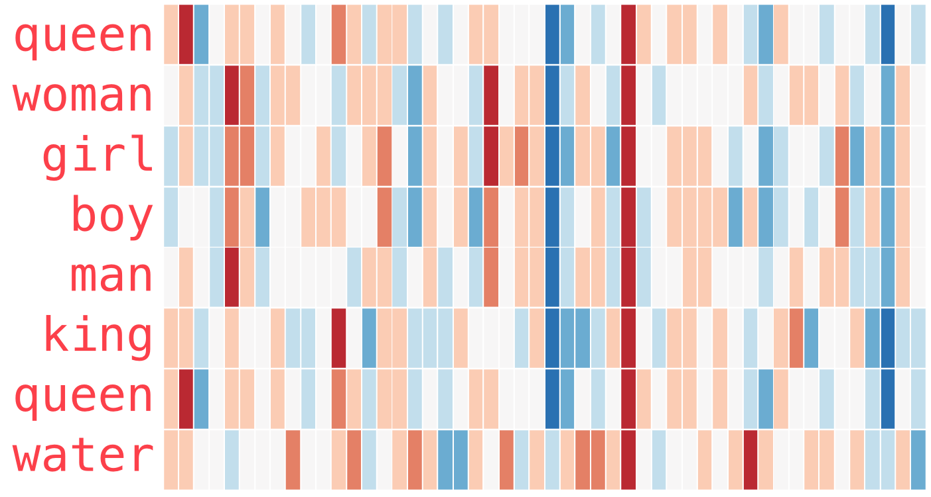
Related Work – Short Text Classification
Approaches
criticism of “Bag of words” context
representation of documents as an extraction of semantic relationships
dense (Wang et al. 2017b) vs. sparse vectors (Chen et al. 2019)
sparse: tf-idf and count vectorizer
dense: word2vec, doc2vec etc.
no consensus for classifiers
0
0
0
0
Java
Python
developer
Entwickler
Example 1: „Java developer“
0
0
0
0
Java
Python
developer
Entwickler
sparse
dense
source: Alammar, J. The illustrated Word2vec. 2019 <https://jalammar.github.io/illustrated-word2vec/.> Accessed: 09.12.2021
Notes:
Wang et al 2017b achieve better performance with sparse vectors while Chen et al. (2019) argues for dense vectors

Slide 8
Research Gap
no classification attempts for the German job market
but would facilitate several downstream tasks:
solid database
job market analyses
improvement of job search engines
improvement of job recommendation systems
Notes:
KldB 2010 reflects current market trends job portals use different categories for job titles
KldB 2010 is based on ISCO (International Standard Classification of Occupation)
could improve job search engines and recommendation systems in Germany

Slide 9
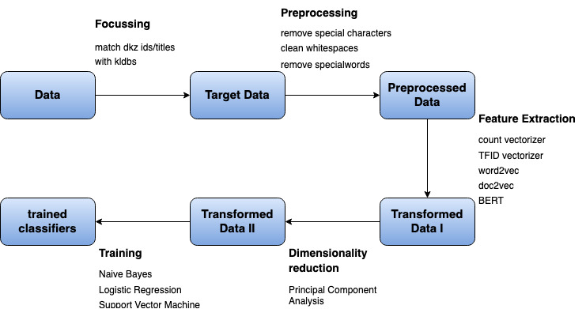
Method

Slide 10
Method

Slide 11
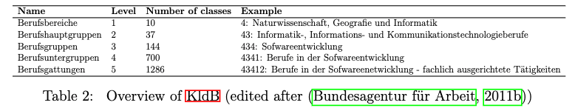
Data
data from the job portal of the ”Bundesagentur für Arbeit” (BA):
job title
Dokumentationskennziffer (Dkz)
KldB Taxonomy 2010
Overview of KldB (edited after (Bundesagentur für Arbeit, 2011b)

Slide 12
Method

Slide 13

Target Data
the ”Dkz” id from the “BA” can be matched with the KldB id
Input data example:

Slide 14
Method

Slide 15

Preprocessed Data
removed stopwords, special characters
Zipf’s law: most frequent words → get a list of special words → removed from title
Input data example:

Slide 16
Method

Slide 17
Transformed Data I
baselines: count vectorizer and tf-idf vectorizer
approaches for improvement:
word2vec with and without prior knowledge
doc2vec with and without prior knowledge
BERT with and without prior knowledge

Slide 18
Method

Slide 19
Transformed Data II
Principal component Analysis (PCA)
reduces features to n_components to speed up the classifiers
choose n_components such that the explained variance ratio is approx. 0.95

Slide 20
Results

Slide 21
First Results

Slide 22
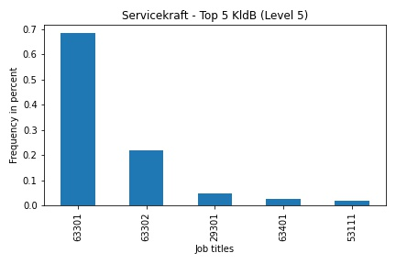
Discussion/Limitation
Ambiguity between level of requirement
63301: „Berufe im Gastronomieservice (ohne Spezialisierung) – Helfer/Anlerntätigkeiten“
63302: „Berufe im Gastronomieservice (ohne Spezialisierung) - fachlich ausgerichtete Tätigkeiten“

Slide 23
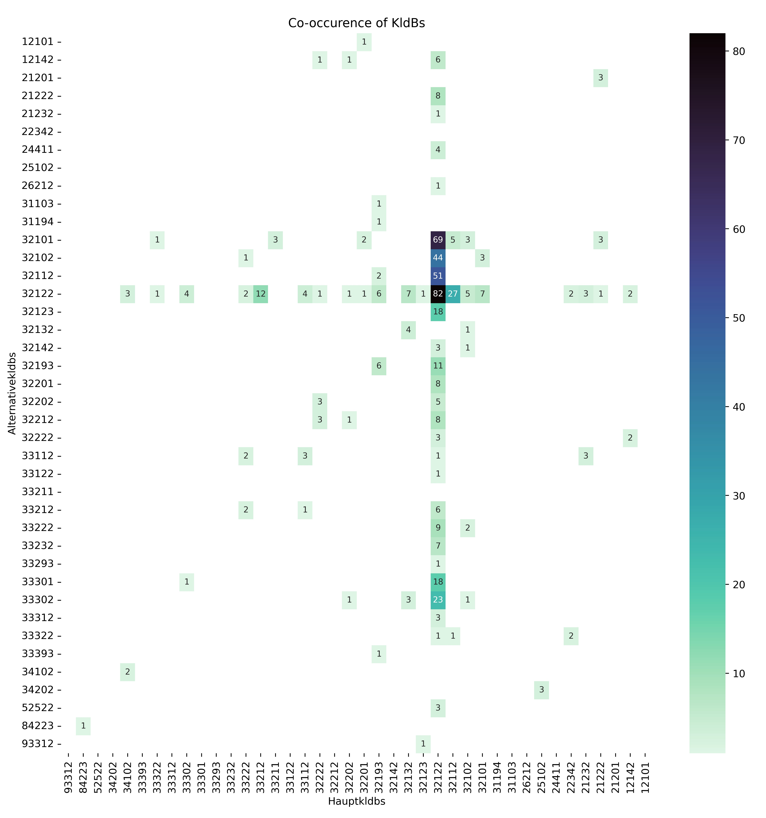
Discussion/Limitation
32122 has many alternatives
→ Differentiation is really difficult
32122 often as an alternative
„Berufsuntergruppen“ (4th digit) difficult to differentiate (32122, 32112, 32102, 32101)

Slide 24
Literature
Zhu et al 2017
Neculoiu et al 2016,
Wang et al (2019)
Decorte et al. 2021

