Slide 1

Job title classification
Rahkakavee Baskaran
Department of Economics
December 16, 2021
Notes:
Hey everyone, I would like to present today the topic of my masterthesis.
The thesis is about job title classification.

Slide 2
Research Task
Related Work
Method
Results
Discussion
Research Task
Examine the classification of German job titles into the classes of the KLDB 2010 taxonomy. The analysis is based on three perspectives:
vectorization techniques
classifiers
including of additional knowledge
Notes:
More precisely I examine the classification of German job titles into the classes of the KLDB 2010 Taxonomy. KLDB means Klassifikation der Berufe.
The analysis is based on three perspectives:
First I would like to compare the performance of different techniques of how to convert job titles into numerical representation. This is also called feature extraction or vectorization
Second I will compare also the performance of different classifiers
And third I will have a look on the impact of including additional information besides the training data in the step of vectorization.

Slide 3
Table of Contents
Research task
Related work and research gap
Method
First results and discussion
Notes:
I will start with the related work and the research gap of the task.
Then I will explain you my pipeline for classification and finally I’ ll show you my results, as well some limitations.

Slide 4
Research Task
Related Work
Method
Results
Discussion
Related Work – Challenges
Domain-specific
some work for the English-speaking job market
traditional (Zhu et al 2017) vs. Deep Learning Methods (Neculoiu et al 2016)
framing as classification task (Wang et al. 2019) vs. framing as a string representation approach of similar job titles (Decorte et al. 2021)
Multiclass
decomposition into multiple binary problems vs. naturally handling
no clear answer so far
different approaches like SVM(Guo and Wang 2015) or Convolutional Neural Networks (Farooq etc. al 2017)
Short texts
Notes:
The main challenges of this classification task can be summarized into these three points here.

Slide 5
Research Task
Related Work
Method
Results
Discussion
Related Work – Challenges
Domain-specific
some work for the English-speaking job market
traditional (Zhu et al 2017) vs. Deep Learning Methods (Neculoiu et al 2016)
framing as classification task (Wang et al. 2019) vs. framing as a string representation approach of similar job titles (Decorte et al. 2021)
Multiclass
decomposition into multiple binary problems vs. naturally handling
no clear answer so far
different approaches like SVM(Guo and Wang 2015) or Convolutional Neural Networks (Farooq etc. al 2017)
Short texts
Notes:
My focus in the MA is on the last point, the short text classification, which is why I won't go into detail about the other two challenges.
And we'll continue right away with the challenges of short text classification

Slide 6
Research Task
Related Work
Method
Results
Discussion
Related Work – Short Text Classification
job titles have often not more than 50 characters
sparseness
few word co-occurrence
missing shared context
noisiness
ambiguity
Notes:
The problem of job titles is that they are often have not more than 50 characters, so in fact we short texts.
Short texts are sparse, have few word-occurences and they miss context.
In addition, short texts suffer often from ambiguity.
All of these characteristics makes it difficult for the classifiers to learn differences and similarities between the titles.

Slide 7
Research Task
Related Work
Method
Results
Discussion
Related Work – Short Text Classification
Approaches
criticism of “Bag of words” context
representation of documents as an extraction of semantic relationships
dense (Wang et al. 2017) vs. sparse vectors (Chen et al. 2019)
sparse: tf-idf and count vectorizer
dense: word2vec, doc2vec etc.
no consensus for classifiers
Notes:
There are different approaches to deal with short text classification.
Often the bag of words approach is criticized.
Instead, representation with prior knowledge and semantic relationship extraction are preferred by researchers.
But in general there is also a discussion about whether to use dense or sparse vectors.
And last there is no consensus which classifier performs best. Deep Learning methods are used more often recently.

Slide 8
Research Task
Related Work
Method
Results
Discussion
Research Gap
no classification attempts for the German job market
but would facilitate several downstream tasks:
solid database
job market analyses
improvement of job search engines
improvement of job recommendation systems
Notes:
So much about the related works.
Now the question is this classification even relevant?
Shortly said, as far as I know there are no classification attempts for german job titles.
But a classifcation would facilitate several downstream task such as job market analysis, which is why it is important to solve this classification problem.

Slide 9
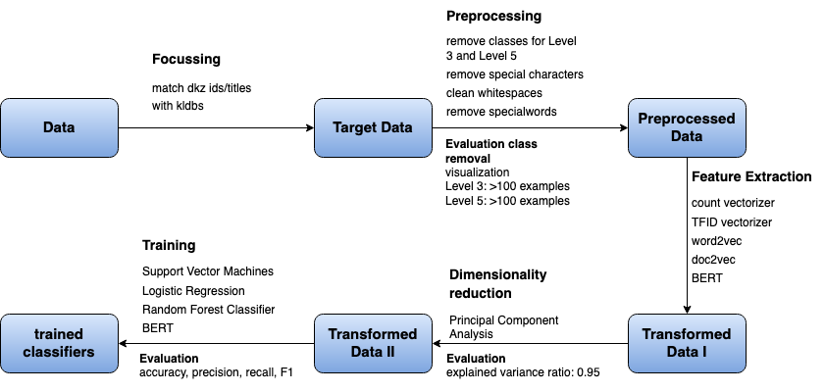
Research Task
Related Work
Method
Results
Discussion
Method
Notes:
So what is now my strategy?
Here you can see an overview of my pipline with the steps I take to train classifiers. We do not have the time to look at each point in detail.

Slide 10
Research Task
Related Work
Method
Results
Discussion
Method
Notes:
First, let’s have a look on the raw data.

Slide 11
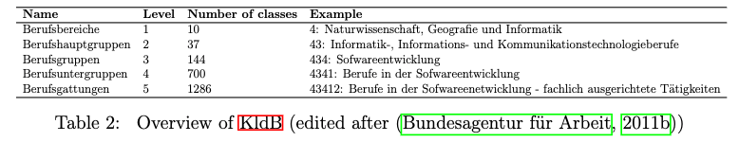
Research Task
Related Work
Method
Results
Discussion
Data
data from the job portal of the ”Bundesagentur für Arbeit” (BA):
job title
“Dokumentationskennziffer” (Dkz)
KldB Taxonomy 2010
Overview of KldB (edited after (Bundesagentur für Arbeit, 2011)
Notes:
I have two datasets:
First the data from the job portal from the Bundesagentur für Arbeit
It includes job titles and for each job title and the so called dkz number, which is a unique ID and which can be mapped to the class labels of the taxonomy
Second, I have my classes from the Taxonomy.
The Taxonomy is structured hierarchically with 5 levels.
On level 1 the occupations are first grouped into 10 broader professional areas. They are enumerated from 0 to 9.
Each area has subcategories which form then level 2 and so on. I hope you get the structure.
My goal is to implement classifiers to predict the Level 1, Level 3 and Level 5 class labels, because those contain the most valuable information considering the downstream tasks.

Slide 12
Research Task
Related Work
Method
Results
Discussion
Method
Notes:
From these two datasets I have the target the data

Slide 13
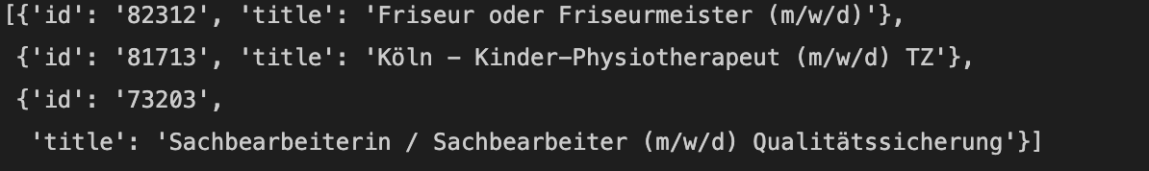
Research Task
Related Work
Method
Results
Discussion
Target Data
the ”Dkz” id from the “BA” can be matched with the KldB class id
trainings data example (Level 5)
Notes:
, Each training example consists of the class id and the title. The goal of the classifier is to take these titles as an input and to output the correct id

Slide 14
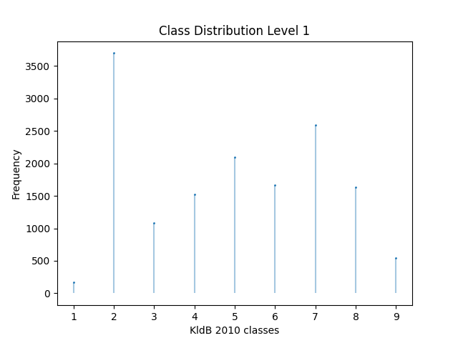
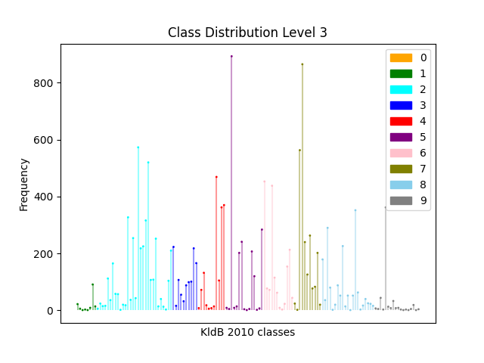
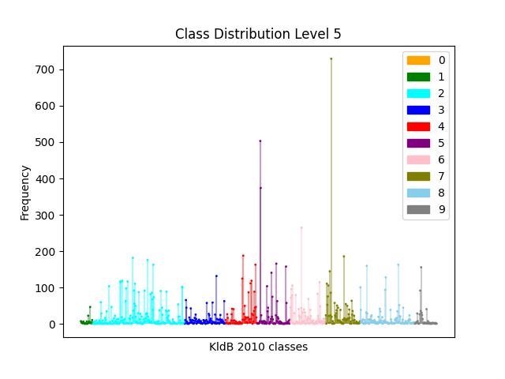
Research Task
Related Work
Method
Results
Discussion
Target Data – Class Distribution
Notes:
A quick analysis of the class distribution shows that especially for Level 3 and 5 the data is unbalanced, which has to be considered in the evaluation of the classifiers. So we should keep this in mind.

Slide 15
Research Task
Related Work
Method
Results
Discussion
Method
Notes:
As a next step a preprocessed the data, which you can see here

Slide 16
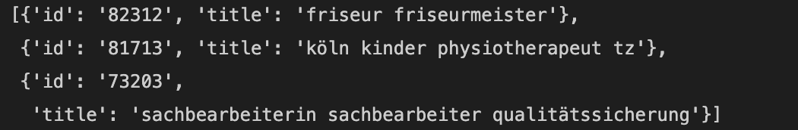
Research Task
Related Work
Method
Results
Discussion
Preprocessed Data
remove stopwords, special characters, lowercase
Zipf’s law: most frequent words → get a list of special words → remove from title
remove classes for Level 3 and Level 5 (Threshold 100)
Input data example
Notes:
One important preprocessing step is that I removed from level 3 and 5 classes, where I have not enough training examples. I choose 100 examples as a threshold.

Slide 17
Research Task
Related Work
Method
Results
Discussion
Method
Notes:
The next step vectorization.

Slide 18
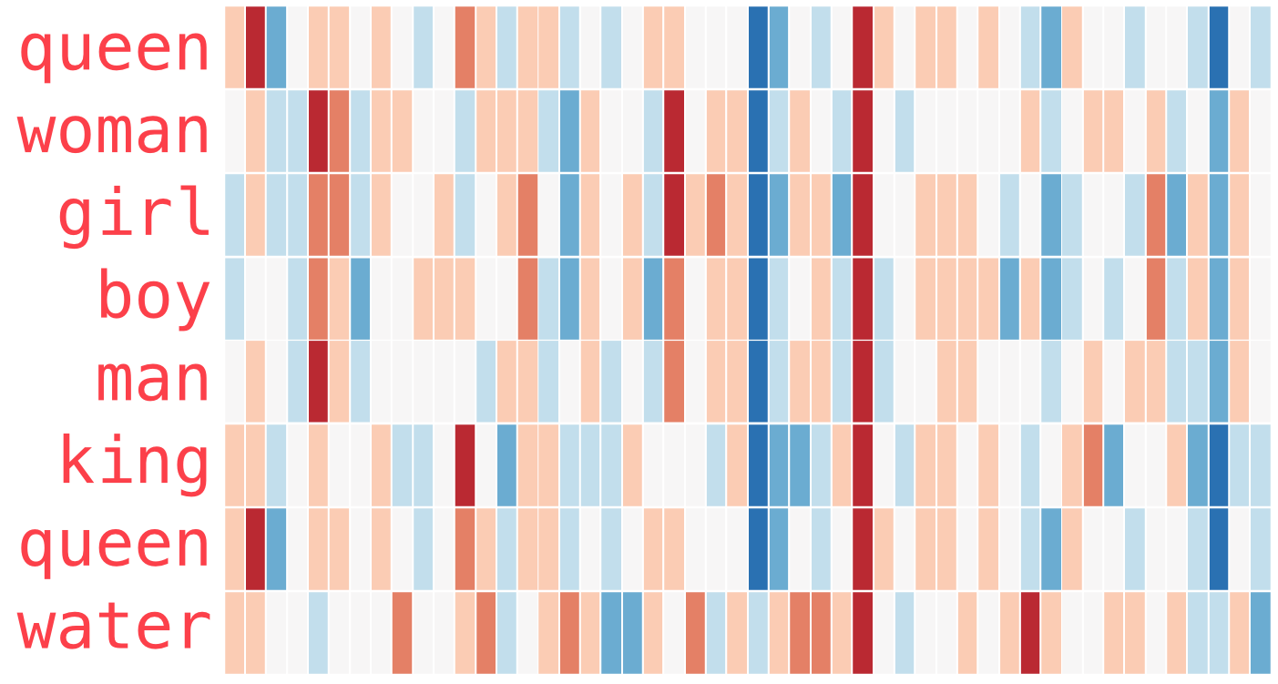
Research Task
Related Work
Method
Results
Discussion
Transformed Data I
sparse methods: count vectorizer and tf-idf vectorizer.
dense methods
word2vec:
pretrained model from google with fine tuning
with and without additional information
doc2vec
with and without additional information (epochs=10, vector size=300, window=5)
BERT pretrained model
BERT with fine tuning and one classification layer
0
0
0
0
Java
Python
developer
Entwickler
Example 1: „Java developer“
1
0
1
0
Java
Python
developer
Entwickler
Source: Alammar, J. The illustrated Word2vec. 2019 <https://jalammar.github.io/illustrated-word2vec/> accessed: 09.12.2021
Notes:
I used sparse and dense techqniues for comparison. For sparse: Count and TFIDF
For dense: Word2vec with a pretrained model with Fine tuning. One time only with my training data and one time with additional knowledge
Same for Doc2vec but from scratch not fine tuned
And last BERT without any fine tuning
Then a BERT with fine tuning and classification layer on top
Note the last method does not output a numerical representation of the titles, but the class id already since I add a classification layer on top of the fine tuning.

Slide 19
Research Task
Related Work
Method
Results
Discussion
Method
Notes:
Due to computational reasons, I did a second transofmratio

Slide 20
Research Task
Related Work
Method
Results
Discussion
Transformed Data II
Principal component Analysis (PCA)
reduces features to n_components to speed up the classifiers
choose n_components such that the explained variance ratio is approx. 0.95
Notes:
I used pca for dimensionality reductionto speed up the calculcations of my classifiers.

Slide 21
Research Task
Related Work
Method
Results
Discussion
Results
Notes:
For training, I used SVM, LR, RF and for the
and for the BERT model I used a softmax classification layer.

Slide 22
Research Task
Related Work
Method
Results
Discussion
Evaluation metrics
Evaluation measurements
Precision: ability of model to return only relevant cases
in addition
Accuracy: How well does the classifier classifies across all classes?
Recall: ability of model identify all relevant instances
Problem: favours majority classes
F-Score: harmonic mean between precision and recall
Notes:
For measurement I used accuaracy, precision, recall and F1 score. Accuaracy has the disadvantage that it facvors major classes. -→ Thus for unbalanced data it can be misleading to rely only on accuaracy, which is why

Slide 23
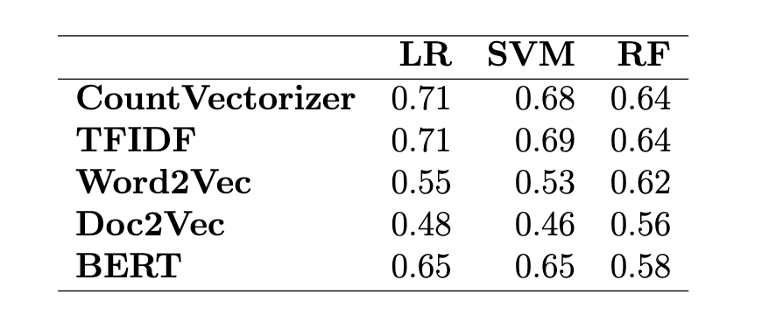
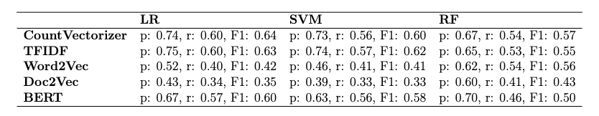
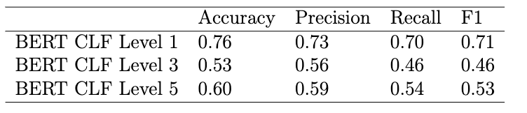
Research Task
Related Work
Method
Results
Discussion
First Results – Level 1
Accuracy
1. Vectorization Techniques
good performance
differences depend on classifier
for example, besides Doc2vec, all vectorizations perform quite similar for RF
Precision (p), Recall (r), F1 - Macro
Word2vec and Doc2vec dense techniques have poor performance for LR and SVM poor
2. Classifiers
LR and SVM perform better than RF
there is no huge difference between LR and SVM
3. additional information
Notes: Short training data set with 15000 examples (for Level 3 and 5 results see Appendix A)
Notes:
Here you can see the results.
The first table shows the accuracy, the second the other metrics and the last table provides all performance results of the Bert Clf.
Since the training time is long I did not had the time to include also the vectorizer for WORD2vec and DO2vec with additional information. So here you can only see the results without additional information training.
Let's look at the first perspective. A comparison of the vectorizations techqniues shows that the sparse vectors with LR performed really well compared to dense once. An exception is BERT, which outperform with a fine tuning all the other techniques.
Furthemore the magnitude of the differences depends on the classifier.
Comparing the classifiers, we can say that SVM and LR outperform RF.
And to the last point I cannot show you anything as said, but from my experiments I know that it doesnt help to improve, it even has a lower performance than without additional knowledge.

Slide 24
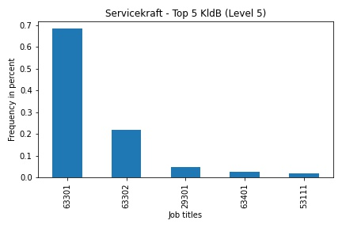
Research Task
Related Work
Method
Results
Discussion
Discussion/Limitation
Occupation: „Servicekraft“
Ambiguity between the level of requirements
63301: „Berufe im Gastronomieservice (ohne Spezialisierung) – Helfer/Anlerntätigkeiten“
63302: „Berufe im Gastronomieservice (ohne Spezialisierung) - fachlich ausgerichtete Tätigkeiten“
Notes: Further example Appendix B
Notes:
So much about the results.
Before I come to my questions for the discussion, I would like to show you two limitations.
Here I filtered all titles with the word "servicekraft" and printed the frequency of the class labels to which the titles are assigned.
What we can see is that most of these titles are associated with 1 or 2 as the last digit. This shows really well the ambiguity in the data and why it is almost impossible to predict these differences for a classifier.

Slide 25
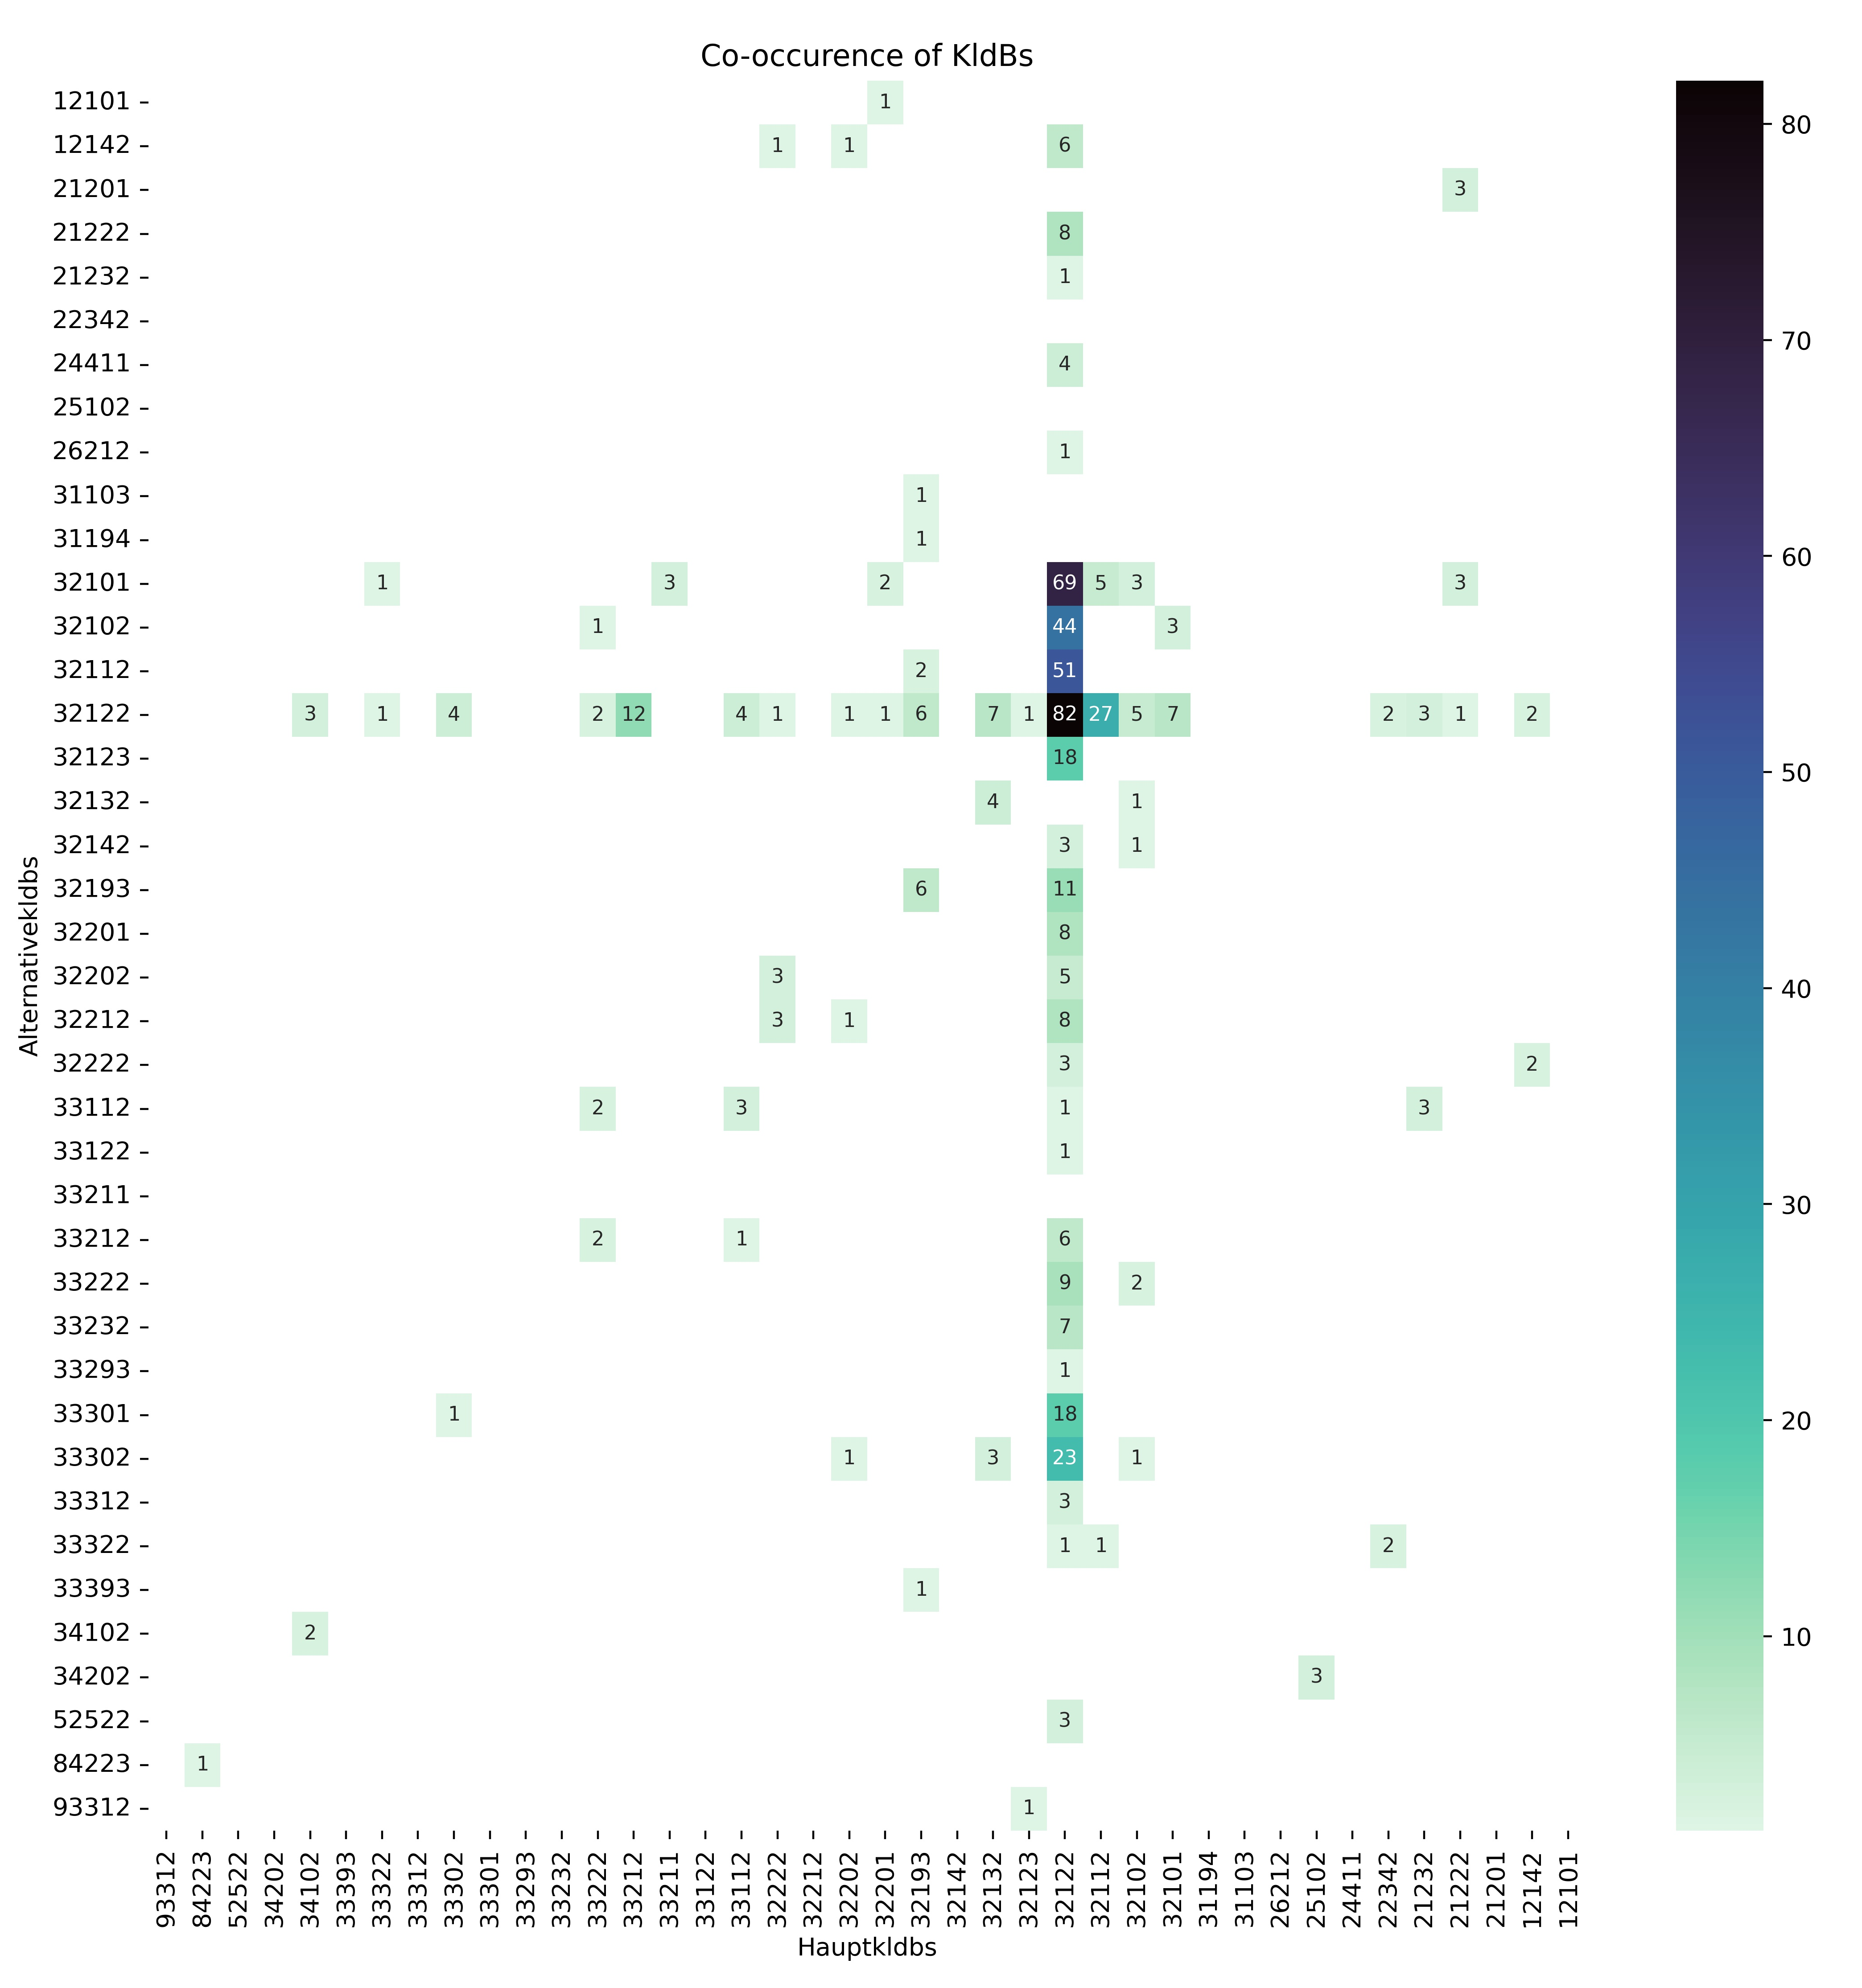
Research Task
Related Work
Method
Results
Discussion
Discussion/Limitation
Occupation: „Maurer“
32122 has many alternatives
→ Differentiation is difficult
32122 often as an alternative
„Berufsuntergruppen“ (4th digit) difficult to differentiate (32122, 32112, 32102, 32101)
Notes:
The question is now could we improve this with a better training data? Because it seems like it is a ambiguity in the data?
Here I have another analysis. The job portal data includes besides the main class label, which I used for training, also alternatives labels, if employers are unsure about it.
I plotted here for the occupation Maurer the co occurrence of alternatives and the ids which I used for training.
You can see here from the class label 32122 a vertical line. This indicates that also in the real world the classification of a title to a id is not clear, becaue it has a huge range of alternatives.
Thus both the ambiguity in the data itself and also the ambiguity in the real world shows that there are limitations in the improving of the performance.

Slide 26
Research Task
Related Work
Method
Results
Discussion
Discussion/Limitation
I. Pre-processing
How reasonable is it to exclude classes of level 3 and 5?
Advantage
efficient in terms of time complexity
evaluation metrics more meaningful
Disadvantage:
level 3: 46 classes remain
level 5: 38 classes remain
II. Evaluation
There is also the possibility to evaluate the the classes with k-fold cross validation.
parameter k: number of groups that a given data sample is to be split
currently: one split into training and test data
k-fold cross validation:
split into k groups, one is test data the remaining groups training
fit model and evaluate
repeat with each group as test data
take the mean of all them and report also the confidence interval (possible with all the evaluation metrics)
Notes:
Now I have two questions:
1. As I said I excluded classes of Level 3 and Level 5. This is efficient in terms of time complexity and also each class has predictions the evaluation metrics are more meaningful.
A further practical reason is also that I'm not able to train level 5 with SVM without exlcuding since I used ensemble techqniues for SVM to speed up the calculation and this is not possible with classes, which have not enough training examples. If I use SVM without any ensemble technqiue it would take more than 5 days, which is to much time.

Slide 27
Research Task
Related Work
Method
Results
Discussion
Literature
Decorte, J. J., Van Hautte, J., Demeester, T., & Develder, C. (2021). JobBERT: Understanding Job Titles through Skills. arXiv preprint arXiv:2109.09605.
Farooq, A., Anwar, S., Awais, M., & Rehman, S. (2017, October). A deep CNN based multi-class classification of Alzheimer's disease using MRI. In 2017 IEEE International Conference on Imaging systems and techniques (IST) (pp. 1-6). IEEE.
Guo, H., & Wang, W. (2015). An active learning-based SVM multi-class classification model. Pattern recognition, 48(5), 1577-1597.
Neculoiu, P., Versteegh, M., & Rotaru, M. (2016, August). Learning text similarity with siamese recurrent networks. In Proceedings of the 1st Workshop on Representation Learning for NLP (pp. 148-157).
Matthes, B., & Paulus, W. (2013). Klassifikation der Berufe. Struktur, Codierung und Umsteigeschlüssel. FDZ-Methodenreport, 8, 1-35.
Wang, J., Abdelfatah, K., Korayem, M., & Balaji, J. (2019, December). DeepCarotene-Job Title Classification with Multi-stream Convolutional Neural Network. In 2019 IEEE International Conference on Big Data (Big Data) (pp. 1953-1961). IEEE.
Wang, J., Wang, Z., Zhang, D., & Yan, J. (2017, August). Combining Knowledge with Deep Convolutional Neural Networks for Short Text Classification. In IJCAI (Vol. 350).
Zhu, Y., Javed, F., & Ozturk, O. (2017, May). Document embedding strategies for job title classification. In The Thirtieth International Flairs Conference.

Slide 28
Appendix

Slide 29
A. Results

Slide 30
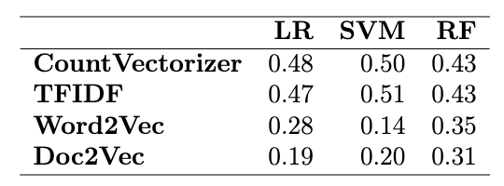
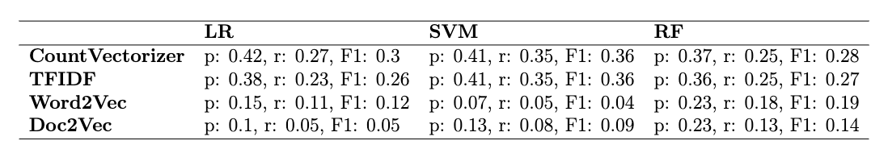
A. First Results – Level 3 – classes not removed

Slide 31
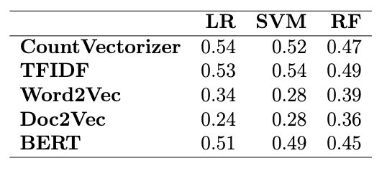
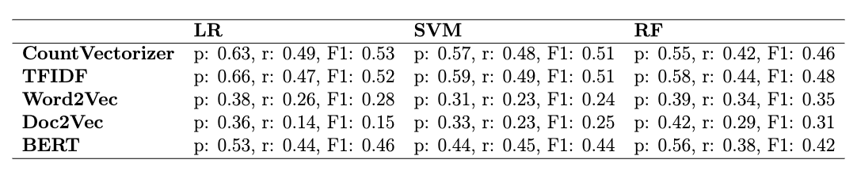
First Results – Level 3 – classes removed
Accuracy
Precision (p), Recall (r), F1 - Macro
Notes:
Frage: Nur noch 46 Klassen übrig. Aber wenn ich example Zahl runter mache, läuft der SVM nicht durch + bei der Berechnung von Precision etc. wird vieles auf Null gesetzt, weil keine Predictions (threshold ausgesucht nach ungefähr elbow technique, wobei ich etwas weiter runter gegangen bin, weil sonst wieder ill-defined Precision and Recall)

Slide 32
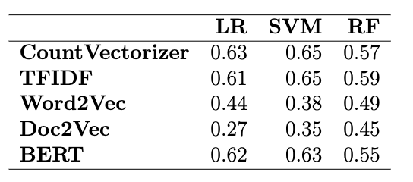
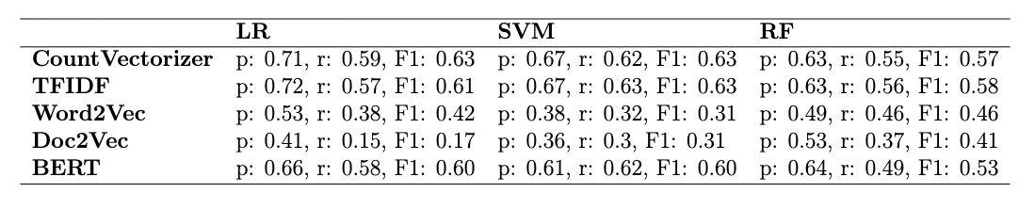
First Results – Level 5 – classes removed
Accuracy
Precision (p), Recall (r), F1 - Macro
Notes:
Frage: Nur noch 38 Klassen übrig. Aber wenn ich example Zahl runter mache, läuft der SVM nicht durch + bei der Berechnung von Precision etc. bekomme wird vieles auf Null gesetzt, weil keine Predictions (threshold habe ich nach elbow method gemacht)

Slide 33
B. Limitations

Slide 34
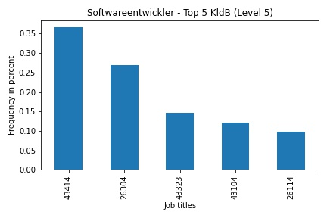
Discussion/Limitation
Occupation: „Softwareentwickler“
Ambiguity between Berufsbereichen
43414: Naturwissenschaft, Geografie und Informatik
26304: Rohstoffgewinnung, Produktion und Fertigung
Ambiguity within Berufsbereichs/ Berufshauptgruppe
43323
43104
43414
Informatik- Informations- und Kommunikationstechnologieberufe

Slide 35
C. Definitions

Slide 36
Vectorization – sparse vectors
Example - Count Vectorizer
Assume that the job titles can only be constructed using the following four words: Java, Python, developer and Entwickler. This is our vocabulary, which has in our case the length 4
We construct for the vectorization a vector of length 4 for each job title
The order of the words in the titles do not matter.
For each title we go through each word in the word vector and replace it with a one, if the word occurs in the title.
These vectors are called sparse because as the vocabulary increases, the length of the vector increases, so we get a vector with many zeros and a high dimensional space
0
0
0
0
Java
Python
developer
Entwickler
Example 1: „Java developer“
1
0
1
0
Java
Python
developer
Entwickler
Notes:
Frage: Nur noch 46 Klassen übrig. Aber wenn ich example Zahl runter mache, läuft der SVM nicht durch + bei der Berechnung von Precision etc. wird vieles auf Null gesetzt, weil keine Predictions (threshold ausgesucht nach ungefähr elbow technique, wobei ich etwas weiter runter gegangen bin, weil sonst wieder ill-defined Precision and Recall)

Slide 37
Vectorization – dense vectors/word embeddings
abstract Example
assume each word is represented by a coloured vector
in contrast to count vectorizer word embeddings learn the similarity between words
each column represent a dimension
if the colour is the same for two words in the same dimension this means that the words are similar in that dimension
Source: Alammar, J. The illustrated Word2vec. 2019 <https://jalammar.github.io/illustrated-word2vec/> accessed: 09.12.2021
Notes:
Frage: Nur noch 46 Klassen übrig. Aber wenn ich example Zahl runter mache, läuft der SVM nicht durch + bei der Berechnung von Precision etc. wird vieles auf Null gesetzt, weil keine Predictions (threshold ausgesucht nach ungefähr elbow technique, wobei ich etwas weiter runter gegangen bin, weil sonst wieder ill-defined Precision and Recall)

