Slide 1

Job Title Matching
Rahkakavee Baskaran
Department of Economics
December 16, 2021

Slide 2
Table of Contents
Research task
Related work and research gap
Method
First results and discussion

Slide 3
Research Task
Short

Slide 4
Related Work
Short

Slide 5
Research Gap
Short

Slide 6
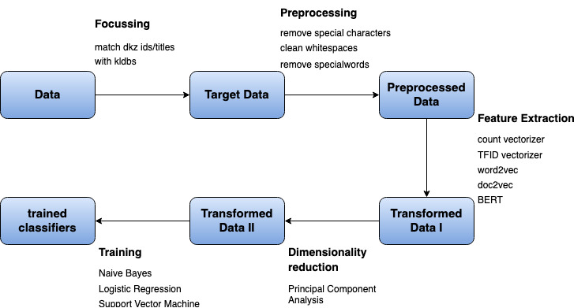
Method

Slide 7
Method

Slide 8
Data
Short

Slide 9
Method

Slide 10
Target Data
Short

Slide 11
Method

Slide 12
Preprocessed Data
Short

Slide 13
Method

Slide 14
Transformed Data I
Short

Slide 15
Method

Slide 16
Transformed Data II
Short

Slide 17
Results

Slide 18
First Results
Short

Slide 19
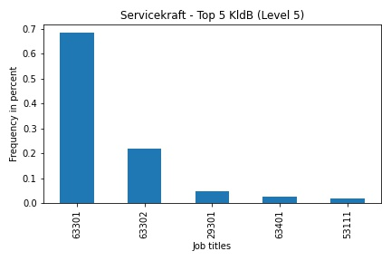
Discussion/Limitation
Ambiguity between level of requirement
63301: „Berufe im Gastronomieservice (ohne Spezialisierung) – Helfer/Anlerntätigkeiten“
63302: „Berufe im Gastronomieservice (ohne Spezialisierung) - fachlich ausgerichtete Tätigkeiten“

Slide 20
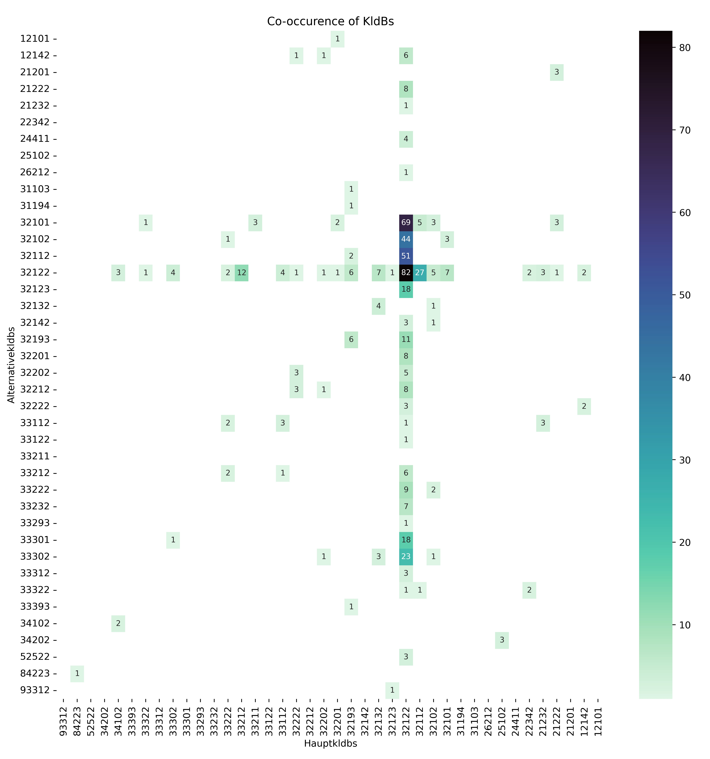
Discussion/Limitation
32122 has many alternatives
→ Differentiation is really difficult
32122 often as an alternative
„Berufsuntergruppen“ (4th digit) difficult to differentiate (32122, 32112, 32102, 32101)

