Slide 1

Job Title Matching
Rahkakavee Baskaran
Department of Economics
December 16, 2021
Notes:
Vorschläge für die Änderung des Titels
An evaluation of different vectorization techniques for German job titlte classification
Job title classification for German job advertisements– An evaluation of different vectorization techniques

Slide 2
Research Task
Related Work
Method
Results
Discussion
Research Task
Compare and improve the classification of job titles of German job postings with the Taxonomy KldB 2010 by applying different vectorization techniques based on the challenges of short text classification.
Notes:
Fragen: Ein simpler Word2vec und Doc2vec mit Fine tuning + including searchwords (vor allem in den Ergebnissen sind die embeddings jetzt ohne searchwords) ist das doch nicht wirklich “based on the challenges of short text classification“ oder?
Es gibt ein Paper das genau die gleichen Ergebnisse rausbekommen hat wie ich, dagegen stehen viele Ansätze mit deep learning und dense vectors
Was rechtfertigt es nochmal für short text classifcation nochmal „solche alten Ansätze“ anzuschauen (Felix Kommentar)
Fokussierung vielleicht auf dense vs. sparse vectorization techniques? Aber warum dann nochmal BERT

Slide 3
Table of Contents
Research task
Related work and research gap
Method
First results and discussion

Slide 4
Research Task
Related Work
Method
Results
Discussion
Related Work – Challenges
Domain-specific
some work for the English-speaking job market
traditional (Zhu et al 2017) vs. Deep Learning Methods (Neculoiu et al 2016)
framing as classification task (Wang et al. 2019) vs. framing as a string representation approach of similar job titles (Decorte et al. 2021)
Multiclass
decomposition into multiple binary problems vs. naturally handling
no clear answer so far
different approaches like SVM(Guo and Wang 2015) or Convolutional Neural Networks (Farooq etc. al 2017)
Short Text

Slide 5
Research Task
Related Work
Method
Results
Discussion
Related Work – Challenges
Domain-specific
some work for the English-speaking job market
traditional (Zhu et al 2017) vs. Deep Learning Methods (Neculoiu et al 2016)
framing as classification task (Wang et al. 2019) vs. framing as a string representation approach of similar job titles (Decorte et al. 2021)
Multiclass
decomposition into multiple binary problems vs. naturally handling
no clear answer so far
different approaches like SVM(Guo and Wang 2015) or Convolutional Neural Networks (Farooq etc. al 2017)
Short Text

Slide 6
Research Task
Related Work
Method
Results
Discussion
Related Work – Short Text Classification
job titles have often not more than 50 characters
sparseness
few word co-occurrence
missing shared context
noisiness
ambiguity
Notes:
Wang et al 2017b achieve better performance with sparse vectors while Chen et al. (2019) argues for dense vectors

Slide 7
Research Task
Related Work
Method
Results
Discussion
Related Work – Short Text Classification
Approaches
criticism of “Bag of words” context
representation of documents as an extraction of semantic relationships
dense (Wang et al. 2017) vs. sparse vectors (Chen et al. 2019)
sparse: tf-idf and count vectorizer
dense: word2vec, doc2vec etc.
no consensus for classifiers
Notes:
Wang et al 2017b achieve better performance with sparse vectors while Chen et al. (2019) argues for dense vectors

Slide 8
Research Task
Related Work
Method
Results
Discussion
Research Gap
no classification attempts for the German job market
but would facilitate several downstream tasks:
solid database
job market analyses
improvement of job search engines
improvement of job recommendation systems
Notes:
KldB 2010 reflects current market trends job portals use different categories for job titles
KldB 2010 is based on ISCO (International Standard Classification of Occupation)
could improve job search engines and recommendation systems in Germany

Slide 9
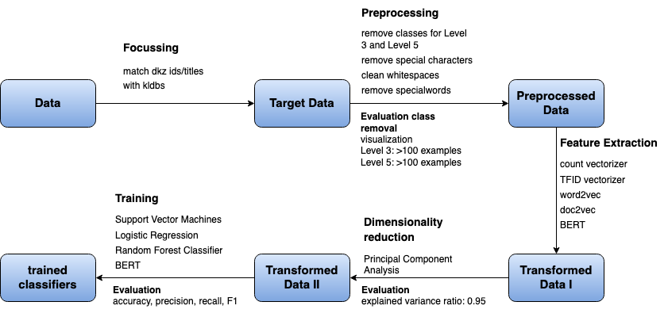
Research Task
Related Work
Method
Results
Discussion
Method

Slide 10
Research Task
Related Work
Method
Results
Discussion
Method

Slide 11
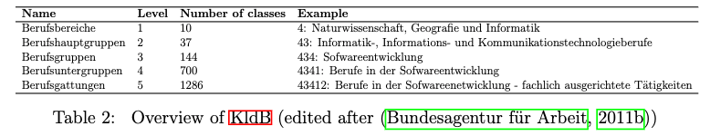
Research Task
Related Work
Method
Results
Discussion
Data
data from the job portal of the ”Bundesagentur für Arbeit” (BA):
job title
“Dokumentationskennziffer” (Dkz)
KldB Taxonomy 2010
Overview of KldB (edited after (Bundesagentur für Arbeit, 2011b)

Slide 12
Research Task
Related Work
Method
Results
Discussion
Method

Slide 13
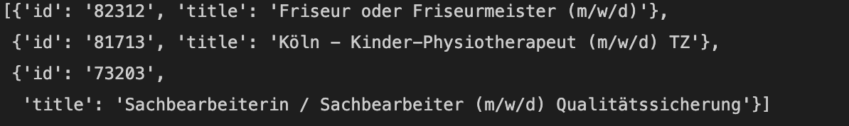
Research Task
Related Work
Method
Results
Discussion
Target Data
the ”Dkz” id from the “BA” can be matched with the KldB class id
trainings data example (Level 1)

Slide 14
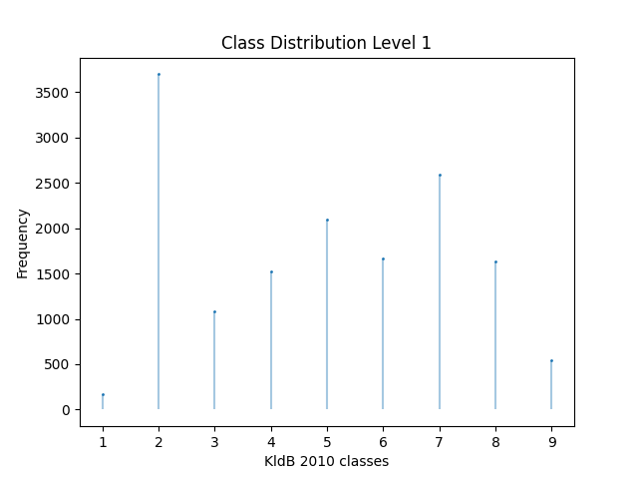
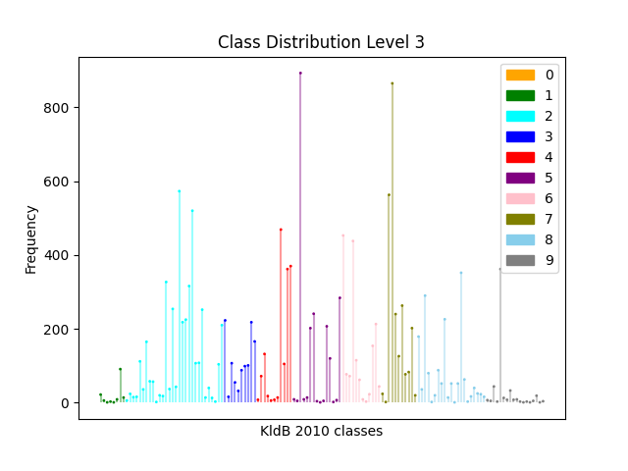
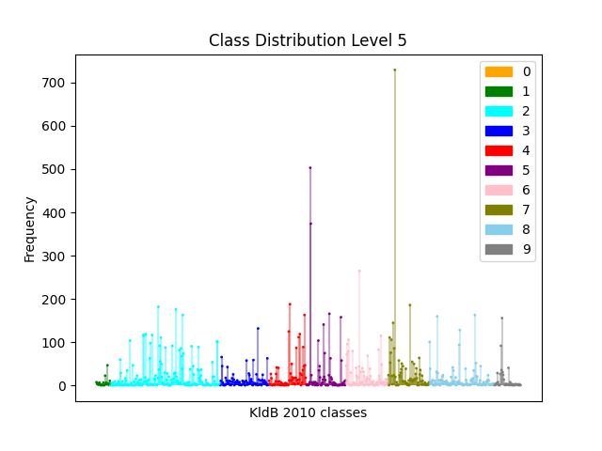
Research Task
Related Work
Method
Results
Discussion
Target Data – Class Distribution

Slide 15
Research Task
Related Work
Method
Results
Discussion
Method

Slide 16
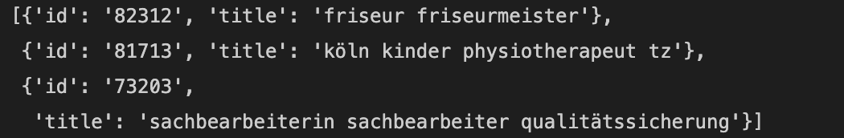
Research Task
Related Work
Method
Results
Discussion
Preprocessed Data
remove stopwords, special characters, lowercase
Zipf’s law: most frequent words → get a list of special words → remove from title
remove classes for Level 3 and Level 5
Input data example

Slide 17
Research Task
Related Work
Method
Results
Discussion
Method

Slide 18
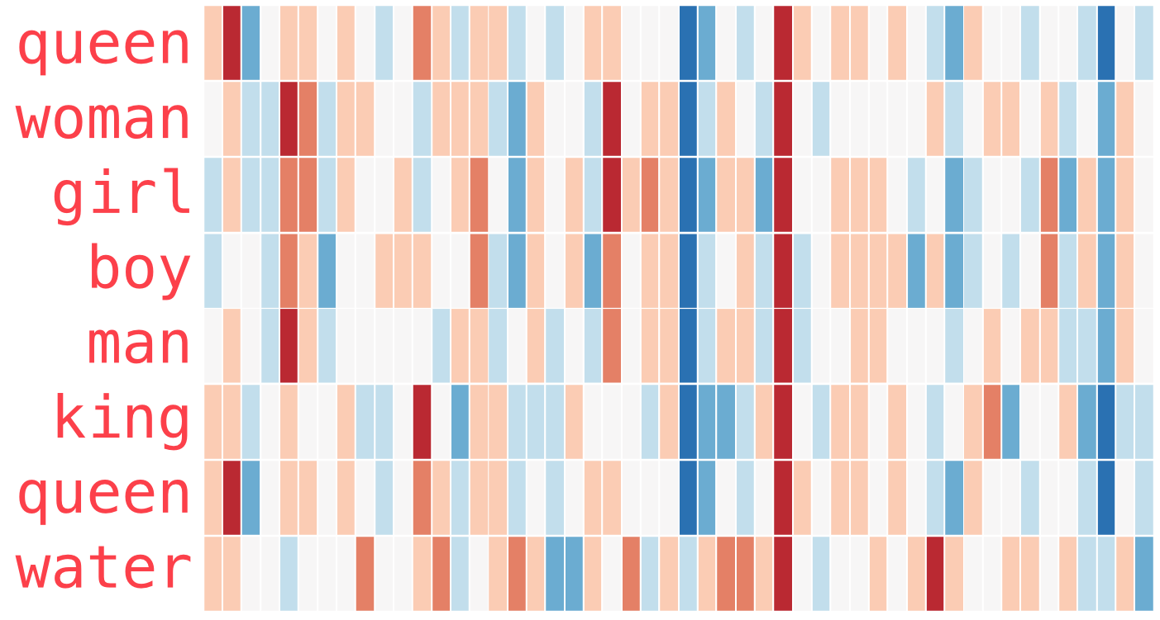
Research Task
Related Work
Method
Results
Discussion
Transformed Data I
baselines: count vectorizer and tf-idf vectorizer.
approaches for improvement:
word2vec:
pretrained model from google with fine tuning
with and without additional information
doc2vec
with and without additional information (epochs=10, vector size=300, window=5)
BERT pretrained model
BERT with fine tuning and one classification layer
0
0
0
0
Java
Python
developer
Entwickler
Example 1: „Java developer“
1
0
1
0
Java
Python
developer
Entwickler
Source: Alammar, J. The illustrated Word2vec. 2019 <https://jalammar.github.io/illustrated-word2vec/> accessed: 09.12.2021

Slide 19
Research Task
Related Work
Method
Results
Discussion
Method

Slide 20
Research Task
Related Work
Method
Results
Discussion
Transformed Data II
Principal component Analysis (PCA)
reduces features to n_components to speed up the classifiers
choose n_components such that the explained variance ratio is approx. 0.95

Slide 21
Research Task
Related Work
Method
Results
Discussion
Results

Slide 22
Research Task
Related Work
Method
Results
Discussion
First Results
Evaluation measurements
Precision: ability of model to return only relevant cases
in addition
Accuracy: How well does the classifier classifies across all classes?
Recall: ability of model identify all relevant instances
Problem: favours majority classes
F-Score: harmonic mean between precision and recall

Slide 23
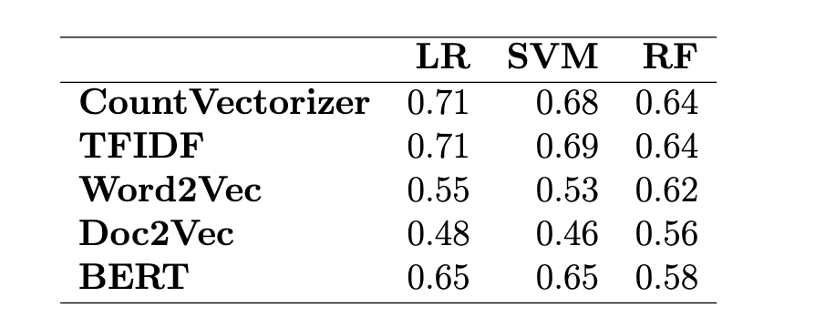
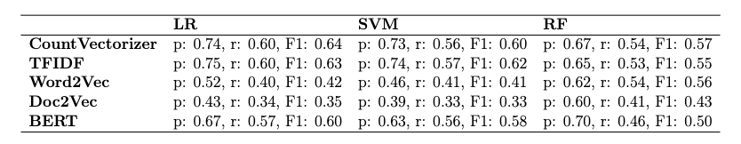
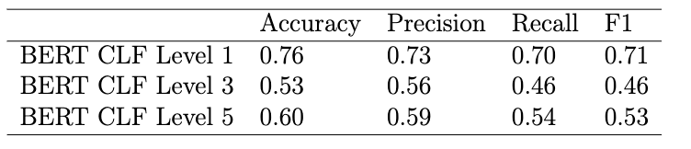
Research Task
Related Work
Method
Results
Discussion
First Results – Level 1
Accuracy
good performance
differences depends on classifier
for example, besides Doc2vec, all vectorizations performs quite similar for RF
Word2vec and Doc2vec dense techniques have poor performance for LR and SVM poor
Precision (p), Recall (r), F1 - Macro
Notes: Short training data set with 15000 examples (for Level 3 and 5 results see Appendix A)

Slide 24
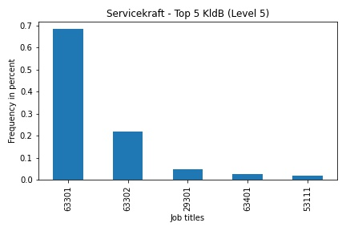
Research Task
Related Work
Method
Results
Discussion
Discussion/Limitation
Occupation: „Servicekraft“
Ambiguity between level of requirement
63301: „Berufe im Gastronomieservice (ohne Spezialisierung) – Helfer/Anlerntätigkeiten“
63302: „Berufe im Gastronomieservice (ohne Spezialisierung) - fachlich ausgerichtete Tätigkeiten“
Notes: Further example Appendix B

Slide 25
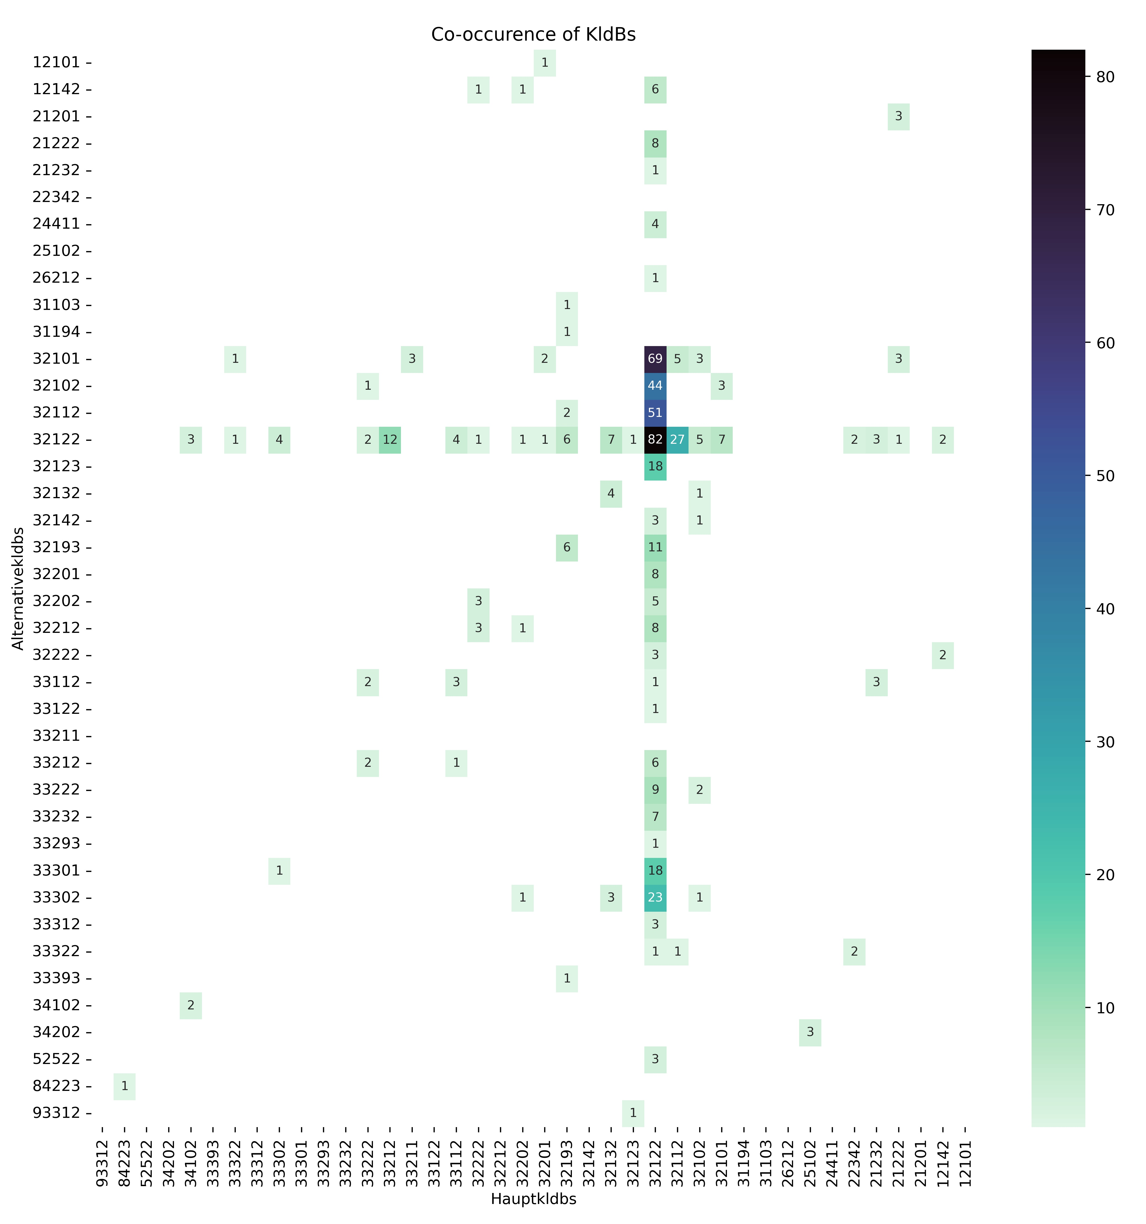
Research Task
Related Work
Method
Results
Discussion
Discussion/Limitation
Occupation: „Maurer“
32122 has many alternatives
→ Differentiation is difficult
32122 often as an alternative
„Berufsuntergruppen“ (4th digit) difficult to differentiate (32122, 32112, 32102, 32101)

Slide 26
Research Task
Related Work
Method
Results
Discussion
Discussion/Limitation
I. Pre-processing
How reasonable is it to exclude classes of level 3 and 5?
Advantage
efficient in terms of time complexity
evaluation metrics more meaningful
Disadvantage:
level 3: 46 classes remain
level 5: 38 classes remain
II. Evaluation
Should I add additional evaluation metrics to the existing ones, such as k-fold cross-validation?

Slide 27
Appendix

Slide 28
A. Results

Slide 29
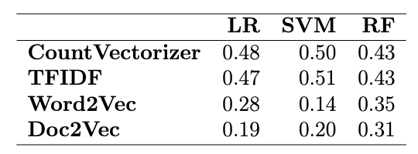
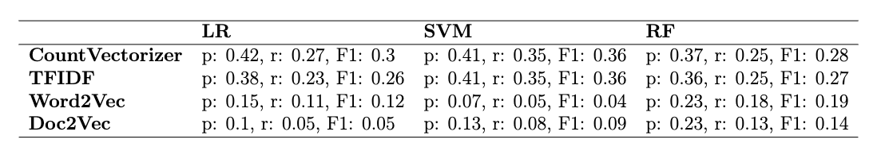
A. First Results – Level 3 – classes not removed
best performance
differences depends on classifier
for example, besides Doc2vec, all vectorizations performs quite similar for RF
Word2vec and Doc2vec dense techniques have poor performance for LR and SVM poor

Slide 30
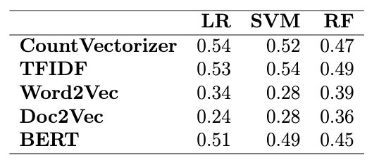
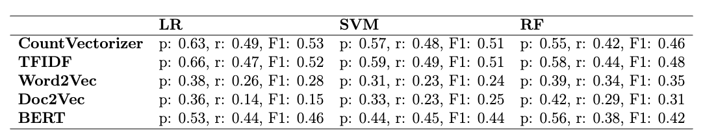
First Results – Level 3 – classes removed
Accuracy
Precision (p), Recall (r), F1 - Macro
Notes:
Frage: Nur noch 46 Klassen übrig. Aber wenn ich example Zahl runter mache, läuft der SVM nicht durch + bei der Berechnung von Precision etc. wird vieles auf Null gesetzt, weil keine Predictions (threshold ausgesucht nach ungefähr elbow technique, wobei ich etwas weiter runter gegangen bin, weil sonst wieder ill-defined Precision and Recall)

Slide 31
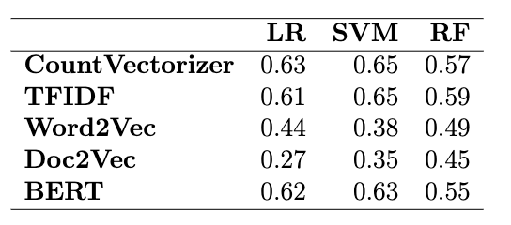
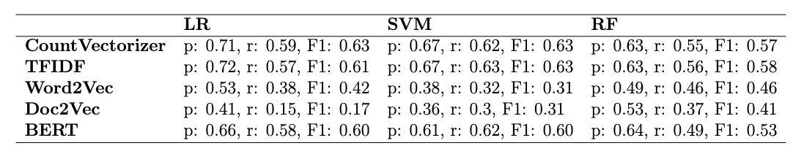
First Results – Level 5 – classes removed
Accuracy
Precision (p), Recall (r), F1 - Macro
Notes:
Frage: Nur noch 38 Klassen übrig. Aber wenn ich example Zahl runter mache, läuft der SVM nicht durch + bei der Berechnung von Precision etc. bekomme wird vieles auf Null gesetzt, weil keine Predictions (threshold habe ich nach elbow method gemacht)

Slide 32
B. Limitations

Slide 33
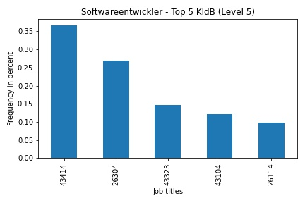
Discussion/Limitation
Occupation: „Softwareentwickler“
Ambiguity between Berufsbereichen
43414: Naturwissenschaft, Geografie und Informatik
26304: Rohstoffgewinnung, Produktion und Fertigung
Ambiguity within Berufsbereichs/ Berufshauptgruppe
43323
43104
43414
Informatik- Informations- und Kommunikationstechnologieberufe

