Slide 1


Fast adiabatic control near the quantum speed limit
Jonathan Vandermause^{1,2}
Chandrasekhar Ramanathan²
¹Harvard University
²Dartmouth College
June 6, 2017
Notes:
Thanks for the introduction
Work done with Sekhar Ramanathan at Dartmouth

Slide 2
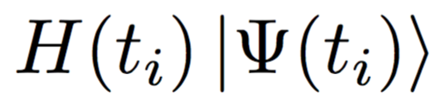
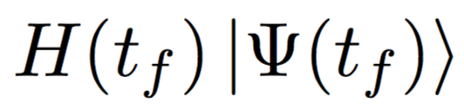
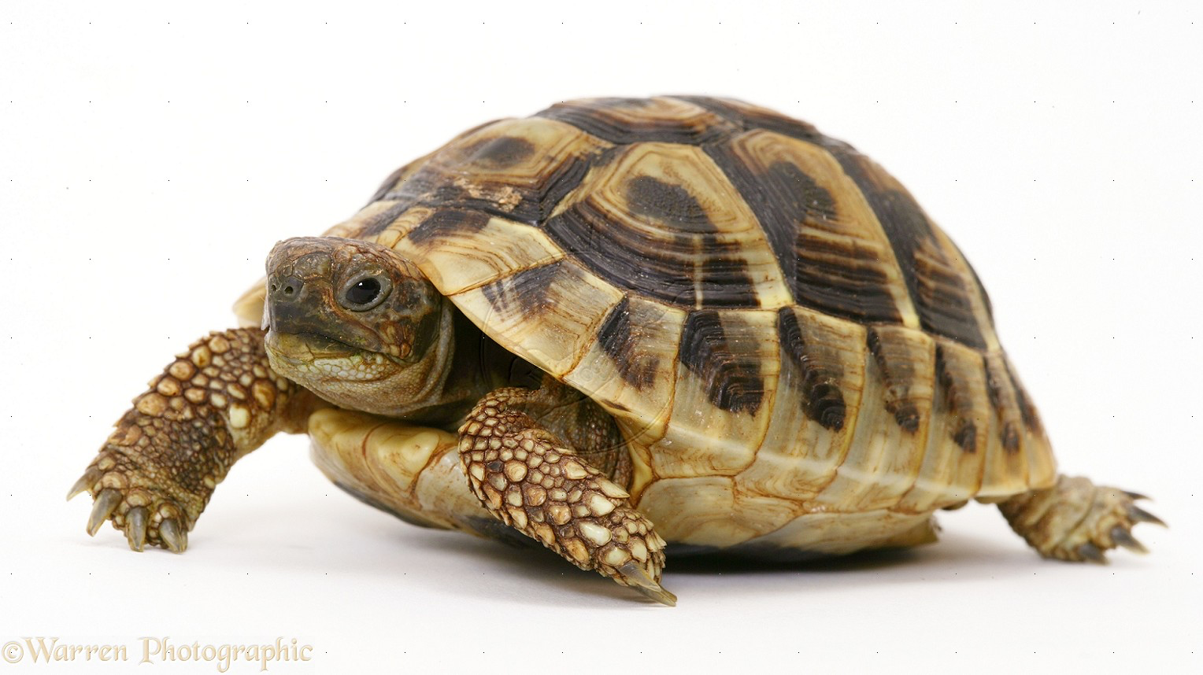
Adiabatic quantum control
Steers an initial state to a target state while keeping only a single level populated.
Notes:
-What is adiabatic quantum control? Typically slow (dragging)

Slide 3
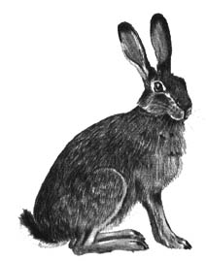
Adiabatic quantum control
Steers an initial state to a target state while keeping only a single level populated.
Berry’s superadiabatic Q-factors can be used as a metric to search for fast, robust adiabatic pulses subject to available controls.
JV and CR, Phys. Rev. A 93, 052329 (2016)
Notes:
-Turn the tortoise into a hare: adiabatic pulses can be fast

Slide 4
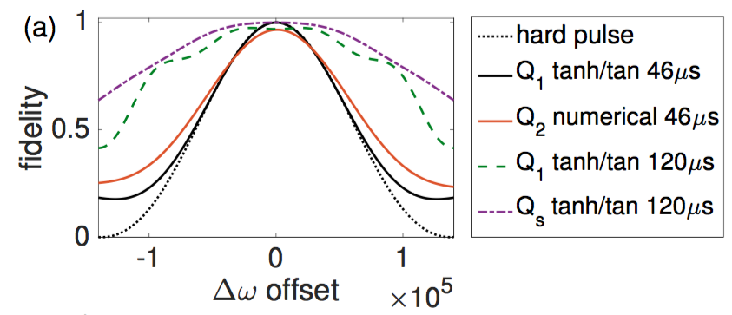
Adiabatic quantum control
Iterative frame transformation
design and implement multi-qubit transformations
robust to errors
coefficient
2-qubit NMR operation
pulse length (s)
JV and CR, Phys. Rev. A 93, 052329 (2016)
Notes:
-Brief look at theory
-Showed that pulses are robust, and that two-spin transformation can be implemented on an NMR spectrometer

Slide 5
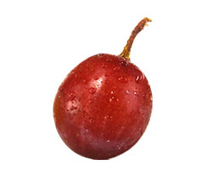

Adiabatic quantum control
This talk: Adiabatic pulses can achieve high fidelities near the quantum speed limit (QSL).
QSL = minimum time required to perform a given transformation.
QSL can be found using optimal control algorithms (e.g. Krotov or GRAPE):
Caneva et al., Phys. Rev. Lett. 103, 240501 (2009)
Notes:
-Goal of this talk to study the limits of adiabatic quantum control

Slide 6
Example: Landau-Zener transition
Two-level Hamiltonian:
drive amplitude
(constant)
detuning
(control field)
Notes:
-Bread and butter AMO

Slide 7
Example: Landau-Zener transition
Two-level Hamiltonian:
Method: Shape the detuning in Fourier space by optimizing sine modes.
drive amplitude
(constant)
detuning
(control field)
+
+
+ … =
Notes:
-Simple optimization scheme for maximizing Q-factors

Slide 8
Example: Landau-Zener transition
Notes:
What I’ll be plotting

Slide 9
Example: Landau-Zener transition
--
hard pulse
Notes:
Start with a hard pulse – drive on resonance

Slide 10
Example: Landau-Zener transition
--
hard pulse
GRAPE
Notes:
Below the pi pulse length, can do no better than a hard pulse

Slide 11
Example: Landau-Zener transition
--
hard pulse
GRAPE
QSL
Notes:
This defines the quantum speed limit

Slide 12
Example: Landau-Zener transition
--
hard pulse
GRAPE
QSL
ramp
Notes:
Starting point a ramp

Slide 13
Example: Landau-Zener transition
--
hard pulse
GRAPE
QSL
ramp
Q1
Notes:
Dramatic improvement by maximizing Q1

Slide 14
Example: Landau-Zener transition
--
hard pulse
GRAPE
QSL
ramp
Q1
Q2
Notes:
Similar results for Q2

Slide 15
Example: Landau-Zener transition
--
hard pulse
GRAPE
QSL
ramp
Q1
Q2
Short Slepian
The theory of adiabatic Slepian pulses was first introduced in:
J. Martinis and M.R. Geller, PRA 90, 022307 (2014)
Notes:
-Martinis’s Slepian pulses do best of all – choose a particular pulse length and optimize
-Remarkably, pulse performs well extremely close to the quantum speed limit

Slide 16
Example: Landau-Zener transition
Q1
Q2
Short Slepian
Slepian QSL x 1.5
--
hard pulse
GRAPE
QSL
ramp
The theory of adiabatic Slepian pulses was first introduced in:
J. Martinis and M.R. Geller, PRA 90, 022307 (2014)

Slide 17
Example: Landau-Zener transition
Q1
Q2
Short Slepian
Slepian QSL x 1.5
We have found an adiabatic pulse that:
performs at >0.98 fidelity at the QSL
achieves perfect fidelity at 1.1 x QSL
We plan to implement these pulses on an NMR spectrometer soon.
--
hard pulse
GRAPE
QSL
ramp
The theory of adiabatic Slepian pulses was first introduced in:
J. Martinis and M.R. Geller, PRA 90, 022307 (2014)

Slide 18

Thanks
NSF CHE-1410504
Paul K. Richter and Evelyn E. Cook Richter Memorial Fund
Wilder Fellowship
Purcell Fellowship

