Slide 1


Here's your outline to get started
Key facts about your topic
Scalability is the capability of a system, network, or process to handle a growing amount of work, or its potential to be enlarged to accommodate that growth. For example, a system is considered scalable if it is capable of increasing its total output under an increased load when resources are added. An analogous meaning is implied when the word is used in an economic context, where a company's scalability implies that the underlying business model offers the potential for economic growth within the company.
See more: Open the Notes below for more information.
Notes:
QuickStarter has created an outline to help you get started on your presentation. Some slides include information here in the notes to provide additional topics for you to research.

Slide 2
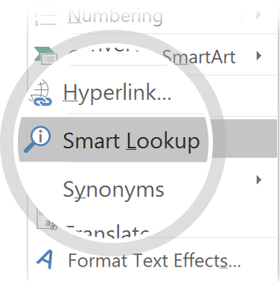
Related topics to research
NonStop
Neil J. Gunther
System Administrator
Memory hierarchy
Random-access memory
Single-core
Single instruction, multiple threads
Manycore processor
Integration appliance
Use Smart Lookup to learn more
1
Highlight one of the related topics
Right-click on the topic
Choose "Smart Lookup"
2
3

Slide 3

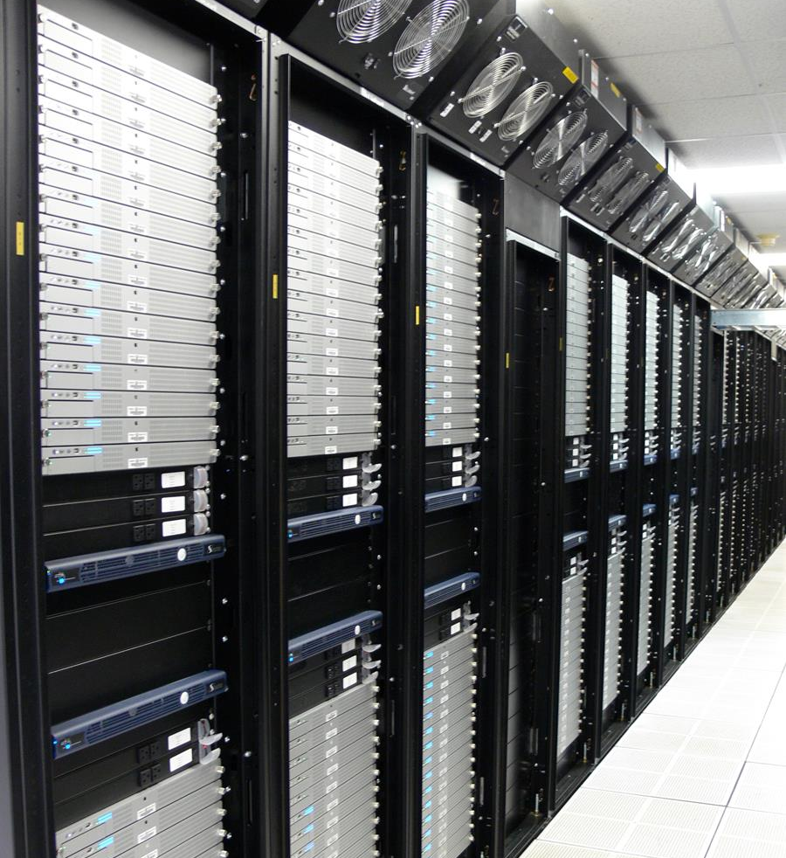
Auto-Scalability of Web Applications
Done By: Sara Al-Rasbi 200909464
Rahma Ali
Nada Aboueata 200900288

Slide 4
Contents
Measures
Examples
Horizontal and vertical scaling
Database scalability
Strong versus eventual consistency (storage)
Performance tuning versus hardware scalability
Weak versus strong scaling

Slide 5
Introduction
Keys characteristics of Cloud computing is Elasticity
Three main markets associated to cloud computing :
Infrastructure-as-Service (IaaS)
Platform-as-Service (PaaS)
Software-as-Service (SaaS)
Auto-scaling
Reactive
Proactive

Slide 6
Background
Resource Scaling
Horizontal scaling
Add or remove server replica that’s running on a VM
Vertical scaling
Adjusting number of resources allocated to an already running virtual machines.
Quality of Services.
Service Level agreement.
MAPE loop Autonomous

Slide 7
Threshold-based Rules
Used to be very popular with cloud providers.
Simple: defines policies and rules that trigger the scaling process
Two threshold: Upper Threshold (ThrU), lower Threshold (ThrL)
Rules: conditions -> consequence
Conditions include performance metrics (e.g CPU load, requests arrival rate)
Consequences includes the scaling action.
May include a duration to monitor the state if the condition is met

Slide 8
Example
M. Z. Hasan et.al. proposed an Integrated and Autonomic Cloud Resources Scaler (IACRS).
Considers performance metrics from different domains (storage, network, and storage) in combination.
System inputs:
Resource to be monitored and scaled when needed.
Performance metrics to be monitored
Group ID of the resource
Threshold and scaling policies.
Notes:
Authors argues that other consider the metrics in isolation

Slide 9
Control Theory

Slide 10
Queuing theory

Slide 11
Reinforcement Learning

Slide 12
Time Series Analysis
Sampling
performance metrics are periodically sampled at fixed time intervals.
Predicting values
Identification of pattern followed by the time series and extrapolate it to predict future values.
Resource Allocation
The predicted values are used to make the final decision of allocating resources

Slide 13
Introduction
Workload & resource usage prediction
Three main markets associated to cloud computing :
Infrastructure-as-Service (IaaS)
Platform-as-Service (PaaS)
Software-as-Service (SaaS)
Auto-scaling
Reactive
Proactive

Slide 14
Defini
Workload & resource usage prediction
Direct prediction
Averaging methods
Auto regression
Auto-regression moving average
Indirect prediction
Pattern matching
Signal processing
Auto correlation

Slide 15
Example

Slide 16
Comparsions

Slide 17
Evaluation

Slide 18
Conclusion

