Slide 1
Web development
Rahma Ismail
GoMyCode

Slide 2
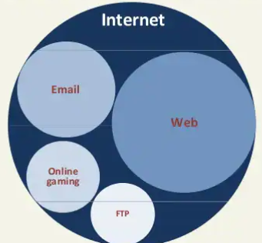
How does the web work?
The World-Wide Web (WWW or simply the Web) is only a subset of the Internet.

Slide 3
How does the web work?
The web is a system for publishing pages of information on the internet, and for linking pages together using links.
Anyone can publish a page by uploading it to a web server.
Anyone can type the precise address - the URL (uniform resource locator) - for every page he wanted to search.

Slide 4
What do you need to be a web developer?
A numerate degree in a subject such as maths or science will be useful.
A web developer should have an experience of elements such as:
User experience (UX)
User interface (UI)
Visual design
Coding languages including HTML and CSS

Slide 5
What do you need to be a web developer?
Frontend web programing languages and skills such as JavaScript, Ajax and web animation techniques
Backend web programing languages such as C# or Java, PHP and Ruby
Design software like Photoshop and Illustrator and Sketch
An understanding of SEO
Web servers and how they function

Slide 6
What is the role of a web developer?
A web developer essentially makes a website work by building the functionality, interactivity and visible structure of the site, normally based on the vision of designers and other key roles.
He is also responsible for ensuring a site functions correctly on all browsers - both desktop and mobile - through testing.

