Slide 1

Rahma Hassan
Esraa Yasser
Basma Sherbeni
Kerilos Gerges
Fady Ibrahim

Slide 2



Maven Fuzzy factory performance analysis

Slide 3
Project Summary
01
02
03
04
05
Channel Mix
&
Resilience
Data
Quality
Growth
Story
Conversion Funnel
Efficiency
06
07
08
09
10
Landing
&
Billing
Margin
&
Refunding
Cross-sell
Matrix
Repeating Customers
Strategic Summary

Slide 4
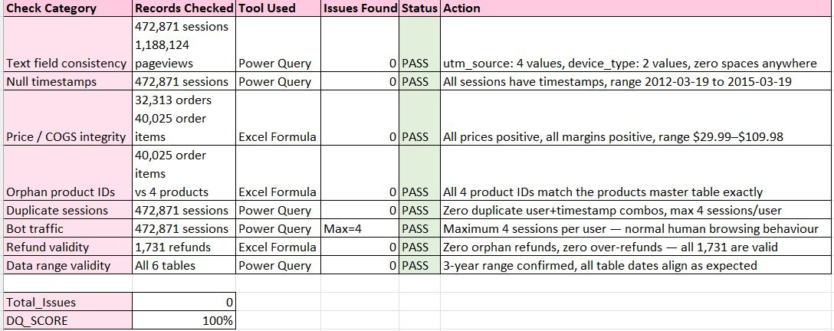
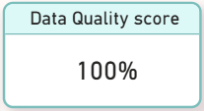

01
Challenges met working with the data
Data quality
Insight: 1.7M+ records, 0 issues — fully clean and reliable.
Recommendation: Use full dataset, no cleaning needed.
Impact: All metrics are verifiable; data is trustworthy.
01

Slide 5
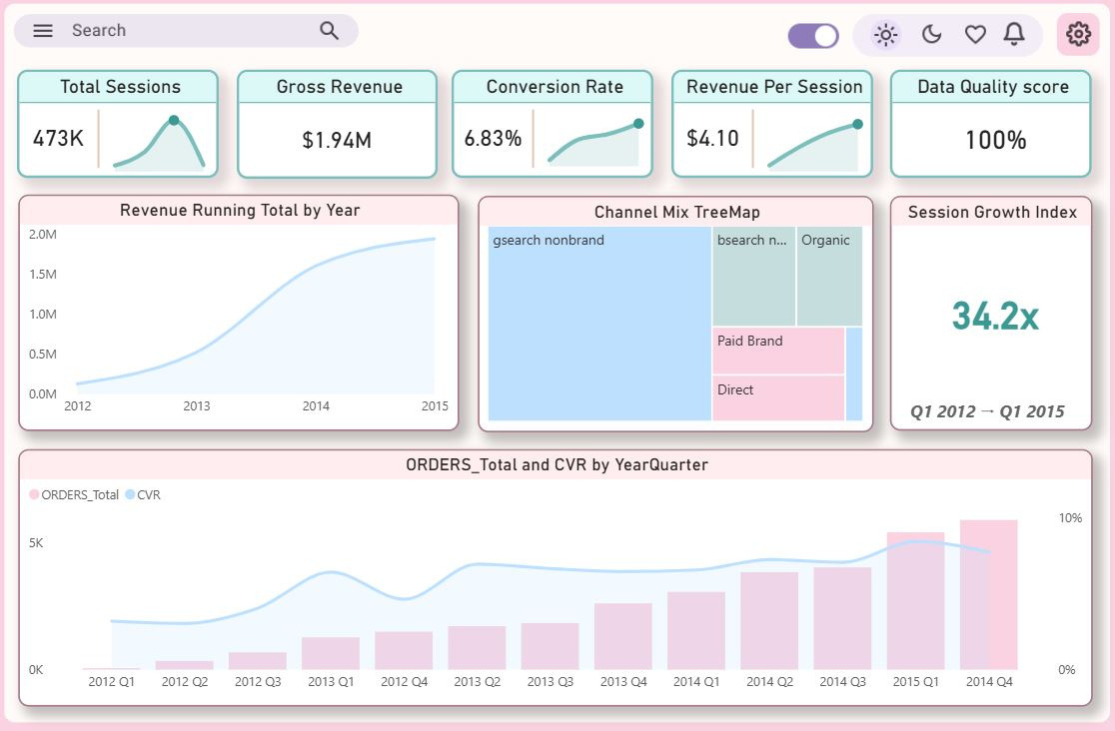
02
Growth Story:
Executive Overview
Data Quality is getting automatically alarmed by deformed and wrong data entries in real time ensuring clear analysis-
Insight: 3-year growth: sessions 34x, orders 90x, revenue $1.94M.
Recommendation: Anchor the story on this compounding growth.
Impact: $1.94M revenue, 8.44% CVR, $5.30 RPS from near zero.
02

Slide 6
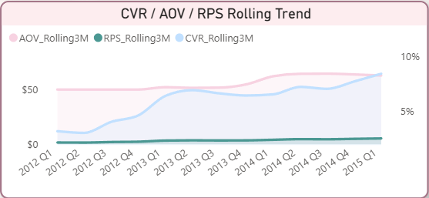
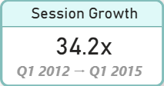
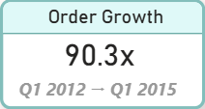
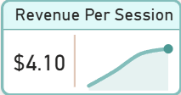
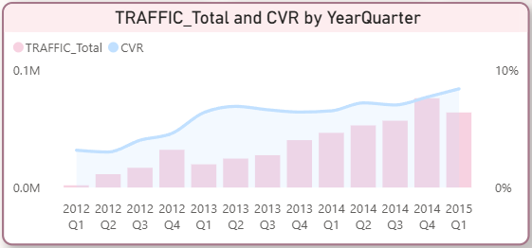
03
Efficiency — CVR, AOV, Revenue Per Session
Growth Story
Insight: Three key inflection points drove growth.
Recommendation: Highlight these points on the chart.
Impact: CVR nearly tripled to 8.44% in 3 years.
Efficiency
Insight: CVR, AOV, RPS all improved together.
Recommendation: Track RPS as main health metric.
Impact: Visitor value 3.4x higher than launch.
03

Slide 7
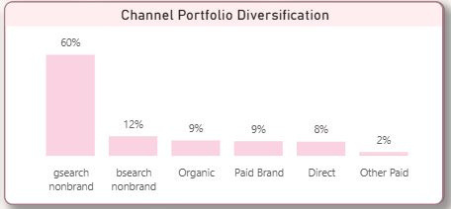
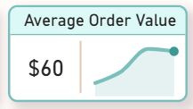
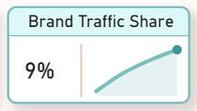
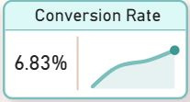
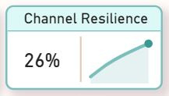
03
Efficiency — Channel Diversification
Channel Diversification
Insight: gsearch nonbrand drives 60% of sessions — single point of failure.
Recommendation: Reduce paid retargeting; redirect budget to new acquisition.
Impact: Frees budget while maintaining traffic quality.
04

Slide 8
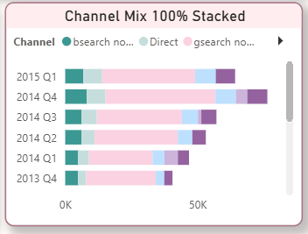
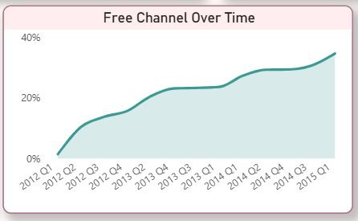
04
Channel Mix & Resiliance
Channel Mix
Channel Resiliance
Insight: Free traffic grew to 35% by 2015.
Recommendation: Target 50% channel resilience, invest in brand & content.
Impact: 1/3 revenue survives without paid ads — strong brand equity.
05

Slide 9

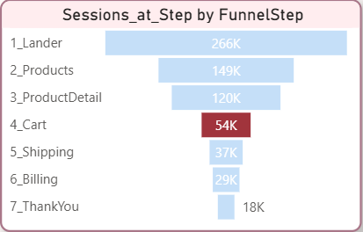
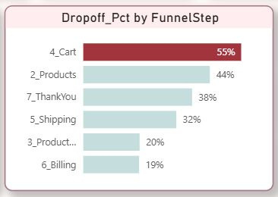
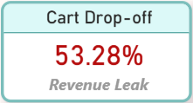
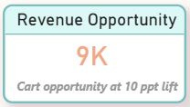
05
Conversion Funnel - biggest revenue leak
Conversion Funnel
Insight: 55% drop-off on product pages.
Recommendation: A/B test product page (CTA, urgency, social proof).
Impact: 10pp lift ≈ $108K/year recovered revenue which is also 9k/month
06

Slide 10

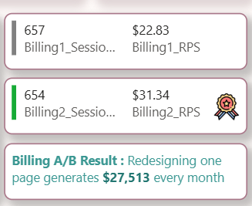
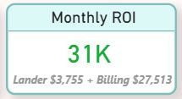
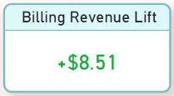
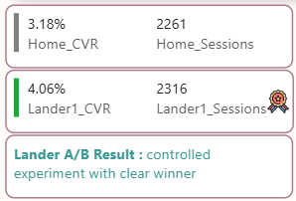
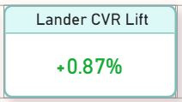
06
Landing & Billing Pages A/B Test
Billing Page A/B Test
Insight: /billing-2 lifts revenue 37% → $27.5K/month.
Recommendation: Keep design; monitor CVR.
Impact: Highest-value experiment in dataset.
Landing Page A/B Test
Insight: /lander-1 lifted conversion 0.87pp → $3.8K/month.
Recommendation: Use same method for product page tests.
Impact: Ongoing revenue: $31K/month from two experiments.
07

Slide 11
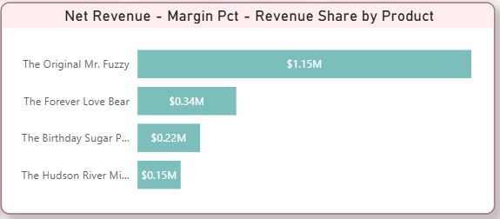
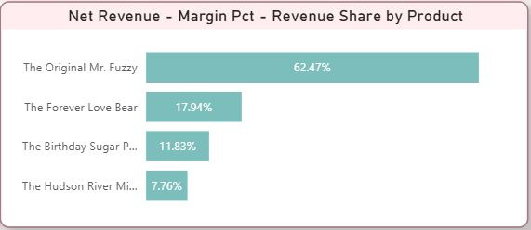
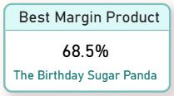
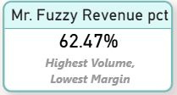
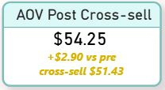
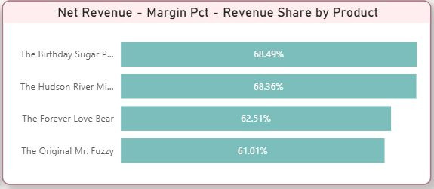
08
Product Revenue & Margin
Product Revenue & Share
Product Margin
Insight: Mr. Fuzzy = 62% revenue pct, lowest margin; Sugar Panda = high margin.
Recommendation: Shift marketing to high-margin products.
Impact: Portfolio margin improves with small shifts.
08

Slide 12
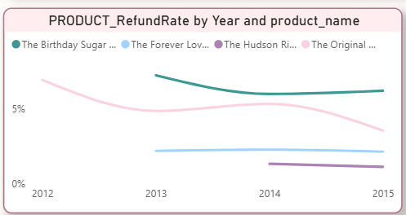
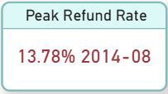
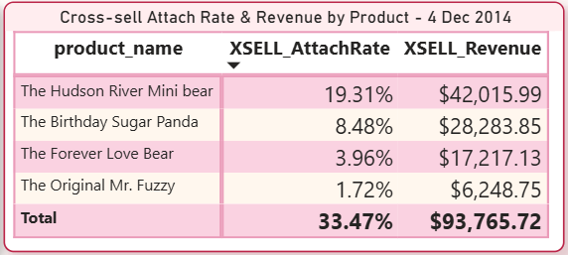
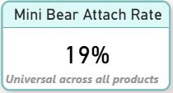
07
Refund Crisis & Cross Selling
Refund Crisis + Supplier Story
Insight: Refund spike resolved in <30 days via new supplier.
Recommendation: Alert at 6% refund rate, monthly audits.
Impact: Fast data-driven fix prevented structural issues.
Cross-Sell Matrix — Mini Bear universal
Insight: Mini Bear attaches 21% across all products.
Recommendation: Make Mini Bear the sole cross-sell at checkout.
Impact: Lift to 28% ≈ $106K/year additional revenue.
09

Slide 13
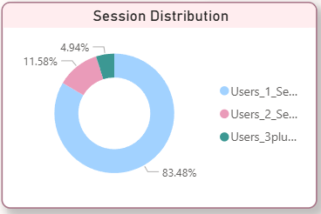
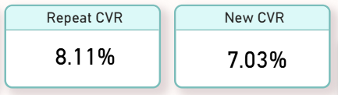
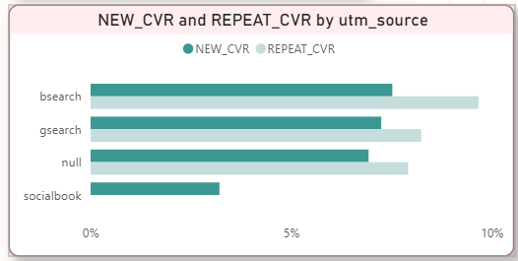

09
Customer Loyalty & Lifetime Value Analysis (2014)
User Retention Breakdown
Conversion Efficiency by Channel
Customer Lifetime Value (LTV) Analysis: New vs. Repeat
Insight: Repeat users 2.42x more valuable; zero email capture.
Recommendation: Implement email capture, CRM, suppress retargeting for returners.
Impact: Increases repeat value and retention at minimal cost.
2.4x More Valuable
10

Slide 14
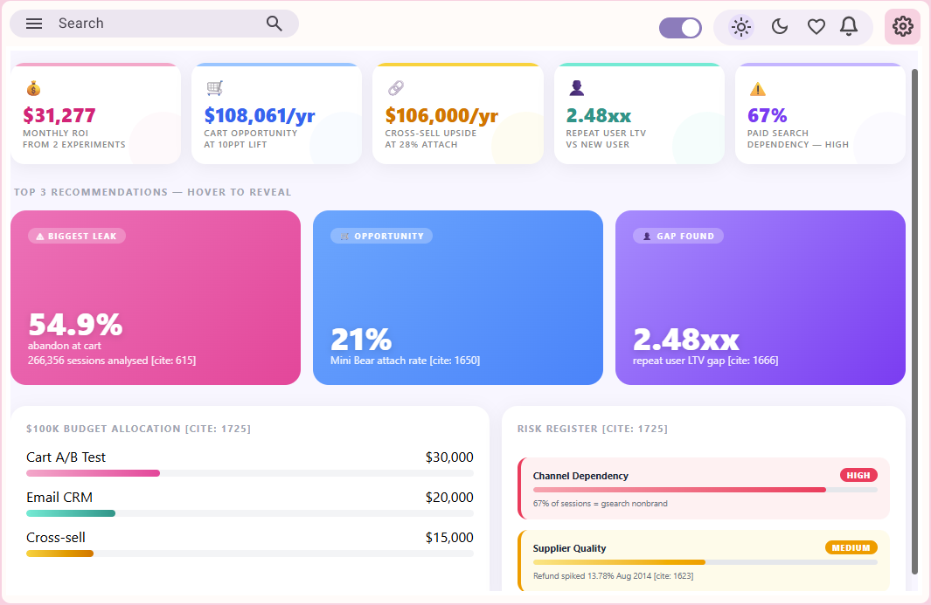
Strategic Summary — HTML/CSS showcase
Recommendation Dashboard
Insight: Experiments generate $31K/month; 3 new actions ≈ $214K/year.
Recommendation: Prioritize cart drop-off → cross-sell → email CRM.
Impact: Total uplift ≈ $320K/year; all metrics dynamic and data-backed.
11

Slide 15

Thank You

