Slide 1

Agenda
Introduction
Import Data
transform
visualization
Conclusion

Slide 2

Introduction
District-wise agricultural data for 20 major crops in India, including area, yield, and production, are provided, enabling detailed analysis of productivity trends. The dataset encompasses both traditional crop varieties and High Yielding Varieties (HYVs), offering insights into modern agricultural practices. With detailed documentation, it ensures clarity and accuracy in analysis. This valuable resource aids policymakers, researchers, and stakeholders in understanding localized agricultural dynamics and optimizing interventions. It serves as a comprehensive tool for evidence- based decision-making and strategic planning in India's agricultural sector.

Slide 3

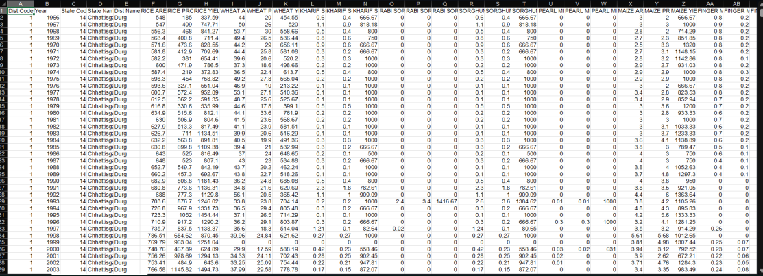
Data overview

Slide 4
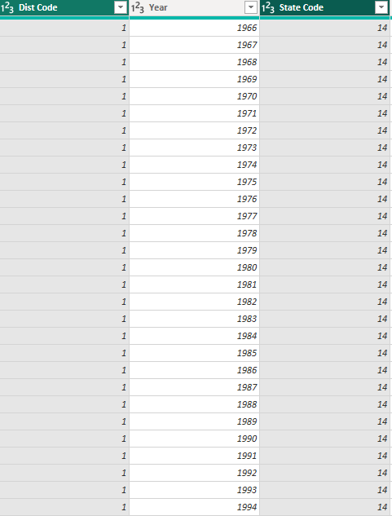
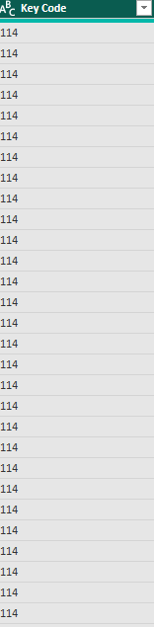
Transform Data By Power Query

Slide 5
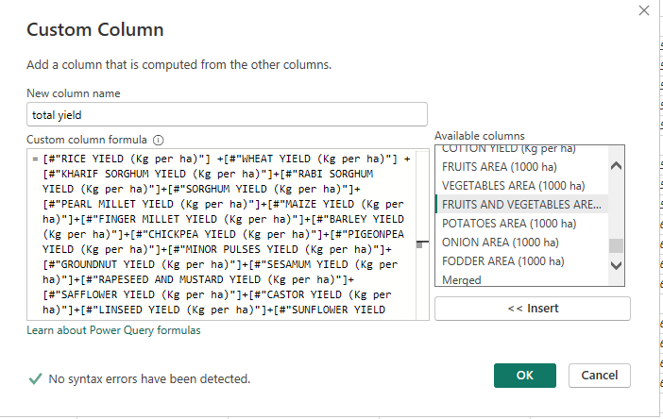
Create Custom Columns

Slide 6
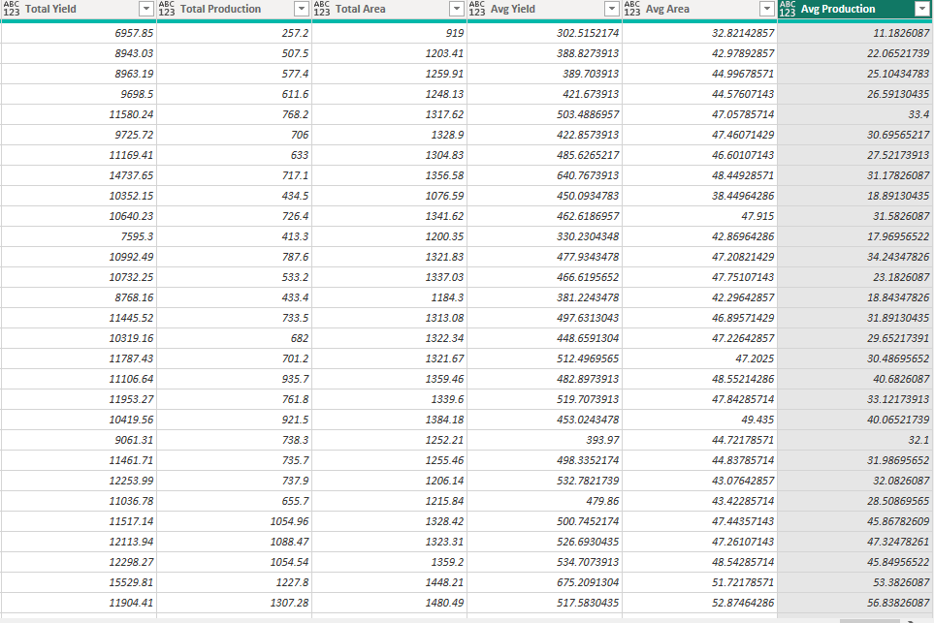
Custom Columns After Creation

Slide 7
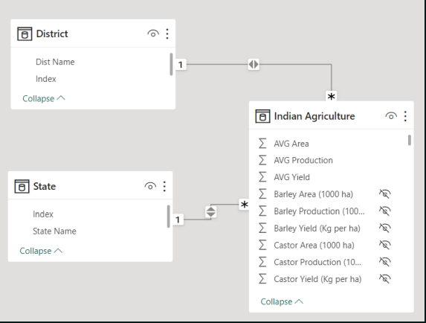
Data Modeling

Slide 8
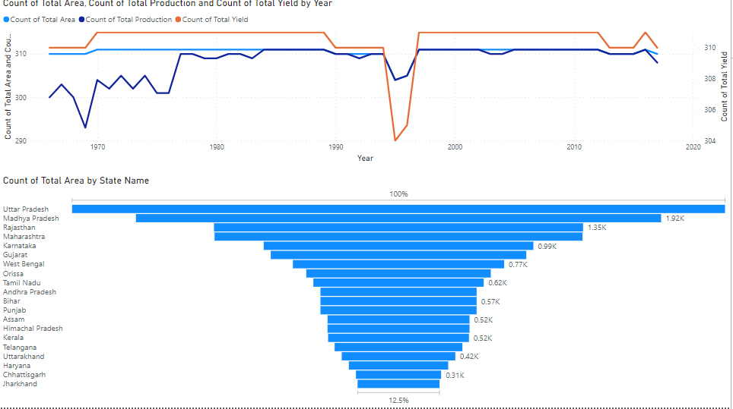
Data Visualization

Slide 9
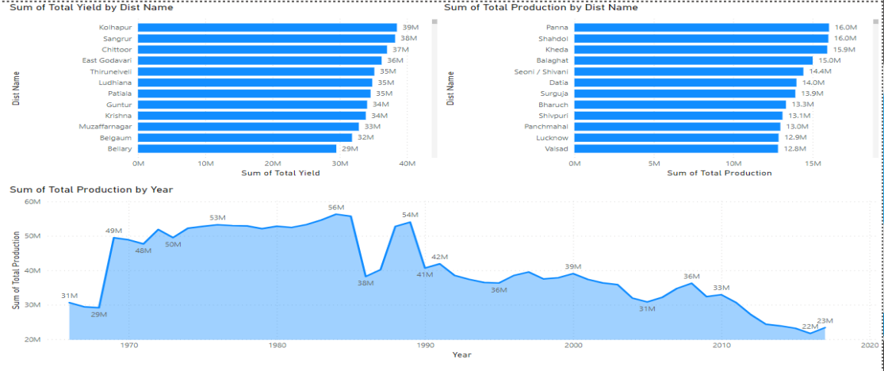
Data Visualization

Slide 10
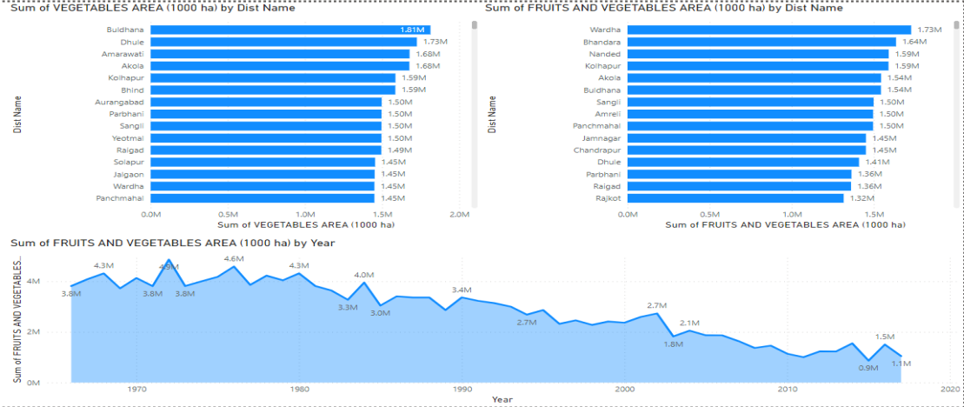
Data Visualization

Slide 11

Conclusion
"Through advanced data analysis techniques, valuable insights can be gleaned from agricultural data, enabling optimization of crop yields, resource allocation, and pest management strategies. By leveraging data-driven approaches, farmers can make informed decisions to enhance productivity, sustainability, and resilience in their operations."

