Slide 1


EFREI PARIS
PANTHEON ASSAS
CAREER RECOMMENDATION
MASTER 2
PFE
Presented by Rahma ALBEKBASHY

Slide 2

Thesis Defense Presentation
Page 2/12
INTRODUCTION
In today's rapidly evolving job market, making informed career choices can be challenging.
Our system leverages advanced data analytics and machine learning to provide personalized career recommendation
Thesis Defense | Efrei 2024

Slide 3











AVAILABLE RESSOURCES
Page 3/12
Data Source
Data deployment
Thesis Defense | Efrei 2024

Slide 4
Page 4/12
Steps To Succeed
Data
Collection
Data
Storage
Data
Ingestion
Data
Processing
Data
Warehousing
Visuals
From where did we get the data?
choice, cost and space
Convert and Deployment
Cleaning and Machine learning
Large scale data Analysis
Our Human Machine Interface
Thesis Defense | Efrei 2024

Slide 5
Page 5/12
Thesis Defense Presentation
01
DATA COLLECTION
Data Sources
10 Requests/Sec
Linkedin, Indeed & FranceTravail APIs for job offers
Coursera API for certified courses
DataGouv for studies Diplomas
Data collected everyday from 3 pm to 9 pm
Data Base
Data amount:
216 000 data /day !
Data
Collection
Data
Storage
Data
Ingestion
Data
Processing
Data
Warehousing
Visuals

Slide 6
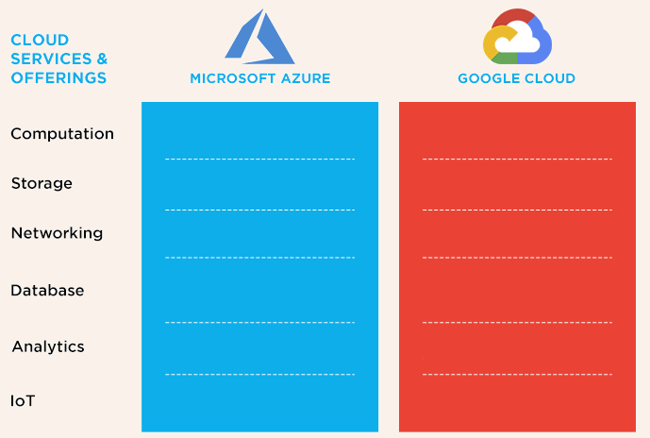



Thesis Defense Presentation
Page 6/12
02
DATA STORAGE
Raw data are Stored in Azure Data Lake Storage:
Highly scalable Storage
Secured cloud storage
IOT designed for big data analytics
Free App Functions Implementation
Data
Collection
Data
Storage
Data
Ingestion
Data
Processing
Data
Warehousing
Visuals

Slide 7



Thesis Defense Presentation
Page 7/12
03
DATA INGESTION
Azure Data Factory:
In order to prepare for the next step, we need data in azure compatible format
Convert data to parquet is the solution
Raw Data
in CSV
Raw Data
in Parquet
Data
Collection
Data
Storage
Data
Ingestion
Data
Processing
Data
Warehousing
Visuals

Slide 8
Thesis Defense Presentation
Page 8/12
04
DATA PROCESSING &
MACHINE LEARNING
The machine learning algorithms employed demonstrated impressive performance.
Root Mean Squared Error (RMSE) of 4.01 a
R-squared (R²) value of 0.999.
highly accurate
effectiveness
minimal error
strong foundation for future enhancements
Raw Data
in parquet
Cleaned Data
in parquet
Cleaned Data
in CSV
Data
Collection
Data
Storage
Data
Ingestion
Data
Processing
Data
Warehousing
Visuals

Slide 9
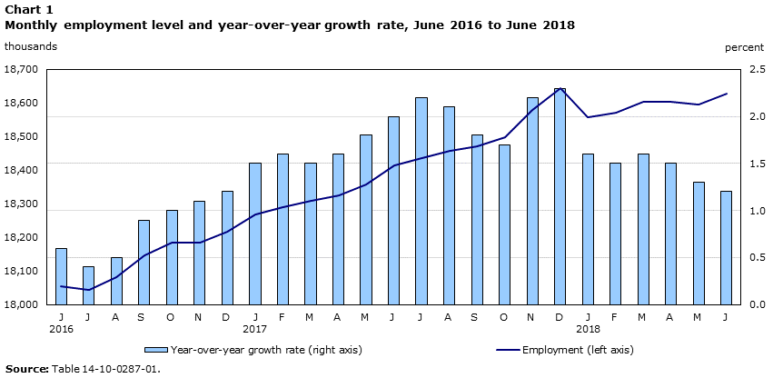
Thesis Defense Presentation
Page 9/12
05
DATA WAREHOUSING
Centralized Data Storage
Centralized Data Storage
All data from diverse sources was ingested and stored in Synapse, providing a single source of truth for our analytical processes.
Efficient Querying
Dedicated SQL pools were used to execute complex queries and perform large-scale data Analysis.
This enabled us to derive insights from extensive datasets quickly and effectively.
Monthly Employment level and growth rate
Data
Collection
Data
Storage
Data
Ingestion
Data
Processing
Data
Warehousing
Visuals

Slide 10
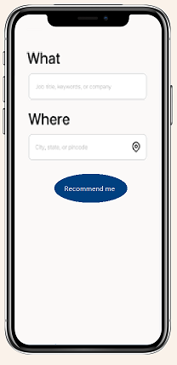
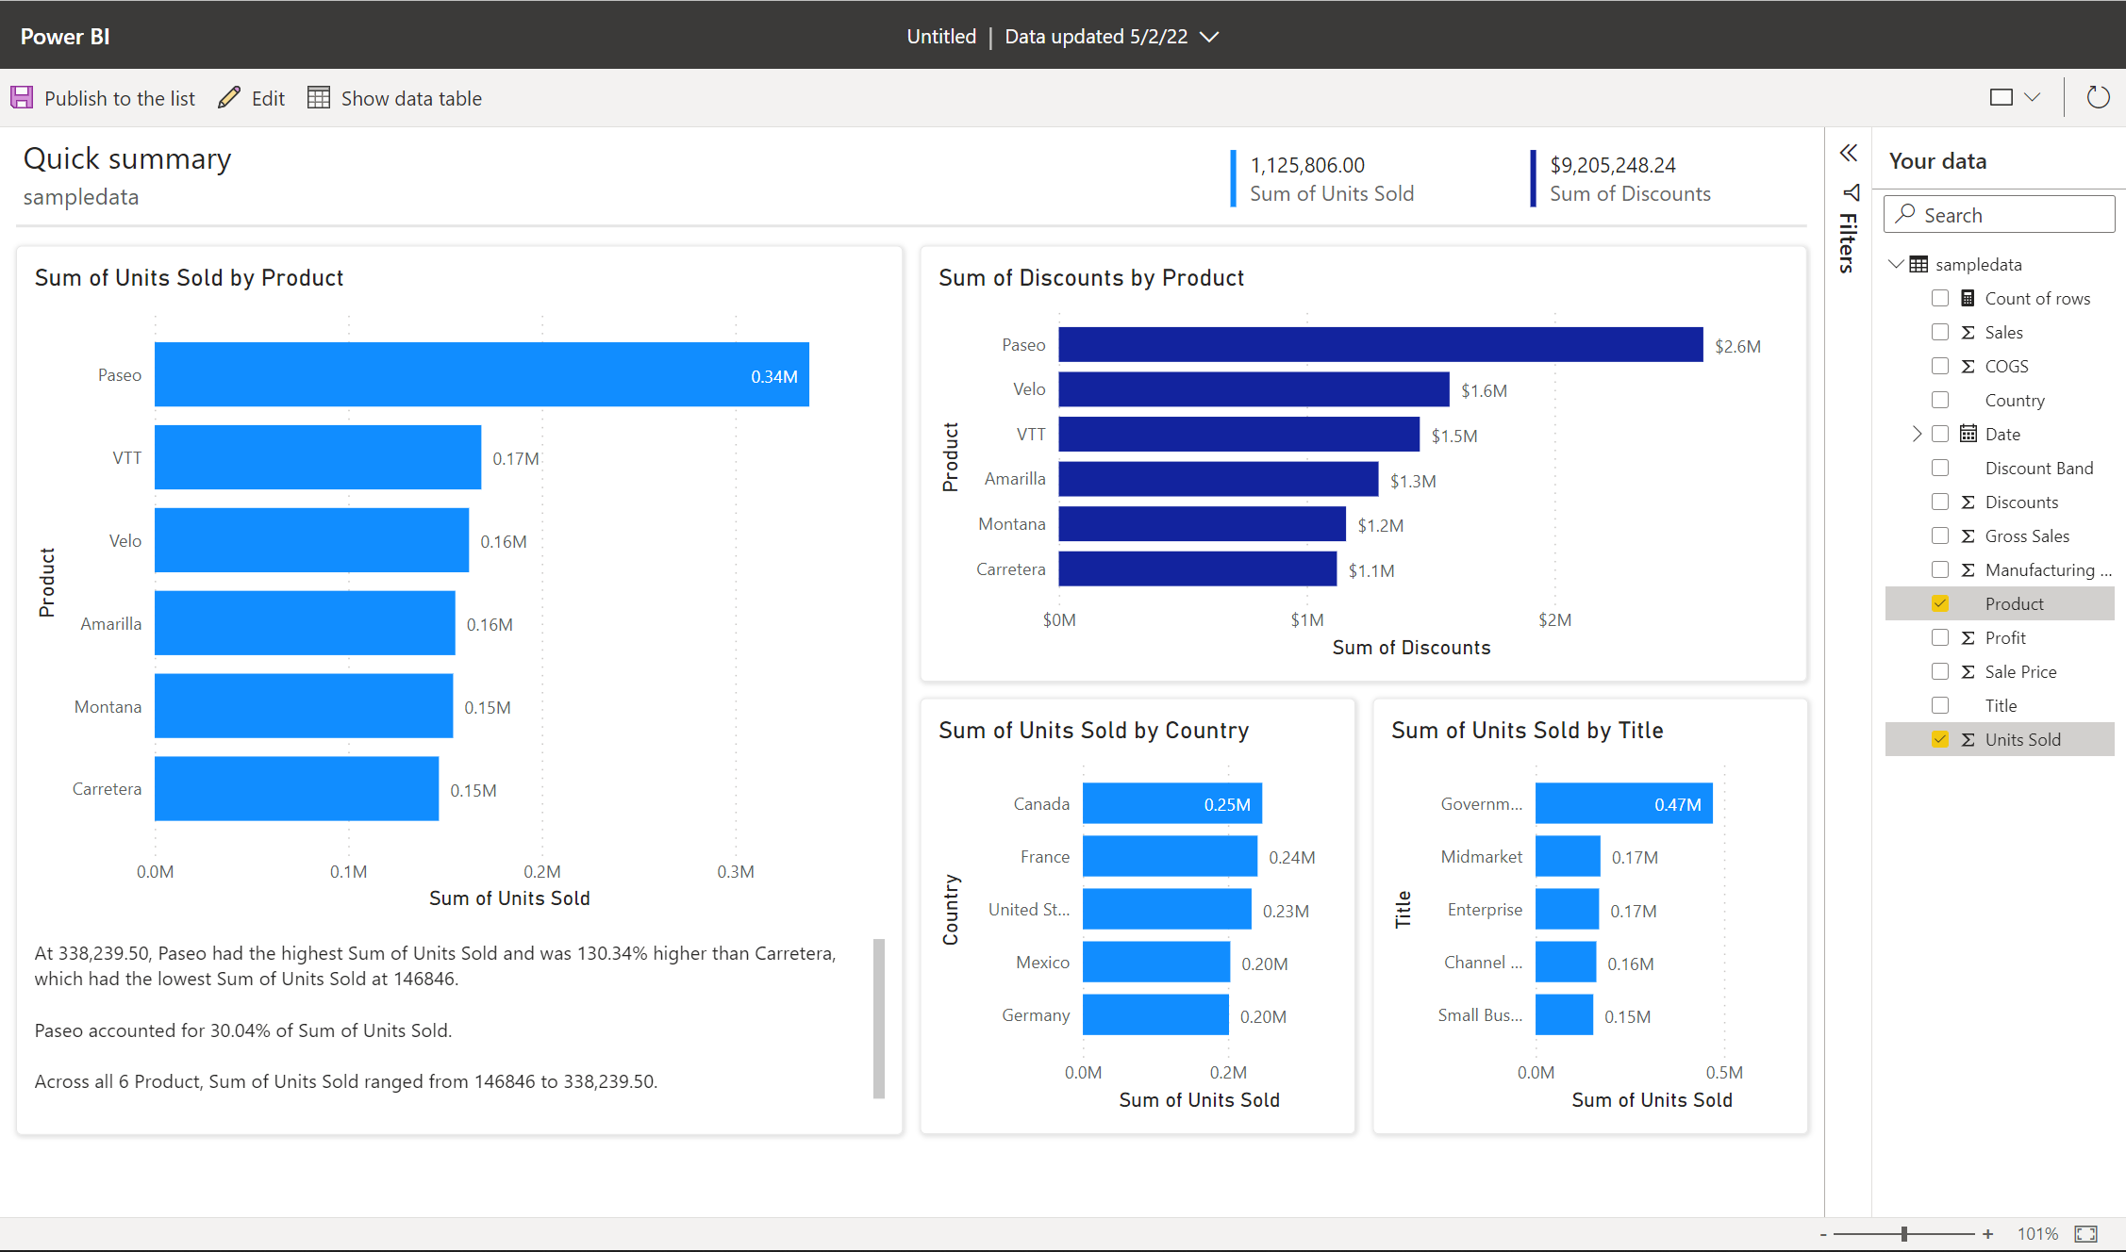
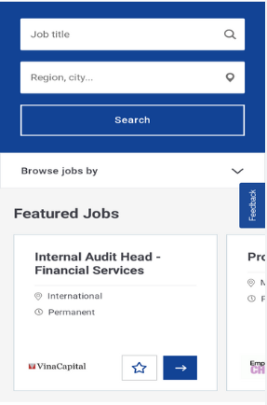
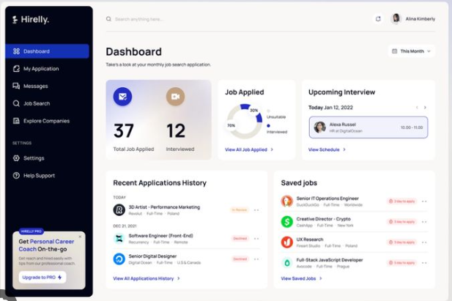

Thesis Defense Presentation
Page 10/12
06
Visuals
A Human machine interface model on powerbi That recommends the perfect job for your profile !
Data
Collection
Data
Storage
Data
Ingestion
Data
Processing
Data
Warehousing
Visuals

Slide 11

Thesis Defense Presentation
Page 11/12
Challenges
API Limitations and Restrictions
Data Security and Compliance
Cost and Service Analysis
Data Quality Issues
Data Refresh and Synchronization in Power BI
Project Coordination and Management

Slide 12

Thesis Defense Presentation
Page 12/12
Conclusion
Excitement
Thrilled to work with cutting-edge technologies and create something impactful
Challenge
Faced complex tasks that pushed me to grow and enhance my skills.
Satisfaction
Experienced a deep sense of accomplishment upon overcoming obstacles.
Learning
Gained valuable insights and knowledge throughout the process.
Gratitude
Felt thankful to my university for providing the knowledge, resources, and support that enabled me to successfully complete this project

Slide 13

THANK YOU
EFREI PARIS
PANTHEON ASSAS
Presentation by Rahma ALBEKBASHY
MASTER DATA ENGINEERING

Slide 14

EFREI PARIS
PANTHEON ASSAS
Architecture
Page 11/11
Data Collection
Thesis Defense | Efrei 2024

Slide 15

Data Storge & Ingestion
Data Cleaning
Data Collection

Slide 16
Page 4/10
Steps To Succeed
1
2
3
4
5
Data Collection
Data Storage
Data Ingestion
Data Processing
Data
Warehousing
and visuals
From where did we get the data?
choice, cost and space
Convert and Deployment
Cleaning and Machine learning
Large scale data aggregation

Slide 17
1
2
3
4
5
Data Collection
Data Storage
Data Ingestion
Data Processing
Data
Warehousing
and visuals
From where did we get the data?
choice, cost and space
Convert and Deployment
Cleaning and Machine learning
Large scale data aggregation

Slide 18
Thesis Defense Presentation
Page 8/10
05
DATA WAREHOUSING
Centralized Data Storage
All data from diverse sources was ingested and stored in Synapse, providing a single source of truth for our analytical processes.
Efficient Querying
Dedicated SQL pools were used to execute complex queries and perform large-scale data aggregations.
This enabled us to derive insights from extensive datasets quickly and effectively.

