Slide 1
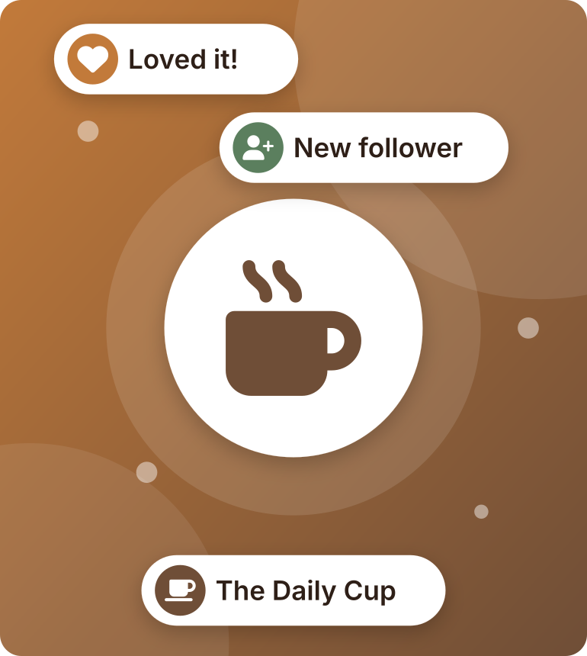
Digital Marketing Proposal
PRESENTED BY PULSE MARKETING
For The Daily Cup Café
Notes:
Introduce yourselves and Pulse Marketing.
"Today we'll show you how we can help The Daily Cup reach more customers and grow its business."

Slide 2
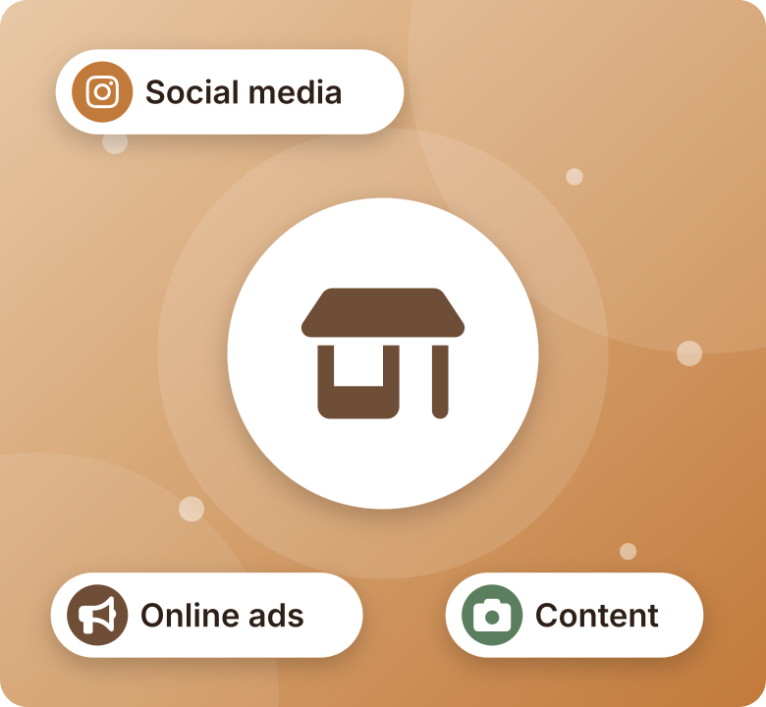




Executive Summary
01 EXECUTIVE SUMMARY
Our goal: help The Daily Cup grow
Increase brand awareness
Attract more customers
Increase sales
Improve social media presence
Notes:
Our marketing agency wants to help The Daily Cup grow its business.
Our goals are to:
- Increase brand awareness.
- Attract more customers.
- Increase sales.
- Improve social media presence.
We will use social media, online advertising, and creative content to achieve these goals (shown in the picture).

Slide 3
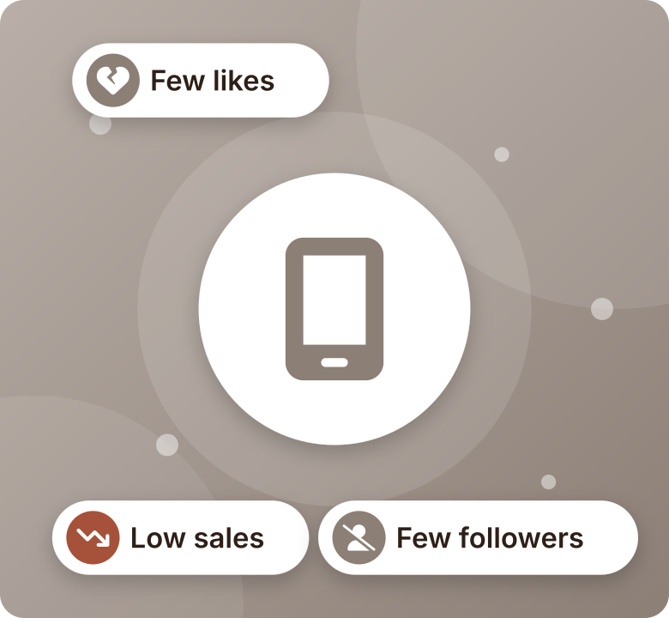





The Challenges
02 PROBLEM STATEMENT
Low brand awareness
Few followers, low engagement
Strong competition from other cafés
Hard to attract new customers
Low sales in some periods
Notes:
The café may face some challenges:
- Low brand awareness.
- Few followers and low engagement on social media.
- Strong competition from other cafés.
- Difficulty attracting new customers.
- Low sales during some periods.

Slide 4
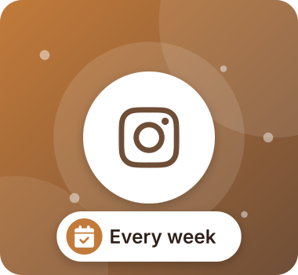

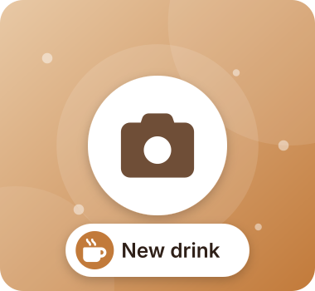
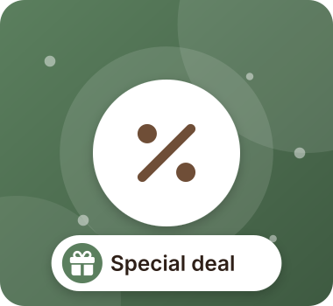
Our Four Main Services
03 PROPOSED SOLUTION
Social Media Management
Paid Advertising
Content Creation
Promotions
12 posts, 8 reels and daily stories a month
Targeted Facebook and Instagram ads near the café
A professional photo and video shoot every month
2 special offers a month to bring people in
Notes:
Our agency offers four main services:
- Social Media Management: create regular posts, reels, and stories.
- Paid Advertising: run Facebook and Instagram ads.
- Content Creation: take attractive photos and videos of products.
- Promotions: offer discounts and special deals to attract customers.

Slide 5






Five Simple Steps
04 IMPLEMENTATION PLAN
1
2
3
4
5
Research
Audience
Content Plan
Launch
Measure
Market and competitors
Identify who to target
A plan for the month
Publish content and ads
Track results and improve
What we learn in step 5 improves next month's plan
Notes:
We will follow five simple steps:
1. Research the market and competitors.
2. Identify the target audience.
3. Create a monthly content plan.
4. Publish content and launch advertisements.
5. Measure results and improve the campaign.

Slide 6
Monthly Budget
05 BUDGET
Social media management
5,000 EGP
Paid advertising
4,000 EGP
13,000
EGP / month
Content creation
3,000 EGP
Reporting and optimization
1,000 EGP
Total
13,000 EGP
This is a proposed budget for the presentation.
Notes:
Monthly budget:
- Social media management: 5,000 EGP
- Paid advertising: 4,000 EGP
- Content creation: 3,000 EGP
- Reporting and optimization: 1,000 EGP
Total: 13,000 EGP per month.
This is a proposed budget for the presentation.

Slide 7




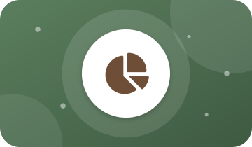
The First Month
06 TIMELINE
WEEK 1
WEEK 2
WEEK 3
WEEK 4
Research and planning
Content creation
Launch marketing campaigns
Measure results and improve
Notes:
Week 1: Research and planning.
Week 2: Content creation.
Week 3: Launch marketing campaigns.
Week 4: Measure results and improve.

Slide 8
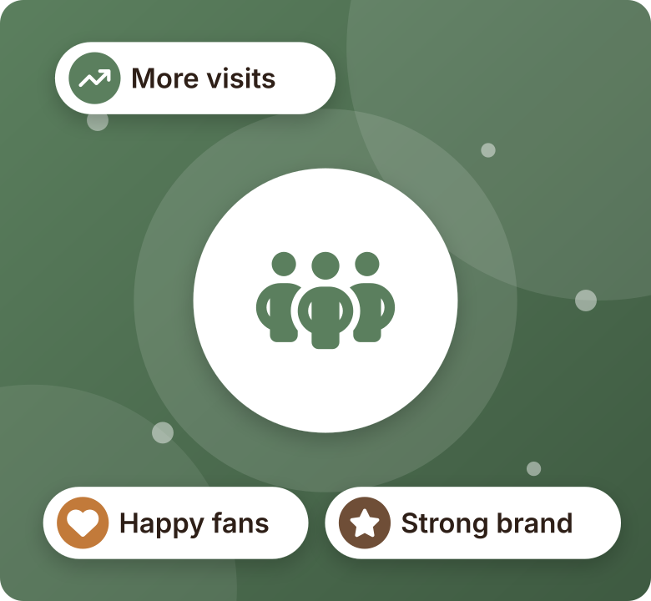



How the Café Benefits
07 BENEFITS
Reach more people
Attract new customers
Build a strong brand
Improve customer engagement
Better chance of higher sales
Notes:
Working with our agency will help the café:
- Reach more people.
- Attract new customers.
- Build a strong brand.
- Improve customer engagement.
- Increase the chance of higher sales.

Slide 9

Our Month-One Targets
08 EXPECTED RESULTS
40K+
+500
100+
+10
people nearby see The Daily Cup
new Instagram followers
messages, calls and direction requests
extra customers every day
You see every number, every week
A simple weekly report: reach, followers, messages, visits and sales
Targets are based on a 4,000 EGP monthly ad budget and are confirmed after the week-1 review.
Notes:
These are our targets for the first month:
- 40,000+ people in the area see The Daily Cup through ads and content.
- 500+ new Instagram followers.
- 100+ messages, calls and direction requests.
- 10 extra customers every day by the end of the month.
We don't hide anything: every week the owner receives a simple report with reach, followers, messages, visits and sales.
Targets are based on a 4,000 EGP monthly ad budget and are confirmed after we review the café's current numbers in week 1.

Slide 10
The Plan Pays for Itself
09 RETURN ON INVESTMENT
13,000 EGP
monthly investment
÷
100 EGP
profit per customer*
=
130
customers a month
Less than 5
extra customers a day covers the full cost. Our target is 10.
*Assumes an average bill of 150 EGP and about 65% margin after ingredients. At target: 10 customers × 30 days × 100 EGP = 30,000 EGP.
Notes:
This is the most important slide for the owner: the plan pays for itself.
- Each customer spends about 150 EGP. After ingredients, the café keeps about 100 EGP.
- 13,000 EGP divided by 100 EGP = 130 customers a month, which is less than 5 extra customers a day.
- Our target is 10 extra customers a day: 10 × 30 days × 100 EGP = about 30,000 EGP extra profit per month, more than double the cost.
Ask the owner: "Do you think 5 more customers a day is possible with better marketing?"

Slide 11



After the First Month
10 FUTURE WORK
Long-term strategy
Expand the best ads
Seasonal offers
Loyalty programs
Food influencers
Notes:
After the first month, we plan to:
- Work with local food influencers.
- Launch loyalty programs for regular customers.
- Create seasonal offers.
- Expand successful advertising campaigns.
- Develop a long-term marketing strategy.

Slide 12




Why Pulse Marketing
11 WHY CHOOSE US
Café specialists
Your own team
Weekly reports
We know what brings people into a café
A dedicated manager for The Daily Cup
See exactly what your money does
No long-term contract
Free audit
Reach guarantee
Month to month: stay because it works
A free review of your pages in week 1
Miss the reach target? An extra week of ads at no fee
Notes:
Why the owner should choose us:
- Café specialists: we focus on cafés and restaurants, so we know what brings people in.
- Your own team: one dedicated account manager for The Daily Cup.
- Weekly reports: the owner sees exactly what their money does.
The bottom row removes the risk for the owner:
- No long-term contract: month to month, they stay because it works.
- Free audit: we review their pages for free in week 1.
- Reach guarantee: if we miss the reach target, we run the ads for an extra week at no fee.

Slide 13
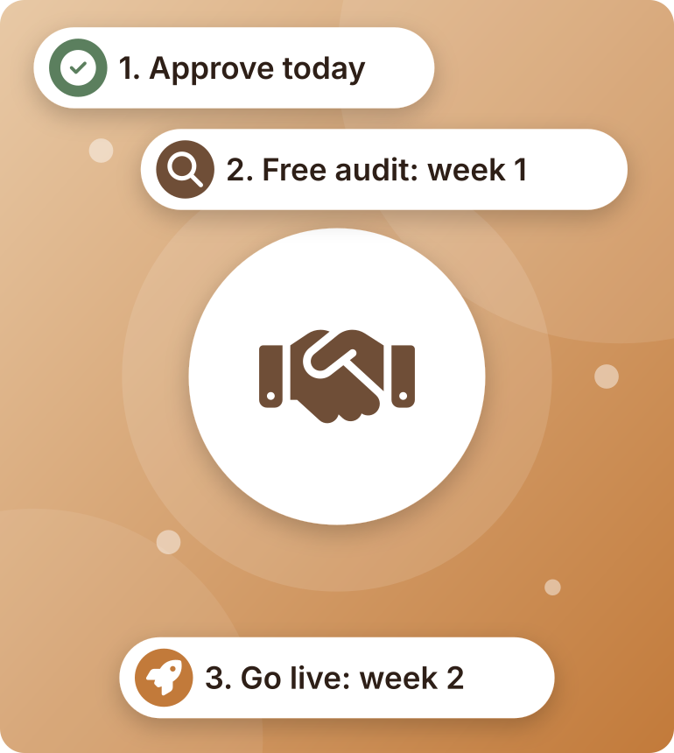
Let's Grow Together!
12 CONCLUSION
Start this month and see results within 30 days.
Start this month: free menu photo shoot
Pulse Marketing | [Phone] | [Email]
Notes:
Summary: The Daily Cup gets more visibility, more customers and more sales, and the plan pays for itself with less than 5 extra customers a day.
Clear next steps (shown on the right):
1. Approve the proposal today.
2. We do a free audit of the café's pages in week 1.
3. The first content and ads go live in week 2.
Bonus: if they start this month, they get a free professional photo shoot of the menu.
Our agency is ready to help The Daily Cup grow and reach more customers. Let's grow together!
Thank the owner and open for questions.

