Slide 1
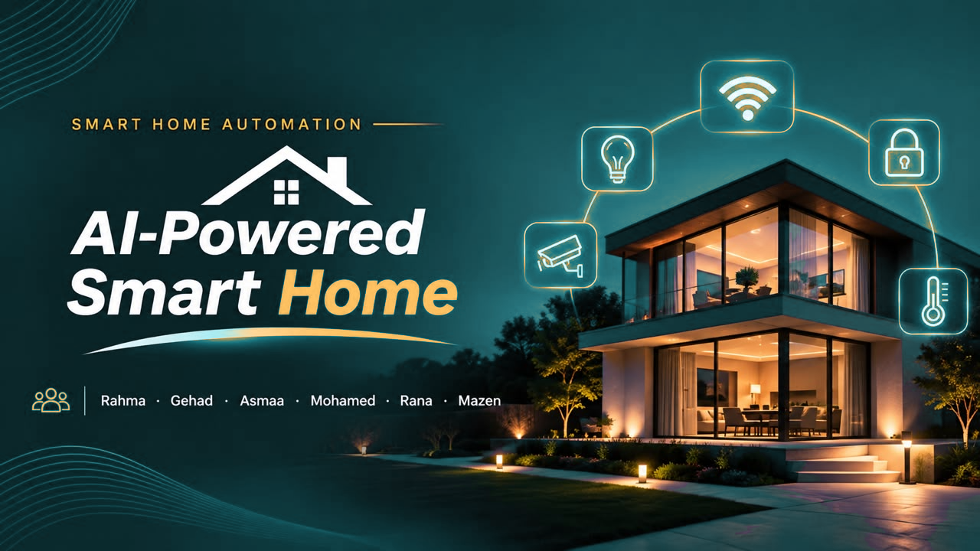

Slide 2

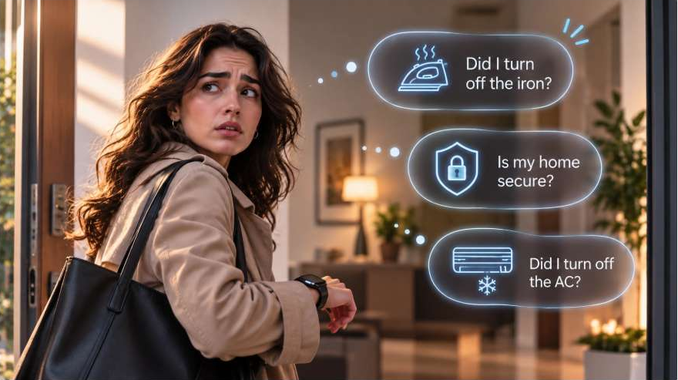
Ever Left Home With Doubts?

Slide 3
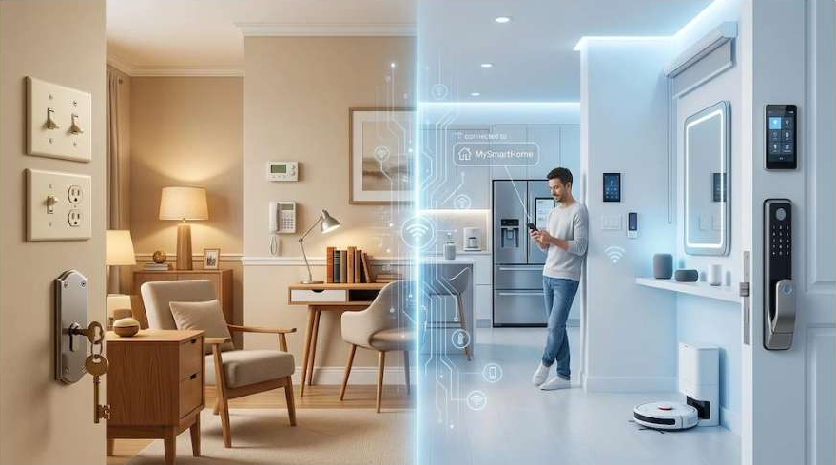
What if your home could take care of all these things for you?
Less worry.
More comfort.
Better control.

Slide 4
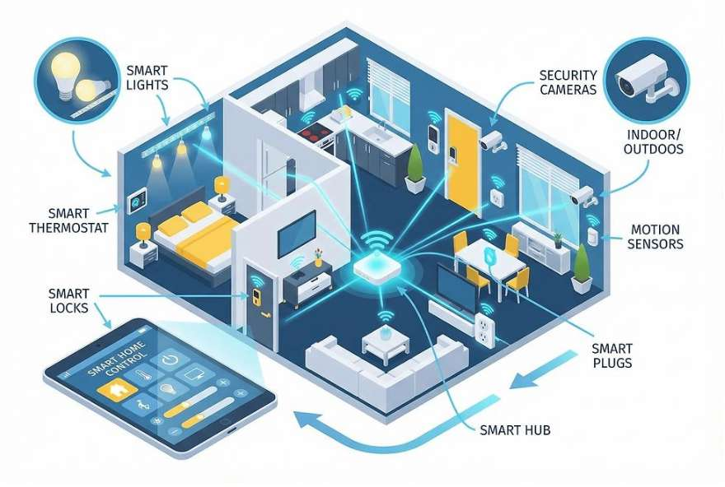
What Is a Smart Home?
A connected living environment where devices communicate and work together to provide automation, monitoring, and centralized control.
Automation
Monitoring
Centralized control

Slide 5
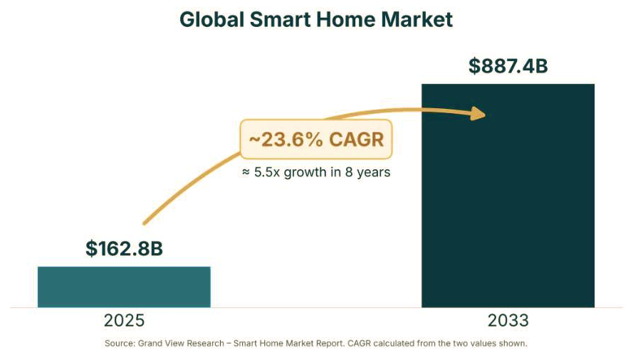
A Rapidly Growing Global Market

Slide 6

OUR PROJECT VISION
To transform everyday living into a smarter, safer, and more comfortable experience.

Slide 7





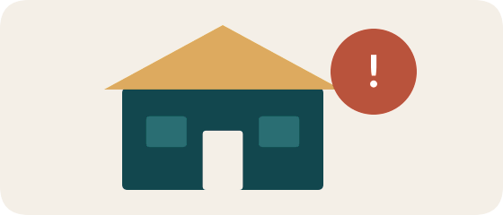

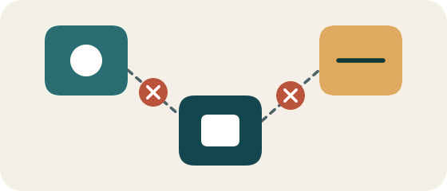
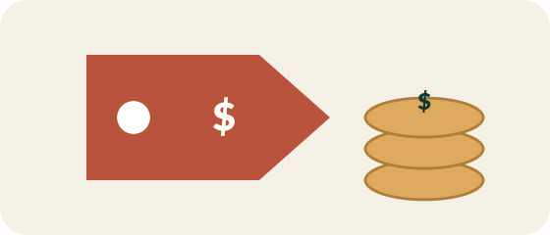

Problem Statement: Five Everyday Challenges
01
02
03
04
05
Security & Safety Concerns
Energy Inefficiency
Lack of Convenience & Control
Cost Worries
Hard to Adapt (Tech Fear)
People worry about their home when they are away.
Lights or air conditioning may stay on.
Separate devices are difficult to manage.
Fear that smart home systems are too expensive.
Fear that the technology is too complex to use.

Slide 8


Market Research: What Do Customers Value?
41%
37%
19%
chose saving money as a preferred outcome
chose safety and security
chose convenience and time savings
Source: ASHB / Harbor Research, 2024 – survey of 760 consumers

Slide 9





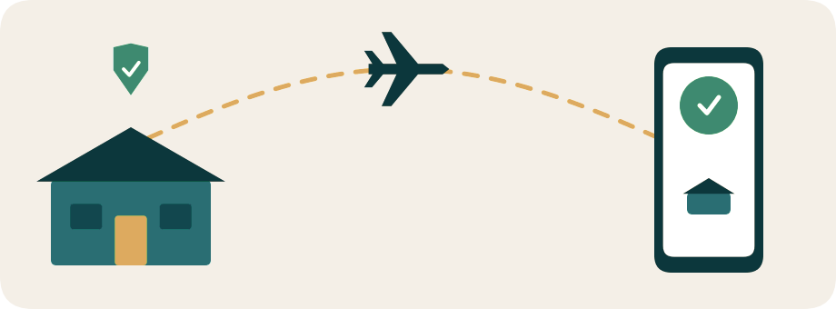
Target Audience
Primary Audience:
People planning or building a new home
Families with Children or Pets:
Need safety alerts and monitoring
People Who Travel Often:
Need remote access and peace of mind

Slide 10




Customer Needs: What Our Solution Must Deliver
Peace of Mind:
Real-time alerts and 24/7 monitoring
One Simple App:
Control the whole home from one place
Lower Bills:
Our goal: cut energy use by 30%
Safe Family:
Child and pet safety alerts

Slide 11






Our AI-Powered Smart Home Solution
Our Solution
An integrated smart home system.
AI-powered automation.
Centralized control through a mobile application.
Smart lighting, security, and climate control.
Voice commands and remote access.

Slide 12


Why Choose Our Solution?
Value Proposition
Convenience:
Easy control from anywhere.
Security:
Better home monitoring and protection.
Energy Efficiency:
Reduce unnecessary energy consumption.
Time Saving:
Automate daily activities.
Smart Living:
A more comfortable lifestyle.

Slide 13




Smart Lighting
Smart Lighting System
Automatic Control:
Lights turn on/off based on room occupancy.
Brightness Adjustment:
Control light intensity according to your needs.
Lighting Scenes:
Different settings for studying, relaxing, and entertainment.
Energy Saving:
Reduce unnecessary electricity consumption.
Remember:
Automatic – Brightness – Scenes – Energy Saving

Slide 14




Voice Control
Hands-Free Operation: Control devices using voice commands.
Simple Commands: Turn lights on/off or adjust temperature.
Example:
“Turn on the living room lights.”
Easy Interaction: No need to open the mobile application.
Convenience: Faster control, especially when your hands are busy.

Slide 15

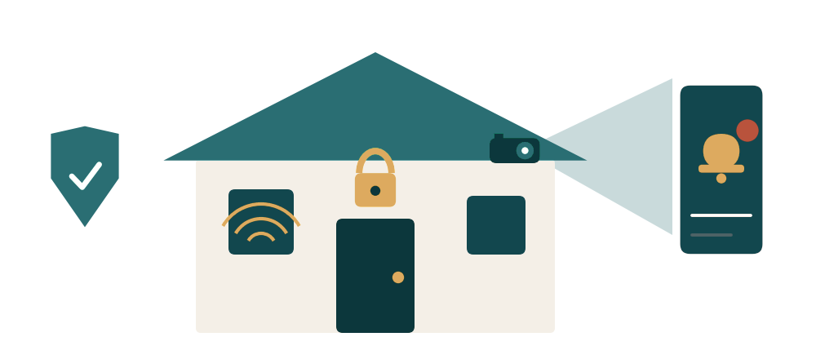

Smart Security
Smart Door Locks: Control and monitor door access.
Motion Sensors: Detect unexpected movements.
Security Cameras: Monitor your home remotely.
Remember:
Detect – Monitor – Alert – Protect
Instant Notifications: Receive alerts about suspicious activity.
Remote Monitoring: Check your home from anywhere.

Slide 16





Smart Climate Control
22°C
Temperature Management:
Adjust room temperature remotely.
Automatic Control:
Manage cooling based on user preferences.
Example:
Set the temperature to 22°C before arriving home.
Remote Access:
Prepare your home before arriving.
Energy Efficiency:
Avoid unnecessary cooling when nobody is home.

Slide 17



One Application – Complete Control
Mobile Application
Centralized Control: Manage all connected devices from one place.
Lighting Management: Turn lights on/off and adjust brightness.
Climate Management: Control air conditioning and temperature.
Security Monitoring: Check cameras and sensors.
Instant Notifications: Stay updated about your home.
Remote Access: Control your home from anywhere.
Key message
One application instead of multiple applications for different devices.

Slide 18
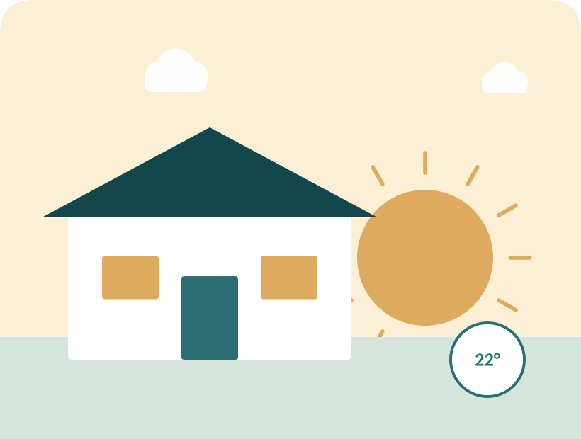
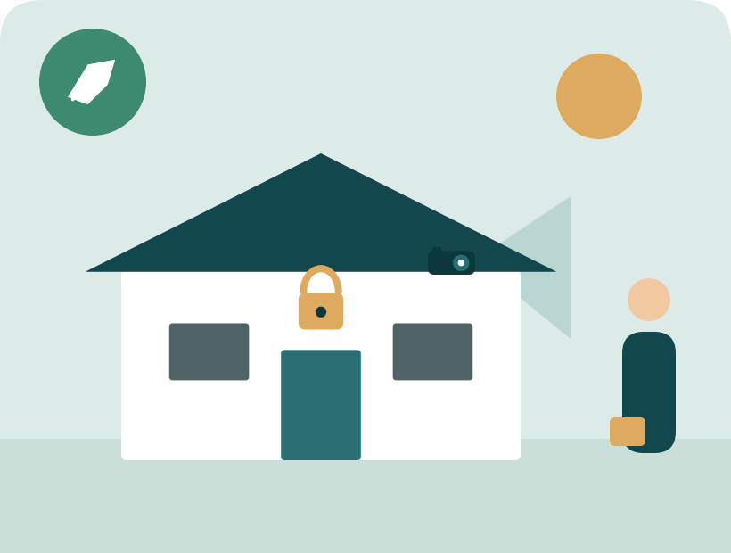
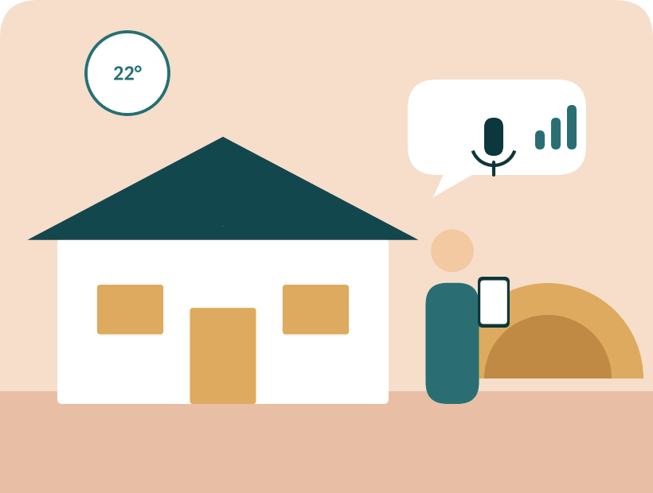
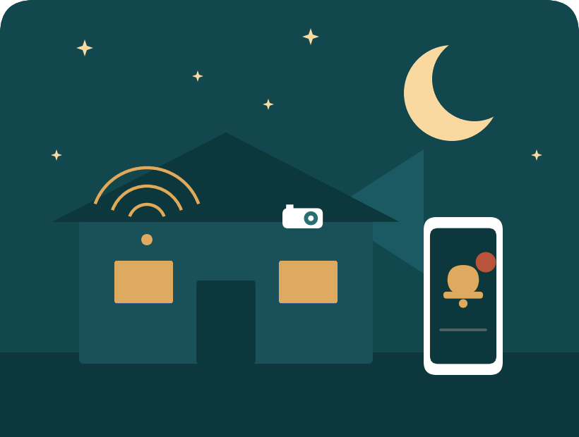
A Day in a Smart Home
MORNING
DAYTIME
EVENING
NIGHT
Lights turn on
Away from home
Welcome home
Safe all night
Lighting and climate are ready before you wake up.
Doors locked, cameras watching, nothing wasting energy.
Already 22°C. Control lights by voice or from the app.
Motion sensors detect movement and alert your phone.

Slide 19
Competitor Analysis: Market Overview
The smart home market is growing as customers look for convenient, secure, energy-efficient and automated homes.
OUR INTEGRATED SMART HOME SYSTEM COMBINES
Smart Lighting
Smart Security
Climate Control
Mobile Application
Voice Control
Centralized System Integration
Individuals and families looking for affordable, convenient and secure smart home solutions.
Target market

Slide 20
Direct & Indirect Competitors
1. Direct Competitors
2. Indirect Competitors
Provide smart home automation systems and integrated solutions.
Alternatives customers may choose instead of a complete system.
Aura Smart Home: Smart locks, lighting, climate control, wireless and KNX automation.
Vento Smart: Integrated lighting, security, climate, networking and automation.
Teknetic Egypt: Home automation, lighting, cameras, locks and climate control.
Yala: Home and business automation, security and climate control.
SONOFF: Affordable individual smart switches, sensors and lighting controllers.
Tuya Smart: Smart devices controlled through mobile applications.
Xiaomi Smart Home: Individual smart cameras, sensors and automation products.
Traditional Security Providers: Standalone CCTV, alarms and conventional security systems.

Slide 21
Our Competitive Advantage
“One Smart Home. One Connected System. Complete Control.”
01
All-in-One Solution
Lighting, security, climate control and voice commands in one system.
02
Cost-Effective Design
Essential smart home features at a competitive price.
03
Centralized Control
All connected devices managed through one mobile app.
04
Flexible Customization
Choose the features you need and expand later.
05
Security & Privacy
Cybersecurity built into the system architecture.
06
Local Technical Support
Installation help, maintenance and customer support.
Main differentiation: smart home technology that is more accessible without sacrificing integration, usability or security.

Slide 22
Marketing & Distribution Channels
Building awareness, demonstrating value, reaching customers
Social Media: Facebook, Instagram, TikTok and promo videos
Distribution Strategy
Website: Product info, features, pricing, online inquiries
Direct online sales.
Installation through our technical team.
Partnerships with electronics suppliers.
Collaboration with real estate developers and interior designers.
Demonstrations: Live demos and smart home prototypes
Real Estate Partnerships: Property developers and contractors
Electronics Retailers: Smart device and electronics stores
Direct Sales: Homeowners and businesses
Referral Marketing: Satisfied customers recommend the system

Slide 24


How Will We Make Money?
Business Model & Revenue Streams
Business Model:
Revenue Streams:
B2C – Selling directly to homeowners.
Installation and customization services.
Subscription-based services.
Smart devices and hardware sales.
Installation fees.
Monthly or yearly subscriptions.
Maintenance and technical support.
Additional smart home features.

Slide 25


Slide 26
Meet the Team
Team Member | Role
Eng. Mazen Adel | Project Manager
Eng. Mohamed Ayman | Software & Testing
Eng. Rahma Mohammed | Business Development
Eng. Rana Saber | Hardware & System Architecture
Eng. Gehad Mohammed | Security Engineer
Eng. Asmaa Khaled | Network & IoT

Slide 27


