Slide 1




FINAL PROJECT
Roaya
Smart City Transformation
A city that saves your time, your money, and your planet.
Notes:
PROJECT MANAGER · slide 1
Good morning, everyone. I'm Mai, the Project Manager of team Roaya.
🎬 ابتسم وبص للجنة، واتكلم براحة.
Every day, many of us lose time in traffic. Today, let me introduce you to someone who loses a lot more. His name is Ahmed.

Slide 2
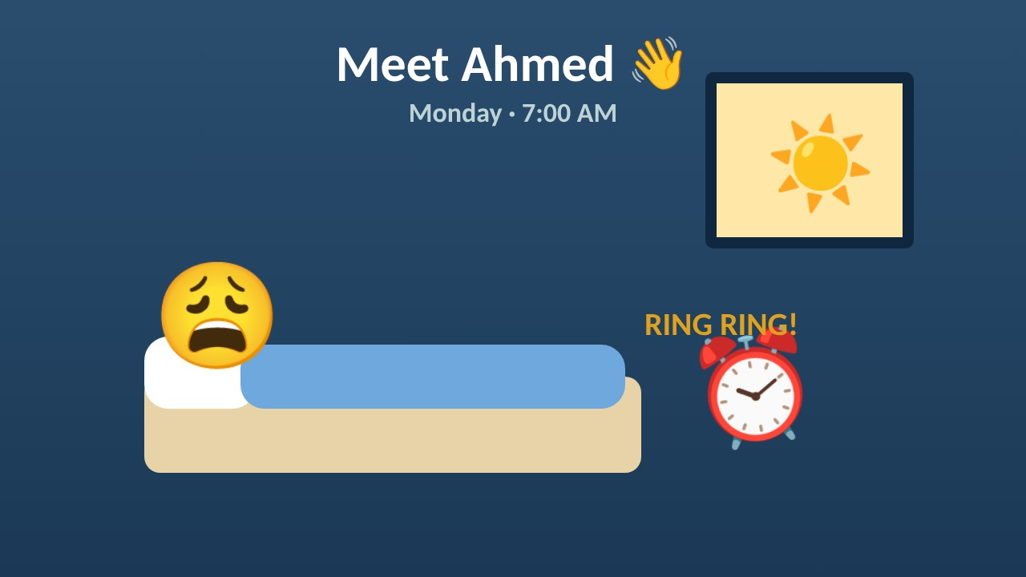
Notes:
PROJECT MANAGER · slide 2
🎬 الفيديو بيشتغل لوحده (دقيقة). اقف على جنب وبص على الشاشة معاهم.
Poor Ahmed! Traffic, a high bill, and a long line. That's why we started Roaya. Roaya means "vision" in Arabic.

Slide 3






OUR TEAM
Six managers, one vision
Mai Nasser Abubakr
Mariam Mahmoud Dabeesh
Rahma Khaled Ahmed
Project Manager
Planning Manager
Technical Manager
Charter & objectives
Schedule & milestones
Technology & resources
Moaz Hamed Ibrahim
Omnia Sayed Abdelhakim
Karim Mohamed Gad
Finance Manager
Risk & Quality Manager
Stakeholder Manager
Budget & funding
Risks & quality
Stakeholders & communication
Roaya · Smart City Transformation · 03
Notes:
PROJECT MANAGER · slide 3
We are six managers, and each of us will tell you about one part of the plan.
🎬 وإنت بتقول كل دور، صاحبه يرفع إيده ويبتسم.
Planning, Technical, Finance, Risk and Quality, and Stakeholders. And I'm the Project Manager.

Slide 4

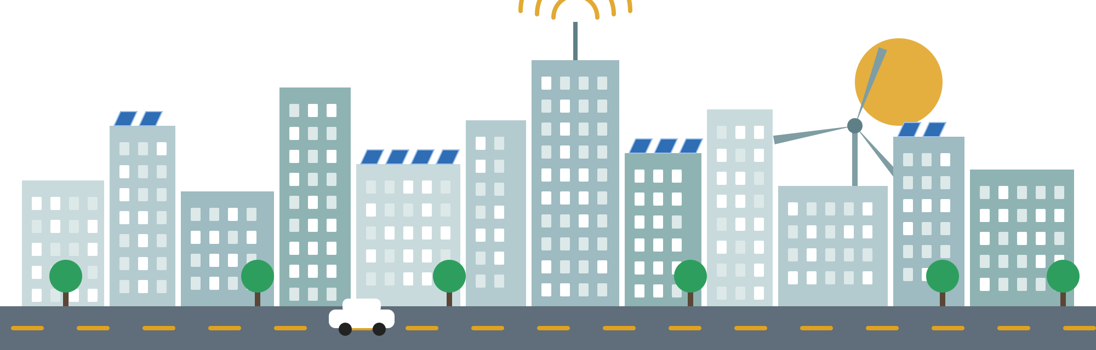

PROJECT CHARTER
Project Manager
Why Roaya?
Mai Nasser Abubakr
Easier
Make city life…
Less time in traffic
Safer
Faster emergency help
Greener
Clean solar energy
24 months
550M EGP
7 phases
6 deliverables
Roaya · Smart City Transformation · 04
Notes:
PROJECT MANAGER · slide 4
Why Roaya? To make city life easier, safer and greener.
Easier, because people spend less time in traffic. Safer, because help arrives faster. And greener, because the city uses clean solar energy.
The project takes 24 months and 550 million pounds, in 7 phases.

Slide 5







OBJECTIVES
Project Manager
What we will achieve
Mai Nasser Abubakr
−30%
−20%
15 min
50%
traffic jams
energy & water
to anywhere
solar power
8 min
20,000
Smart
80%
emergency response
new jobs
security
services online
Roaya · Smart City Transformation · 05
Notes:
PROJECT MANAGER · slide 5
We have eight clear goals. For example: 30% less traffic, half of our power from the sun, and emergency help in under 8 minutes.
🎬 شاور على هدف الـ 15 دقيقة على السلايد.
My favourite goal is this one: 15 minutes to anywhere in the city!
We will measure each goal in the pilot and at the end of the project.

Slide 6






SCOPE AND DELIVERABLES
Project Manager
Six things we will deliver
Mai Nasser Abubakr
D1
D2
D3
Current state assessment
Roadmap & business case
Integration architecture
Mar 2027
Jun 2027
Sep 2027
D6
D4
D5
Security & data governance
Pilot & KPI report
Scale-up & change plan
Sep 2027
Sep 2028
Oct 2028
Roaya · Smart City Transformation · 06
Notes:
PROJECT MANAGER · slide 6
Our work ends with six deliverables, from the first study in 2027 to the final plan in 2028. The sponsor approves each one before we move on.
➡️ So, when will all this happen? Our Planning Manager, Mariam, will tell you.

Slide 7



PROJECT SCHEDULE
Planning Manager
24 months, 7 phases
Mariam Mahmoud Dabeesh
2027
2028
Assessment
Roadmap
Design
Infrastructure
Testing
Pilot
Rollout
Roaya · Smart City Transformation · 07
Notes:
PLANNING MANAGER · slide 7
Thank you. I'm Mariam, the Planning Manager.
Building a city is like building a house: walls first, then the roof. So we work in 7 phases, over 24 months.
First, we study the city as it is today: the roads, energy, water and services. Then we decide what to build first and how much it costs, and we design how all the systems will connect.
In 2027, we study, plan and design. In 2028, we build, test, try it in one district, and then open it to the whole city.
Each phase has one owner, so we always know who is responsible.

Slide 8

MILESTONES
Planning Manager
Eight checkpoints to the finish
Mariam Mahmoud Dabeesh
Mar 2027
Sep 2027
Jun 2028
Oct 2028
Assessment
Architecture & security
Systems tested
Scale-up plan
Jun 2027
Mar 2028
Sep 2028
Dec 2028
Roadmap
Infrastructure ready
Pilot report
Project closure
Each checkpoint needs the sponsor’s approval before the next phase.
Roaya · Smart City Transformation · 08
Notes:
PLANNING MANAGER · slide 8
We have eight checkpoints. At each one, the sponsor must say yes before we continue.
In 2027, we finish the assessment, the roadmap and the design. In 2028, the infrastructure is ready, the systems are tested, and the pilot report is ready.
🎬 شاور على العلم الدهبي في الآخر.
And this gold flag is the finish line: December 2028.
Why checkpoints? Because they turn a two-year project into small goals that we can check. If something is late, we know early, and we can fix it.

Slide 9


PHASE 4 · INFRASTRUCTURE
Planning Manager
Inside the biggest phase
Mariam Mahmoud Dabeesh
Oct ’27
Nov
Dec
Jan ’28
Feb
Mar
Network & fiber
EGP 80M
Sensors & cameras
EGP 100M
Solar systems
EGP 45M
Contractors & buying
EGP 13M
6 months
238M EGP · 43% of budget
186 people at peak
Roaya · Smart City Transformation · 09
Notes:
PLANNING MANAGER · slide 9
The biggest phase is Phase 4: six months to build the network, the sensors, the cameras and the solar panels.
Up to 186 people work in this phase at the same time. It takes 43% of the budget, so we check it every week.
Every week, I update the Gantt chart and share a status report with the team. If anything is late, we write down the reason and fix it early, not at the end.
➡️ But what exactly will we build? Our Technical Manager, Rahma, will show you.

Slide 10




SMART TECHNOLOGY
Technical Manager
What we will build
Rahma Khaled Ahmed
IoT sensors
Smart cameras
Smart traffic lights
Measure traffic, energy & water
Keep our streets safe
Turn green when the road is empty
Solar energy
Control center
City app
Clean energy, lower bills
The brain of the city
City services on your phone
Roaya · Smart City Transformation · 10
Notes:
TECHNICAL MANAGER · slide 10
Thank you. I'm Rahma, the Technical Manager.
So now, think of a traffic light that knows the road is empty and turns green for you. That's the kind of city we're building.
To build this city, we will install sensors that measure traffic, energy and water, smart cameras that help keep our streets safe, and smart traffic lights. We will also use solar panels that give us clean energy and lower bills, and then connect everything through one control center and a city app.
➡️ So, how does it all work together?

Slide 11
HOW IT WORKS
Technical Manager
How it all connects
Rahma Khaled Ahmed
1 · Collect
2 · Send
3 · Decide
4 · Show
Sensors and cameras read the streets
The fiber network carries the data
The control center acts, like turning a light green
Citizens see the result in the city app
Example: the road is empty → the light turns green → you get home sooner.
Roaya · Smart City Transformation · 11
Notes:
TECHNICAL MANAGER · slide 11
Well, it works in four steps: first, sensors collect the data; then, the network sends it to the control center; after that, the control center analyzes the information and makes decisions; and finally, citizens see the result in the app.
🎬 شاوري على الـ 4 خطوات على السلايد وإنتي بتقوليهم، من الشمال لليمين.
In other words, the control center is the brain of the city.
And from the app, citizens can pay bills and renew documents from their phone.
For example, if there is an accident, the cameras see it, and the control center sends help faster.
So: when the road is empty, the system detects it, sends the information, and changes the traffic light to green.
The result? Less waiting, less traffic, and more time for everyone!
➡️ But to build all this, we need the right resources.

Slide 12




RESOURCE ALLOCATION
Technical Manager
Our five resources
Rahma Khaled Ahmed
People
Materials
Equipment
Money
Time
186 at peak
(incl. 6 managers)
Fiber, cables,
manuals
Sensors, cameras,
servers
EGP 550M
24 months
Roaya · Smart City Transformation · 12
Notes:
TECHNICAL MANAGER · slide 12
So now, let's look at our resources. We need five types.
First, people: around 186 in the infrastructure phase. They include engineers, technicians, software and cybersecurity experts.
Second, materials, like cables.
Third, equipment, like cameras, smart meters, and servers.
And finally, money and time.
➡️ Now, let's talk about the budget. Our Finance Manager, Moaz, will tell you.

Slide 13
BUDGET
Finance Manager
Where the money goes
Moaz Hamed Ibrahim
550M
EGP total budget
including a 50M backup
Roaya · Smart City Transformation · 13
Notes:
FINANCE MANAGER · slide 13
Thank you. I'm Moaz, the Finance Manager.
Many of us pay high electricity bills. Solar energy will help with that.
Our budget is 550 million pounds. Almost half goes to infrastructure, and we keep 50 million as a backup.
To be exact: 250 million for infrastructure, 150 million for software and the control center, 60 million for cybersecurity, and 40 million for training.
The 50 million backup is about 10% of the budget, for anything unexpected, like higher prices.

Slide 14


BUDGET BY PHASE
Finance Manager
When we spend it
Moaz Hamed Ibrahim
43%
goes to Phase 4, infrastructure
Every month: budget vs. actual
More than 10% over plan? We flag it.
Roaya · Smart City Transformation · 14
Notes:
FINANCE MANAGER · slide 14
Most of the money goes to Phase 4, the building phase. Every month, I compare what we spent with the plan. If we spend more than 10% over the plan, we act at once.
The first three phases are study and design, so together they cost only about 42 million.
Testing takes 120 million, the pilot 43 million, and the rollout to the whole city 57 million.
🎬 موقف قصير: احكيه بهدوء.
For example, if prices go up, we use the backup money, and we delay the less important work.
And before we buy anything, I check the suppliers, to make sure they are reliable.

Slide 15







FUNDING AND REVENUE
Finance Manager
Where the money comes from
Moaz Hamed Ibrahim
FUNDING
REVENUE
Government budget
Land & offices
Transport tickets
Selling solar energy
Investors & partners
50M backup
Data center space
Smart services
Roaya · Smart City Transformation · 15
Notes:
FINANCE MANAGER · slide 15
The money comes from the government and from investors. And the city also earns money: from offices, tickets, and selling solar energy. So the city doesn't depend only on the government.
The main budget, 500 million, comes from the government, and investors and private partners add extra funding.
The city can also rent space in its data center, and charge for smart services, like smart parking.
Investors want to know how they get their money back, and this plan shows them.
Every month, I send a budget report to the sponsor and the investors.
➡️ But every big project has risks. Our Risk and Quality Manager, Omnia, will explain.

Slide 16

RISK MANAGEMENT
Risk & Quality Manager
Our top risks
Omnia Sayed Abdelhakim
15
12
12
12
Cyberattack
Device failure
Budget overrun
Data privacy
Firewalls + 24/7 monitoring
Test first, keep spares
Monthly review + backup
Clear privacy policy
Score = probability × impact. High risks are reviewed every week.
Roaya · Smart City Transformation · 16
Notes:
RISK & QUALITY MANAGER · slide 16
Thank you. I'm Omnia, the Risk and Quality Manager.
We have four big risks: a cyberattack, device failure, going over budget, and data privacy. For each one, we have a plan.
We score each risk with a simple rule: how likely it is, times how big the damage is.
For the cyberattack, we use firewalls and 24/7 monitoring. For devices, we test them first and keep spare units. For the budget, we review costs every month. And for privacy, we follow the data protection law.
We review the high risks every week.
➡️ So, where do our risks sit?

Slide 17
RISK MATRIX
Risk & Quality Manager
Where our risks sit
Omnia Sayed Abdelhakim
R1
R1
Cyberattack
15
R5
R3 R4
R2
Device failure
12
R3
Budget overrun
12
Impact ↑
R6 R7
R2
R4
Data privacy
12
R6
Supplier delays
9
R7
Low app use
9
R5
Slow approvals
8
Probability →
Roaya · Smart City Transformation · 17
Notes:
RISK & QUALITY MANAGER · slide 17
This is our risk matrix. The darker the color, the bigger the danger.
🎬 شاور على R1 في الجدول. موقف قصير: عدّ الخطوات على صوابعك (1، 2، 3).
For example, if hackers attack the city: first, we stop the attacked system. Second, our security team fixes it. Third, we tell the people. No panic: we have a plan.
Each high risk has a clear trigger and a plan. For example, if more than 5% of the devices fail in one area, we replace them with spare units.
The lighter area is moderate risk, like supplier delays. We review those every month.
➡️ Managing risks is one half. The other half is quality.

Slide 18




QUALITY ASSURANCE
Risk & Quality Manager
How we protect quality
Omnia Sayed Abdelhakim
99%
85%
system uptime
citizen satisfaction
Checklist
Test
Fix issues
Final test
Approve
Roaya · Smart City Transformation · 18
Notes:
RISK & QUALITY MANAGER · slide 18
For quality, we have two goals: the system works 99% of the time, and 85% of people are happy.
We test everything before it goes live. If we find a problem, we write it down and fix it at once.
Quality control has five simple steps: checklists, testing, fixing issues, a final test, and then the Project Manager's approval. And all equipment must meet safety and cybersecurity standards.
We also check quality in every phase: design, installation, testing, and the pilot.
➡️ Now, let's talk about the people. Our Stakeholder Manager, Karim.

Slide 19

STAKEHOLDERS
Stakeholder Manager
Everyone we work with
Karim Mohamed Gad
Government
Citizens
Investors
Roaya
Utilities
Tech providers
Contractors
Roaya · Smart City Transformation · 19
Notes:
STAKEHOLDER MANAGER · slide 19
Thank you. I'm Karim, the Stakeholder Manager.
We can build the smartest city in the world, but if people don't use it, it fails.
We work with the government, investors, tech companies, contractors, and utilities. But the most important are the citizens, people like Ahmed.
If citizens don't use the app, all our work is wasted.
➡️ But not all of them need the same attention.

Slide 20
STAKEHOLDER MAP
Stakeholder Manager
Power and interest
Karim Mohamed Gad
High
power
KEEP SATISFIED
MANAGE CLOSELY
Utilities
Government
Investors
Citizens
Low
power
MONITOR
KEEP INFORMED
Contractors
Tech providers
Low interest
High interest
Roaya · Smart City Transformation · 20
Notes:
STAKEHOLDER MANAGER · slide 20
So we put them on a map. The government, investors and citizens get the most attention. Utilities, we keep happy. And contractors and tech companies, we keep informed.
Utilities need to know early, because our work touches their water and power networks.
➡️ And to keep all these people on board, we need good communication.

Slide 21


COMMUNICATION PLAN
Stakeholder Manager
How we stay in touch
Karim Mohamed Gad
Weekly
Every 2 weeks
Monthly
Monthly
24 hours
Team meeting
Contractors
Sponsor & investors
Citizens: app & social media
Critical issues to sponsor
Roaya · Smart City Transformation · 21
Notes:
STAKEHOLDER MANAGER · slide 21
The team meets every week and contractors every two weeks; the sponsor, investors, and citizens get monthly updates, and any serious problem reaches the sponsor within 24 hours.
🎬 امسكي البروشور وارفعيه، وبعد الجملة اديه للجنة.
This is our brochure for citizens: simple words, in Arabic and English.
And before any work in the streets, we tell people at least one week before.
➡️ Before we finish, here is what we learned.

Slide 22

LESSONS LEARNED
Stakeholder Manager
What we learned
Karim Mohamed Gad
Start approvals early
Security from day one
Pilot first
Keep citizens involved
In phases 1 and 2
Starting at the design phase
One district, then the whole city
So they really use the services
Roaya · Smart City Transformation · 22
Notes:
STAKEHOLDER MANAGER · slide 22
Four lessons: start early, think about security from day one, test small first, and keep people involved.
And we write down the lessons at the end of each phase, so we can do better next time.
➡️ So, what does all this mean for Ahmed?

Slide 23

ROAYA ·
Thank you
Smart, green and connected.
Scan for all our files
Notes:
STAKEHOLDER MANAGER · slide 23
With Roaya, his Monday becomes a lot easier.
The traffic light turns green for him, he renews his ID from his phone, and his bills are lower.
You can scan the QR code to see all our files. Thank you for listening.
🎬 الفريق كله يقف جنب بعض ويبتسم، وممكن تنحنوا خفيف.

