Slide 1

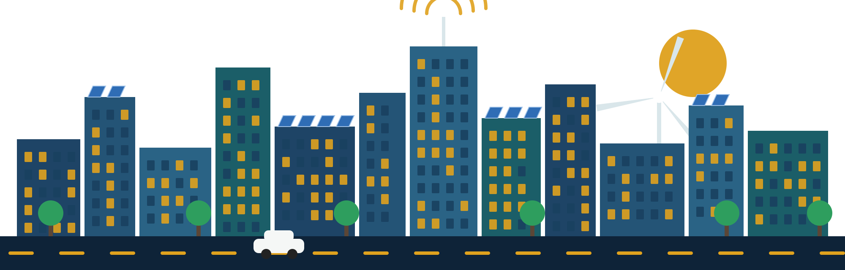
FINAL PROJECT
Roaya
Smart City Transformation
A city that saves your time, your money, and your planet.
Notes:
PROJECT MANAGER · slide 1
Good morning, everyone, and thank you for being here. I'm [Name], the Project Manager of team Roaya.
Roaya is an Arabic word. It means vision. And our vision is simple: to take a normal city and turn it into a smart, green and connected city.
A city that saves your time, your money, and your planet.
But before we talk about plans and numbers, let me introduce you to someone. His name is Ahmed.

Slide 2
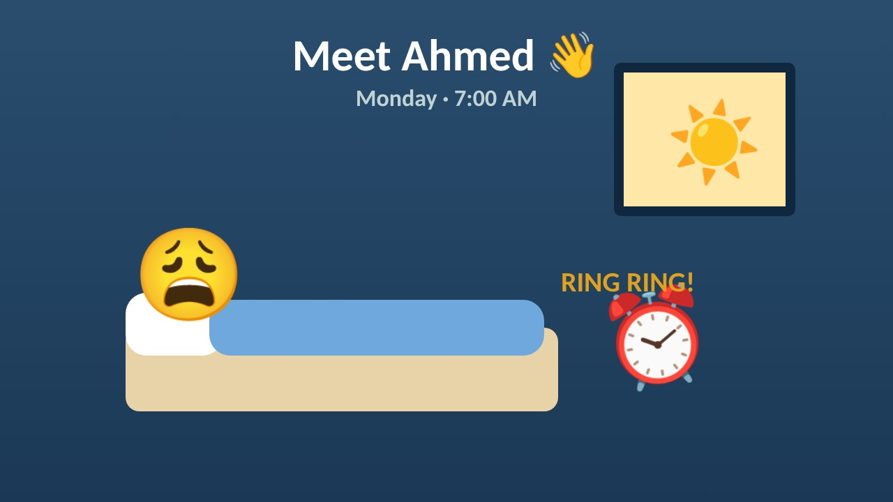
Notes:
PROJECT MANAGER · slide 2
(The video plays by itself, about one minute. Wait until it ends.)
Poor Ahmed. Traffic, a big electricity bill, and a long line just to renew his ID. Many of us have lived a Monday like this. That's exactly why we started Roaya.

Slide 3






OUR TEAM
Six managers, one vision
Project Manager
Planning Manager
Technical Manager
Charter & objectives
Schedule & milestones
Technology & resources
Finance Manager
Risk & Quality Manager
Stakeholder Manager
Budget & funding
Risks & quality
Stakeholders & communication
Roaya · Smart City Transformation · 03
Notes:
PROJECT MANAGER · slide 3
We are six managers, and each of us owns one part of the plan.
I will present the charter and the objectives. Then our Planning Manager will show the schedule, our Technical Manager the technology and resources, our Finance Manager the budget, our Risk and Quality Manager the risks and quality, and our Stakeholder Manager the people and communication.

Slide 4

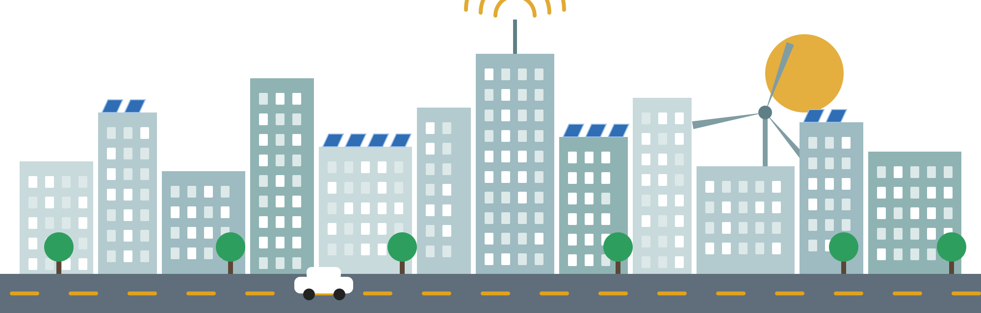

PROJECT CHARTER
Project Manager
Why Roaya?
Easier
Make city life…
Less time in traffic
Safer
Faster emergency help
Greener
Clean solar energy
24 months
550M EGP
7 phases
6 deliverables
Roaya · Smart City Transformation · 04
Notes:
PROJECT MANAGER · slide 4
So, why Roaya? Our purpose is to use technology to make city life easier, safer and greener, and to give citizens better public services.
Easier, because people spend less time in traffic, and many services move online.
Safer, because smart cameras and a control center help emergency teams arrive faster.
Greener, because the city gets a big part of its power from clean solar energy.
Here are the main facts. The project takes 24 months, from January 2027 to December 2028. The total budget is 550 million Egyptian pounds. The work is split into 7 phases, and it ends with 6 deliverables. Each phase ends with a milestone that our sponsor approves before the next one starts.
We also expect a big impact: a better quality of life, a cleaner environment with less pollution, and new jobs and investment in technology.

Slide 5







OBJECTIVES
Project Manager
What we will achieve
−30%
−20%
15 min
50%
traffic jams
energy & water
to anywhere
solar power
8 min
20,000
Smart
80%
emergency response
new jobs
security
services online
Roaya · Smart City Transformation · 05
Notes:
PROJECT MANAGER · slide 5
A vision is nice, but we need clear targets. So we set eight objectives that we can measure.
First, 30% less traffic within two years. Second, 20% less energy and water use. Third, you can reach anywhere in the city in under 15 minutes. Fourth, half of the city's power comes from the sun.
Fifth, a safe city: emergency help arrives in under 8 minutes. Sixth, 20,000 new jobs. Seventh, better security systems. And eighth, 80% of government services online by the end of 2028. So Ahmed can renew his ID from his couch.
We measure the starting point in the first phase, and we report the results in the pilot report and at the end of the project.
➡️ Now, how do we get there in 24 months? Our Planning Manager, [Name], will show you the schedule.

Slide 6







PROJECT SCHEDULE
Planning Manager
24 months, 7 phases
2027
2028
Assessment
Roadmap
Design
Infrastructure
Testing
Pilot
Rollout
Roaya · Smart City Transformation · 06
Notes:
PLANNING MANAGER · slide 6
Thank you. I'm [Name], the Planning Manager.
Building a smart city is like building a house: you can't put the roof before the walls. So we planned the work step by step, in 7 phases over 24 months.
Phase 1 is the assessment, from January to March 2027. We study the city as it is today: roads, energy, water and services.
Phase 2 is the roadmap and business case, from April to June. Here we decide what to build first and how much it costs.
Phase 3 is the design, from July to September. We design how all the systems will connect, and how we will protect them.
Phase 4 is infrastructure, and it's the biggest one. It takes six months, from October 2027 to March 2028. This is where we lay the fiber network, install sensors and cameras, and set up the solar panels.
Phase 5 is integration and testing, from April to June 2028. We connect everything to the control center and test it.
Phase 6 is the pilot. For three months we run the smart city in one district only, and we learn from it.
And Phase 7, from October to December 2028, is the rollout to the whole city, with staff training and closing the project.
Each phase has one main owner. The Project Manager leads the first and the last phase, the Finance Manager leads the roadmap and business case, and the Technical Manager leads the four phases in the middle: design, infrastructure, testing and the pilot.

Slide 7

MILESTONES
Planning Manager
Eight checkpoints to the finish
Mar 2027
Sep 2027
Jun 2028
Oct 2028
Assessment
Architecture & security
Systems tested
Scale-up plan
Jun 2027
Mar 2028
Sep 2028
Dec 2028
Roadmap
Infrastructure ready
Pilot report
Project closure
Each checkpoint needs the sponsor’s approval before the next phase.
Roaya · Smart City Transformation · 07
Notes:
PLANNING MANAGER · slide 7
To keep the project on track, we have eight milestones. Think of them as checkpoints on a road.
In 2027 we have three: the assessment in March, the roadmap in June, and the architecture and security framework in September.
In 2028 we have five: the infrastructure is ready in March, the systems are tested in June, the pilot report is ready in September, the scale-up plan in October, and the project closes in December.
At each checkpoint, the sponsor must approve our work before we start the next phase. This protects us from building on a weak base.
Why milestones? Because they turn a two-year project into small goals that we can check. If a milestone is late, we know early, and we can act before the delay grows.
Every week I update the Gantt chart and share a status report with the team. If anything is late, we write down the reason and fix it early, not at the end.
The full task list and the Gantt chart are in our schedule file, and you can find it with the QR code at the end.
➡️ We know when. But what exactly will we build? Our Technical Manager, [Name], will tell you.

Slide 8




SMART TECHNOLOGY
Technical Manager
What we will build
IoT sensors
Smart cameras
Smart traffic lights
Solar energy
Control center
City app
Roaya · Smart City Transformation · 08
Notes:
TECHNICAL MANAGER · slide 8
Thank you. I'm [Name], the Technical Manager.
Think of a traffic light that knows the road is empty and turns green for you. That's the kind of city we're building.
We will install sensors, smart cameras, and smart traffic lights, use solar energy, and connect everything through one control center and a city app.
Let me explain each one in simple words.
Sensors are small devices on roads, pipes and buildings. They measure traffic, energy and water all day.
Smart cameras help keep the streets safe, and they tell the control center when something is wrong.
Smart traffic lights change by themselves, depending on the real traffic. This is how we cut traffic jams.
Solar panels give the city clean energy, and they lower the bills for families like Ahmed's.
The control center is the brain of the city. All the data comes here, in one place, so the team can see the whole city on one screen and act fast.
And the city app is for citizens. From their phone, they can pay bills, renew documents and get news about the city.
As Technical Manager, I also follow four of our success measures: energy and water use, the share of solar power, emergency response time, and services online.
➡️ But to build all this, we need the right resources.

Slide 9




RESOURCE ALLOCATION
Technical Manager
Our five resources
People
Materials
Equipment
Money
Time
186 at peak
(incl. 6 managers)
Fiber, cables,
manuals
Sensors, cameras,
servers
EGP 550M
24 months
Roaya · Smart City Transformation · 09
Notes:
TECHNICAL MANAGER · slide 9
We need five types: people, around 186 in the infrastructure phase, materials like cables, equipment like cameras, money, and time.
Let's start with people. We have our six managers, plus engineers, technicians, software and cybersecurity specialists, trainers, and contractor crews. About 120 of the 186 are contractor crews.
Materials are things we use up, like fiber cables, construction materials and training manuals.
Equipment is what we install and use: sensors, cameras, smart meters, solar systems, servers and field vehicles.
Money is 550 million pounds, and time is 24 months.
Some of this we already have. Our six managers are ready, and the city already has about 300 cameras and 120 kilometres of fiber.
But we still have gaps. For engineers and technicians, we have 5 of the 46 we need. For software, data and cybersecurity, we have 1 of 21. And we have no contractor crews yet, so we will get 120 people through infrastructure contractors. Sensors, solar systems and the control center will come through our technology and energy partners.
Every task in our plan has one owner, a time, the resources it needs, and a budget. So nothing is left without a responsible person.
➡️ So, how much does all this cost? Our Finance Manager, [Name], will tell you.

Slide 10
BUDGET
Finance Manager
Where the money goes
550M
EGP total budget
including a 50M backup
Roaya · Smart City Transformation · 10
Notes:
FINANCE MANAGER · slide 10
Thank you. I'm [Name], the Finance Manager.
Let's talk about money. Our total budget is 550 million Egyptian pounds.
The biggest part, 250 million, goes to infrastructure: sensors, networks and cameras. That's almost half of the budget.
150 million goes to software, the apps and the control center.
60 million goes to cybersecurity, because a smart city must also be a safe city online.
And 40 million goes to training and awareness, so that staff and citizens know how to use the new services.
That's 500 million for the main work. On top of it, we keep 50 million, about 10%, as a backup budget for anything unexpected, like higher prices.
To give you a feeling of the numbers: the sensors and cameras alone cost 100 million, the network and fiber 80 million, and the control center and online services another 100 million.
When do we spend it? Most of the money is spent in Phase 4, infrastructure: 238 million, about 43% of the budget.
And how do we control it? Every month I compare the actual spending with the plan, and I send a report to the sponsor and the investors. If anything is more than 10% over plan, we flag it and act immediately.
If spending goes more than 10% over plan, we can release the backup budget and delay low-priority work.
And before we buy anything, I evaluate the suppliers, to check their quality and reliability. In Phase 4, I also manage the contractors and the buying, with contracts that have clear deadlines.

Slide 11







FUNDING AND REVENUE
Finance Manager
Where the money comes from
FUNDING
REVENUE
Government budget
Land & offices
Transport tickets
Selling solar energy
Investors & partners
50M backup
Data center space
Smart services
Roaya · Smart City Transformation · 11
Notes:
FINANCE MANAGER · slide 11
Now, where does the money come from? The main budget, 500 million, comes from the government. Investors and private partners add extra funding. And we keep the 50 million backup.
But a smart city doesn't only spend money. It also earns money, and we have five sources of revenue.
First, selling and renting land, offices and homes. Second, transport tickets and highway tolls. Third, selling extra solar energy to the national grid. Fourth, renting space in our data center. And fifth, fees for smart services, like smart parking and ads on smart screens.
So the city doesn't depend only on the government budget.
Why is this important? Because investors want to know how they get their money back. And our revenue plan shows them that a smart city is not only a cost; it is also an investment.
I also follow one of our success measures: creating 20,000 new jobs.
➡️ Of course, any big project has risks. Our Risk and Quality Manager, [Name], will show you how we handle them.

Slide 12



RISK MANAGEMENT
Risk & Quality Manager
Our top risks
15
12
12
12
Cyberattack
Device failure
Budget overrun
Data privacy
Firewalls + 24/7 monitoring
Test first, keep spares
Monthly review + backup
Clear privacy policy
Score = probability × impact. High risks are reviewed every week.
Roaya · Smart City Transformation · 12
Notes:
RISK & QUALITY MANAGER · slide 12
Thank you. I'm [Name], the Risk and Quality Manager.
No project goes exactly as planned. So instead of hoping nothing goes wrong, we prepare.
We score each risk with a simple formula: probability times impact, each from 1 to 5. A score of 12 or more is a high risk. High risks have a contingency plan, and we review them every week.
We have four high risks.
The first and the biggest is a cyberattack, with a score of 15. If hackers attack the control center, the whole city is affected. So we use firewalls, 24/7 monitoring and regular security testing. And if an attack happens, we isolate the affected systems and inform the authorities and the citizens.
The second is device failure. Sensors or cameras may stop working. So we test devices before we install them, and we keep spare units. If more than 5% of devices fail in one area, we replace them and switch to manual operation until it's fixed.
The third is a budget overrun. We review costs every month, and we have the 50 million backup.
The fourth is data privacy. People may worry about cameras and their personal data. So we follow the data protection law and publish a clear privacy policy.
Each risk also has an owner and a strategy. Most of the time we reduce the risk. For data privacy, we avoid it, by removing the cause. And for supplier delays, we transfer it, by putting penalties in the contracts.
We also have three moderate risks: supplier delays, low use of the app, and slow government approvals. We review them every month, we update the risk register every month, and at the end of each phase we do a full review to find new risks.

Slide 13




QUALITY ASSURANCE
Risk & Quality Manager
How we protect quality
99%
85%
system uptime
citizen satisfaction
Checklist
Test
Fix issues
Final test
Approve
Roaya · Smart City Transformation · 13
Notes:
RISK & QUALITY MANAGER · slide 13
Now, quality. For us, quality means two clear targets: the systems work 99% of the time, and at least 85% of citizens are satisfied during the pilot.
We protect quality in five steps. First, we use checklists for the design, the installation and the systems. Second, we test every system before it goes live. Third, if we find any issue, we record it in the quality log and fix it immediately. Fourth, we run a final test before the pilot and before the city-wide launch. And fifth, the Project Manager gives the final approval.
All equipment must meet safety, electrical and cybersecurity standards, and citizen data must follow the data protection law.
We also check quality in every phase: a design review in Phase 3, an installation inspection in Phase 4, system and security testing in Phase 5, and citizen feedback in the pilot.
➡️ Now, let's talk about the people behind the project. Our Stakeholder Manager, [Name], will tell you more.

Slide 14

STAKEHOLDERS
Stakeholder Manager
Everyone we work with
Government
Citizens
Investors
Roaya
Utilities
Tech providers
Contractors
Roaya · Smart City Transformation · 14
Notes:
STAKEHOLDER MANAGER · slide 14
Thank you. I'm [Name], the Stakeholder Manager.
We can build the smartest city in the world, but if people don't use it, it fails.
We work with the government, investors, tech companies, contractors, and utilities. But the most important are the citizens, people like Ahmed.
A stakeholder is anyone who affects the project, or is affected by it. Let me tell you why each one matters.
The government gives the approvals and most of the budget. Investors bring extra money. Tech companies provide the devices and the software. Contractors do the work in the streets. And utility companies run the electricity and water networks that we connect to.
And the citizens are the reason for the project. If they don't trust it or don't use the app, all our work is wasted. That's why one of our risks is low use of the new services. To avoid it, we run awareness campaigns, keep the app easy, and offer training sessions.
In the pilot, we also collect citizens' feedback, and our target is at least 85% satisfaction.
➡️ And to keep all these people on board, we need good communication.

Slide 15


COMMUNICATION PLAN
Stakeholder Manager
How we stay in touch
Weekly
Every 2 weeks
Monthly
Monthly
24 hours
Team meeting
Contractors
Sponsor & investors
Citizens: app & social media
Critical issues to sponsor
Roaya · Smart City Transformation · 15
Notes:
STAKEHOLDER MANAGER · slide 15
The team meets every week and contractors every two weeks; the sponsor, investors, and citizens get monthly updates, and any serious problem reaches the sponsor within 24 hours.
Our rule is simple: every update has one owner, a fixed time, and a clear channel.
For example, the sponsor gets a monthly progress report by email and a review meeting. Investors get a monthly budget report. And contractors meet the Technical Manager on site or on a video call.
For citizens, we use social media, the city app and the project website, in simple Arabic and English. And before any work in the streets, like cutting water or electricity, we tell people at least one week before.
And when there is a problem, we know who to call. Small issues are solved in the weekly team meeting. Delays, budget problems or high risks go to the Project Manager within two working days. And a serious problem, like a security incident, reaches the sponsor within 24 hours.
➡️ So, what does all this mean for Ahmed?

Slide 16

ROAYA ·
Thank you
Smart, green and connected. Questions?
Scan for all our files
Notes:
STAKEHOLDER MANAGER · slide 16
With Roaya, his Monday becomes a lot easier.
The traffic light turns green for him, and he gets to work in 14 minutes. His electricity bill is lower, thanks to the solar panels. He renews his ID from his phone. And at night, his street is safe, and help arrives in under 8 minutes.
To sum up, Roaya is a 24-month plan, with a budget of 550 million pounds, to make a normal city smart, green and connected.
You can scan the QR code to see all our files. Thank you for listening, and we're happy to answer your questions.

