Slide 1

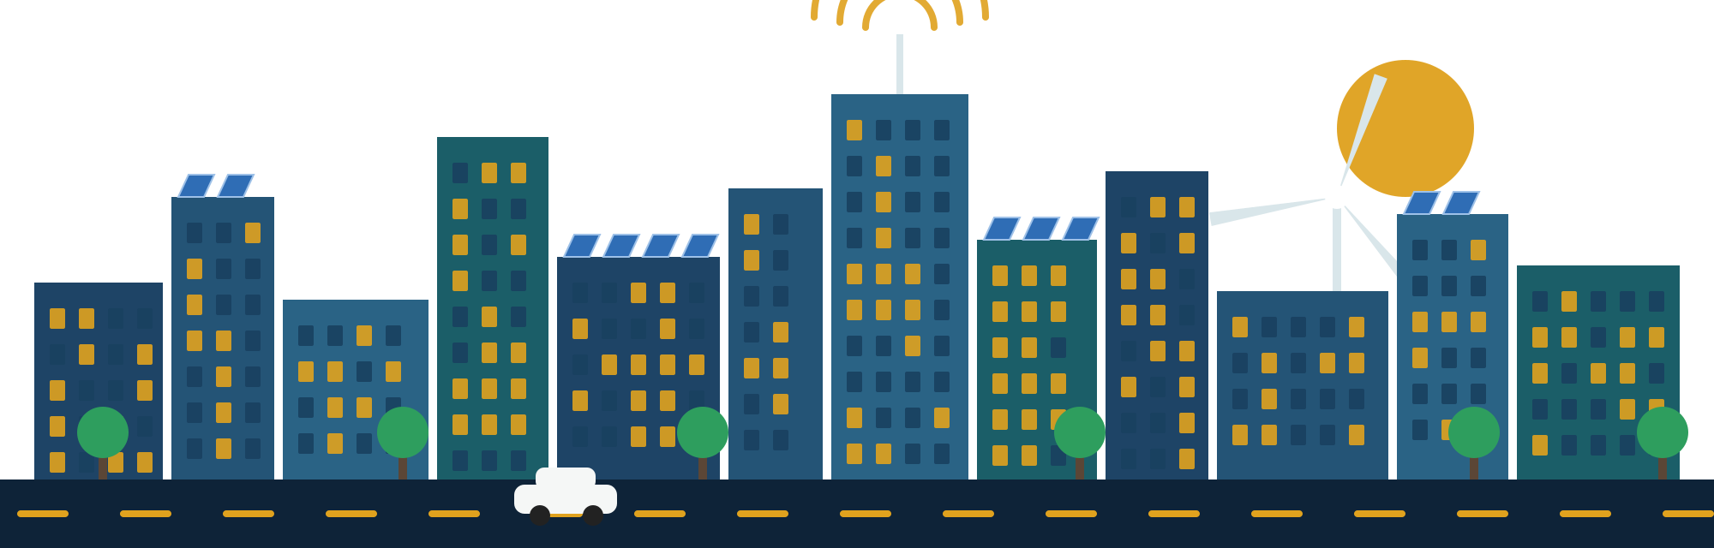
FINAL PROJECT
Roaya
Smart City Transformation
A city that saves your time, your money, and your planet.
Notes:
PROJECT MANAGER · slide 1
Good morning, everyone, and thank you for being here. I'm [Name], the Project Manager of team Roaya.
Roaya is an Arabic word. It means vision. And our vision is simple: to take a normal city and turn it into a smart, green and connected city.
A city that saves your time, your money, and your planet.
But before we talk about plans and numbers, let me introduce you to someone. His name is Ahmed.

Slide 2
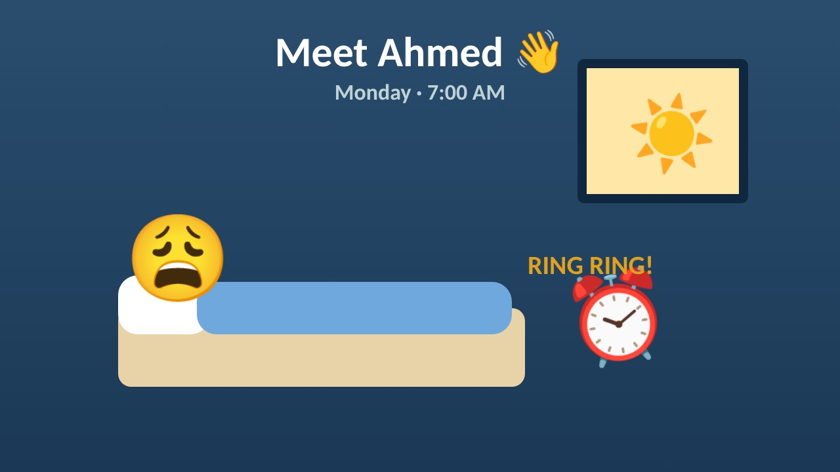
Notes:
PROJECT MANAGER · slide 2
(The video plays by itself, about one minute. Wait until it ends.)
Poor Ahmed. Traffic, a big electricity bill, and a long line just to renew his ID. Many of us have lived a Monday like this. That's exactly why we started Roaya.

Slide 3






OUR TEAM
Six managers, one vision
Project Manager
Planning Manager
Technical Manager
Charter & objectives
Schedule & milestones
Technology & resources
Finance Manager
Risk & Quality Manager
Stakeholder Manager
Budget & funding
Risks & quality
Stakeholders & communication
Roaya · Smart City Transformation · 03
Notes:
PROJECT MANAGER · slide 3
We are six managers, and each of us owns one part of the plan.
I will present the charter and the objectives. Then our Planning Manager will show the schedule, our Technical Manager the technology and resources, our Finance Manager the budget, our Risk and Quality Manager the risks and quality, and our Stakeholder Manager the people and communication.

Slide 4

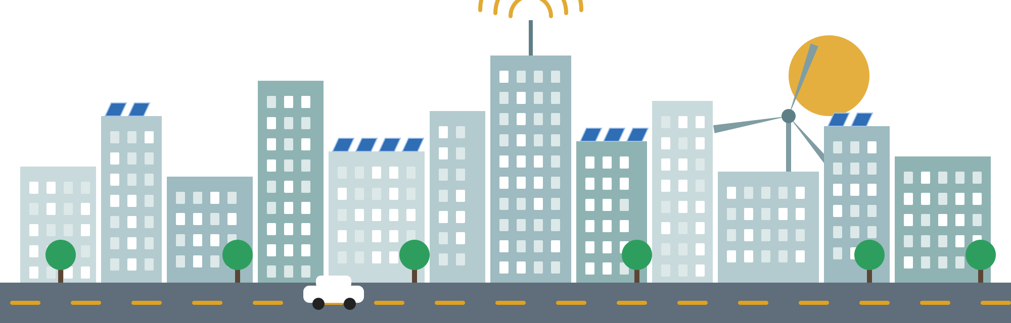

PROJECT CHARTER
Project Manager
Why Roaya?
Easier
Make city life…
Less time in traffic
Safer
Faster emergency help
Greener
Clean solar energy
24 months
550M EGP
7 phases
6 deliverables
Roaya · Smart City Transformation · 04
Notes:
PROJECT MANAGER · slide 4
So, why Roaya? Our purpose is to use technology to make city life easier, safer and greener, and to give citizens better public services.
Easier, because people spend less time in traffic, and many services move online.
Safer, because smart cameras and a control center help emergency teams arrive faster.
Greener, because the city gets a big part of its power from clean solar energy.
The project takes 24 months, from January 2027 to December 2028, with a total budget of 550 million Egyptian pounds, in 7 phases.

Slide 5







OBJECTIVES
Project Manager
What we will achieve
−30%
−20%
15 min
50%
traffic jams
energy & water
to anywhere
solar power
8 min
20,000
Smart
80%
emergency response
new jobs
security
services online
Roaya · Smart City Transformation · 05
Notes:
PROJECT MANAGER · slide 5
A vision is nice, but we need clear targets. So we set eight objectives that we can measure.
First, 30% less traffic within two years. Second, 20% less energy and water use. Third, you can reach anywhere in the city in under 15 minutes. Fourth, half of the city's power comes from the sun.
Fifth, a safe city: emergency help arrives in under 8 minutes. Sixth, 20,000 new jobs. Seventh, better security systems. And eighth, 80% of government services online by the end of 2028. So Ahmed can renew his ID from his couch.

Slide 6






SCOPE AND DELIVERABLES
Project Manager
Six things we will deliver
D1
D2
D3
Current state assessment
Roadmap & business case
Integration architecture
Mar 2027
Jun 2027
Sep 2027
D6
D4
D5
Security & data governance
Pilot & KPI report
Scale-up & change plan
Sep 2027
Sep 2028
Oct 2028
Roaya · Smart City Transformation · 06
Notes:
PROJECT MANAGER · slide 6
Our scope covers the whole journey: from studying the city, to designing the system, building it, testing it in one district, and then rolling it out to the whole city.
And this journey gives six deliverables.
In 2027 we deliver four: the current state assessment in March, the roadmap and business case in June, and in September, the integration architecture and the security and data governance framework.
In 2028 we deliver two: the pilot and KPI report in September, and the scale-up and change management plan in October.
The sponsor approves each deliverable before we move to the next phase.
➡️ Now, how do we get there in 24 months? Our Planning Manager, [Name], will show you the schedule.

Slide 7



PROJECT SCHEDULE
Planning Manager
24 months, 7 phases
2027
2028
Assessment
Roadmap
Design
Infrastructure
Testing
Pilot
Rollout
Roaya · Smart City Transformation · 07
Notes:
PLANNING MANAGER · slide 7
Thank you. I'm [Name], the Planning Manager.
Building a smart city is like building a house: you can't put the roof before the walls. So we planned the work step by step, in 7 phases over 24 months.
Phase 1 is the assessment, from January to March 2027. We study the city as it is today: roads, energy, water and services.
Phase 2 is the roadmap and business case, from April to June. Here we decide what to build first and how much it costs.
Phase 3 is the design, from July to September. We design how all the systems will connect, and how we will protect them.
Phase 4 is infrastructure, the biggest phase. I'll come back to it in a minute.
Phase 5 is integration and testing. Phase 6 is a three-month pilot in one district. And Phase 7, at the end of 2028, is the rollout to the whole city.
Each phase has one main owner. The Project Manager leads the first and the last phase, the Finance Manager leads the roadmap and business case, and the Technical Manager leads the four phases in the middle: design, infrastructure, testing and the pilot.

Slide 8

MILESTONES
Planning Manager
Eight checkpoints to the finish
Mar 2027
Sep 2027
Jun 2028
Oct 2028
Assessment
Architecture & security
Systems tested
Scale-up plan
Jun 2027
Mar 2028
Sep 2028
Dec 2028
Roadmap
Infrastructure ready
Pilot report
Project closure
Each checkpoint needs the sponsor’s approval before the next phase.
Roaya · Smart City Transformation · 08
Notes:
PLANNING MANAGER · slide 8
To keep the project on track, we have eight milestones. Think of them as checkpoints on a road.
In 2027 we have three: the assessment in March, the roadmap in June, and the architecture and security framework in September.
In 2028 we have five: the infrastructure is ready in March, the systems are tested in June, the pilot report is ready in September, the scale-up plan in October, and the project closes in December.
At each checkpoint, the sponsor must approve our work before we start the next phase. This protects us from building on a weak base.
Why milestones? Because they turn a two-year project into small goals that we can check. If a milestone is late, we know early, and we can act before the delay grows.

Slide 9


PHASE 4 · INFRASTRUCTURE
Planning Manager
Inside the biggest phase
Oct ’27
Nov
Dec
Jan ’28
Feb
Mar
Network & fiber
EGP 80M
Sensors & cameras
EGP 100M
Solar systems
EGP 45M
Contractors & buying
EGP 13M
6 months
238M EGP · 43% of budget
186 people at peak
Roaya · Smart City Transformation · 09
Notes:
PLANNING MANAGER · slide 9
Now, let's zoom into Phase 4, the biggest phase. It runs for six months, from October 2027 to March 2028.
Four jobs run at the same time: upgrading the network and fiber, installing sensors and cameras, installing solar systems, and managing the contractors and buying the equipment.
This phase uses 238 million pounds, about 43% of the budget, and up to 186 people. If it's late, the whole project is late.
That's why I update the Gantt chart every week and share a status report with the team. If anything is late, we write down the reason and fix it early, not at the end.
➡️ We know when. But what exactly will we build? Our Technical Manager, [Name], will tell you.

Slide 10




SMART TECHNOLOGY
Technical Manager
What we will build
IoT sensors
Smart cameras
Smart traffic lights
Measure traffic, energy & water
Keep our streets safe
Turn green when the road is empty
Solar energy
Control center
City app
Clean energy, lower bills
The brain of the city
City services on your phone
Roaya · Smart City Transformation · 10
Notes:
TECHNICAL MANAGER · slide 10
Thank you. I'm [Name], the Technical Manager.
Think of a traffic light that knows the road is empty and turns green for you. That's the kind of city we're building.
We will install sensors that measure traffic, energy and water, smart cameras that help keep our streets safe, and smart traffic lights. We will use solar panels that give us clean energy and lower bills, and connect everything through one control center and a city app.
➡️ So, how does it all work together?

Slide 11
HOW IT WORKS
Technical Manager
How it all connects
1 · Collect
2 · Send
3 · Decide
4 · Show
Sensors and cameras read the streets
The fiber network carries the data
The control center acts, like turning a light green
Citizens see the result in the city app
Example: the road is empty → the light turns green → you get home sooner.
Roaya · Smart City Transformation · 11
Notes:
TECHNICAL MANAGER · slide 11
It works in four steps: sensors collect the data, the network sends it, the control center decides, and citizens see the result in the app.
The control center is the brain of the city: all the data comes to one place.
And from the app, citizens can pay bills and renew documents from their phone.
So: the road is empty, the light turns green, and Ahmed gets home sooner.
➡️ But to build all this, we need the right resources.

Slide 12




RESOURCE ALLOCATION
Technical Manager
Our five resources
People
Materials
Equipment
Money
Time
186 at peak
(incl. 6 managers)
Fiber, cables,
manuals
Sensors, cameras,
servers
EGP 550M
24 months
Roaya · Smart City Transformation · 12
Notes:
TECHNICAL MANAGER · slide 12
We need five types: people, around 186 in the infrastructure phase, materials like cables, equipment like cameras, money, and time.
Some of this we already have, like cameras and fiber. The rest, we buy through our partners.
➡️ So, how much does all this cost? Our Finance Manager, [Name], will tell you.

Slide 13
BUDGET
Finance Manager
Where the money goes
550M
EGP total budget
including a 50M backup
Roaya · Smart City Transformation · 13
Notes:
FINANCE MANAGER · slide 13
Thank you. I'm [Name], the Finance Manager.
Let's talk about money. Our total budget is 550 million Egyptian pounds.
The biggest part, 250 million, goes to infrastructure: sensors, networks and cameras. That's almost half of the budget.
150 million goes to software, the apps and the control center.
60 million goes to cybersecurity, because a smart city must also be a safe city online.
And 40 million goes to training and awareness, so that staff and citizens know how to use the new services.
That's 500 million for the main work. On top of it, we keep 50 million, about 10%, as a backup budget for anything unexpected, like higher prices.
To give you a feeling of the numbers: the sensors and cameras alone cost 100 million, the network and fiber 80 million, and the control center and online services another 100 million.

Slide 14


BUDGET BY PHASE
Finance Manager
When we spend it
43%
goes to Phase 4, infrastructure
Every month: budget vs. actual
More than 10% over plan? We flag it.
Roaya · Smart City Transformation · 14
Notes:
FINANCE MANAGER · slide 14
And when do we spend it?
The first three phases are about studying and design, so they cost only about 42 million together.
Phase 4, infrastructure, takes the biggest share: 238 million, about 43% of the budget.
Testing takes 120 million, the pilot 43 million, and the rollout 57 million. And the 50 million backup stays aside.
How do we control it? Every month I compare the actual spending with the plan, and I send a report to the sponsor and the investors. If anything is more than 10% over plan, we flag it and act immediately.
If spending goes more than 10% over plan, we can release the backup budget and delay low-priority work.
And before we buy anything, I evaluate the suppliers, to check their quality and reliability. In Phase 4, I also manage the contractors and the buying, with contracts that have clear deadlines.

Slide 15







FUNDING AND REVENUE
Finance Manager
Where the money comes from
FUNDING
REVENUE
Government budget
Land & offices
Transport tickets
Selling solar energy
Investors & partners
50M backup
Data center space
Smart services
Roaya · Smart City Transformation · 15
Notes:
FINANCE MANAGER · slide 15
Now, where does the money come from? The main budget, 500 million, comes from the government. Investors and private partners add extra funding. And we keep the 50 million backup.
But a smart city doesn't only spend money. It also earns money, and we have five sources of revenue.
First, selling and renting land, offices and homes. Second, transport tickets and highway tolls. Third, selling extra solar energy to the national grid. Fourth, renting space in our data center. And fifth, fees for smart services, like smart parking and ads on smart screens.
So the city doesn't depend only on the government budget.
Why is this important? Because investors want to know how they get their money back. And our revenue plan shows them that a smart city is not only a cost; it is also an investment.
➡️ Of course, any big project has risks. Our Risk and Quality Manager, [Name], will show you how we handle them.

Slide 16

RISK MANAGEMENT
Risk & Quality Manager
Our top risks
15
12
12
12
Cyberattack
Device failure
Budget overrun
Data privacy
Firewalls + 24/7 monitoring
Test first, keep spares
Monthly review + backup
Clear privacy policy
Score = probability × impact. High risks are reviewed every week.
Roaya · Smart City Transformation · 16
Notes:
RISK & QUALITY MANAGER · slide 16
Thank you. I'm [Name], the Risk and Quality Manager.
No project goes exactly as planned. So instead of hoping nothing goes wrong, we prepare.
We score each risk with a simple formula: probability times impact, each from 1 to 5. A score of 12 or more is a high risk. High risks have a contingency plan, and we review them every week.
We have four high risks.
The first and the biggest is a cyberattack, with a score of 15. So we use firewalls, 24/7 monitoring and regular security testing.
The second is device failure. So we test devices before we install them, and we keep spare units.
The third is a budget overrun. We review costs every month, and we have the 50 million backup.
The fourth is data privacy. So we follow the data protection law and publish a clear privacy policy.

Slide 17
RISK MATRIX
Risk & Quality Manager
Where our risks sit
R1
R1
Cyberattack
15
R5
R3 R4
R2
Device failure
12
R3
Budget overrun
12
Impact ↑
R6 R7
R2
R4
Data privacy
12
R6
Supplier delays
9
R7
Low app use
9
R5
Slow approvals
8
Probability →
Roaya · Smart City Transformation · 17
Notes:
RISK & QUALITY MANAGER · slide 17
Here are all seven risks on our risk matrix. Up means more impact, and right means more likely.
The orange area is high risk: the four risks I just told you about. Each of them has a contingency plan. For example, if more than 5% of devices fail in one area, we replace them with spare units and switch to manual operation until it's fixed. And if there is a cyberattack, we isolate the affected systems and inform the authorities and the citizens.
The yellow area is moderate. Supplier delays: we use contracts with deadlines and late-delivery penalties. Low use of the app: we run awareness campaigns and training. And slow approvals: we start them early, with one person to follow up.
We review high risks every week, update the risk register every month, and do a full risk review at the end of each phase.

Slide 18




QUALITY ASSURANCE
Risk & Quality Manager
How we protect quality
99%
85%
system uptime
citizen satisfaction
Checklist
Test
Fix issues
Final test
Approve
Roaya · Smart City Transformation · 18
Notes:
RISK & QUALITY MANAGER · slide 18
Now, quality. For us, quality means two clear targets: the systems work 99% of the time, and at least 85% of citizens are satisfied during the pilot.
We protect quality in five steps. First, we use checklists for the design, the installation and the systems. Second, we test every system before it goes live. Third, if we find any issue, we record it in the quality log and fix it immediately. Fourth, we run a final test before the pilot and before the city-wide launch. And fifth, the Project Manager gives the final approval.
All equipment must meet safety, electrical and cybersecurity standards, and citizen data must follow the data protection law.
We also check quality in every phase: a design review in Phase 3, an installation inspection in Phase 4, system and security testing in Phase 5, and citizen feedback in the pilot.
➡️ Now, let's talk about the people behind the project. Our Stakeholder Manager, [Name], will tell you more.

Slide 19

STAKEHOLDERS
Stakeholder Manager
Everyone we work with
Government
Citizens
Investors
Roaya
Utilities
Tech providers
Contractors
Roaya · Smart City Transformation · 19
Notes:
STAKEHOLDER MANAGER · slide 19
Thank you. I'm [Name], the Stakeholder Manager.
We can build the smartest city in the world, but if people don't use it, it fails.
We work with the government, investors, tech companies, contractors, and utilities. But the most important are the citizens, people like Ahmed.
A stakeholder is anyone who affects the project, or is affected by it. Let me tell you why each one matters.
The government gives the approvals and most of the budget. Investors bring extra money. Tech companies provide the devices and the software. Contractors do the work in the streets. And utility companies run the electricity and water networks that we connect to.
And the citizens are the reason for the project. If they don't trust it or don't use the app, all our work is wasted.
➡️ But not all of them need the same attention.

Slide 20
STAKEHOLDER MAP
Stakeholder Manager
Power and interest
High
power
KEEP SATISFIED
MANAGE CLOSELY
Utilities
Government
Investors
Citizens
Low
power
MONITOR
KEEP INFORMED
Contractors
Tech providers
Low interest
High interest
Roaya · Smart City Transformation · 20
Notes:
STAKEHOLDER MANAGER · slide 20
So we put them on a map of power and interest.
The government, investors and citizens have high power and high interest, so we manage them closely. We meet them, report to them, and listen to them.
Utilities have high power, so we keep them satisfied. We tell them early about any work that touches their networks.
And contractors and tech providers, we keep informed, with a meeting every two weeks.
➡️ And to keep all these people on board, we need good communication.

Slide 21


COMMUNICATION PLAN
Stakeholder Manager
How we stay in touch
Weekly
Every 2 weeks
Monthly
Monthly
24 hours
Team meeting
Contractors
Sponsor & investors
Citizens: app & social media
Critical issues to sponsor
Roaya · Smart City Transformation · 21
Notes:
STAKEHOLDER MANAGER · slide 21
The team meets every week and contractors every two weeks; the sponsor, investors, and citizens get monthly updates, and any serious problem reaches the sponsor within 24 hours.
Our rule is simple: every update has one owner, a fixed time, and a clear channel.
For citizens, we use social media, the city app and the project website, in simple Arabic and English. And before any work in the streets, like cutting water or electricity, we tell people at least one week before.
And when there is a problem, we know who to call. Small issues are solved in the weekly team meeting. Delays, budget problems or high risks go to the Project Manager within two working days. And a serious problem, like a security incident, reaches the sponsor within 24 hours.
➡️ Before we finish, here is what we learned.

Slide 22

LESSONS LEARNED
Stakeholder Manager
What we learned
Start approvals early
Security from day one
Pilot first
Keep citizens involved
In phases 1 and 2
Starting at the design phase
One district, then the whole city
So they really use the services
Roaya · Smart City Transformation · 22
Notes:
STAKEHOLDER MANAGER · slide 22
Four things we learned: start approvals early, think about security from day one, test in one district before the whole city, and keep citizens involved.
➡️ So, what does all this mean for Ahmed?

Slide 23

ROAYA ·
Thank you
Smart, green and connected. Questions?
Scan for all our files
Notes:
STAKEHOLDER MANAGER · slide 23
With Roaya, his Monday becomes a lot easier.
The traffic light turns green for him, and he gets to work in 14 minutes. His electricity bill is lower, thanks to the solar panels. He renews his ID from his phone. And at night, his street is safe, and help arrives in under 8 minutes.
You can scan the QR code to see all our files. Thank you for listening, and we're happy to answer your questions.

