Slide 1
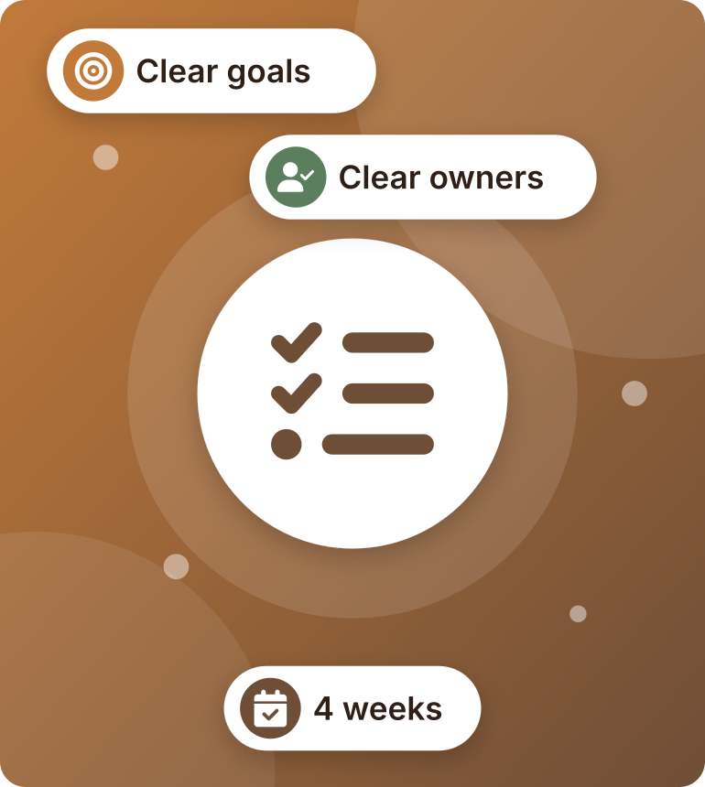
Action Plan
PRESENTED BY PULSE MARKETING
Our first month with The Daily Cup
OUR TEAM
Rahma Khaled
Aya Reda
Mahmoud Ibrahim
Abader Zarif
Notes:
Presenter: Rahma Khaled
"Good morning. We are Pulse Marketing: Rahma, Aya, Mahmoud and Abader.
Today we show you our plan for the first month with The Daily Cup."

Slide 2
Our Plan in 7 Steps
OVERVIEW
1
Define your goals
4 clear goals for month one
2
List the tasks
11 tasks
3
Set a timeline
4 weeks
4
Assign responsibilities
Each task has one owner
5
Identify resources
Money, tools and the café's help
6
Monitor and assess progress
We check the results every week
7
Review and adjust
We fix what doesn't work
Notes:
Presenter: Rahma Khaled
Our plan has 7 steps.
We set goals, list the tasks, set a timeline, and give every task an owner.
Then we get the resources, check the results, and fix what doesn't work.

Slide 3




Our Goals for Month One
STEP 1 · DEFINE YOUR GOALS
S
Specific
M
Measurable
A
Achievable
R
Relevant
T
Time-bound
REACH
FOLLOWERS
MESSAGES
CUSTOMERS
40K+
+500
100+
+10
people see the café
new followers
messages and calls
more customers a day
We check these goals every week.
Notes:
Presenter: Rahma Khaled
Step 1 is our goals. They are SMART: clear, measurable and with a deadline.
In month one we want:
- 40,000 people to see the café.
- 500 new followers.
- 100 messages and calls.
- 10 more customers every day.

Slide 4




11 Tasks in 4 Groups
STEP 2 · LIST THE TASKS
Prepare
Create
Launch
Measure
1
Study the market
4
Make a content plan
7
Start the ads
10
Weekly report
2
Know our customers
5
Take photos and videos
8
Post and reply
11
Final review
3
Check the café's pages
6
Design posts and reels
9
Start the offers
Notes:
Presenter: Aya Reda
Step 2 is the tasks. We have 11 tasks in 4 groups:
- Prepare: study the market, know our customers, and check the café's pages.
- Create: make a content plan, take photos and videos, and design posts and reels.
- Launch: start the ads, post and reply, and start the offers.
- Measure: a weekly report and a final review.

Slide 5
4 Weeks, Clear Deadlines
STEP 3 · SET A TIMELINE
WEEK 1
WEEK 2
WEEK 3
WEEK 4
Study the market
Know our customers
Check the pages
Content plan
Photos and videos
Prepare the ads
Start the ads
Post and reply
Start the offers
Keep posting
Improve the ads
Final review
DEADLINE
Research done
DEADLINE
Content ready
DEADLINE
Campaign live
DEADLINE
Review done
Notes:
Presenter: Aya Reda
Step 3 is the timeline. The plan takes 4 weeks:
- Week 1: we study the market and check the pages.
- Week 2: we make the content and prepare the ads.
- Week 3: the campaign starts.
- Week 4: we improve the ads and do the final review.
Every week has a clear deadline.

Slide 6


Who Does What
STEP 4 · ASSIGN RESPONSIBILITIES
Rahma Khaled
Account manager
Aya Reda
Social media
Mahmoud Ibrahim
Ads and reports
Abader Zarif
Design and photos
TASKS
TASKS
TASKS
TASKS
Market study
Customer research
Final review
Content plan
Posting and replies
Offers
Page check
Ads
Weekly report
Photos and videos
Post design
Notes:
Presenter: Mahmoud Ibrahim
Step 4 is who does what. Every task has one owner:
- Rahma is the account manager. She does the market study and the final review.
- Aya does social media: the content plan, posting and the offers.
- Mahmoud does the ads and the weekly report.
- Abader takes the photos and videos and designs the posts.

Slide 7



What We Need
STEP 5 · IDENTIFY RESOURCES
Budget: 13,000 EGP
Tools
From the café
Social media: 5,000
Ads: 4,000
Content: 3,000
Reports: 1,000
Meta Business Suite
Meta Ads Manager
Canva and CapCut
Google Sheets
Page access
Menu and prices
Time for photos
Weekly sales
Notes:
Presenter: Mahmoud Ibrahim
Step 5 is what we need.
- Money: 13,000 EGP a month.
- Tools: Meta for posts and ads, Canva and CapCut for design, and Google Sheets for reports.
- From the café: access to the pages, the menu and prices, time for photos, and the weekly sales.

Slide 8



How We Check Progress
STEP 6 · MONITOR AND ASSESS PROGRESS
What we check | Target | Where
Reach | 40K+ | Meta Ads Manager
Followers | +500 | Instagram
Messages | 100+ | Inbox and calls
Cost per message | Under 40 EGP | Meta Ads Manager
Customers | +10 a day | Café sales
Every day
Check ads and comments
Every Sunday
Report to the owner
Week 4
Final review
Notes:
Presenter: Mahmoud Ibrahim
Step 6 is checking progress. We watch 5 numbers: reach, followers, messages, cost per message, and new customers.
Every day we check the ads and comments. Every Sunday we send the owner a report. In week 4 we do the final review.

Slide 9





If Something Is Weak, We Fix It
STEP 7 · REVIEW AND ADJUST
IF Few people see us
THEN Put more money in the best ad
IF Few likes
THEN More reels, new post times
IF Views but no messages
THEN Add a clear offer
IF Few new customers
THEN Better offer, target nearby people
End of month: we meet the owner and plan month two
Notes:
Presenter: Abader Zarif
Step 7 is review and fix. We don't wait for the end of the month:
- If few people see us, we put more money in the best ad.
- If we get few likes, we post more reels.
- If people watch but don't send messages, we add a clear offer.
- If few new customers come, we make the offer better.
At the end of the month, we meet the owner and plan month two.

Slide 10
The Whole Plan on One Page
SUMMARY
Task | Owner | Week 1 | Week 2 | Week 3 | Week 4
Study the market | Rahma
Know our customers | Rahma
Check the café's pages | Mahmoud
Make a content plan | Aya
Take photos and videos | Abader
Design posts and reels | Abader
Prepare and start the ads | Mahmoud
Post and reply | Aya
Start the offers | Aya
Weekly report | Mahmoud
Final review | Rahma
Notes:
Presenter: Abader Zarif
This is the whole plan on one page: every task, who does it, and when. Each colour is one person.

Slide 11
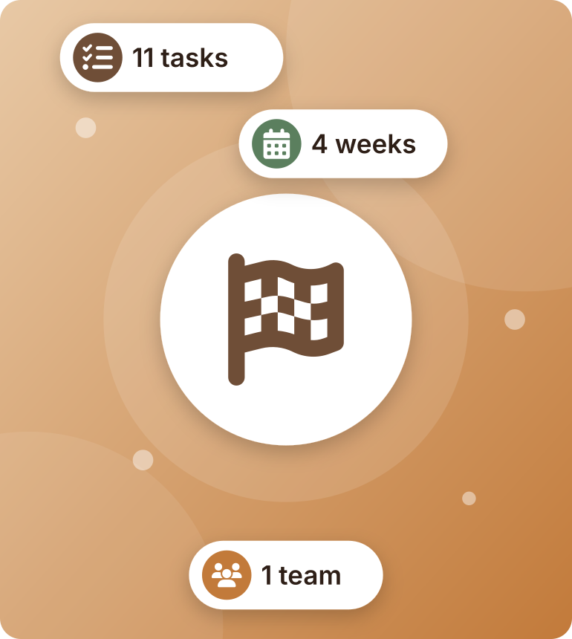
Let's Make It Happen!
NEXT STEP
Say yes today, and we start in week 1.
Pulse Marketing
Notes:
Presenter: Abader Zarif
So: 4 goals, 11 tasks, 4 weeks, and one team.
Say yes today, and we start in week 1. Thank you! Any questions?

