Slide 1
Energy-Efficient Secure Clustering in
Wireless Sensor Networks Using Hybrid Cryptography
A Comparative Simulation Study: LEACH / HEED / PEGASIS Family vs. the Proposed Hybrid Protocol (v1-v8)
Supervised by: Dr. Hesham ElZouka Presented by: Eng. Rahma Khaled Oshba
Dr. Amani Saad
Dr. Khaled Saada
Master's Thesis Defense -- Research Progress Presentation

Slide 2
Agenda
01 — Introduction & Research Motivation
02 — Background & Related Work
03 — Research Methodology & Simulation Environment
04 — Original Protocols: Reference Study
05 — Edited & Improved Protocols
06 — Proposed Hybrid Protocol (v1–v8)
07 — Proposed Protocol Experiments & Variants
08 — Results & Comparative Discussion
09 — Findings, Limitations & Future Work
10 — Conclusion
11 — Questions & Discussion

Slide 3
SECTION 1
Introduction & Research Motivation
Wireless Sensor Networks, Energy Efficiency & Security Challenges, Research Problem

Slide 4
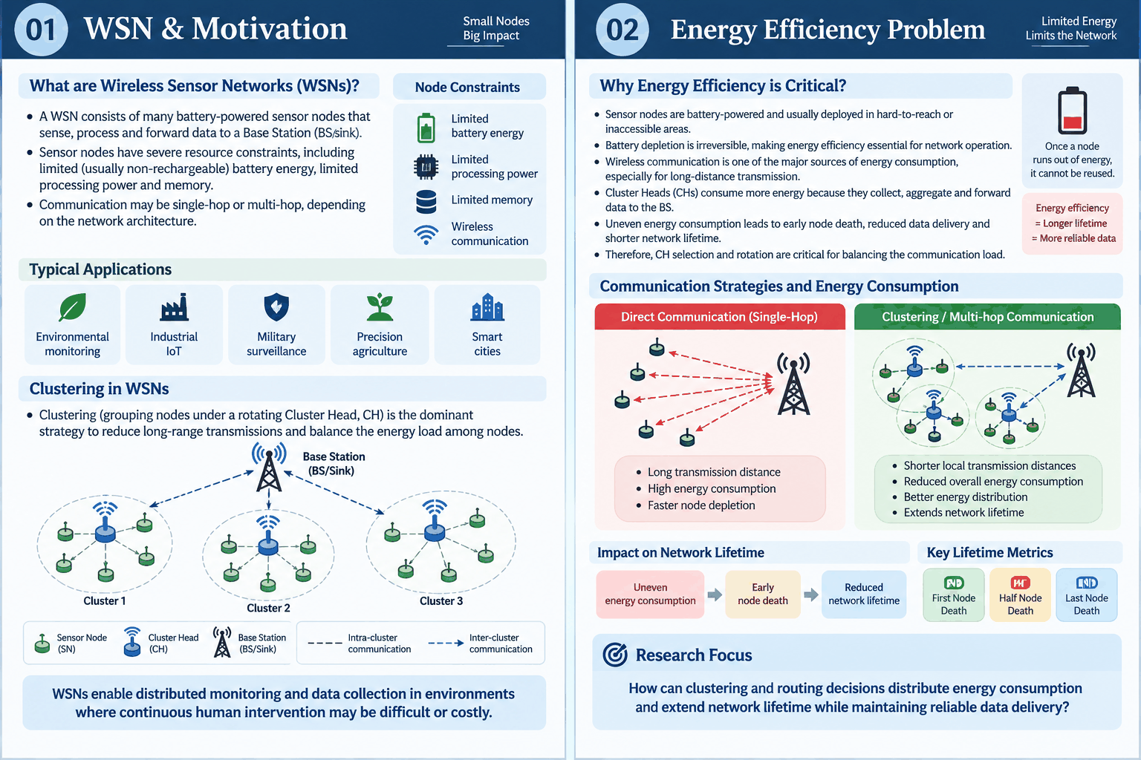
Wireless Sensor Networks WSN & Motivation
1.1
What are Wireless Sensor Networks (WSNs)?
A WSN consists of many battery-powered sensor nodes that sense, process and forward data to a Base Station (BS/sink).
Sensor nodes have severe resource constraints, including limited (usually non-rechargeable) battery energy, limited processing power and memory.
Communication may be single-hop or multi-hop, depending on the network architecture.
Communication Strategies and Energy Consumption

Slide 5
Wireless Sensor Networks WSN & Motivation
1.1
Clustering in WSNs
Clustering (grouping nodes under a rotating Cluster Head, CH) is the dominant strategy to reduce long-range transmissions and balance the energy load among nodes.

Slide 6
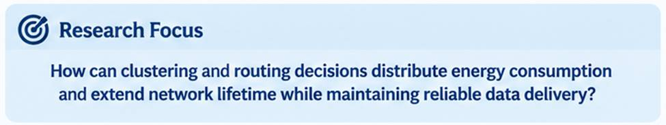
Energy Efficiency Problem
1.2
Why Energy Efficiency is Critical?
Sensor nodes are battery-powered, making energy conservation essential.
Wireless communication is a major energy consumer, especially over long distances.
CHs consume more energy due to data collection, aggregation, and forwarding.
Uneven energy consumption causes early node death and shorter network lifetime.
Therefore, CH selection and rotation are critical for balancing energy consumption.

Slide 7
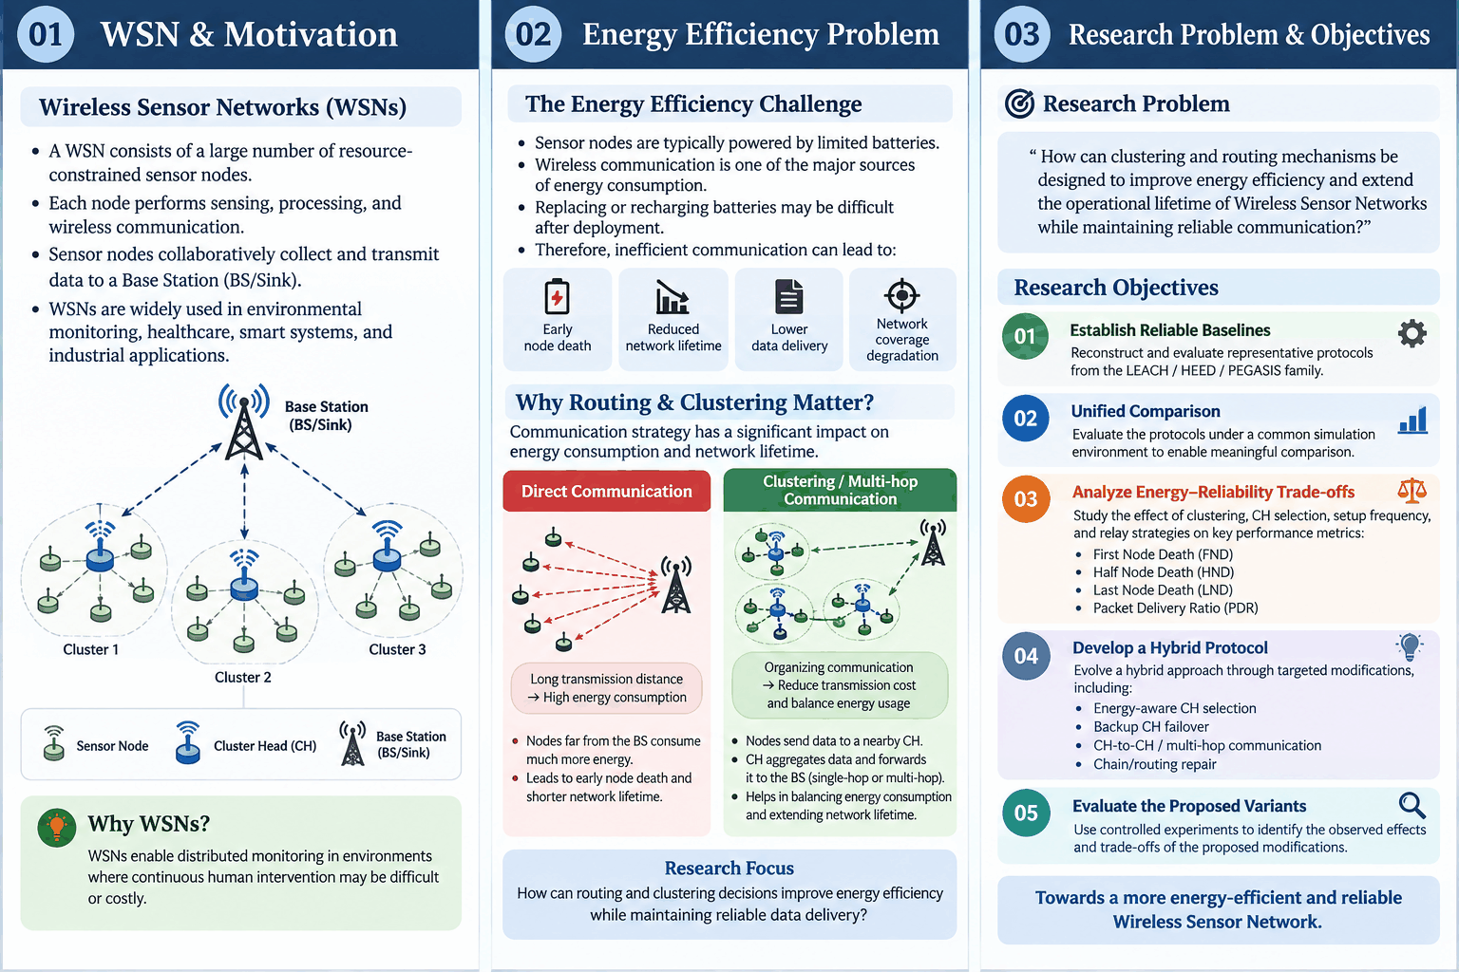
Research Problem & Objectives
1.3
Research Problem
How can clustering and routing mechanisms be designed to improve energy efficiency and extend the operational lifetime of Wireless Sensor Networks while maintaining reliable communication?
Research Objectives

Slide 8
SECTION 2
Background & Related Routing Protocols
LEACH, HEED, PEGASIS, H-LEACH, SH-LEACH

Slide 9
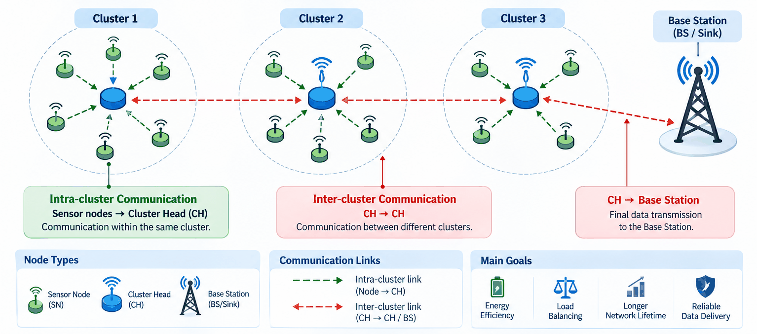
WSN Routing & Clustering
2.1
Routing: Determines how data reaches the BS.
Clustering: Groups nodes under a Cluster Head (CH).

Slide 10
LEACH & HEED
2.2
Two Foundations: LEACH and HEED
What do they teach us?
➔ LEACH → Lightweight & distributed CH rotation ➔ HEED → Energy + Communication Cost
Remaining Issues
LEACH: selection quality can be weak because energy/connectivity are not explicitly considered.
HEED: better CH selection comes with additional iterative control overhead, while cluster reuse and CH-failure recovery remain unaddressed.
Key Insight
Can we combine LEACH's lightweight rotation with HEED's CH-quality awareness?
Protocol | LEACH | HEED
Main idea | Probabilistic CH rotation | Energy + communication-cost-based CH selection
CH selection | Random/probabilistic | Iterative
Energy awareness | ❌ Limited | ✅ Residual energy
Connectivity/load awareness | ❌ | ✅
Main strength | Simple & low overhead | Better-informed CH selection
Main limitation | Uneven CH/cluster distribution | Higher control overhead

Slide 11
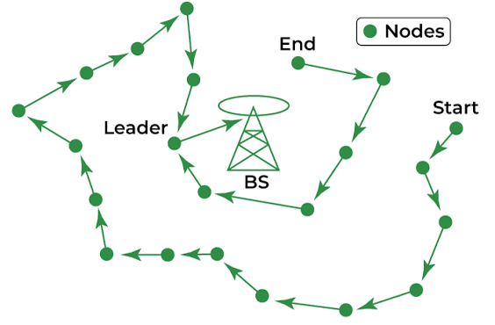
PEGASIS
2.3
PEGASIS: From Clustering to Relay-Based Communication
Chain-Based Communication
Main Idea
Greedy chain formation
One leader per round
Data aggregation along the chain
Limitation
Single-chain dependency
Higher communication delay
Research Relevance
Inspires CH-to-CH relay in the proposed protocol.

Slide 12
H-LEACH & SH-LEACH (Hybrid Family)
2.4
SH-LEACH
Focus: Stochastic CH selection & stability
Combines LEACH + HEED concepts
Stochastic CH selection
Targets improved cluster stability
Research Relevance:
→ Shows the value of combining LEACH and HEED ideas.
H-LEACH
Focus: Energy-aware CH selection
Residual + maximum energy
Threshold-based CH election
Energy-based node eligibility
Research Relevance:
→ Motivates energy-aware CH selection.
What do these hybrids show?
Hybridization can improve CH selection or stability — but different parts of the communication problem remain unresolved.

Slide 13
Recent Related Work
2.5
Paper | Protocol | Main Idea | Limitation | Gap
Kaur, Kour & Singh, 2025 | EECH-HEED | HEED+EECH dual-zone selection + adaptive threshold sensing | Zone-based heterogeneity assumption; not a LEACH+HEED fusion | Does not address multi-round reuse or CH-failure recovery
Juwaied & Jackowska-Strumillo, 2025 | DL-HEED | Graph Neural Network replaces HEED's CH-selection formula | HEED-only enhancement; requires GNN training/inference overhead | No rotation/reuse mechanism; no inter-cluster relay strategy
Subedi et al., 2024 | TLC-LEACH | Two-level grid clustering + angular boundary-node reassignment | Solves the boundary problem only; does not combine LEACH with HEED | No CH-failure recovery; no energy x connectivity scoring
El-Sayed et al., 2026 | RL-ILEACH | Tabular Q-learning embedded in ILEACH's CH-selection | PDR improvement not statistically significant in the paper's own tests | No LEACH+HEED fusion; no CH-to-CH relay mechanism
Razaque et al., 2016 / Shrestha et al., 2015 | H-LEACH / SH-LEACH | Direct LEACH+HEED fusion via energy-weighted probability | No multi-round reuse, no failure recovery, no relay mechanism | This is the gap the proposed protocol (v1-v7) directly targets

Slide 14
Research Gap
2.6
Existing Approaches | Addressed | Still Missing
LEACH | Lightweight CH rotation | Energy/connectivity awareness
HEED | Energy + communication cost | Low-overhead reuse & failure recovery
PEGASIS | Relay-based communication | Robustness of a single chain
H-LEACH / SH-LEACH | Improved CH selection / stability | Integrated reuse + failover + relay
Recent Hybrid Work | Specialized improvements | Combined cross-layer mechanism
The Identified Gap
The reviewed approaches address different aspects of WSN operation. Based on the literature and our experimental observations, we investigate an integrated framework combining:
1. Energy-aware CH Selection: Energy + Connectivity
＋
2. Multi-round Cluster Reuse: Reduce repeated setup overhead
＋
3. CH Failure Recovery: Backup CH / Failover
＋
4. Inter-Cluster Relay: CH-to-CH communication
Our Direction:
An integrated hybrid clustering & routing approach

Slide 15
SECTION 3
Simulation Environment & Evaluation Methodology
Unified Environment, Network & Energy Model, Performance Metrics, Experimental Design, Foundational PHY/MAC Validation

Slide 16
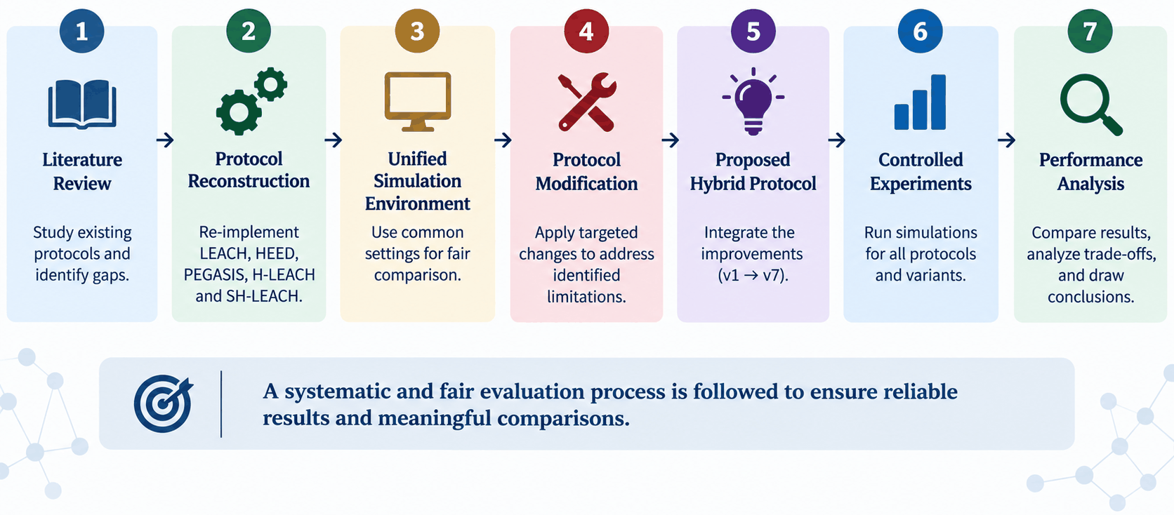
Research Methodology / Overall Workflow
3.1

Slide 17
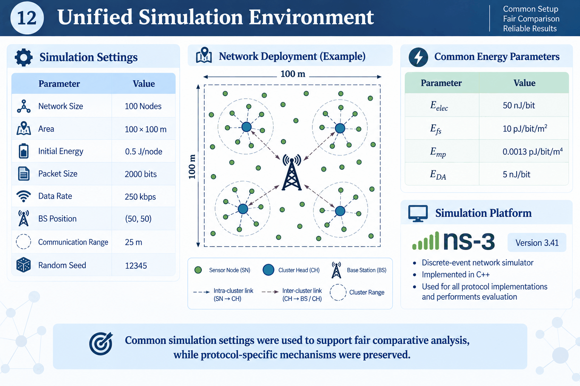
Unified Simulation Environment
3.2

Slide 18
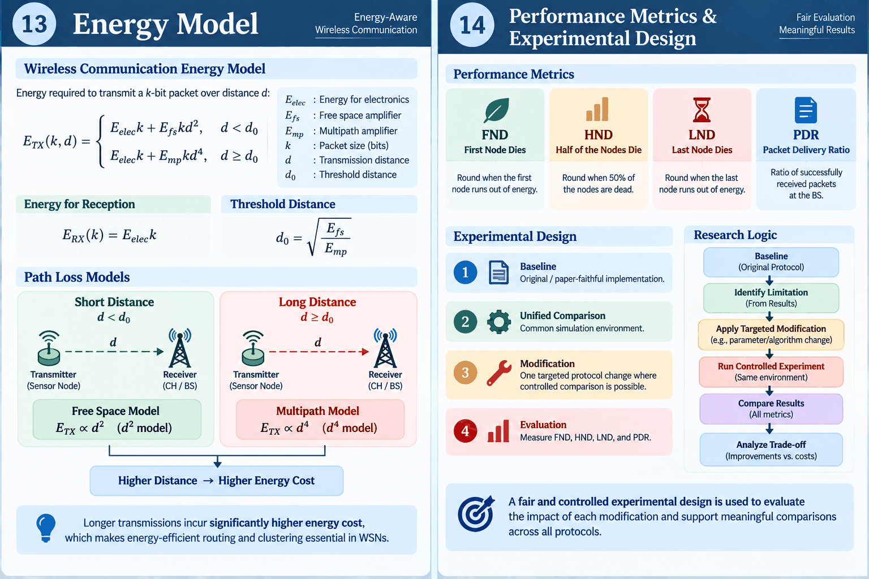
Network & Energy Model
3.3

Slide 19
SECTION 4
Original Protocols: Reference Results
Part I (Reference) & Part II (Hybrid) -- as published in the original papers

Slide 20
Foundational Validation: Full PHY/MAC Baseline (IEEE 802.15.4)
4.1
• Before relying on the analytical model above, a small-scale sanity check was run with the FULL IEEE 802.15.4 (LR-WPAN) protocol stack: real PHY/MAC layers, a spectrum channel with log-distance path loss, and a realistic per-state (TX/RX/idle) energy source.
• Setup: 4 nodes (3 sensors + 1 sink) in a 20x20m field, each sensor sending a 50-byte packet every 10s over a 1000s simulation, with NetAnim visualization and full energy accounting.
Metric | Result
Packets Sent / Received | 300 / 300
Packet Delivery Ratio | 100%
Throughput | 120 bit/s
Energy Consumed (per sensor / sink) | 62.6358 J / 62.6362 J (of 100 J)
Network Lifetime (1000s run) | Not reached -- all nodes still alive

Slide 21
Part I -- Original Reference Protocols (Published Results)
4.2
Why Reconstruct the Original Protocols?
Understand the original algorithmic mechanisms
Verify the implementation logic
Identify protocol limitations
Avoid attributing environmental differences to the algorithm
Key Point
Paper results are not directly comparable because each study uses different simulation conditions.

Slide 22
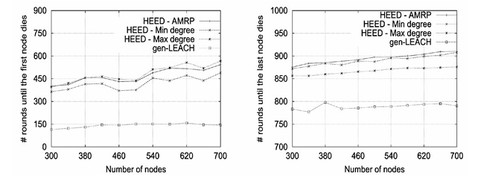
Part I -- Original Reference Protocols (Published Results)
4.1
Protocol | FND | HND | LND | PDR | Source
LEACH | 932 | N/A | 1312 | N/A | Heinzelman et al., 2000)
HEED | Graph only | N/A | Graph only | N/A | Younis & Fahmy, 2004 -- graph shows HEED > gen-LEACH, 300-700 nodes
PEGASIS | 1578 | 2082 | 2192 | N/A | Lindsey & Raghavendra, 2002
• These are the numbers AS REPORTED in each protocol's own original paper -- different fields, radios, and node counts per paper.
• They establish the historical baseline the field has compared against for two decades -- not directly comparable to each other yet.

Slide 23
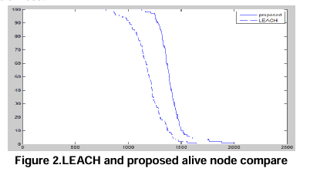
Part II -- Original Hybrid Protocols (Published Results)
4.2
Protocol | FND | HND | LND | PDR | Source
H-LEACH | ~1778 | N/A | ~4312 | N/A | Razaque et al., 2016 --
SH-LEACH | N/A | N/A | Graph only | N/A | Shrestha et al., 2015 -- graph shows FND delayed, LND converges with LEACH late
• H-LEACH and SH-LEACH are the two literature hybrids most structurally related to this thesis's own proposed design.
• Both report improved lifetime over plain LEACH, but neither publishes a directly reproducible numeric table for every metric (some values are graph-read approximations).

Slide 24
Why We Cannot Compare Part I & II Directly
4.3
• Different field sizes (e.g., 50x50m vs 100x100m), different radio models (single-term vs two-slope), different node counts and BS placements across papers.
• This motivates Parts III-IV: reproducing every protocol from scratch in NS-3 under ONE unified, controlled environment.

Slide 25
Our Own NS-3 Baseline (Paper-Exact Environment)
5.0
• Before unifying the environment, every protocol was first reproduced with OUR OWN code inside its OWN paper's exact settings (field size, radio model, BS placement, packet size) -- validating the reconstruction itself, independent of any later environment change.
Protocol | FND | HND | LND | PDR | Note
LEACH | 882 | 970 | 1321 | 98.02% | Paper-exact: 50x50m, far BS, single-term radio (matches paper's own Fig. 3)
HEED | 1106 | 1626 | 1996 | 99.97% | Paper-exact: Table 2 config, far BS, E0=2J, packet=800bit
PEGASIS | 1614 | 2036 | 2167 | 97.75% | Paper-exact: 50x50m, far BS, single-term radio (matches paper's own Table 1)
H-LEACH | 1080 | 1160 | 1210 | 94.75% | Paper-exact, WITH required fallback (paper's literal gate deadlocks without it)
SH-LEACH | 493 | 747 | 884 | 99.53% | Paper-exact: N=100, Cprob=0.10, single-term radio model

Slide 26
Comparison
5.0
Original Reference Protocols (Published Results)
Protocol | FND | HND | LND | PDR | Source
LEACH | 932 | N/A | 1312 | N/A | Heinzelman et al., 2000)
HEED | Graph only | N/A | Graph only | N/A | Younis & Fahmy, 2004 -- graph shows HEED > gen-LEACH, 300-700 nodes
PEGASIS | 1578 | 2082 | 2192 | N/A | Lindsey & Raghavendra, 2002
H-LEACH | ~1778 | N/A | ~4312 | N/A | Razaque et al., 2016 --
SH-LEACH | N/A | N/A | Graph only | N/A | Shrestha et al., 2015 -- graph shows FND delayed, LND converges with LEACH late
Our Own NS-3 Baseline (Paper-Exact Environment)
Protocol | FND | HND | LND | PDR | Note
LEACH | 882 | 970 | 1321 | 98.02% | Paper-exact: 50x50m, far BS, single-term radio (matches paper's own Fig. 3)
HEED | 1106 | 1626 | 1996 | 99.97% | Paper-exact: Table 2 config, far BS, E0=2J, packet=800bit
PEGASIS | 1614 | 2036 | 2167 | 97.75% | Paper-exact: 50x50m, far BS, single-term radio (matches paper's own Table 1)
H-LEACH | 1080 | 1160 | 1210 | 94.75% | Paper-exact, WITH required fallback (paper's literal gate deadlocks without it)
SH-LEACH | 493 | 747 | 884 | 99.53% | Paper-exact: N=100, Cprob=0.10, single-term radio model

Slide 27
SECTION 5
Edited Protocols: Unified Environment
Baseline (Our Own Code) -> Part III (Reference) & Part IV (Hybrid) Unified Reproduction

Slide 28
Edited Reference Protocols (NS-3, Unified Env.)
5.1
Unified Baseline
Same:
➔ 100 Nodes ➔ 100 × 100 m ➔ 0.5 J/node ➔ 2000-bit packets ➔ BS = (50, 50)
➔ Two-slope radio model ➔ Same random seed
Protocol | FND | HND | LND | PDR | Note
LEACH | 1409 | 1626 | 1962 | 98.37% | Unified: 100x100m, BS center, two-slope radio, packet=2000bit
HEED (original cost-direction) | 323 | 570 | 1362 | 99.69% | Unified environment, original cost-direction (bug fixed)
HEED (rotation-fairness variant) | 338 | 549 | 1502 | 99.67% | Unified environment + rotation-fairness penalty
PEGASIS | 1324 | 2353 | 2887 | 98.67% | Unified environment, same chain/leader-rotation logic
• All four reproduced in the SAME 100x100m field, two-slope radio, BS center, 2000-bit packets -- now directly comparable.
• HEED's iterative cost-based selection gives it the fastest FND but also the best PDR (99.69%) among references.

Slide 29
Part IV -- Edited Hybrid Protocols (NS-3, Unified Env.)
5.2
Protocol | FND | HND | LND | PDR | Note
H-LEACH | 2177 | 2255 | 2305 | 97.33% | Unified environment, gate_factor=1.0 (paper's literal condition)
SH-LEACH | 1440 | 1584 | 1604 | 99.17% | Unified environment, packet reduced 4000->2000

Slide 30
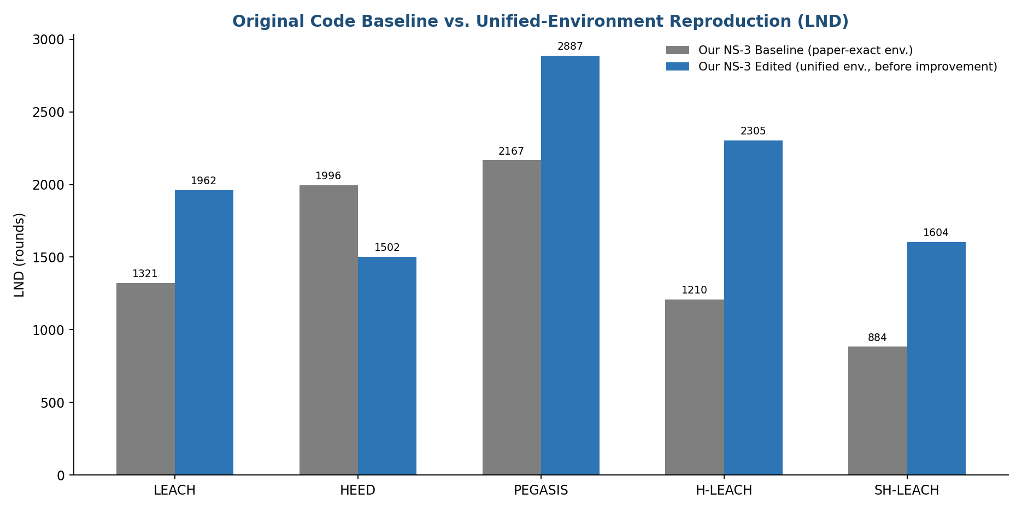
Step 2: Baseline vs. Unified-Environment Reproduction
5.0b

Slide 31
Step 2: Baseline vs. Unified-Environment Reproduction
5.0b
Protocol | Paper-specific | Unified | Main reason for the difference
LEACH | 1321 | 1962 | Different area + BS position + radio model + packet size
HEED | 1996 | 1502 | Mainly 2 J → 0.5 J initial energy, plus other environment changes
PEGASIS | 2167 | 2887 | Different area + BS position + radio model; chain behavior is affected by transmission distances
H-LEACH | 1210 | 2305 | Different radio model + packet size + BS/area + energy settings
SH-LEACH | 884 | 1604 | Different radio model + packet size + overall network conditions

Slide 32
SECTION 6
Improved Hybrid Protocols
Part V -- targeted fixes on top of the edited hybrids

Slide 33
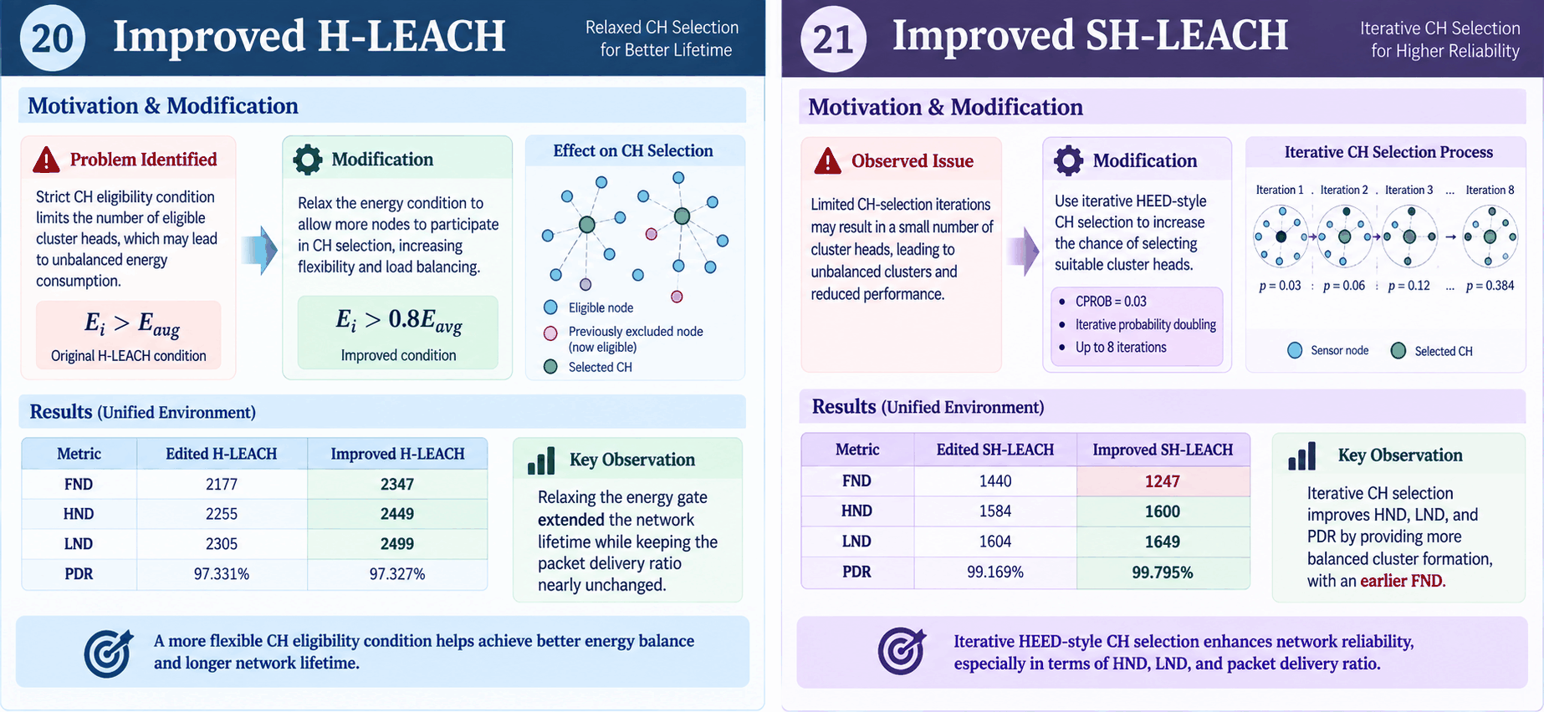
Improved Hybrid Protocols
6.1
Improved SH-LEACH
 | Edited | Improved
FND | 1440 | 1247
HND | 1584 | 1600
LND | 1604 | 1649
PDR | 99.169% | 99.795%

Slide 34
Improved Hybrid Protocols
6.1
Improved H-LEACH
 | Edited | Improved
FND | 2177 | 2347
HND | 2255 | 2449
LND | 2305 | 2499
PDR | 97.331% | 97.327%

Slide 35
Improved Hybrid Protocols
6.1
Before
Protocol | FND | HND | LND | PDR | Note
H-LEACH | 2177 | 2255 | 2305 | 97.33% | Unified environment, gate_factor=1.0 (paper's literal condition)
SH-LEACH | 1440 | 1584 | 1604 | 99.17% | Unified environment, packet reduced 4000->2000
After
Protocol | FND | HND | LND | PDR | Improvement
H-LEACH Improved | 2347 | 2449 | 2499 | 97.33% | Relaxed 'energy > average' gate from 1.0x to 0.8x
SH-LEACH Improved | 1247 | 1600 | 1649 | 99.79% | Iterative HEED-style doubling + Cprob 0.10->0.03

Slide 36
Lessons Carried Forward to the Proposed Protocol
6.3
What Did the Previous Experiments Teach Us?
1. CH Selection
Improving CH selection alone is not sufficient.
2. Control Overhead
Frequent re-clustering increases energy consumption.
3. Cluster Reuse
Longer reuse reduces overhead, but may create stale clusters.
4. CH Failure
CH failure can disconnect members from a valid forwarding path.
5. Inter-Cluster Routing
Direct CH → BS communication may be costly when the BS is far away.
➔ These observations motivated the evolution of the Proposed Hybrid Protocol.

Slide 37
SECTION 7
Proposed Hybrid Protocol
Research Direction & Design Rationale, Hybrid v1-v8, Evolution

Slide 38
Hybrid v1 -> v3: From Baseline to Root-Cause Redesign
7.2
Protocol Evolution: v1 → v2
V1: Hybrid Foundation
Problem
Existing protocols separate: 1. CH selection
2. Cluster formation
Modification
v1 = HEED-based CH Selection + LEACH-based Cluster Formation
Residual Energy → HEED CH Selection → Selected CHs → LEACH-style Nearest-CH Join → CH → BS
Why?
Combine HEED's energy/connectivity-aware CH selection with LEACH's lightweight cluster formation.
Version | Idea | FND | HND | LND | PDR
v1 | HEED-style CH selection + LEACH clustering, no multi-round reuse | 330 | 557 | 1318 | 99.74%

Slide 39
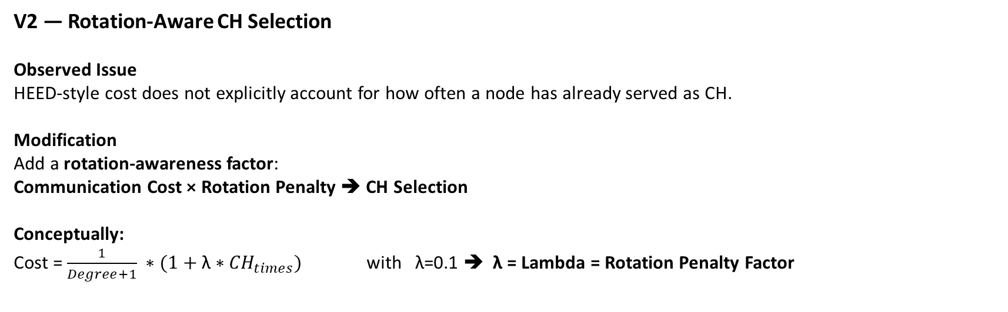
Hybrid v1 -> v3: From Baseline to Root-Cause Redesign
7.2
V2 — Rotation-Aware CH Selection
Observed Issue
HEED-style cost does not explicitly account for how often a node has already served as CH.
Modification
Add a rotation-awareness factor:
Communication Cost × Rotation Penalty ➔ CH Selection
Conceptually:
Cost = $\frac{1}{Degree+1} ∗(1+\text{λ}∗{CH}_{times})$ with λ=0.1 ➔ λ = Lambda = Rotation Penalty Factor
Version | Idea | FND | HND | LND | PDR
v1 | HEED-style CH selection + LEACH clustering, no multi-round reuse | 330 | 557 | 1318 | 99.74%
v2 | + rotation fairness penalty | 345 | 534 | 1393 | 99.79%

Slide 40

Hybrid v1 -> v3: From Baseline to Root-Cause Redesign
7.2
V3: Root-Cause Redesign
Why Redesign v1/v2?
Previous hybrid versions still relied heavily on the original HEED selection process.
Root Cause
The limitation was not only cluster formation —
the CH selection mechanism itself needed a more direct energy–connectivity trade-off.
Modification
A new single-pass CH selection score was introduced:
${Score}_{i}$=$\frac{E_{i}}{E_{0}} ∗(1+{DegreeNorm}_{i})$
SO (Energy + Connectivity ➔ CH Score) → LEACH Threshold → CH Selection
Additional Design
Setup interval = 5 rounds
Nearest-CH cluster joining
Direct CH → BS communication

Slide 41
Hybrid v1 -> v3: From Baseline to Root-Cause Redesign
7.2
Version | Idea | FND | HND | LND | PDR
v1 | HEED-style CH selection + LEACH clustering, no multi-round reuse | 330 | 557 | 1318 | 99.74%
v2 | + rotation fairness penalty | 345 | 534 | 1393 | 99.79%
v3 | Single-pass energy x connectivity score + multi-round reuse (root-caus… | 1730 | 2081 | 2703 | 97.72%

Slide 42
Hybrid v4 -> v7: Tuning, Resilience & Relay
7.3
v4 — Reduce Control Overhead
Problem
Frequent cluster re-formation introduces additional control overhead.
Modification
Setup Interval: 5→15 rounds
Version | Idea | FND | HND | LND | PDR
v3 | Single-pass energy x connectivity score + multi-round reuse (root-caus… | 1730 | 2081 | 2703 | 97.72%
v4 | Longer setup interval (less control overhead, staler cluster… | 1513 | 2219 | 2521 | 94.67%

Slide 43
Hybrid v4 -> v7: Tuning, Resilience & Relay
7.3
v5 — Backup CH Failover
Problem
When a CH dies before the next setup phase:
CH Failure ➔ Cluster Members ➔ No active CH
Modification
Designate a Backup CH during cluster formation.
Primary CH │
└── Backup CH ➔ CH Failure ➔ Backup Promotion
Version | Idea | FND | HND | LND | PDR
v4 | Longer setup interval (less control overhead, staler cluster… | 1513 | 2219 | 2521 | 94.67%
v5 | + Backup CH Failover (pre-designated, zero extra messaging c… | 1513 | 2127 | 2416 | 97.05%

Slide 44
Hybrid v4 -> v7: Tuning, Resilience & Relay
7.3
v6: CH-to-CH Chain
Problem Identified
With direct CH → BS communication, each Cluster Head sends its aggregated data directly to the Base Station.
This may create:
High transmission cost for distant CHs
Uneven energy consumption among CHs
Increased energy burden on some CHs
Modification
Introduce CH-to-CH relay communication
Construct a CH-level chain
Select the CH closest to the BS as the gateway
Non-gateway CHs forward data through neighboring CHs
Gateway CH transmits to the BS
Why?
Reduce long-distance CH → BS transmission and distribute communication energy among Cluster Heads.
Sensor Nodes
↓
CH₁ → CH₂ → CH₃ → CH₄
↓
BS / Sink
Version | Idea | FND | HND | LND | PDR
v6 (Center control) | Same Chain mechanism, BS moved to field center (isolates BS … | 1551 | 1981 | 2106 | 97.494%

Slide 45
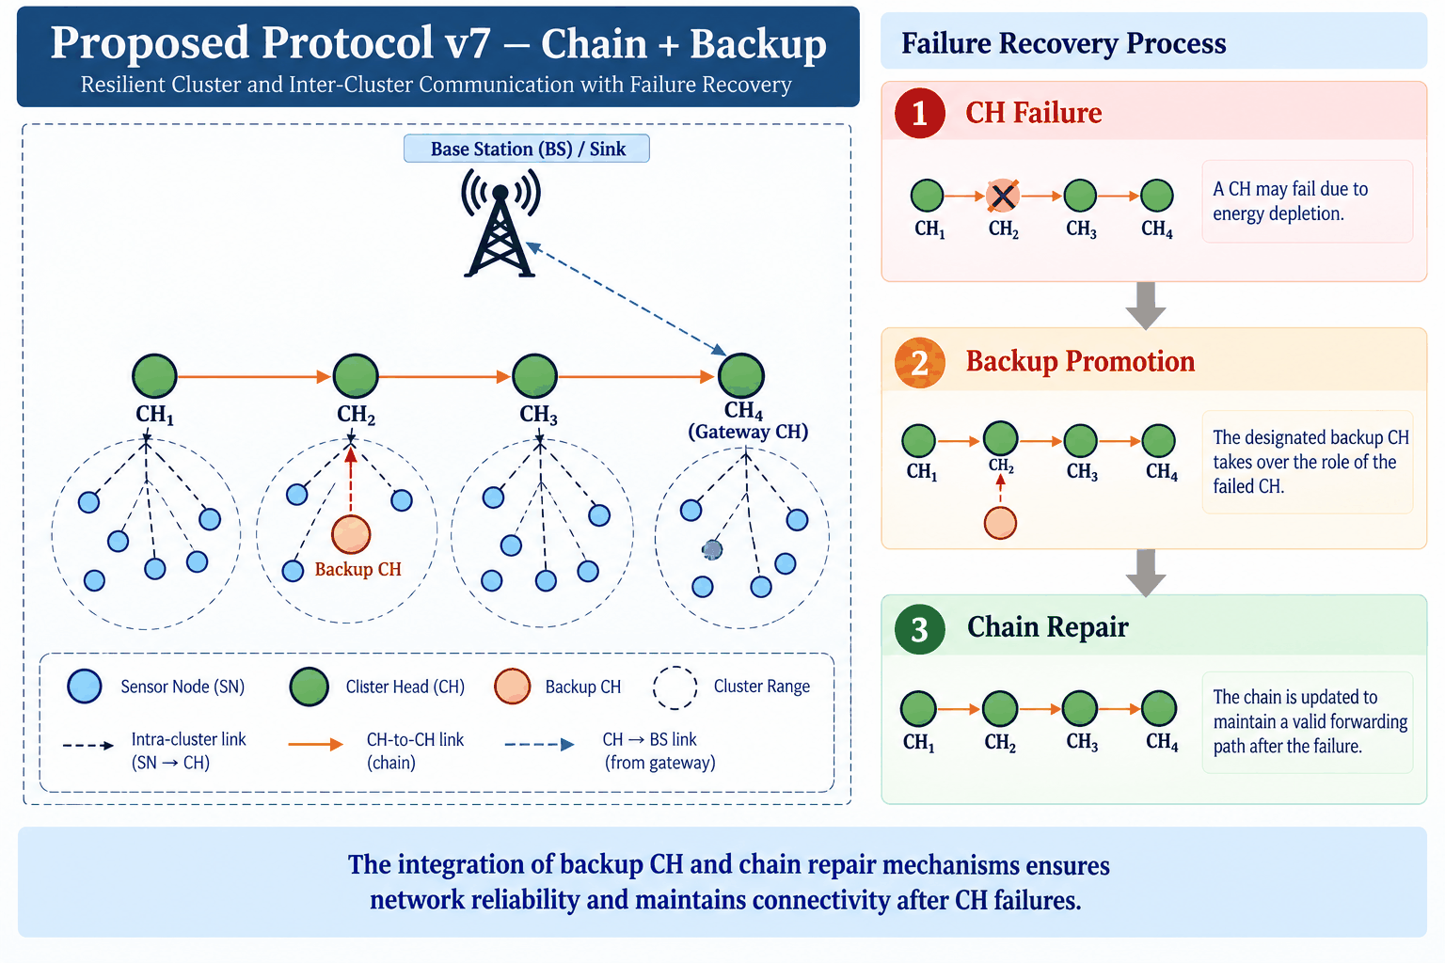
Hybrid v4 -> v7: Tuning, Resilience & Relay
7.3
V7: Chain + Backup — Center BS
Problem Identified
Although v6 introduces CH-to-CH communication, a CH failure can disrupt both:
Its cluster operation
The CH-to-CH chain
CH Failure ➔ Cluster loses its CH ➔ Relay path may also be disrupted

Slide 46
Hybrid v4 -> v7: Tuning, Resilience & Relay
7.3
V7: Chain + Backup — Center BS
Modification
v7 integrates two recovery mechanisms:
1. Backup CH Failover
Designate a backup CH during cluster formation
Promote the backup when the primary CH fails
2. Chain Repair
Remove the failed CH from the chain
Reconnect the affected CHs
Preserve a valid forwarding path
Why?
Maintain cluster connectivity and inter-CH communication after CH failures.

Slide 47
Hybrid v4 -> v7: Tuning, Resilience & Relay
7.3
Version | Idea | FND | HND | LND | PDR
v7 | Chain + Backup Failover + Chain Repair (backup inherits dead… | 1551 | 1976 | 2066 | 98.432%
Failure-Recovery Results
Recovery Indicator | Result
Backup Promotions | 16 successful / 6 rejected
Partial Promotions | 0
Emergency Promotions | 0
Chain Repairs via Backup | 16

Slide 48
Hybrid v4 -> v7: Tuning, Resilience & Relay
7.3
V6: CH-to-CH Chain — Far BS
Why Far-BS Scenario?
To examine the effect of CH-to-BS distance on the proposed relay mechanism.
Experimental Setup
Network area: 100 × 100 m
Same simulation parameters
Same energy model
Same communication range
Far Base Station
CH-to-CH chain enabled
Problem
With a far BS:
CH₁ ────────────────→ BS
CH₂ ────────────────→ BS
CH₃ ────────────────→ BS
Direct CH → BS communication becomes more costly as the transmission distance increases.
Modification
CH₁ → CH₂ → CH₃ → Gateway
↓
BS
Version | FND | HND | LND | PDR
v6 (Far BS) | 1266 | 1910 | 2031 | 97.075%

Slide 49
Hybrid v4 -> v7: Tuning, Resilience & Relay
7.3
V6: CH-to-CH Chain + Backup — Far BS
Problem Identified
The Far-BS scenario increases the importance of maintaining a valid CH-to-CH forwarding structure.
A CH failure may cause:
CH Failure ➔ Cluster disruption + Relay-path disruption ➔ Packet delivery degradation
Modification
v7 = v6 + Backup CH + Chain Repair
Backup CH
A backup is designated during cluster formation.
Chain Repair
When a CH fails:
Failed CH ➔ Backup Promotion ➔ Replace failed CH ➔ Repair CH-to-CH path ➔ Continue forwarding
Why?
Improve the robustness of the CH-to-CH communication structure under CH failures.

Slide 50
Hybrid v4 -> v7: Tuning, Resilience & Relay
7.3
Version | FND | HND | LND | PDR
V7 (Far BS) | 1266 | 1891 | 1976 | 98.135%
Failure-Recovery Results
Recovery Indicator | Result
Backup Promotions | 21 successful / 8 rejected
Partial Promotions | 0
Emergency Promotions | 0
Chain Repairs via Backup | 21

Slide 51
Multihop Variants: v1 vs v2
7.3
Modification
Two Multihop variants were evaluated to investigate the effect of the setup interval:
1. Multihop V1 — 5-Round Setup Interval
•Rebuild clustering and multihop routing every 5 rounds
•Re-select CHs and backup CHs during each setup phase
•Update the multihop routing structure periodically
2. Multihop V2 — 10-Round Setup Interval
•Extend the setup interval from 5 to 10 rounds
•Reuse the same CHs, backup CHs, and routing structure for a longer period
•Reduce the frequency of network reconfiguration
Why?
Evaluate how the setup interval affects energy distribution, network lifetime, and packet delivery while keeping the Multihop mechanism unchanged.

Slide 52
Multihop Variants: v1 vs v2
7.3
Metric | V1 | V2
FND | 1491 | 1381
HND | 1991 | 2071
LND | 2086 | 2241
PDR | 98.49% | 97.88%

Slide 53
v8 — Proactive + Reactive CH Protection
7.6
Mechanism | Problem in v5b | Effect in v8
I1 Epoch-exhaustion fix | All alive nodes already served in the epoch → 998 rounds with 0 CHs (PDR = 0) | New epoch starts early — network never left without a CH
I2 Proactive CH handover | CH dies mid-aggregation → its whole cluster's packets lost | CH hands over to its strongest member BEFORE it dies (1 control packet)
I3 Orphan re-join | Members of a dead CH stay unclustered until next setup | Join nearest surviving CH (known from setup ads, no new messages)
I4 Direct-to-BS | Nodes closer to the BS than to their CH still relay via the CH | Send straight to BS: same/lower TX cost, CH saves RX + aggregation
I5 Energy-gated CH | Weak nodes can still be elected CH and die first | Only nodes with ≥ average residual energy may volunteer
Relative low-energy threshold | 5% of E0 (0.025 J) → every late backup rejected (0/20) | 5% of live average → backup failover works again (18 successful)

Slide 54
v8 Results vs. v5b and v7 (Same Field / Radio Model)
7.6
Version | Idea | FND | HND | LND | PDR
v5b (Center) | Interval 5 + Backup + Repair + Energy-Aware Repair | 1730 | 2091 | 3203* | 97.31%
v7 (Center) | Chain + Backup Failover + Chain Repair | 1551 | 1976 | 2066 | 98.43%
v7.1 (Center) | Multihop routing + Backup + Routing Repair | 1491 | 1991 | 2086 | 98.49%
v8 (Center) | v5b + I1–I5 + relative threshold | 2621 | 2711 | 2761 | 99.22%
v7 (Far BS) | Chain + Backup Failover + Chain Repair | 1266 | 1891 | 1976 | 98.14%
v8 (Far BS) | Same v8 code, BS at (50,−100) | 1471 | 1646 | 1716 | 98.66%
* v5b LND is inflated by stranded nodes: its last 1038 rounds delivered only 59 packets. Delivered packets: v5b 201,505 → v8 268,610 (+33%, same 50 J). 8-topology mean (center BS): v8 2618 / 2720 / 2766 / 99.26% vs v5b 1688 / 2119 / 2374 / 97.56%. Backup failover: 18 successful; proactive handovers: 26.

Slide 55
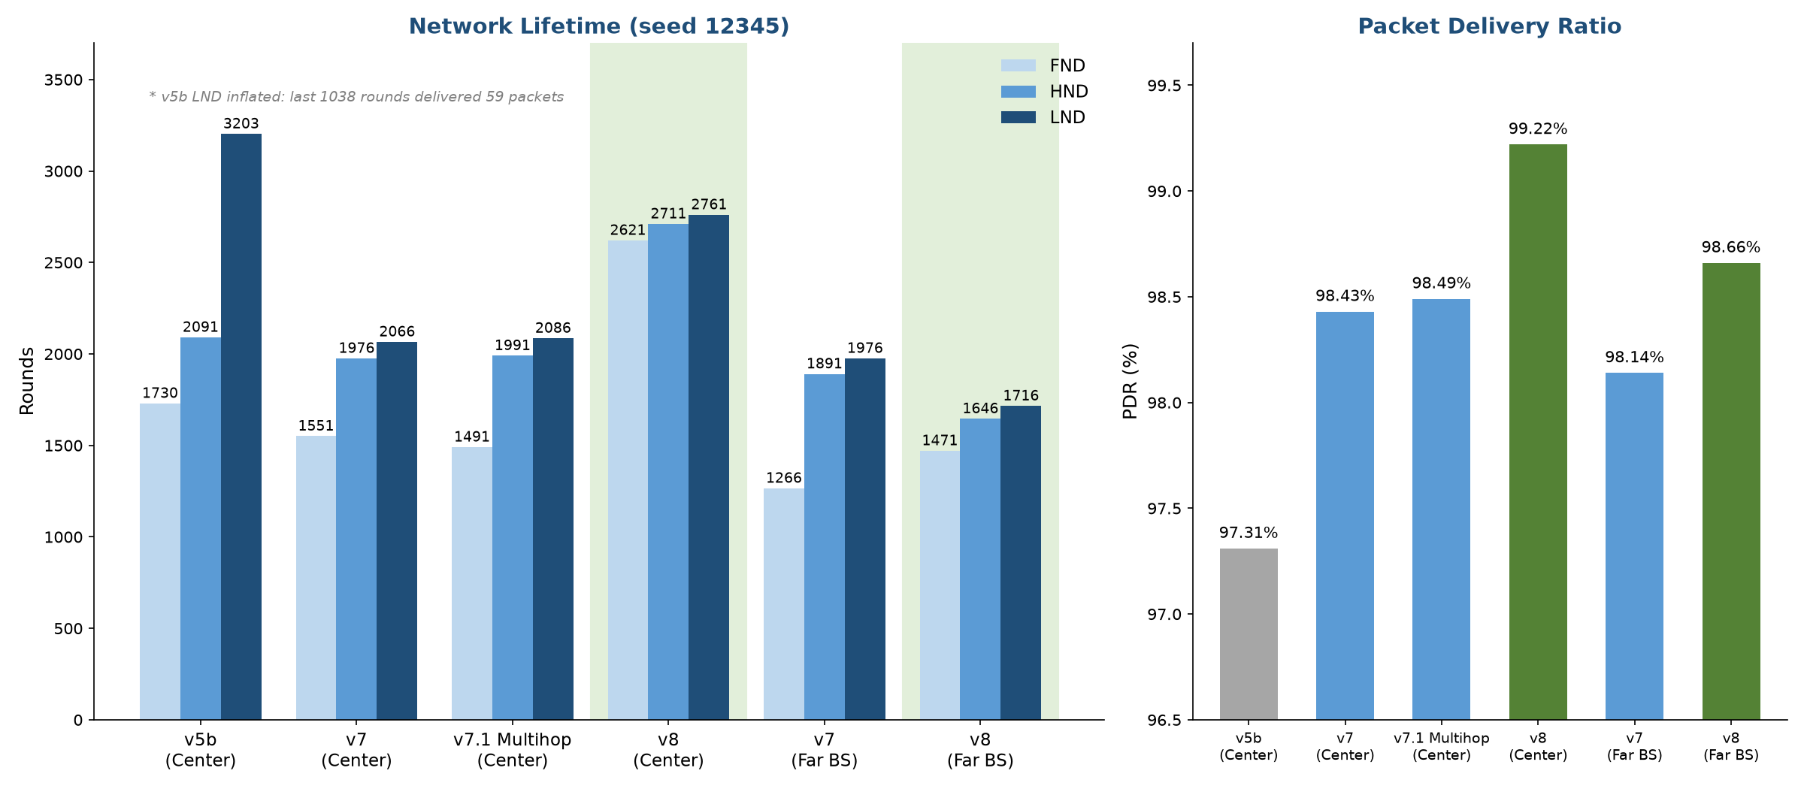
v8 at a Glance: Lifetime & PDR (Center vs. Far BS)
7.6

Slide 56
v8 Ablation: Which Mechanism Matters?
7.6
Variant | Mechanism removed | FND | HND | LND | PDR
v8 (full) | — | 2621 | 2711 | 2761 | 99.22%
v8 − I4 | Direct-to-BS | 1821 | 2001 | 2076 | 99.32%
v8 − I5 | Energy-gated CH election | 2171 | 2641 | 2746 | 99.05%
v8 − I2 | Proactive CH handover | 2585 | 2726 | 2766 | 98.98%
v8 − I1 / − I3 | Epoch fix / Orphan re-join | 2621 | 2711 | 2761 | 99.22%
Threshold only | All of I1–I5 | 1730 | 2086 | 2166 | 98.16%
Direct-to-BS (I4) and the energy gate (I5) carry most of the lifetime gain; proactive handover (I2) mainly adds PDR; I1 and I3 are safety nets with no effect in the full combination for this seed. At the far BS, direct-to-BS almost never fires (76 packets), so the v7 chain still gives the longer HND/LND there.

Slide 57
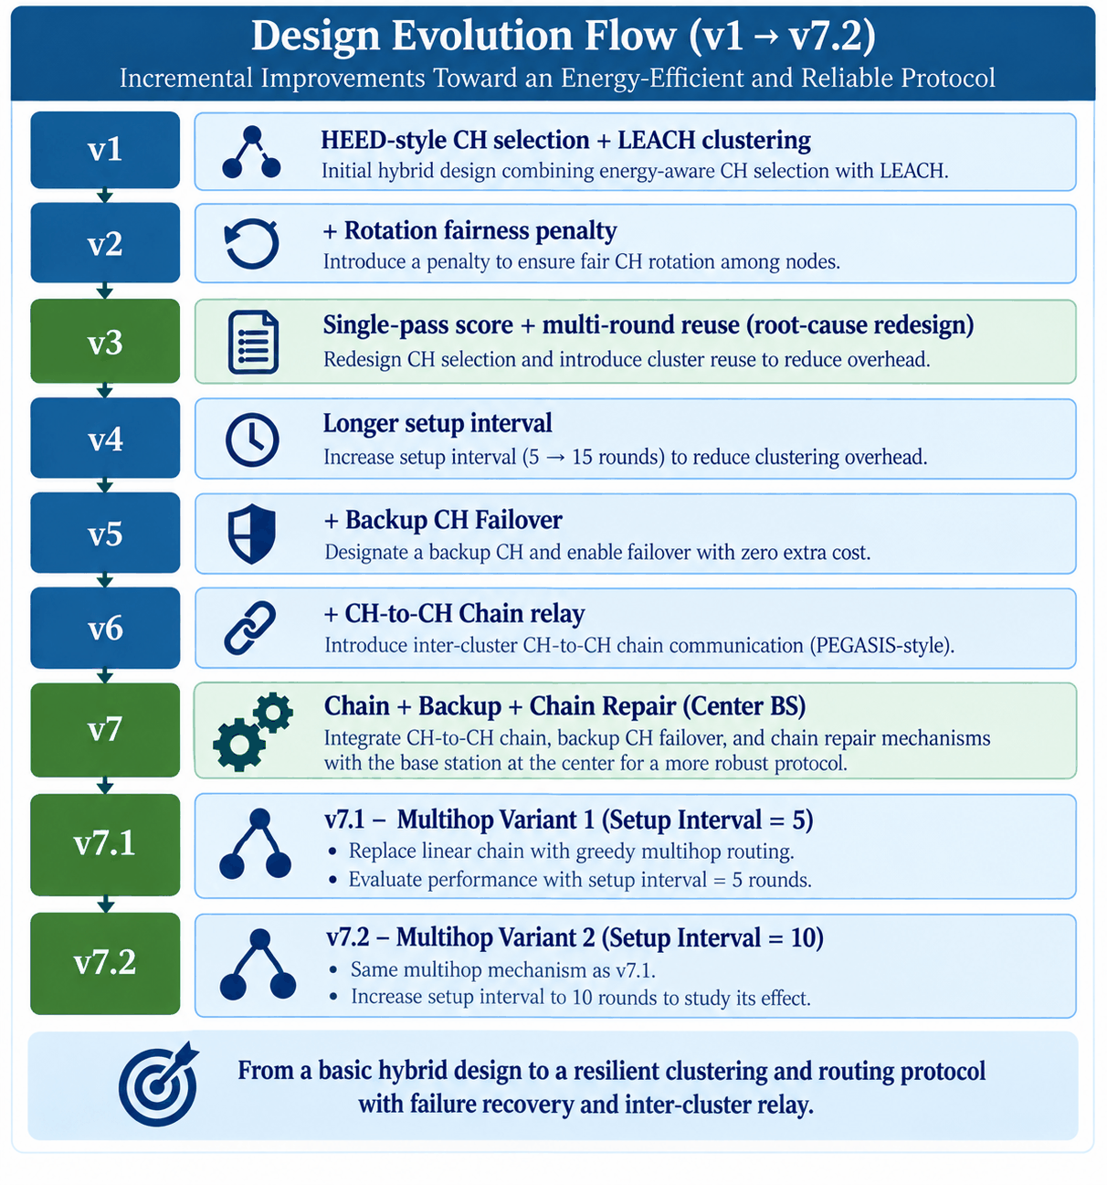
Design Evolution Flow (v1 -> v7)
7.4

Slide 58
Design Evolution Flow (v1 -> v8)
7.4
Version | Idea | FND | HND | LND | PDR
v1 | HEED-style CH selection + LEACH clustering, no multi-round reuse | 330 | 557 | 1318 | 99.74%
v2 | + Rotation fairness penalty | 345 | 534 | 1393 | 99.79%
v3 | Single-pass Energy × Connectivity score + Multi-round reuse | 1730 | 2081 | 2703 | 97.72%
v4 | Longer setup interval: 5 → 15 rounds | 1513 | 2219 | 2521 | 94.67%
v5 | + Backup CH Failover | 1513 | 2127 | 2416 | 97.05%
v6 (Center) | CH-to-CH Chain; BS at field center | 1551 | 1981 | 2106 | 97.494%
v7 (Center) | Chain + Backup Failover + Chain Repair | 1551 | 1976 | 2066 | 98.432%
v6 (Far BS) | CH-to-CH Chain; Far BS | 1266 | 1910 | 2031 | 97.075%
v7 (Far BS) | Chain + Backup Failover + Chain Repair; Far BS | 1266 | 1891 | 1976 | 98.135%
v7.1 (Multihop Int5) | Multihop routing + Backup Failover + Routing Repair (Setup Interval = 5 rounds) | 1491 | 1991 | 2086 | 98.49%
v7.2 (Multihop Int10) | Multihop routing + Backup Failover + Routing Repair (Setup Interval = 10 rounds) | 1381 | 2071 | 2241 | 97.878%
v8 (Center) | v5b + epoch fix + proactive handover + orphan re-join + direct-to-BS + energy-gated CH | 2621 | 2711 | 2761 | 99.22%
v8 (Far BS) | Same v8 code; BS far (50,−100) | 1471 | 1646 | 1716 | 98.66%

Slide 59
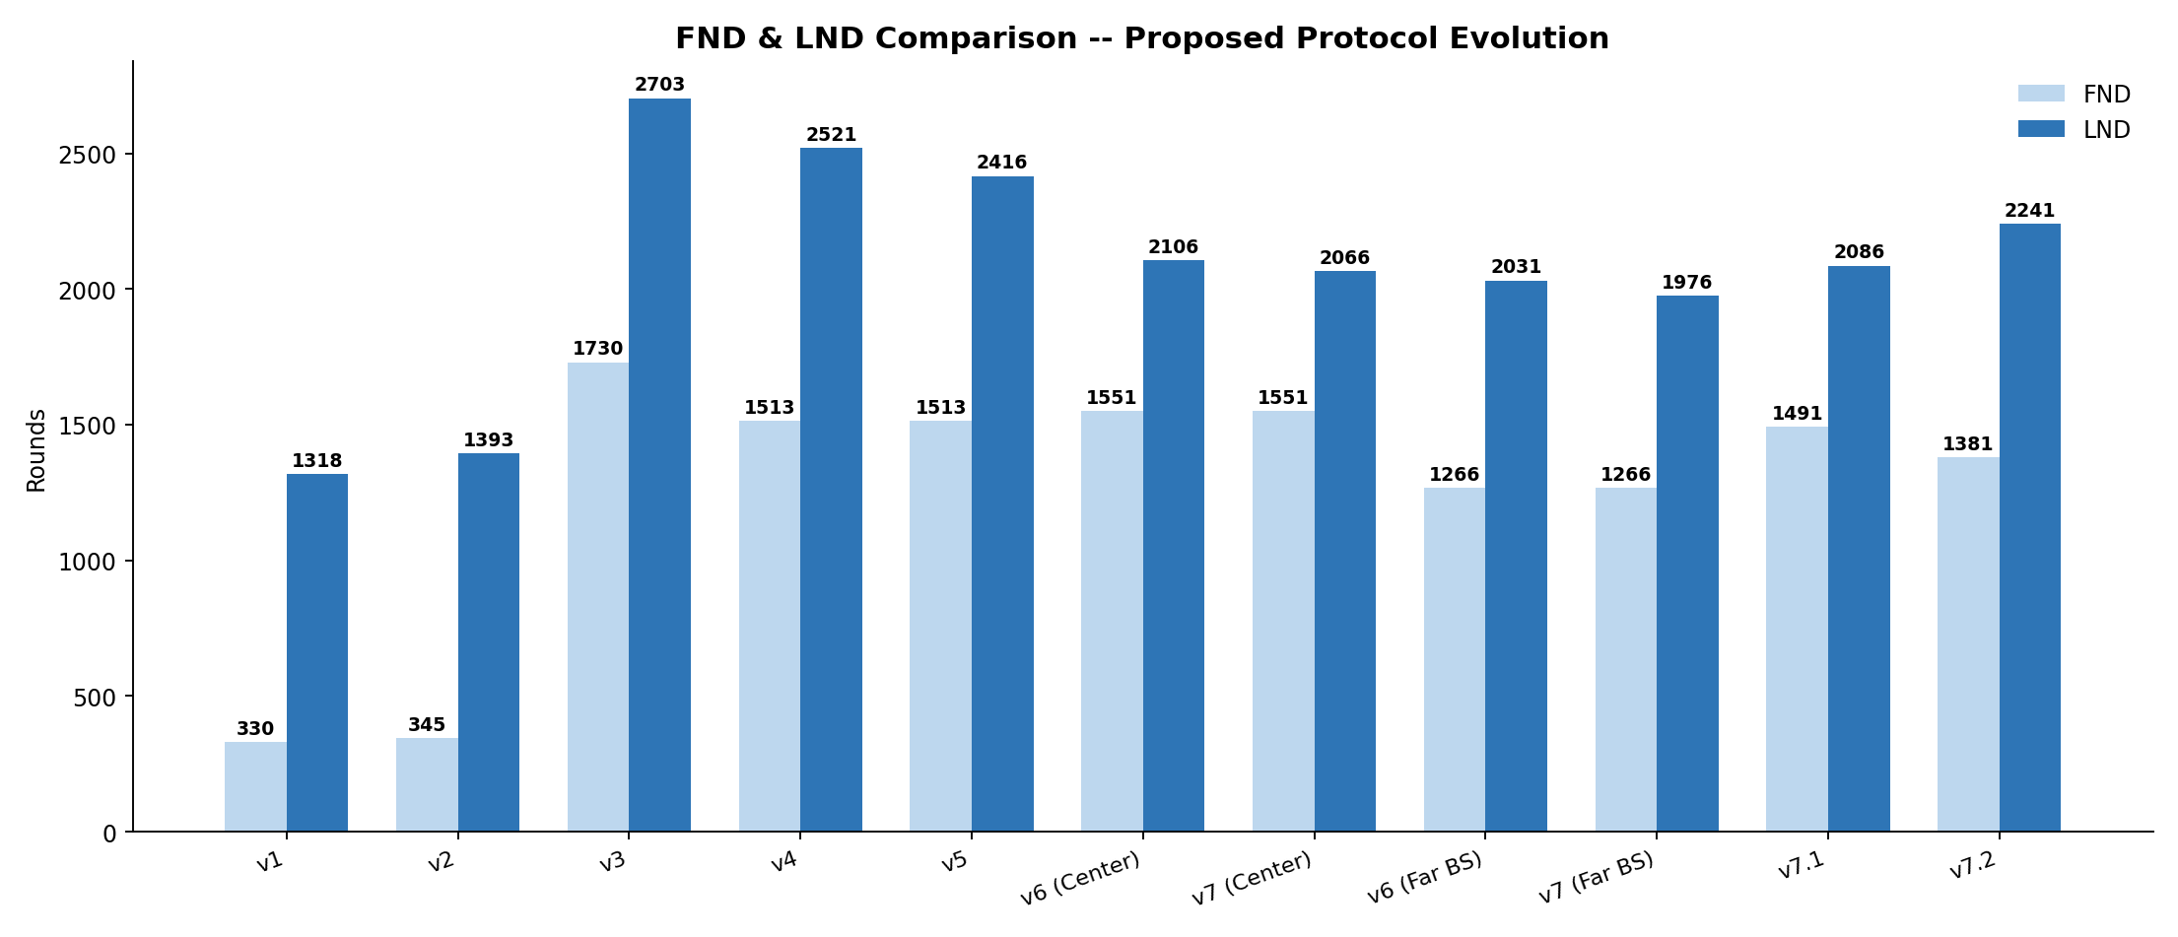
Lifetime & Reliability Trend, v1 -> v7
7.5

Slide 60
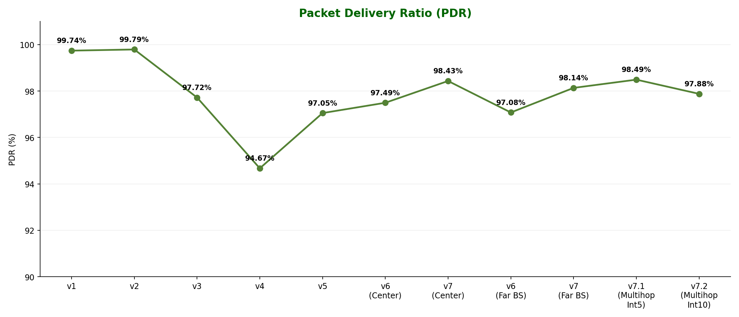
Lifetime & Reliability Trend, v1 -> v7
7.5

Slide 61
SECTION 8
Proposed Protocol Experiments & Variants
Backup CH Failover, CH-to-CH Chain, Multihop Routing, Setup Interval, Center vs Far-BS

Slide 62
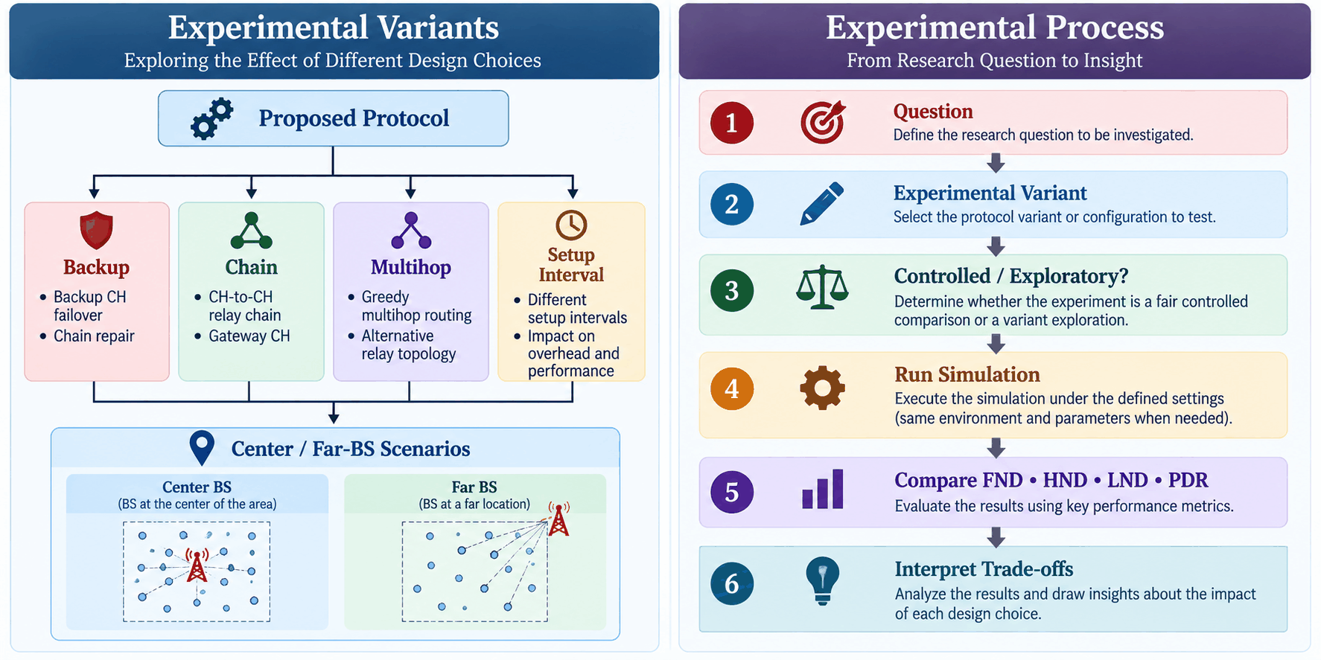
Experimental Variants
8.3
Why Multiple Experimental Variants?
The proposed protocol was not evaluated as a single fixed configuration.
Different variants were introduced to investigate the effect of individual design decisions:
Two Types of Experiments
Experimental Type | Purpose
Controlled Comparison | Change one major factor while keeping the remaining conditions fixed
Variant Exploration | Explore alternative configurations or combinations of mechanisms

Slide 63
Experimental Variants
8.3
Controlled Comparison
Used to isolate the effect of a specific modification whenever possible.
Examples:
v3 → v4: Setup interval
v4 → v5: Backup CH
v6 (Far-BS) → v7 (Far-BS): Backup + Chain Repair
v7 Chain → v7 Multihop Int5: Relay topology
Variant Exploration
Used when multiple design factors change together or when investigating an alternative architecture.
Examples:
Setup-interval variants: 5 / 10 / 15 rounds
Center-BS vs. Far-BS scenarios
Chain vs. Multihop routing configurations

Slide 64
Backup CH Failover & Chain Repair -- Robustness Fixes
8.1
Why Test Backup CH Failover?
A CH may die before the next cluster setup phase.
Without recovery:
CH Failure ➔ Cluster loses its CH ➔ Nodes become disconnected
Experimental Modifications
1. Backup CH Failover
• Designate a backup CH during cluster formation.
• Promote the backup when the primary CH fails.
• Preserve cluster operation during the current setup interval.
2. Routing Repair
When a failed CH is part of the inter-CH routing structure:
CH₁ → CH₂ → CH₃ → CH₄
✕
Failure
The relay structure must be repaired:
CH₁ → Backup → CH₃ → CH₄

Slide 65
Backup CH Failover & Chain Repair -- Robustness Fixes
8.1
What We Measure
Backup Promotions
• Rejected Promotions
• Partial Promotions
• Emergency Promotions
• Chain/Routing Repairs
• FND / HND / LND / PDR
Important Experimental Distinction
Bug fixes are implementation corrections, not new protocol mechanisms.

Slide 66
Backup CH Failover & Chain Repair -- Robustness Fixes
8.1
Bug-Fix Experiment
During v7 development, two implementation issues were identified:
1. Zero-CH Selection
Previously, a selection restriction could result in:
CH_Count = 0
The selection logic was modified to provide a fallback when all eligible nodes had already served.
2. Backup Promotion Rejection
The original backup check could reject a backup if it could not cover the entire remaining setup interval, even when it had enough energy to operate for the next round.
The revised mechanism allows:
Tier 1: designated backup promotion
Tier 2: emergency promotion from a surviving cluster member

Slide 67
CH-to-CH Chain vs. Multihop Routing Tree
8.2
Research Question
Does the relay topology affect the behavior of the proposed protocol?
Variant A — CH-to-CH Chain
CH₁ → CH₂ → CH₃ → CH₄ → BS
Single ordered relay structure
Gateway CH connects to BS
Variant B — Greedy Multihop Routing
→ CH₂ →
CH₁ → → BS
→ CH₃ →
Each CH selects a next-hop CH that is:
Closer to the BS
Within communication range
This creates a multihop routing tree/forest rather than one single chain.

Slide 68
CH-to-CH Chain vs. Multihop Routing Tree
8.2
Controlled Comparison
For a fair comparison:
Only Major Factor Changed
➔ Relay topology: CH-to-CH chain → greedy multihop routing
Metrics
FND • HND • LND • PDR
Backup Promotions • Chain/Routing Repairs
Parameter | Chain | Multihop
Area | 100 × 100 m | 100 × 100 m
BS | Center | Center
Range | 25 m | 25 m
Radio Model | Two-slope | Two-slope
Setup Interval | 5 rounds | 5 rounds
Backup | Yes | Yes
Failure Recovery | Yes | Yes

Slide 69
Center vs. Far-BS + Setup Interval
8.3
A. Center BS vs. Far BS
Research Question
How does BS placement affect the behavior of the proposed relay-based protocol?
Center BS
BS
●
↙ ↓ ↘
CH CH CH
Far BS
CH CH CH
\ | / \ | /
────────→ BS

Slide 70
Center vs. Far-BS + Setup Interval
8.3
Controlled Scenario
For v6:
Center BS
→ v6 Chain
Far BS
→ v6 Chain
The major changed factor is: BS Location
Similarly, v7 can be evaluated under:
Center BS → v7 Chain + Backup
Far BS → v7 Chain + Backup
Purpose
Evaluate whether the relay and recovery mechanisms behave differently when the BS is located far from the sensing field.

Slide 71
Center vs. Far-BS + Setup Interval
8.3
B. Setup-Interval Variations
Research Question
How does the frequency of cluster re-formation affect energy consumption and reliability?
Short Interval
Setup → 5 rounds → Setup → 5 rounds → Setup
Advantages
More frequent cluster adaptation
Potential Cost
Higher setup/control overhead
Long Interval
Setup → 10/15 rounds → Setup → 10/15 rounds
Advantages
Fewer setup operations
Lower repeated control overhead
Potential Cost
Clusters may become stale
CH failures may persist longer before re-clustering

Slide 72
Center vs. Far-BS + Setup Interval
8.3
Experiments Already Performed
Important Note
The 5 → 15 comparison in v3 → v4 is a controlled setup-interval experiment.
But:
v7 Multihop Int5 → Int10 is a setup-interval comparison within the multihop architecture, while v7 Chain Int5 → Multihop Int10 is not a pure topology comparison because both topology and interval change.
Experiment | Setup Interval
v3 | 5 rounds
v4 | 15 rounds
v7 Multihop | 5 rounds
v7 Multihop Variant | 10 rounds

Slide 73
SECTION 9
Comparative Results & Discussion
FND/HND/LND, PDR Graphs, Fair 2x2 Comparison, Original Far-BS/50x50 Check, Variant Explorations, Observations

Slide 74
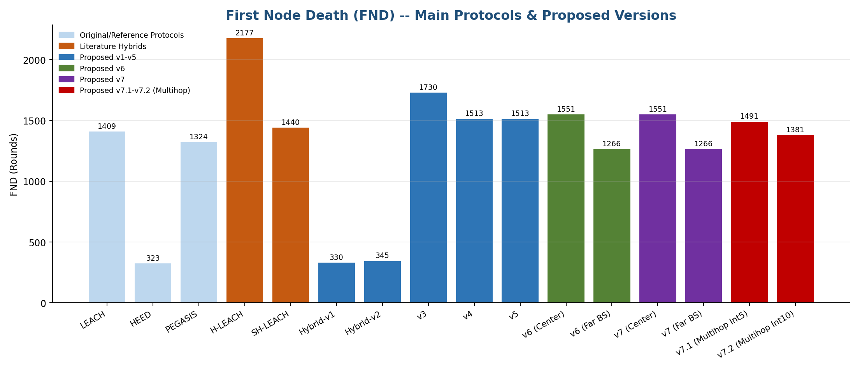
First Node Death (FND) Comparison
34

Slide 75
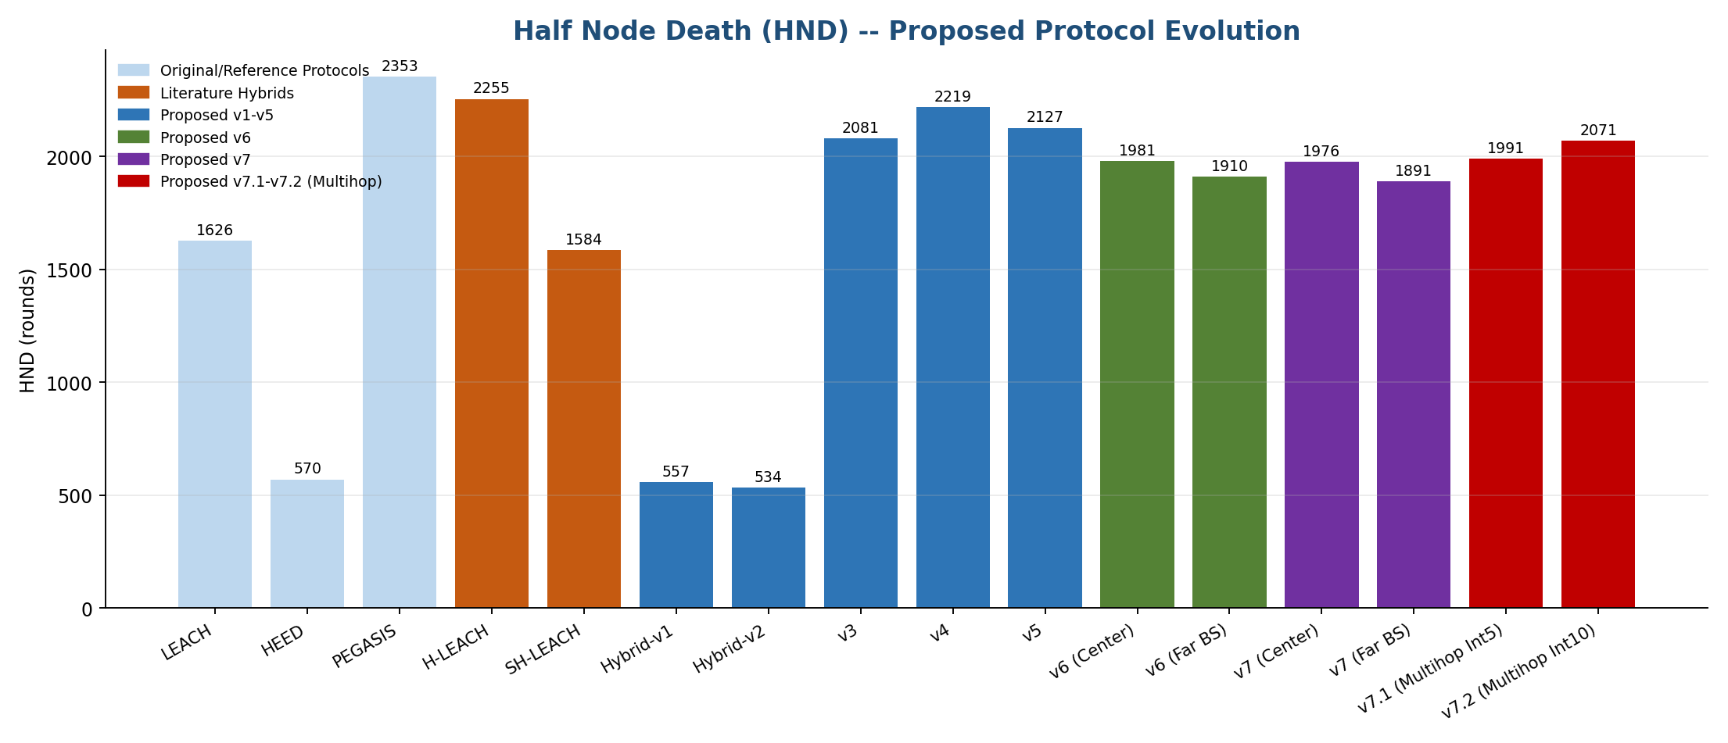
Half Node Death (HND) Comparison
35

Slide 76
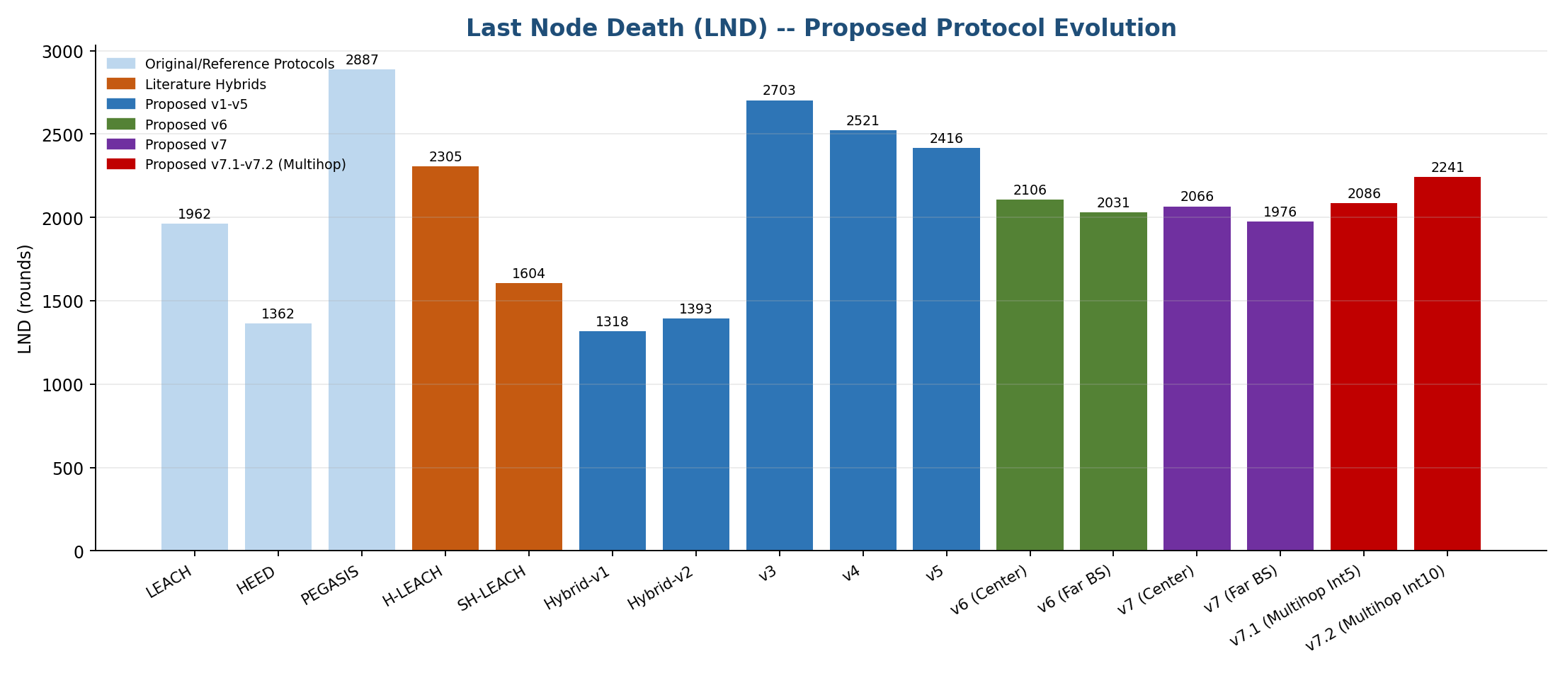
Last Node Death (LND) Comparison
36

Slide 77
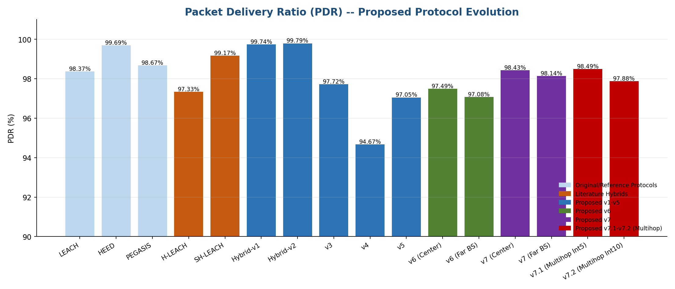
Packet Delivery Ratio (PDR) Comparison
37

Slide 78
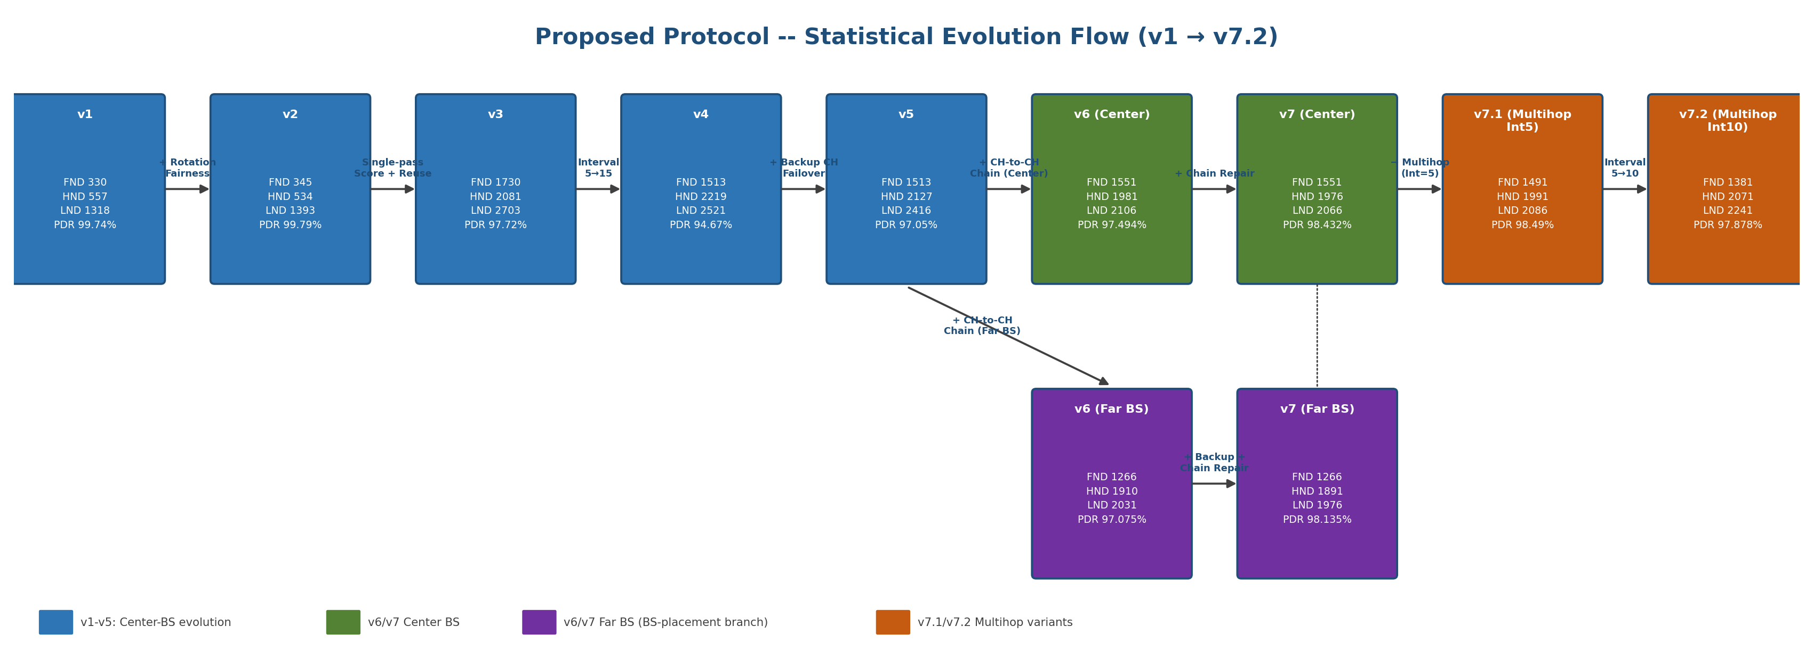
Packet Delivery Ratio (PDR) Comparison
37

Slide 79
Controlled Comparisons
38
Comparison | Changed Factor | Main Observation
v3 → v4 | Setup interval: 5 → 15 | Lower setup frequency, but PDR decreased
v4 → v5 | Backup CH | PDR increased; HND/LND decreased
v3 Far → v6 Far | CH-to-CH chain | FND/HND/LND and PDR all increased
v6 Center → v7 Center | Backup + chain repair | PDR increased; FND unchanged
v6 Far → v7 Far | Backup + chain repair | PDR increased; FND unchanged
v7 Chain → v7 Multihop Int5 | Relay topology | Evaluates chain vs. multihop under controlled settings
v7.1 Multihop Int5 → v7.2 Multihop Int10 | Setup interval: 5 → 10 | FND decreased; HND/LND increased; PDR slightly decreased

Slide 80
Trade-off 1: Lifetime vs. Reliability
38.1
• Longer lifetime does not necessarily mean higher PDR.
Example: v4 → v5 | v4 | v5
PDR | 94.673% | 97.055%
HND | 2219 | 2127
LND | 2521 | 2416

Slide 81
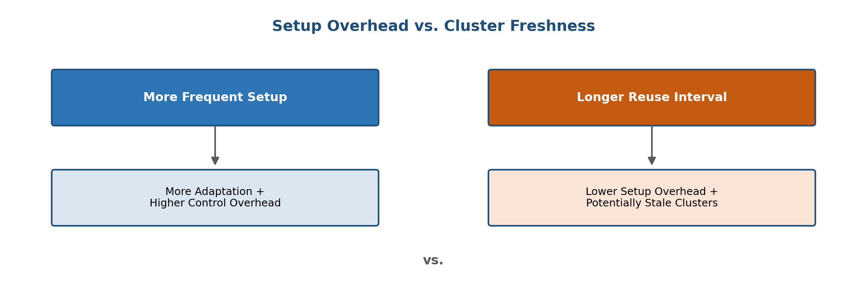
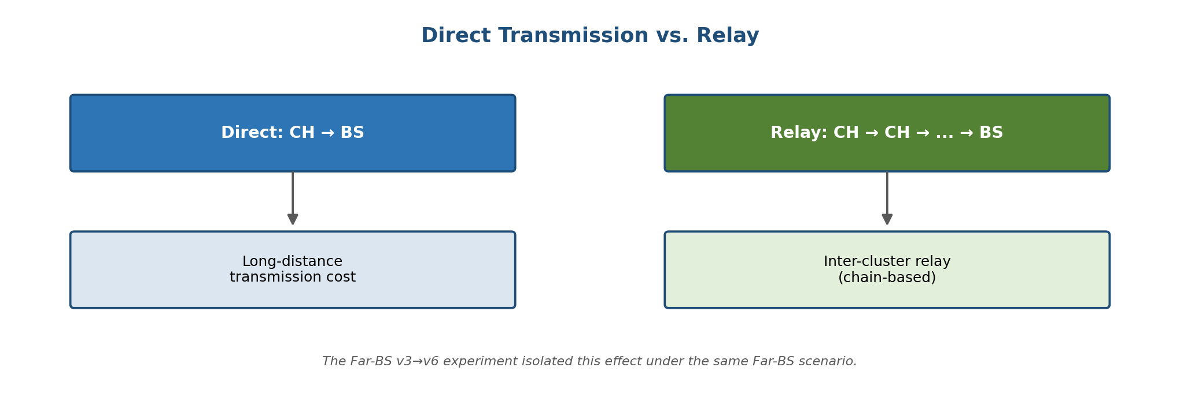
Trade-off 2 & 3: Overhead vs. Freshness, Direct vs. Relay
38.2-3

Slide 82
Trade-off 4: Recovery vs. Lifetime -- Final Takeaway
38.4
• Backup CH recovery is primarily intended to maintain connectivity and data forwarding after a CH failure.
• Recovery mechanisms improve network robustness, but their effect on FND/HND/LND depends on the network state and the recovery overhead.
Final Takeaway
The experiments show that different modifications affect different aspects of network behavior.
The proposed protocol therefore involves trade-offs among energy efficiency, network lifetime, communication reliability, and recovery capability.

Slide 83
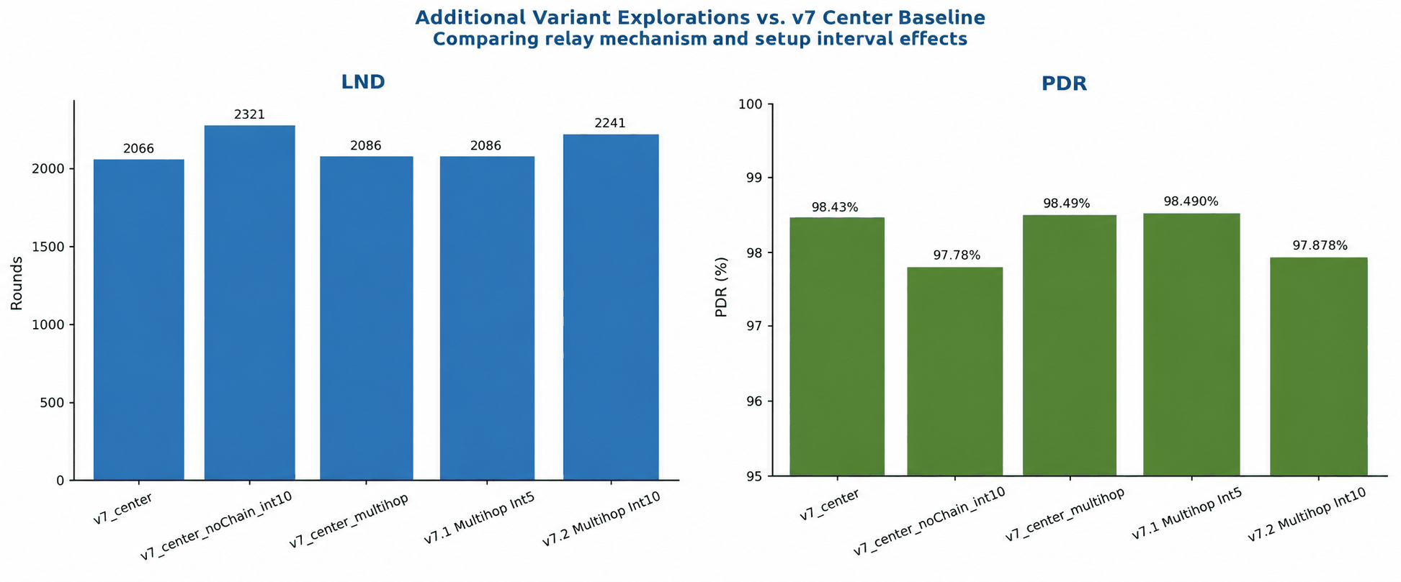
Variant Explorations: No-Chain/Interval=10 vs. Multihop
9.7

Slide 84
Observations & Trade-offs by Scenario
9.8
Priority / Scenario | Observed Result | Trade-off
Lifetime-oriented, center/near BS | v3 achieved the highest observed LND among the non-relay variants (2703 rounds). | No inter-CH relay or recovery overhead, but no failure recovery during the setup interval.
Reliability-oriented, center BS | v7 Center achieved 98.43% PDR, while v7.1 Multihop Int5 reached 98.49%. | Higher reliability is associated with additional inter-CH routing and recovery mechanisms.
Far-BS scenario | v6/v7 Far-BS maintained inter-CH relay and recovery mechanisms under a far BS location. | Far-BS increases communication burden compared with the center-BS scenario.
Chain vs. Multihop | v7.1 Multihop Int5: LND = 2086, PDR = 98.49%. This variant evaluates multihop routing under the same 5-round setup interval. | Multihop replaces the single-chain relay structure with next-hop routing among CHs, adding routing decisions/bookkeeping.
Longer setup interval / fewer control rounds | v7.2 Multihop Int10 achieved LND = 2241, compared with 2086 for v7.1 Multihop Int5. | Fewer setup phases increased LND, but PDR decreased from 98.49% → 97.88%.
No inter-CH relay / interval = 10 | No-Chain Int10 achieved LND = 2321, the highest LND among the compared recent variants. | Eliminates inter-CH relay overhead, but CHs transmit directly to the BS and there is no relay path.

Slide 85
SECTION 10
Research Findings, Limitations & Future Work
What we learned, what remains open

Slide 86
Key Findings
10.1
CH Selection Matters -- Replacing HEED's iterative negotiation with a single-pass Energy x Connectivity score (v2->v3) produced the single largest reliability jump in the whole study (LND +94%), showing that clustering-decision quality dominates over parameter tuning.
Cluster Reuse Trade-off – Re-computing cluster heads only once every several rounds (rather than every round) cuts control-message overhead, but stretching the interval too far without protection (v3->v4, interval 5->15) regresses every metric; interval length is a separate lever from CH-selection quality.
CH-to-CH Relay Improves Reach -- Introducing a CH-to-CH relay chain (v6), tested under identical field/radio conditions at both a center and a far base-station placement, raised PDR at the center placement (97.05%->97.49%) and let the far-BS configuration match the center configuration's FND (1266) by shortening each CH's average hop distance to the sink.

Slide 87
Key Findings
10.1
Backup + Chain/Routing Repair Improves Recovery -- Backup CH failover plus chain repair (v7) lets a promoted backup inherit its dead predecessor's position in the relay path instead of breaking it, raising PDR further at both base-station placements (Center 97.49%->98.43%; Far BS 97.08%->98.14%) at only a small LND cost. Recovery-count validation (100 simulation runs) confirmed 16/16 successful promotions and repairs at the center placement and 21/21 at the far-BS placement.
No Single Modification Optimized All Metrics -- Each proposed step traded off differently: v3 maximized LND/lifetime, v1/v2 maximized PDR, v7 balanced reliability and lifetime best, and the Multihop variants (v7.1/v7.2) pushed PDR to the family's highest point (98.49%) by removing the single-gateway bottleneck of the ordered chain, at a small cost to FND. This confirms that CH-selection quality, cluster-reuse interval, relay topology, and recovery mechanism are four independent design levers, not one.
Preventing CH Death Beats Repairing It -- The optimized v8 adds proactive CH handover (before death) to v5's backup failover (after death), plus direct-to-BS delivery and an energy-gated CH election. At the center BS it reaches FND 2621 / HND 2711 / LND 2761 / PDR 99.22% -- the best of the whole family, with 33% more packets delivered for the same 50 J. The gain is geometry-dependent: at a far BS the relay chain (v7) still gives longer HND/LND.

Slide 88
Limitations & Future Work
10.2
Analytical 100-Node Simulation -- Results come from a custom discrete-event/analytical simulation of a 100-node network, not a hardware testbed; real radio effects (multipath fading, interference, collisions) are approximated, not directly measured.
Limited Deployment Scenarios -- Only two base-station placements (field center and far corner) and a small set of network sizes/densities were tested; behavior at much larger scale or irregular topologies is not yet characterized.
Parameter Sensitivity -- Setup-interval length (5 vs 10 vs 15 rounds) was shown to matter a great deal, but the full sensitivity surface (interacting with node count, radio range, and energy model) was not exhaustively swept.
Recovery Mechanism Scope -- Backup-CH failover and chain/routing repair were validated for single-CH-death events; simultaneous multi-CH failure and adversarial/malicious node behavior were outside this study's scope.

Slide 89
Limitations & Future Work
10.2
Physical Wireless Validation -- Port the protocol to a real WSN hardware testbed (e.g., TelosB/Zolertia motes or an SDR-based emulation) to validate the analytical FND/HND/LND/PDR results against real radio conditions.
Scalability Analysis -- Extend testing to substantially larger networks (500-1000+ nodes) and irregular/obstacle-laden topologies to confirm the CH-to-CH and multihop relay designs scale gracefully.
Routing Optimization -- Explore adaptive setup-interval selection (rather than a fixed 5/10/15-round interval) that reacts to observed CH death rate, and extend the greedy multihop tree to a more globally-optimized routing scheme.
Security Integration -- This thesis's hybrid-cryptography security layer was evaluated separately from these clustering/routing experiments; future work should co-evaluate security overhead (key exchange, authentication) together with the best-performing clustering/routing configuration (v7 / v7.1) under adversarial conditions.

Slide 90
Conclusion
11
This thesis set out to design an energy-efficient, secure clustering protocol for wireless sensor networks that improves on LEACH-family baselines (LEACH, HEED, PEGASIS) and literature hybrids (H-LEACH, SH-LEACH) without sacrificing packet delivery reliability. Starting from a HEED-style cluster-head selection combined with LEACH-style clustering (v1), the protocol was evolved through eleven versions (v1 through v7.2), each introducing one isolated mechanism: a rotation-fairness penalty, a single-pass energy x connectivity scoring function, multi-round cluster-head reuse, backup cluster-head failover, CH-to-CH relay chaining (tested at two base-station placements), chain/routing repair, and finally greedy multihop routing at two setup intervals.

Slide 91
Conclusion
11
The evolution shows that clustering-decision quality (v2->v3) and relay-path resilience (v6->v7) matter far more than any single parameter tweak: the largest reliability gains came from architectural changes, not tuning. The best-balanced configuration is v7 (Center placement), reaching FND 1551 / HND 1976 / LND 2066 / PDR 98.432%, while the Multi-hop variant v7.1 achieves the highest packet delivery ratio in the entire family (PDR 98.49%) by removing the single-gateway bottleneck of the ordered CH-to-CH chain. Combined with the thesis's hybrid cryptography layer, these results demonstrate that energy-aware clustering and secure communication can be co-designed without a significant reliability penalty, providing a practical, extensible foundation for real-world WSN deployments. Building on these lessons, the final optimized v8 -- proactive CH handover plus backup failover, direct-to-BS delivery and an energy-gated CH election -- surpasses every earlier version at the center BS (FND 2621 / HND 2711 / LND 2761 / PDR 99.22%).

Slide 92
Questions & Discussion
Thank you

