Slide 1

Energy-Efficient Secure Clustering in Wireless Sensor Networks Using Hybrid Cryptography
From LEACH, HEED and PEGASIS to a new clustering protocol: v8-Chain
Eng. Rahma Khaled Oshba
Supervised by Dr. Hesham ElZouka · Dr. Amani Saad · Dr. Khaled Saada
Master's thesis

Slide 2








Agenda
Background
Energy & first experiments
Classic protocols
Hybrid protocols
WSNs and clustering
energy model, ns-3, demo
LEACH · HEED · PEGASIS
SH-LEACH · H-LEACH · EECH-HEED
01
02
03
04
Recent work
Proposed protocol
Adding security
Conclusion
and literature review
v1 → v8-Chain
expected cost
limitations · summary
05
06
07
08
2

Slide 3
01
Background
What a wireless sensor network is — and why energy is its main problem

Slide 4
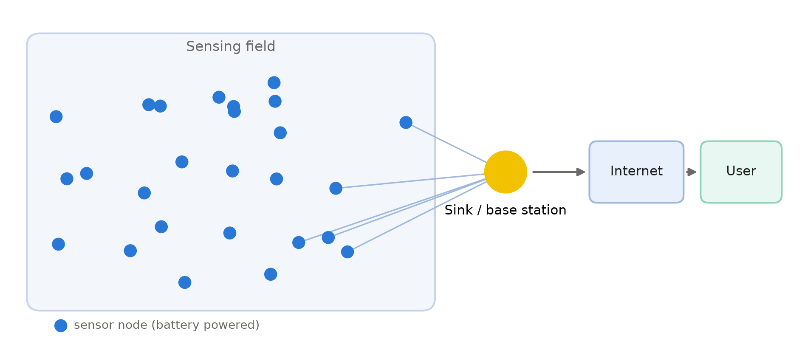






What is a Wireless Sensor Network (WSN)?
Many small battery-powered sensors that measure and report by radio
Sensors are spread over a field (soil, forest, building, body …).
Each sensor measures (temperature, humidity, motion …) and sends its reading by radio.
The readings reach a sink / base station (BS), then the user over the Internet.
Applications
Agriculture
Environment
Health
Industry
Smart city
Security
4
Notes:
A WSN is a set of small battery-powered sensors that measure something and send it by radio to a base station.

Slide 5
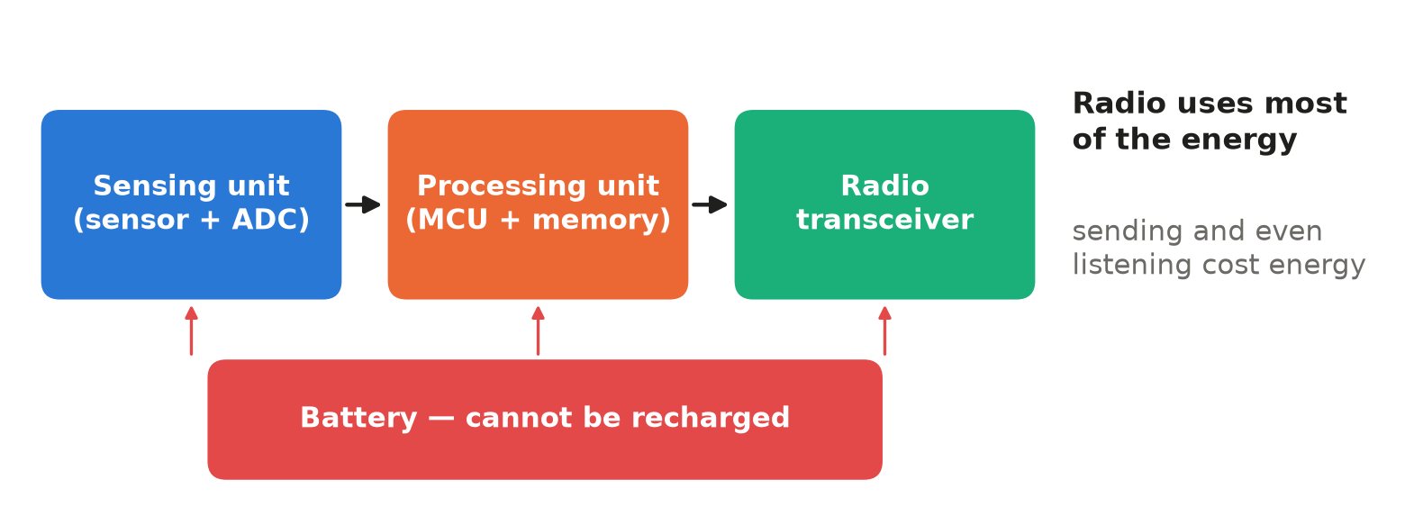


Inside a sensor node
Small, cheap and limited — the battery decides how long it lives
Limited battery
Short radio range
Small CPU and memory
Usually cannot be replaced or recharged in the field.
Tens of metres; far nodes cannot reach the BS cheaply.
Heavy algorithms (and heavy cryptography) are costly.
Radio communication uses most of the energy — even listening costs energy.
5

Slide 6

The main problem: energy
Network lifetime = how long the sensors keep working
Sending one bit costs more the farther it goes: cost grows with d² and, beyond ≈ 88 m, with d⁴.
If every sensor sends directly to a far BS, the far sensors die very early.
When sensors die, parts of the field are no longer monitored.
FND
First Node Dies — round of the first death (stability period). Main metric.
HND
Half Nodes Die — average lifetime.
LND
Last Node Dies — total lifetime.
Solution studied in this thesis: clustering
Group the sensors so that most transmissions are short.
PDR
Packet Delivery Ratio — delivered ÷ generated readings.
6

Slide 7
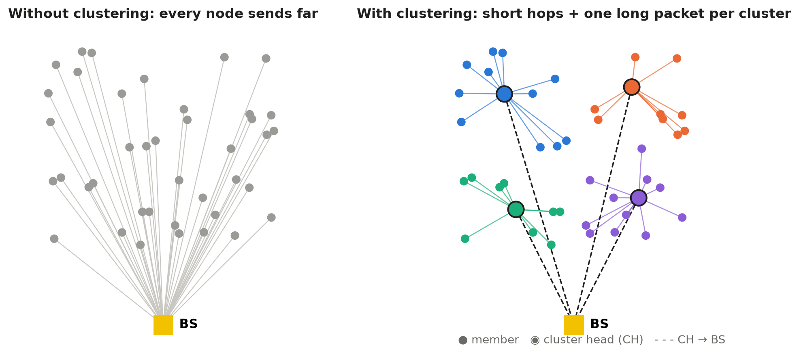
What is clustering?
Members send a short hop to a cluster head (CH); the CH sends one packet to the BS
Cluster head (CH) = the leader of a group. Member = a normal sensor. Fusion = the CH merges all readings into one packet.
7

Slide 8
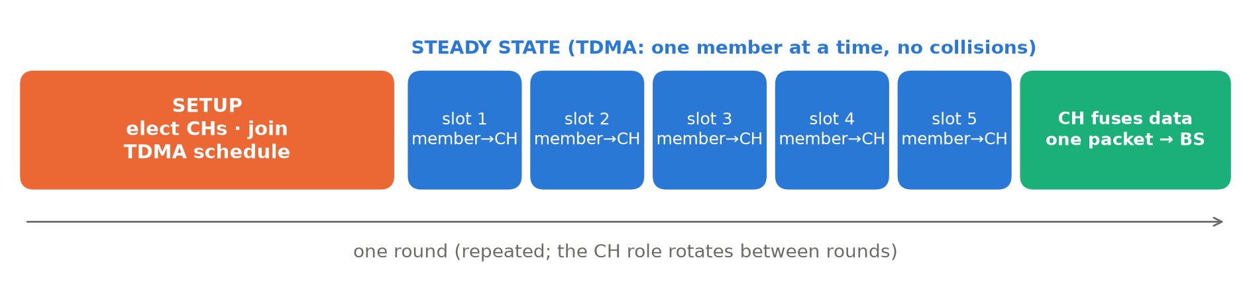
One clustering round
Setup → steady state → the CH role rotates in the next round
Setup
Steady state
Fusion + BS
Choose CHs, CHs advertise, members join the nearest CH, CH sends a TDMA schedule.
Each member sends in its own time slot (TDMA) — no collisions.
The CH fuses members + its own reading and sends one packet to the BS.
Round = one full cycle. Epoch = the rounds needed so that every node serves as CH once.
8

Slide 9





The open problems of clustering
What every protocol in this thesis tries to solve
Who becomes CH?
Fair rotation
Setup overhead
A weak or badly placed CH dies early.
The CH works harder, so the role must rotate.
Electing CHs every round costs messages and energy.
CH failure
Far base station
Security
If the CH dies, its members lose their data.
CH → BS links become very expensive (d⁴).
Radio messages can be read or forged — protection costs energy.
9

Slide 10
02
Energy model & first experiments
How energy is calculated, the tools, and the first ns-3 runs

Slide 11
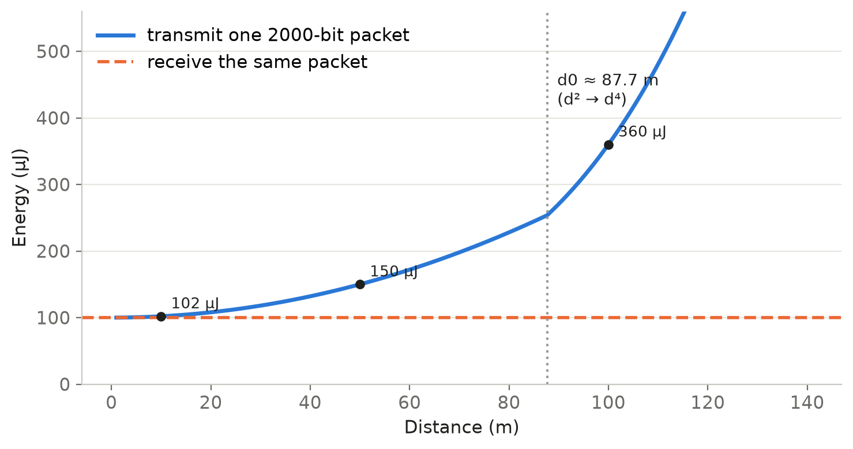
How the energy is calculated
First-order radio model (Heinzelman et al.) — used by every paper we compare with
E_tx(k,d) = k·E_elec + k·ε_fs·d² (d < d0)
E_tx(k,d) = k·E_elec + k·ε_mp·d⁴ (d ≥ d0)
E_rx(k) = k·E_elec
d0 = √(ε_fs / ε_mp) ≈ 87.7 m
Symbol | Meaning | Value
k | bits in the packet | 2000 data / 200 control
E_elec | radio electronics | 50 nJ/bit
ε_fs | amplifier, short range | 10 pJ/bit/m²
ε_mp | amplifier, long range | 0.0013 pJ/bit/m⁴
E_DA | fusion at the CH | 5 nJ/bit/signal
Short links: the electronics dominate — receiving is not free. Long links (> d0): the cost explodes.
11

Slide 12
Worked example — why the CH is the one that dies
100 nodes, 0.5 J each (50 J in total), one 2000-bit reading per node per round
Role in one round | What it pays | Energy
Member (15 m from its CH) | send one packet | ≈ 0.10 mJ
CH with 20 members | receive 20 + fuse 21 + send to BS | ≈ 2.6 mJ
Receiving one control message | 200 bits × 50 nJ | 10 µJ
≈ 26×
a CH spends about 26 times more than a member in the same round
5000
rounds a node could live as a member only (0.5 J ÷ 0.1 mJ)
Every protocol competes on one question: how to rotate the CH role fairly and make it cheaper.
12
Notes:
This is why rotation and CH protection matter. FND measures exactly this.

Slide 13
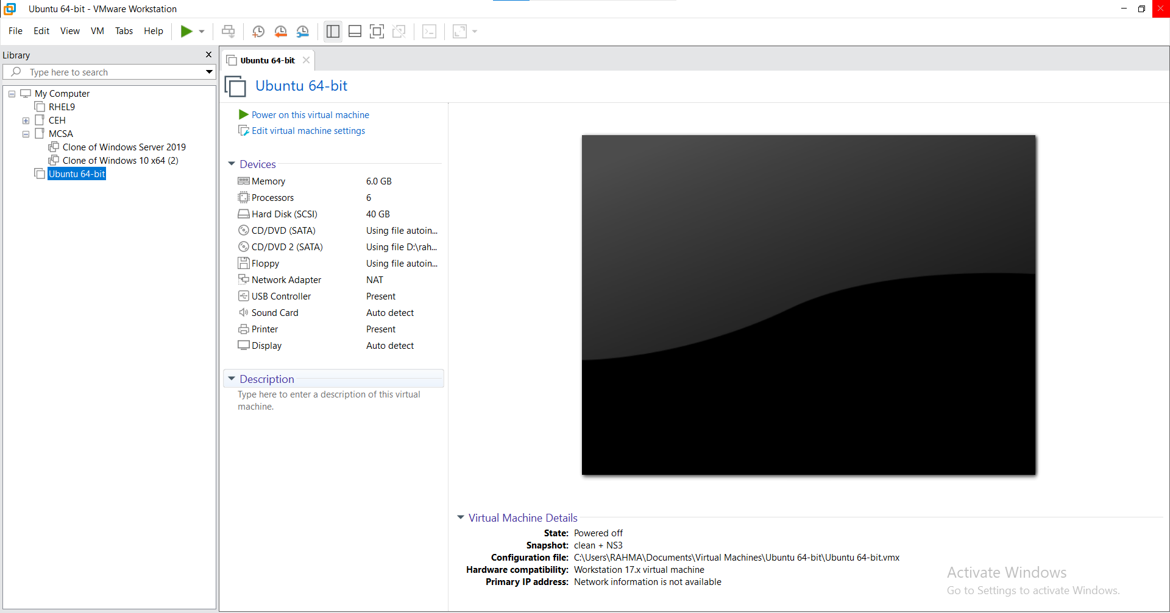

Tools
Ubuntu (VMware) · ns-3.41 (C++) · NetAnim · Wireshark · Python
ns-3.41 built from source inside an Ubuntu virtual machine; results processed in Python.
13

Slide 14
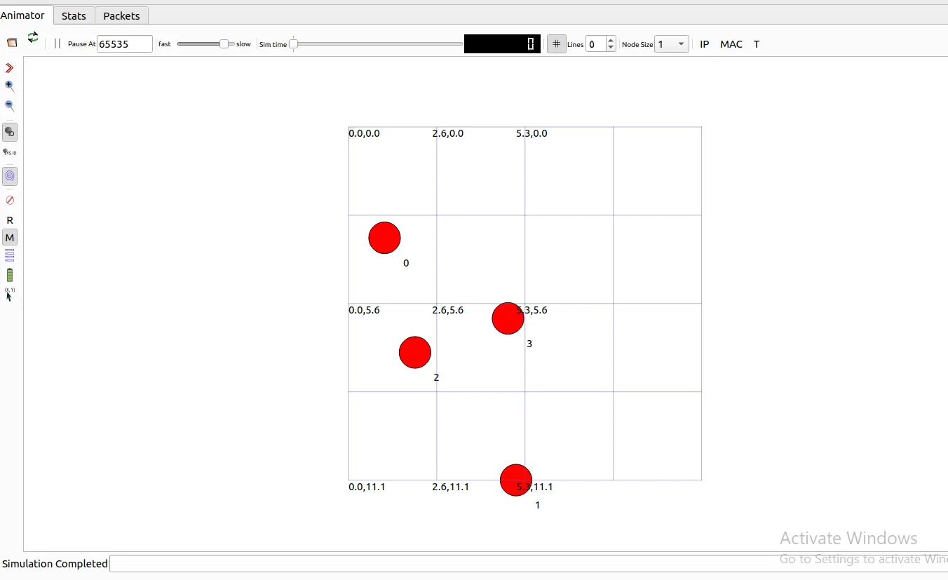
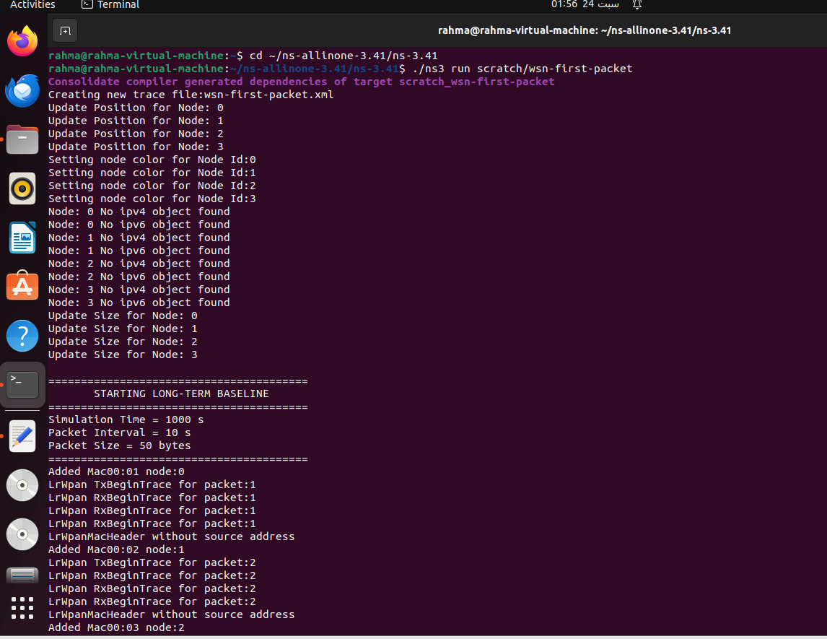
First experiments — real IEEE 802.15.4 packets
WSN-Day3: 3 sensors → sink with ACKs · wsn_first_packet: + energy model + NetAnim
Learned: how packets, ACKs and the energy model work — and that the radio spends energy even when it only listens.
14

Slide 15
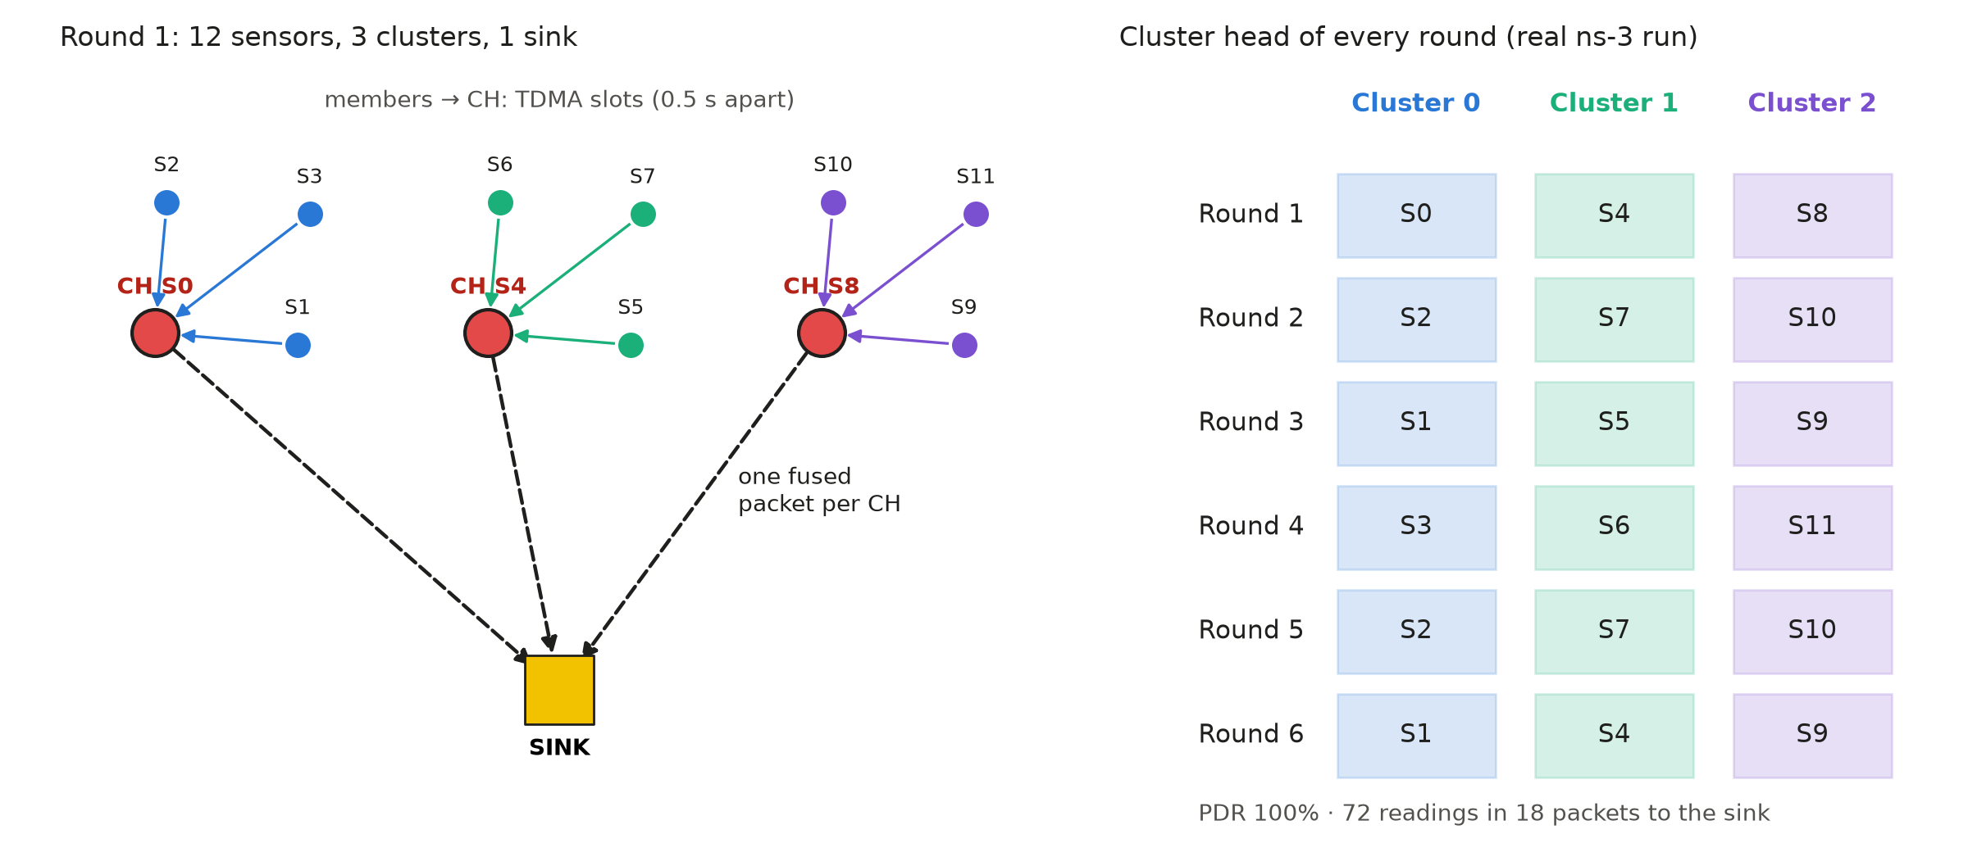
Demo — clustering with real packets
12 sensors · 3 clusters · 1 sink · CH rotates every round · TDMA · fusion
72
100%
18
75%
readings generated in 6 rounds
reached the sink
packets to the sink after fusion
fewer long transmissions
15

Slide 16
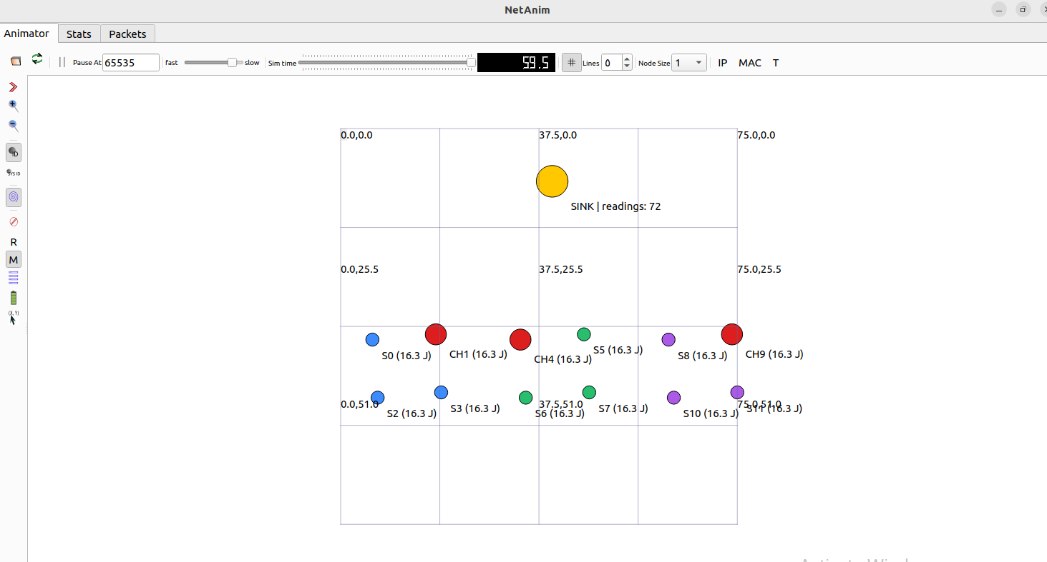
Demo in NetAnim
End of round 6 — red = CH (CH1, CH4, CH9) · colours = clusters · gold = sink with 72 readings
Every node shows its remaining energy (16.3 J of 20 J); the CH role moved to a new node every round.
16

Slide 17
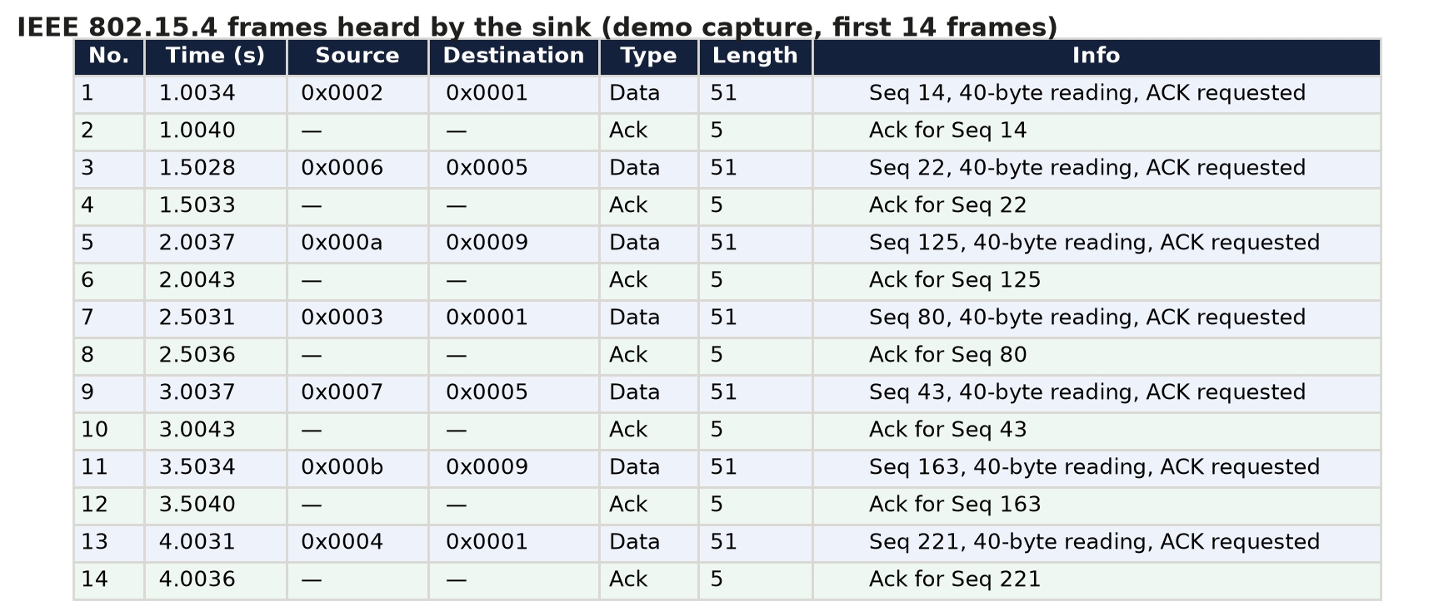
Demo packets in Wireshark
Capture of the sink: 72 data frames + 72 ACKs (IEEE 802.15.4)
Each member frame (51 bytes = 40-byte reading + header + FCS) is answered by a 5-byte ACK.
17

Slide 18
03
Classic protocols
LEACH · HEED · PEGASIS — paper → our ORIGINAL code → our EDITED code

Slide 19



The three classic papers
LEACH (2000) [1]
HEED (2004) [3]
PEGASIS (2002) [4]
Idea
Random CH rotation.
T(n) = P / (1 − P·(r mod 1/P)) if n ∈ G
Weakness
Energy-blind; CHs may be badly placed.
Idea
CH_prob = C_prob·E_res/E_max, doubled every iteration; members join the lowest-cost CH.
Weakness
Negotiation messages every round.
Idea
One greedy chain; data fused along the chain; one leader (i mod N) talks to the BS.
Weakness
Long delay, long chain links, single leader.
19

Slide 20
ORIGINAL — each paper in its own settings
Goal: prove that our code reproduces the paper
 | LEACH | HEED | PEGASIS
Nodes | 100 | 500 | 100
Field | 50 × 50 m | 100 × 100 m | 50 × 50 m
Base station | (25, −100) far | (50, 175) far | (25, 150) far
Energy / node | 0.5 J | 2 J | 0.5 J
Packet | 2000 bits | 1000 bits × 5 frames | 2000 bits
Radio | one amplifier (100 pJ) | two-slope, d0 = 75 m | one amplifier (100 pJ)
Nothing is changed in the algorithms; only the paper's own parameters are used.
20

Slide 21

ORIGINAL results vs the papers
Our code matches the published numbers
Difference
LEACH LND +1.1%
PEGASIS FND +2.4%
PEGASIS HND −3.1%
PEGASIS LND −0.3%
LEACH FND +11.1% (random layout).
HEED: the paper gives graphs only; ours (500 nodes) 734 / 1384 / 2259.
21

Slide 22

EDITED — one unified environment for all protocols
Same algorithms; only the environment changes, so the comparison is fair
Parameter | Value
Nodes | 100, random uniform
Field | 100 × 100 m
Initial energy | 0.5 J per node (50 J total)
Base station | centre (50, 50); far case (50, −100)
Data / control packet | 2000 / 200 bits
Radio model | first-order, two-slope (d² / d⁴)
E_elec | 50 nJ/bit
ε_fs / ε_mp | 10 pJ/bit/m² / 0.0013 pJ/bit/m⁴
d0 = √(ε_fs/ε_mp) | ≈ 87.7 m
E_DA (aggregation) | 5 nJ/bit/signal
Same rules for everyone
• Same node positions (same seed)
• CH advertisement heard by every node
• join + TDMA messages are charged
• CH fuses members + its own reading
• a node without a CH sends directly
• every run lasts until the last node dies
Why these values? They are the standard settings of the LEACH literature and the standard radio model.
22

Slide 23

EDITED results — classic protocols
Unified environment, BS at the centre
LEACH: FND 1383
best first death — the baseline
HEED: FND 634
negotiation paid every round; each message heard by ~20 neighbours
PEGASIS: FND 1324
one 91.5 m chain link killed node 73 early; LND 3504
23

Slide 24
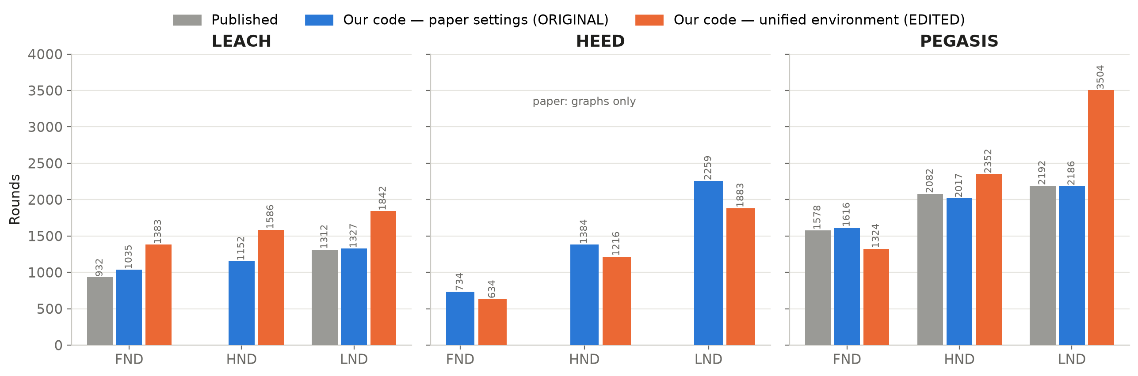
Paper vs ORIGINAL vs EDITED
Why the numbers move between the two environments
LEACH ↑
HEED ↓
PEGASIS FND ↓
cheaper amplifier (10 vs 100 pJ) and a central BS
1 data packet per election instead of 5; fewer nodes, less energy
larger field → one very long greedy link
24

Slide 25
04
Hybrid protocols
LEACH + HEED hybrids — paper → ORIGINAL → EDITED → IMPROVED

Slide 26
The three hybrid papers
Each adds energy (HEED idea) to LEACH-style rotation
SH-LEACH (2015) [5]
P = C·(E/E_max)·(C·r) / (1 + CH_cho mod 1/C)
Energy + round number + CH counter.
H-LEACH (2016) [6]
t(n) = e0 / (1 − e0·(r mod round(1/e0))), e0 = P·E/E_max; CH only if E > E_avg
LEACH threshold with a personal, energy-based probability + an energy gate.
EECH-HEED (2025) [7]
Zone 1 (near BS): HEED. Zone 2: P = (E/E_max)(D/D_max). T = LEACH × α × β
Two zones, multi-hop between CHs, adaptive sensing.
26

Slide 27
ORIGINAL — the hybrids in their own settings
 | SH-LEACH | H-LEACH | EECH-HEED
Deployment | 100 nodes, 100 × 100 m | 100 nodes, 100 × 100 m | 30 near BS + 70 far; 14 advanced nodes
Energy | 0.5 J | 0.5 J | 0.3 – 1.5 J (≈ 56 J total)
Packet | 2000 bits (not stated) | 4000 bits | 4000 bits, E_DA 50 nJ
Radio | one amplifier 100 pJ | two-slope | two-slope
Other | C_prob = 0.1 | no setup messages | adaptive sensing ON
Our result FND / HND / LND | 484 / 583 / 689 | 1078 / 1157 / 1207 | 1121 / 1954 / 3783
Paper | graphs only | LND ≈ 4312 (not reachable*) | 1250 / 1650 / 2200
* With 4000-bit packets the 50 J are used up before round 2500 — the paper must have used an unstated energy value.
27

Slide 28

EDITED — what went wrong
In the unified environment each hybrid shows a design flaw
SH-LEACH
FND 647
r is never reset → the probability keeps growing → up to 100 CHs per round: every node sends alone to the BS.
H-LEACH
FND 1384
"E > average" with equal energy → no CH in round 1 (deadlock); no G-set → bursts of up to 59 CHs.
EECH-HEED
FND 1311
Zone 2: P ≈ 1 → rotation period 1/P ≈ 1 round → the same border nodes are CH every other round (221 times).
All three add energy to LEACH but break its rotation.
28

Slide 29
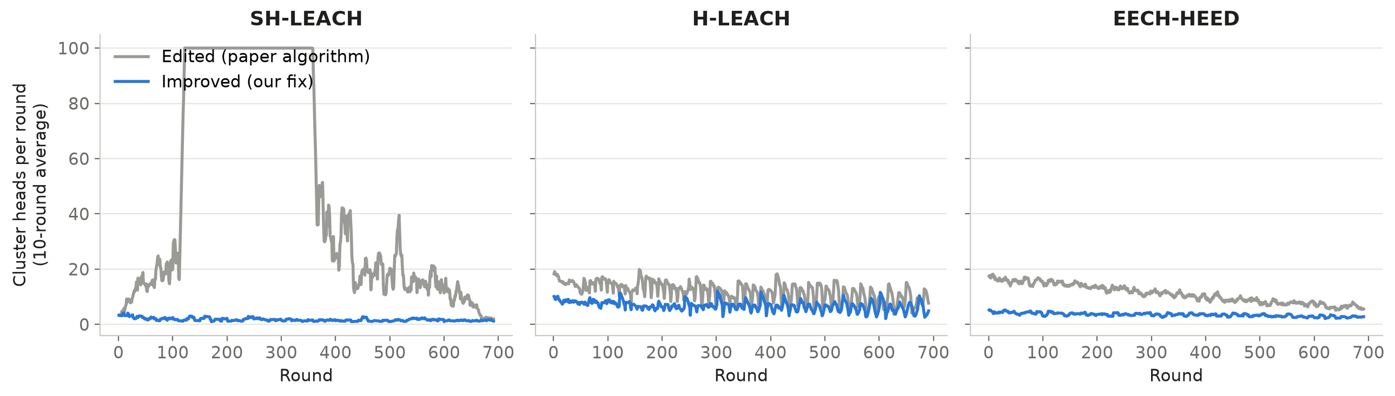
The flaw in numbers — cluster heads per round
Grey = paper algorithm (EDITED) · blue = after our fix (IMPROVED)
SH-LEACH reaches 100 CHs (every node alone); H-LEACH and EECH-HEED elect too many CHs, too often.
29

Slide 30

IMPROVED — our fixes
One or two lines of code per protocol; nothing else changed
SH-LEACH: FND 647 → 1480
r → ((r − 1) mod 1/C) + 1 : the counter restarts every 10 rounds
H-LEACH: FND 1384 → 1473
"E > E_avg" → "E ≥ E_avg" + LEACH G-set restored
EECH-HEED: FND 1311 → 1368
Zone 2 uses the paper's 10 % for the period and the G-set; Eq. 5 becomes a weight
Lesson: energy alone is not enough — the rotation (epoch / G-set) must be kept.
30

Slide 31
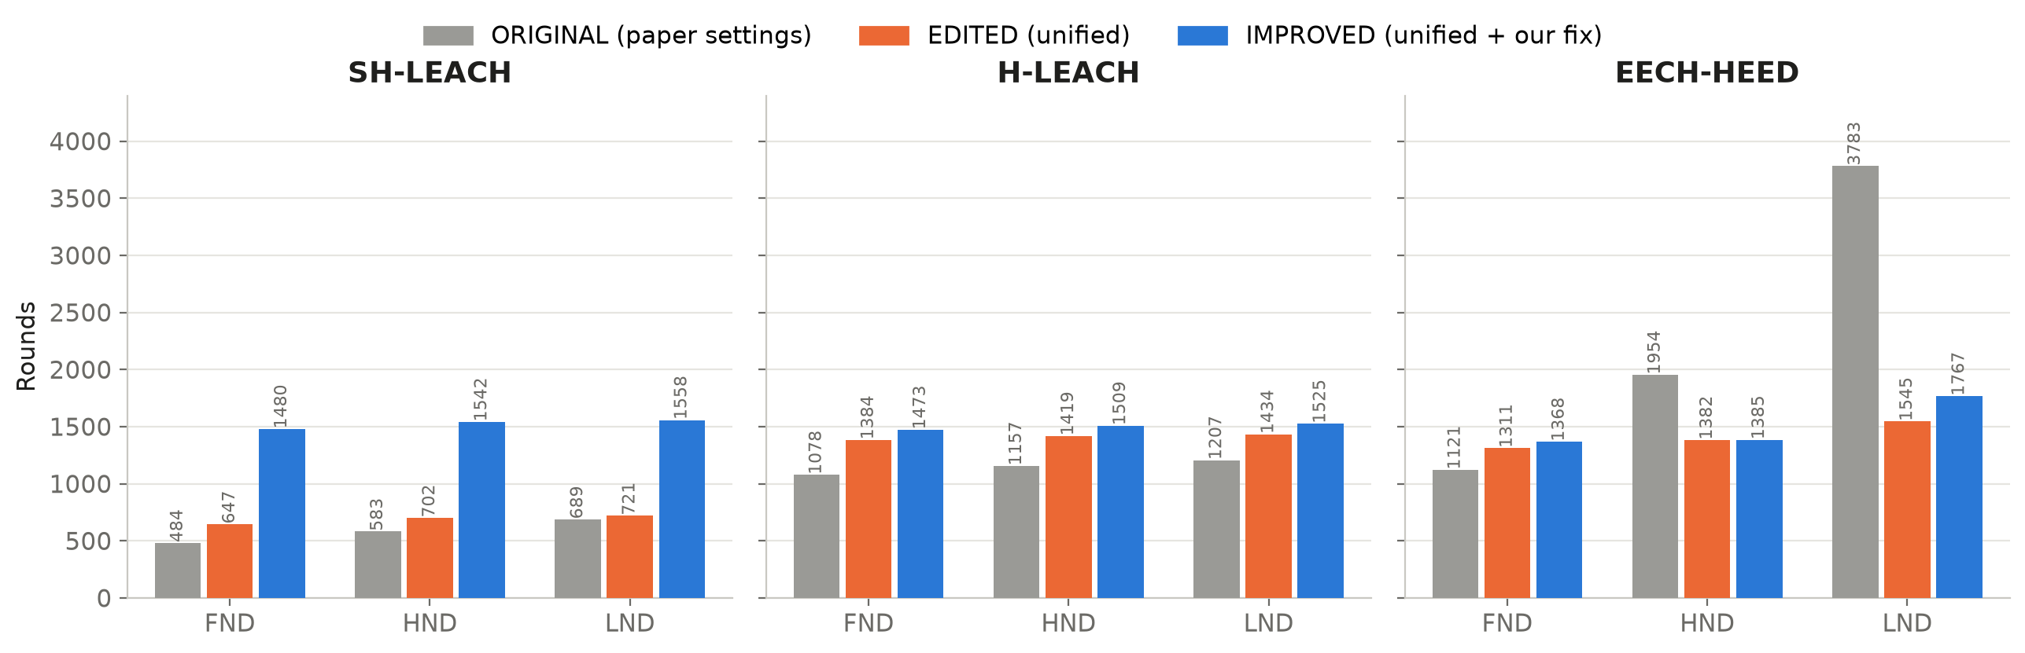
Hybrids — ORIGINAL vs EDITED vs IMPROVED
FND / HND / LND of every version
 | SH-LEACH | H-LEACH | EECH-HEED
ORIGINAL → EDITED | radio model only | packet size + setup messages | deployment + sensing OFF + packet + E_DA
EDITED → IMPROVED | counter restarts | ≥ average + G-set | fixed rotation in zone 2
31

Slide 32
05
Recent work & literature review
Where the research is going (2024 – 2026)

Slide 33
Recent papers (studied, not re-implemented)
They need training data or unpublished models — used to compare ideas
Paper | Idea | Reported result | Limitation
RL-ILEACH 2026 [8] | Q-learning chooses CHs (energy, density, distance) | +784 % lifetime vs LEACH | FND earlier than ILEACH (524 vs 936); learning cost not measured
DL-HEED 2025 [9] | Graph neural network inside HEED | up to +60 % vs HEED | needs training data; heavy on sensors
TLC 2024 [10] | two-level LEACH with a distance threshold | longer lifetime than LEACH variants | no CH-failure protection
EECH-HEED 2025 [7] | two zones + multi-hop + adaptive sensing | FND 1250, PDR 95 % | rotation breaks in zone 2 (fixed by us)
Learning-based election adapts well, but does not always delay the first node death.
33

Slide 34
Literature review — summary
Paper | Year | CH election | Main limitation | Used in our protocol
LEACH [1] | 2000 | random T(n), epoch | energy-blind | rotation T(r) + G-set
LEACH-C [2] | 2002 | central (BS) | global knowledge | radio model
HEED [3] | 2004 | iterative energy + cost | overhead every round | energy × degree (single pass)
PEGASIS [4] | 2002 | chain leader | delay, long links | relay idea (only if cheaper)
SH-LEACH [5] | 2015 | LEACH × energy × r | CH count grows | lesson: keep rotation
H-LEACH [6] | 2016 | LEACH + E > E_avg | deadlock, no G-set | energy gate (I5)
EECH-HEED [7] | 2025 | zones, T·α·β | rotation collapse | relay between CHs
RL-ILEACH [8] / DL-HEED [9] | 2025–26 | learning | training cost | energy + degree features
FTEC [11] · Pachlor [12] | 2019 · 2022 | fault tolerance · rotation review | — | backup CH · handover (I2)
EEUC [13] · Chauhan [14] | 2005 · 2021 | unequal clusters, relays | — | hot-spot lesson, relay rule
34

Slide 35


Research gap
No existing protocol combines
Our answer
• a cheap single-pass CH election (energy + connectivity)
• cluster reuse to cut setup overhead
• protection of the CH before and after it fails
• relaying between CHs only when it saves energy
…and they are never compared in the same environment.
1. Reproduce all protocols fairly (ORIGINAL → EDITED).
2. Fix the flaws of the hybrids (IMPROVED).
3. Build a new protocol step by step (v1 → v8-Chain).
4. Estimate the cost of adding security.
35

Slide 36
06
Proposed protocol
v1 → v8-Chain — one change per version

Slide 37
How the protocol was built
Each version changes one thing, so its effect can be measured alone
v1
v2
v3
v4
v5
v6/v7
v8
v8-Chain
HEED election
FND 322
fairness
FND 338
single pass + reuse
FND 1645
reuse 15
FND 1438
backup CH
FND 1645
CH chain
FND 1415
I1 – I5
FND 2501
smart relay
FND 2501
Two big jumps: v3 (no negotiation + cluster reuse) and v8 (direct-to-BS + energy gate).
37

Slide 38
v1 – v2: starting from HEED
v1 = HEED election + LEACH nearest-CH join · v2 = + fairness penalty cost × (1 + 0.1·timesServed)
What we learned
FND only 322 → 338.
The negotiation of HEED, paid every round, is the real problem — not fairness.
Lesson: remove the iterative negotiation.
38

Slide 39
v3 – v4: single-pass election + cluster reuse
The biggest jump of the whole study
score = T(r) × (E/E0) × (1 + deg/deg_max) = rotation × energy × neighbours
×4.9 longer first-node life
Clusters are kept for 5 rounds, so setup is paid once per 5 rounds.
15 rounds is worse (1438, PDR 95.91%): the CH is overloaded and its members are orphaned when it dies.
Lesson: reuse clusters for 5 rounds — but protect the members when the CH dies.
39

Slide 40

v5: backup CH
The strongest member replaces a dead CH (v5b: only if it has ≥ 5 % of E0)
Version | FND | HND | LND | PDR
v4 | 1438 | 2206 | 2476 | 95.91%
v5 (int 15) | 1438 | 2131 | 2401 | 98.44%
v5-exp (int 5) | 1645 | 2006 | 2101 | 98.82%
v5-exp (int 10) | 1540 | 2091 | 2251 | 98.66%
v5b | 1645 | 2011 | 2106 | 98.56%
Result
The backup protects the data (PDR ↑) but does not delay the first death.
Interval 5 is the best again.
v5b becomes the base of v8.
Lesson: protection improves reliability; lifetime needs something else.
40

Slide 41
v6 – v7: chaining the cluster heads
CHs forward to each other towards the BS (idea from PEGASIS)
Worse, not better
CHs near the BS carry everybody's traffic and die first (the "hot spot" of EEUC [13]).
With the BS at the centre, forced relaying costs more than it saves.
Lesson: relay only when it really saves energy.
41

Slide 42
v8: five improvements on top of v5b
I1 Epoch fix
I2 Handover
I3 Re-join
start a new epoch when nobody is eligible → no round without CHs
a CH that cannot finish the round hands over before it dies
members of a dead CH join the nearest alive CH
2501
I4 Direct-to-BS
I5 Energy gate
a node not farther from the BS than from its CH sends directly
only nodes with E ≥ network average may become CH
FND (v5b 1645) · PDR 99.65%
42

Slide 43
Ablation — which improvement matters?
v8 with one improvement switched off
I4 and I5 make the gain
without I4: 1766
without I5: 2106
I1, I2, I3 are safety nets
no zero-CH rounds, no lost members, stable PDR
43

Slide 44
v8-Chain: energy-aware relay
A CH forwards through another CH only if it is cheaper than going straight to the BS
relay via CH j only if Tx(c → j) + Rx(j) + E_DA(j) < Tx(c → BS)
BS at the centre
BS far away (50, −100)
Centre: nothing to gain, nothing lost (2501). Far BS: +16 % FND (1441 → 1671).
44

Slide 45
Evolution — all versions
First node death (bars) · unified environment, BS at the centre
45

Slide 46
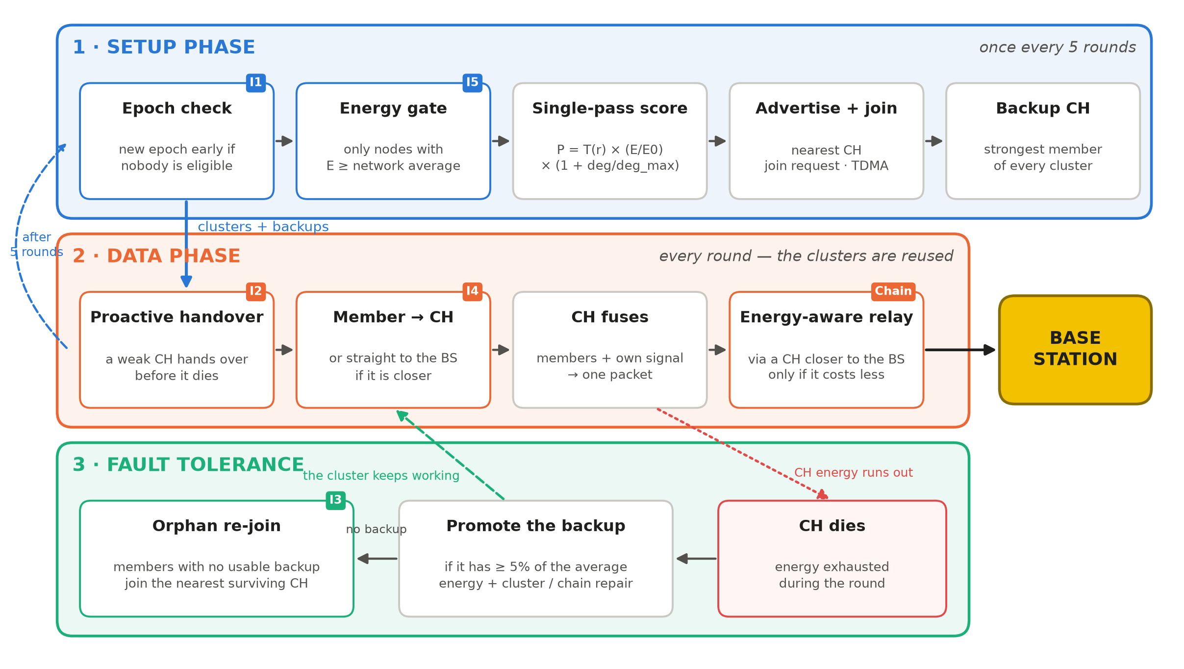
Architecture of v8-Chain
Setup once every 5 rounds · data every round · fault tolerance at any time
46

Slide 47
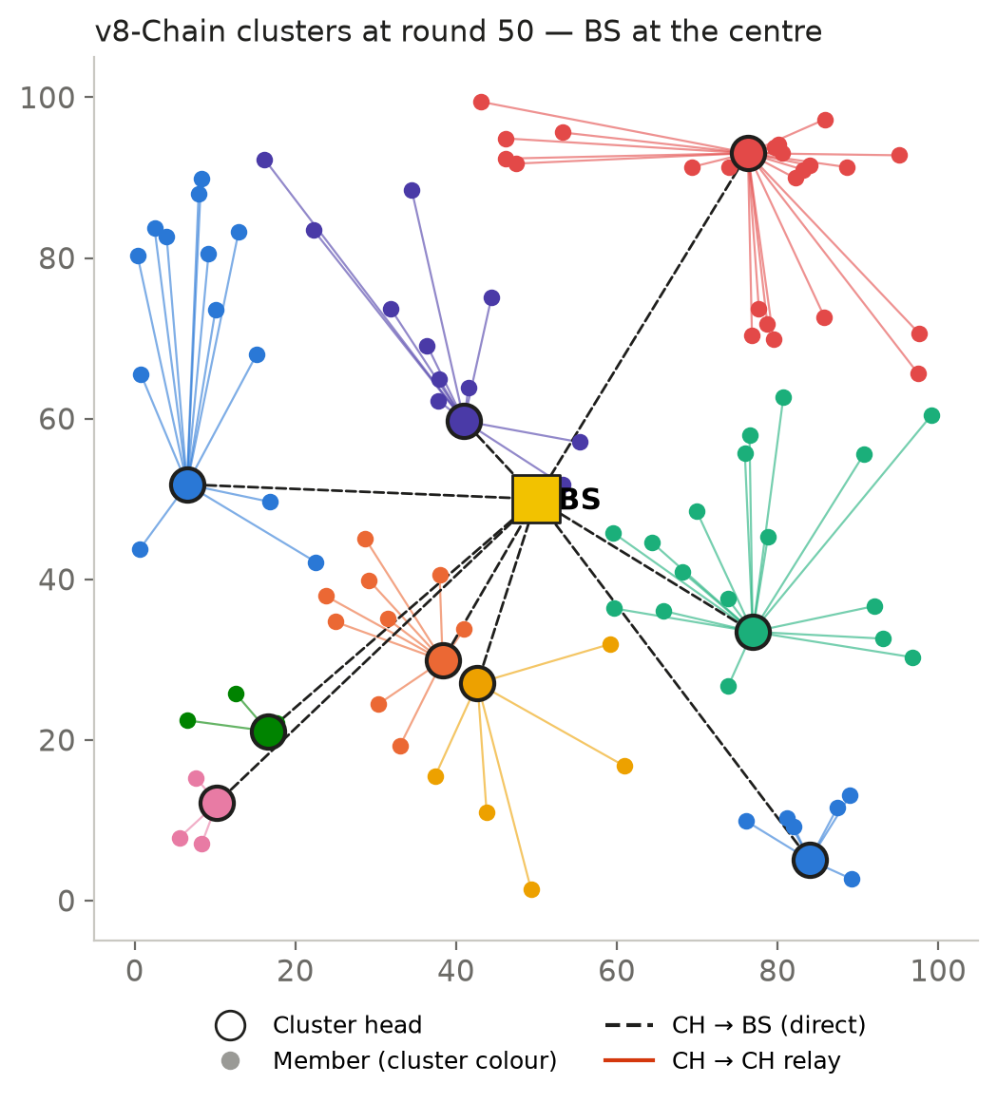
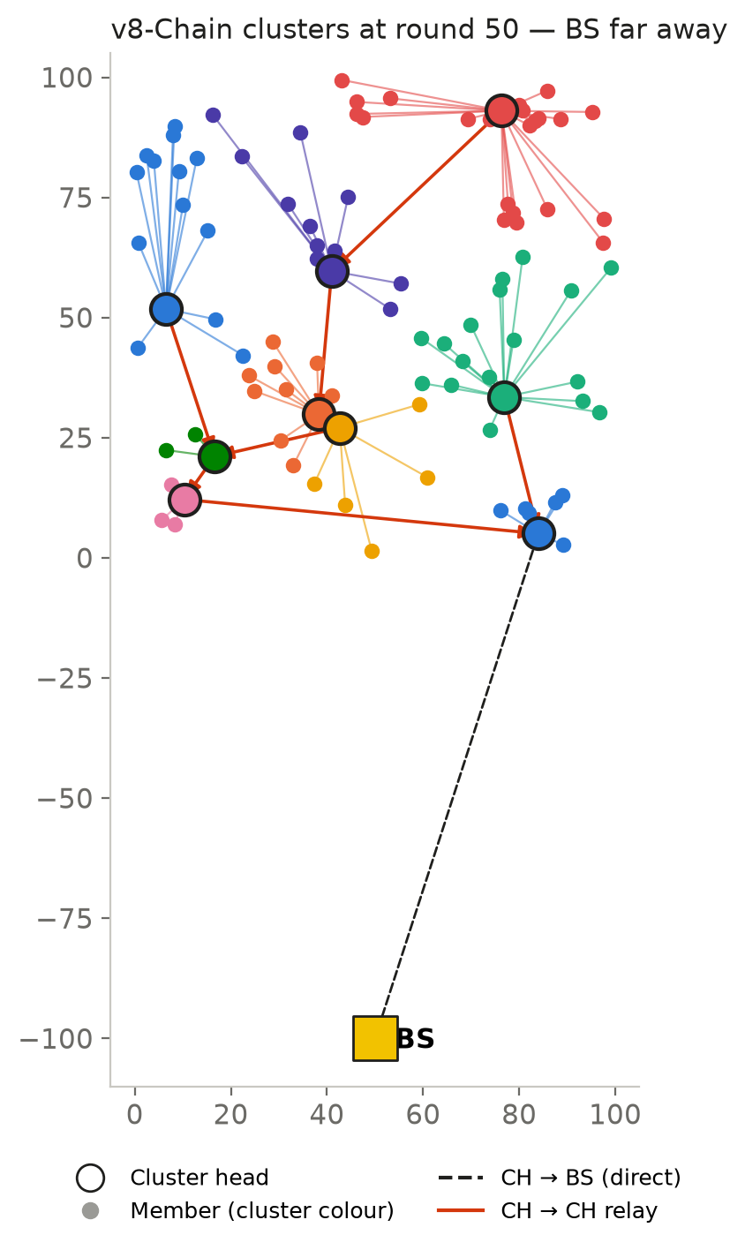
v8-Chain in action
Round 50 — relays appear only where they save energy
47

Slide 48
Final comparison — network lifetime
Best version of every family, unified environment
2501
rounds before the first node dies — the latest of all
+81%
FND vs LEACH (1383)
+69%
FND vs the best hybrid (SH-LEACH+ 1480); +81% vs LEACH
48

Slide 49
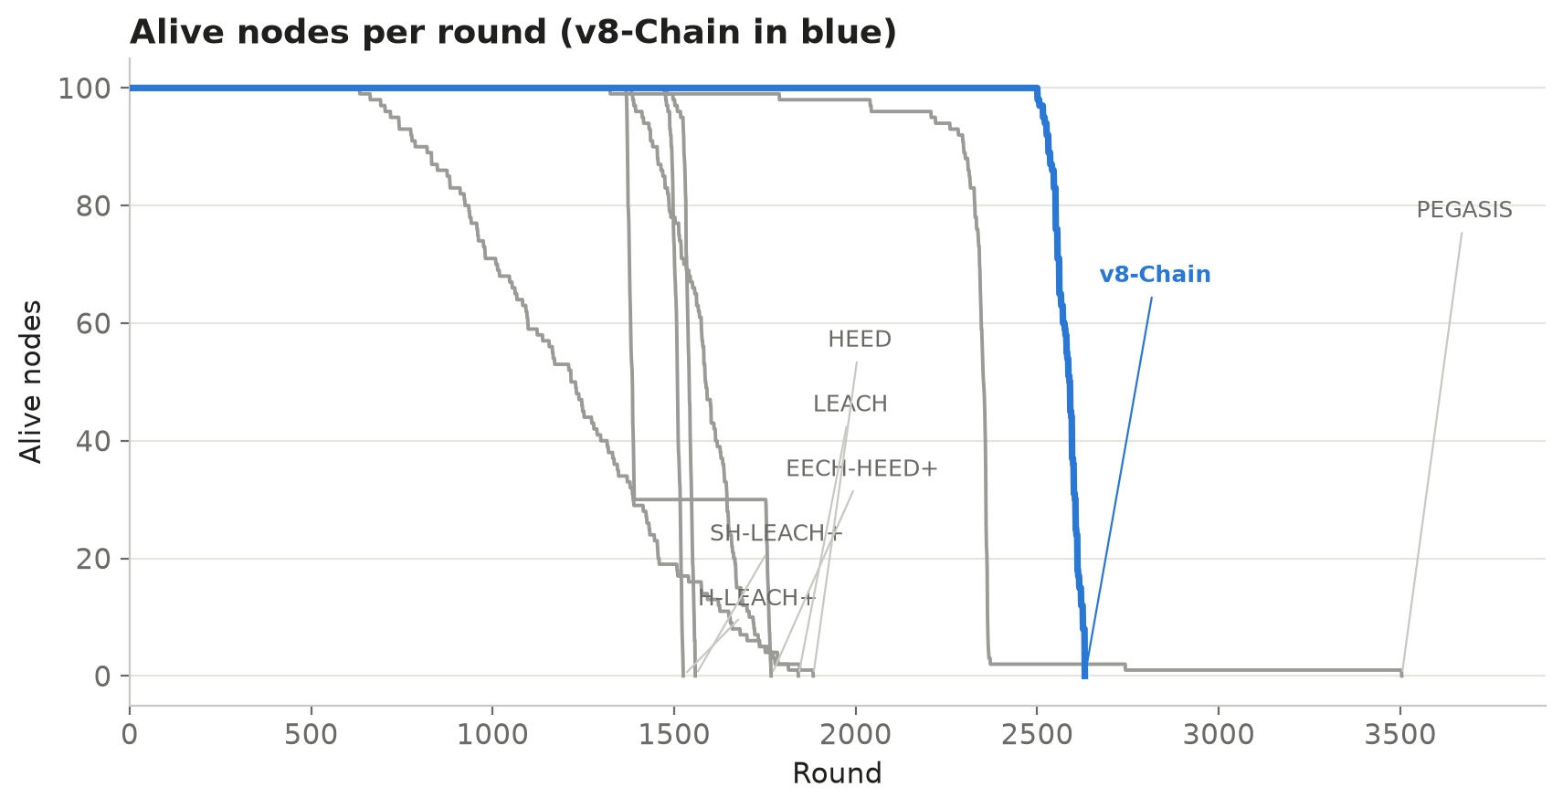
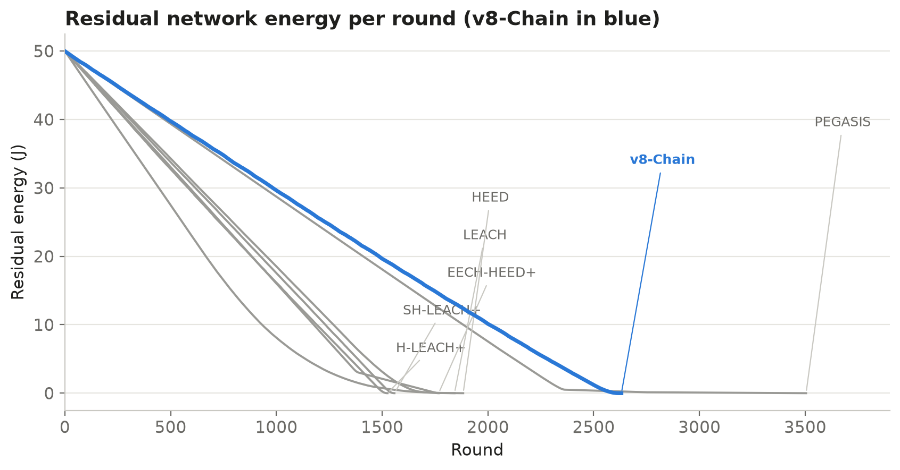
Alive nodes and energy per round
v8-Chain (blue) keeps every node alive longest, then all die together
49

Slide 50
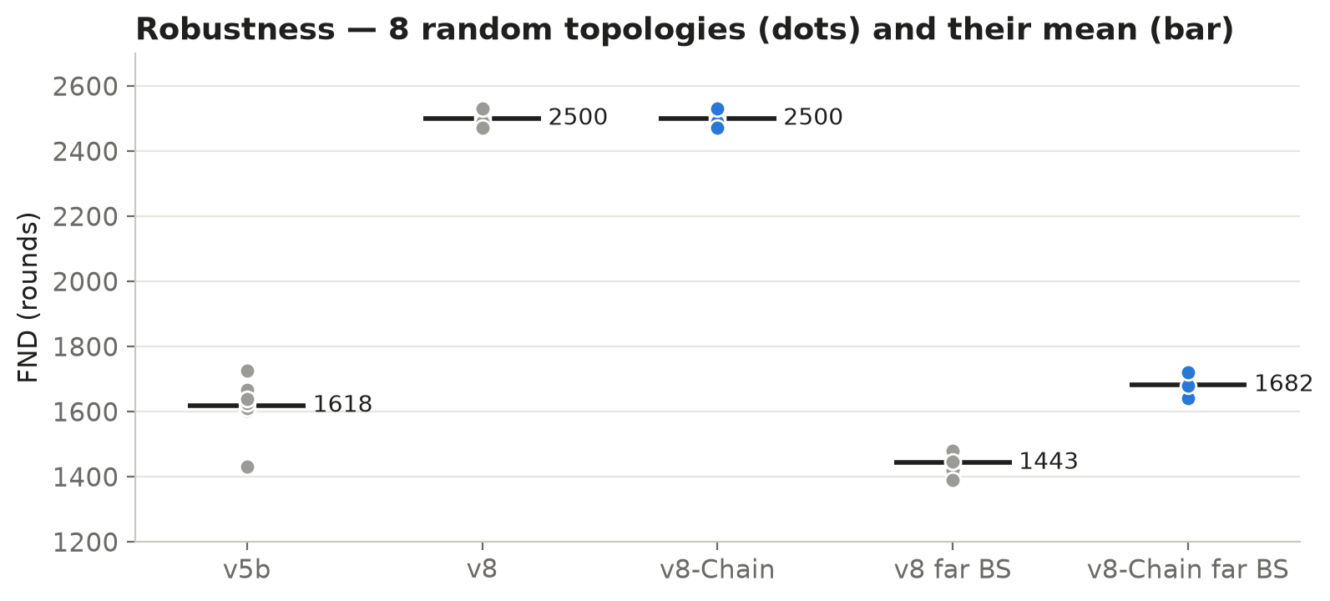
Reliability and robustness
8 random topologies: FND 2471 – 2531 (mean 2500)
All protocols deliver > 99 % of readings; they differ in lifetime. The v8-Chain result is not luck of one layout.
50

Slide 51
Summary of the comparison
Unified environment, BS at the centre
Protocol | Family | FND | HND | LND | PDR | v8-Chain FND gain
LEACH | classic | 1383 | 1586 | 1842 | 99.40% | +81%
HEED | classic | 634 | 1216 | 1883 | 99.68% | +294%
PEGASIS | classic | 1324 | 2352 | 3504 | 99.42% | +89%
SH-LEACH+ | hybrid, fixed | 1480 | 1542 | 1558 | 99.21% | +69%
H-LEACH+ | hybrid, fixed | 1473 | 1509 | 1525 | 99.36% | +70%
EECH-HEED+ | recent hybrid, fixed | 1368 | 1385 | 1767 | 99.51% | +83%
v8-Chain | proposed | 2501 | 2589 | 2631 | 99.64% | —
v8-Chain has the latest first node death of every protocol: from +69 % (SH-LEACH+) to +294 % (HEED).
51

Slide 52


Which version we chose — and why: v8-Chain
Latest first death
Works for any BS position
Reliable
FND 2501 — highest of all protocols and versions
same as v8 at the centre, +16 % when the BS is far
PDR 99.64%; no round without CHs; members never orphaned
Stable
Lightweight and distributed
Each part justified
8 topologies: FND 2471 – 2531
one-step score, local decisions, no training
every mechanism kept only if the ablation shows it helps
52

Slide 53
07
Adding security
What hybrid cryptography is expected to cost on top of v8-Chain

Slide 54

Hybrid cryptography — the plan
Public-key once for keys, fast symmetric encryption for every message
1 Deployment
2 Every message
3 CH fusion
ECC key agreement once per node → shared keys with the BS / cluster
AES encryption + 8-byte integrity code (MIC), as in IEEE 802.15.4 security [17]
CH decrypts, fuses and re-encrypts one packet to the BS
Assumption used in the experiment | Value
Extra bits per frame (auxiliary header + MIC) | 104 bits (data and control)
AES energy (sender and receiver) | 5 nJ/bit (same order as E_DA; assumed)
ECC key setup per node, once | 20 mJ (order reported for 8-bit sensor MCUs [16])
54

Slide 55
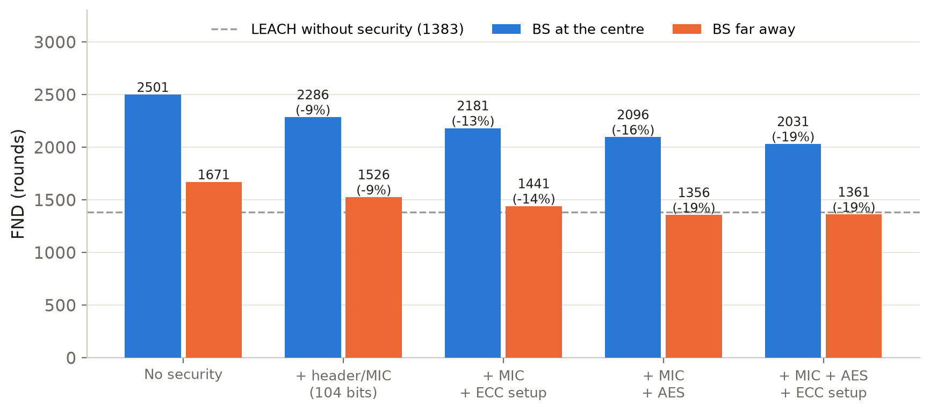
Expected cost of security on v8-Chain
v8-Chain code run with the security overhead switched on (-DSEC_BITS, -DSEC_NJ_PER_BIT, -DSEC_SETUP_MJ)
Expected
FND drops by about 9 % – 19 %.
With everything on: 2031 rounds — still +47 % over LEACH and +37 % over SH-LEACH+ without any security.
PDR stays above 99 %.
Security is affordable on v8-Chain: the lifetime saved by the protocol pays for the protection.
55

Slide 56
08
Conclusion
Limitations, summary and references

Slide 57

Limitations
Analytical energy model
Static, equal nodes
Long runs use the first-order radio model: no collisions, retransmissions or fading (the demo shows packet level on a small scale).
100 static nodes with equal energy; no mobility or heterogeneous hardware.
One field size
Security only estimated
100 × 100 m and 100 nodes; larger networks not tested.
Crypto costs are assumed values; attacks and key management are not simulated.
Missing paper details
PEGASIS keeps a longer LND
Some settings (packet size, sensor signal) had to be assumed and documented.
3504 vs 2631: v8-Chain is designed for the first death, not the last.
57

Slide 58
Summary
2501
+69%
99.64%
rounds before the first node dies
over the best fixed hybrid
packet delivery ratio
Six protocols reproduced and validated against their papers, then compared in one fair environment.
Flaws found and fixed in three hybrids: all of them had broken LEACH's rotation.
v8-Chain built step by step: single-pass election, cluster reuse, CH protection, direct-to-BS, energy gate and energy-aware relay.
Adding hybrid cryptography is expected to cost 9 – 19 % of lifetime — v8-Chain still outlives every unsecured baseline.

Slide 59
References
[1] W. R. Heinzelman, A. Chandrakasan, H. Balakrishnan, "Energy-Efficient Communication Protocol for Wireless Microsensor Networks," Proc. 33rd Hawaii Int. Conf. System Sciences (HICSS), 2000.
[2] W. B. Heinzelman, A. P. Chandrakasan, H. Balakrishnan, "An Application-Specific Protocol Architecture for Wireless Microsensor Networks," IEEE Trans. Wireless Communications, vol. 1, no. 4, 2002.
[3] O. Younis, S. Fahmy, "HEED: A Hybrid, Energy-Efficient, Distributed Clustering Approach for Ad Hoc Sensor Networks," IEEE Trans. Mobile Computing, vol. 3, no. 4, 2004.
[4] S. Lindsey, C. S. Raghavendra, "PEGASIS: Power-Efficient Gathering in Sensor Information Systems," Proc. IEEE Aerospace Conference, 2002.
[5] S. Shrestha, Y. M. Kim, K. Jung, J.-Y. Lee, "The Improved Energy Efficient LEACH Protocol Technology of Wireless Sensor Networks," Int. J. Internet, Broadcasting and Communication (IJIBC), vol. 7, no. 1, pp. 30–35, 2015.
[6] A. Razaque, M. Mudigulam, K. Gavini, F. Amsaad, M. Abdulgader, P. Krishna, "H-LEACH: Hybrid-Low Energy Adaptive Clustering Hierarchy for Wireless Sensor Networks," Proc. IEEE LISAT, 2016.
[7] S. Kaur, S. Kour, M. Singh, "EECH-HEED: an adaptive hybrid clustering protocol for energy efficient soil monitoring in heterogeneous wireless sensor networks," Scientific Reports, vol. 15, 35548, 2025.
[8] H. H. El-Sayed, E. M. Abd-Elgaber, S. K. Refaay, "An intelligent reinforcement learning enhanced improved LEACH protocol for prolonging wireless sensor network lifetime," Scientific Reports, 2026.
[9] A. Juwaied, L. Jackowska-Strumillo, "DL-HEED: A Deep Learning Approach to Energy-Efficient Clustering in Heterogeneous Wireless Sensor Networks," Applied Sciences, vol. 15, no. 16, 8996, 2025.
59

Slide 60
References (continued)
[10] S. Subedi, S. K. Acharya, J. Lee, S. Lee, "Two-Level Clustering Algorithm for Cluster Head Selection in Randomly Deployed Wireless Sensor Networks," Telecom, vol. 5, no. 3, 27, 2024.
[11] J. Jassbi, S. Moridi, "Fault Tolerance and Energy Efficient Clustering Algorithm in Wireless Sensor Networks: FTEC," Wireless Personal Communications, 2019.
[12] R. Pachlor, D. Shrimankar, K. K. Nagwanshi, M. Paliwal, "Cluster-Head Rotation Approaches in Sensor Networks: A Review," arXiv:2206.08892, 2022.
[13] C. Li, M. Ye, G. Chen, J. Wu, "An Energy-Efficient Unequal Clustering Mechanism for Wireless Sensor Networks," Proc. IEEE MASS, 2005.
[14] V. Chauhan, S. Soni, "Energy Aware Unequal Clustering Algorithm with Multi-hop Routing via Low Degree Relay Nodes for Wireless Sensor Networks," J. Ambient Intelligence and Humanized Computing, vol. 12, pp. 2469–2482, 2021.
[15] ns-3 Network Simulator, release 3.41, https://www.nsnam.org, 2024.
[16] A. S. Wander, N. Gura, H. Eberle, V. Gupta, S. C. Shantz, "Energy Analysis of Public-Key Cryptography for Wireless Sensor Networks," Proc. IEEE PerCom, 2005.
[17] IEEE Std 802.15.4-2020, "IEEE Standard for Low-Rate Wireless Networks," 2020.
60

Slide 61
Thank you
Special thanks to my supervisors Dr. Hesham ElZouka, Dr. Amani Saad and Dr. Khaled Saada
Questions and discussion
Code, results and papers: github.com/RahmaOshba/WSNs

