Slide 1
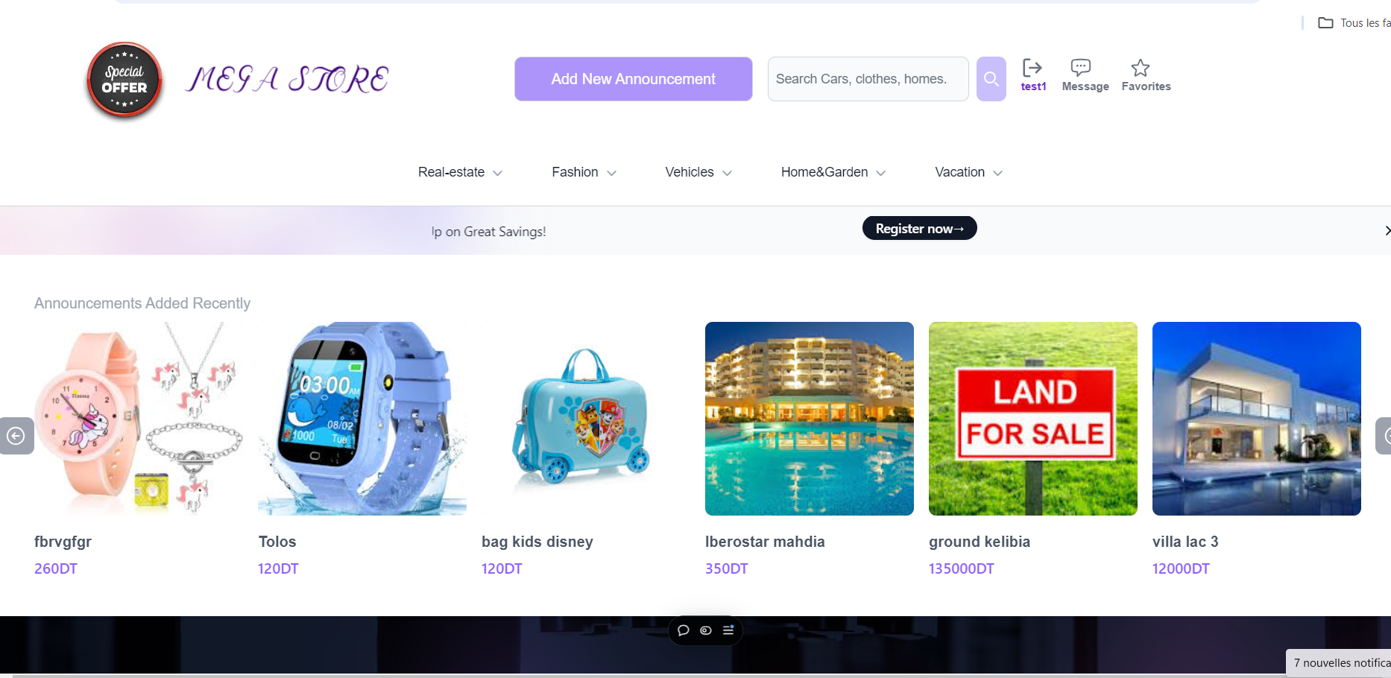
Title: Mega Store Application
Subtitle: A Full-Stack MERN E-Commerce
Name :Rahma Zakhama
Date :16/10/2024

Slide 2
Project Overview
Mega Store is a full-stack eCommerce platform built using the MERN stack (MongoDB, Express, React, Node.js).
It allows users to buy/sell products across multiple categories, including fashion, realestate, home & garden, and vacation.
Features admin functionality for managing products.
Real-time user authentication and authorization.

Slide 3
Tech Stack
Frontend: React, Redux
Backend: Node.js, Express.js
Database: MongoDB
UI Components: Tailwind CSS
Deployment: Deployed on Versel:https://mega-store-front.vercel.app/

Slide 4
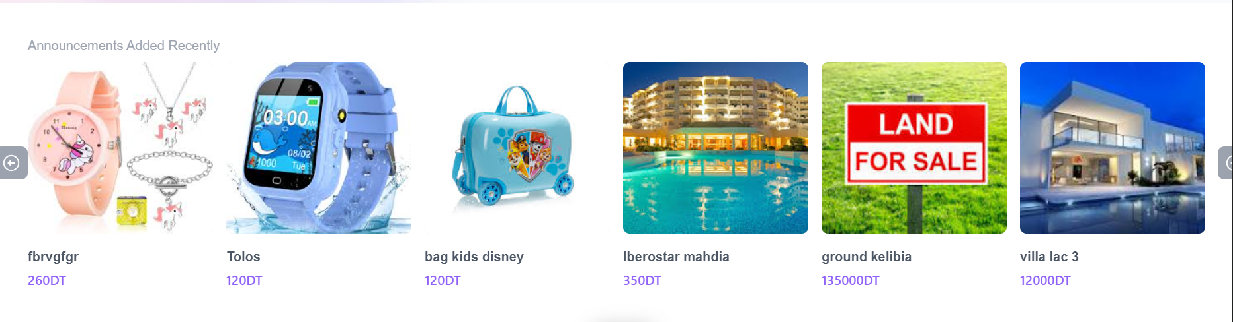
Features:
Consult Products Recently Added

Slide 5
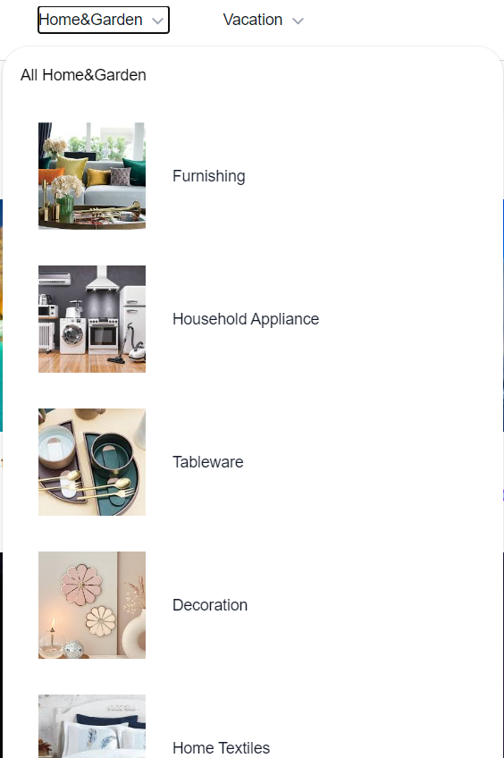
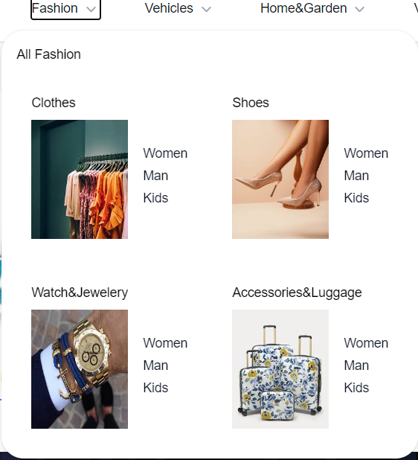
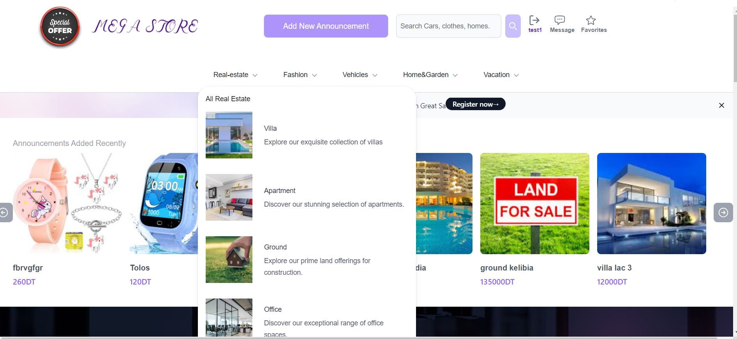
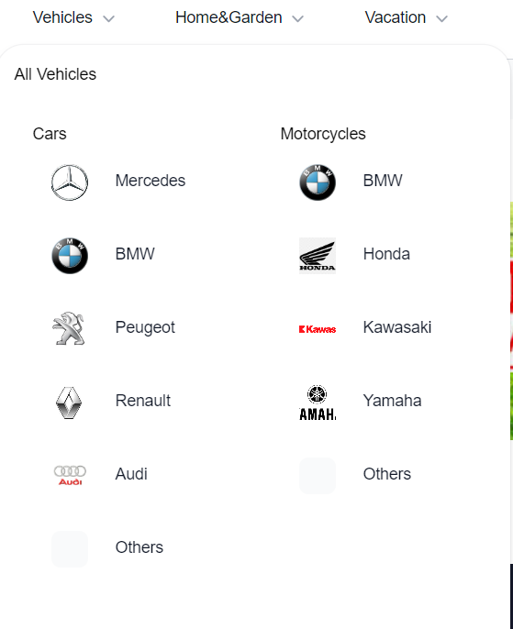
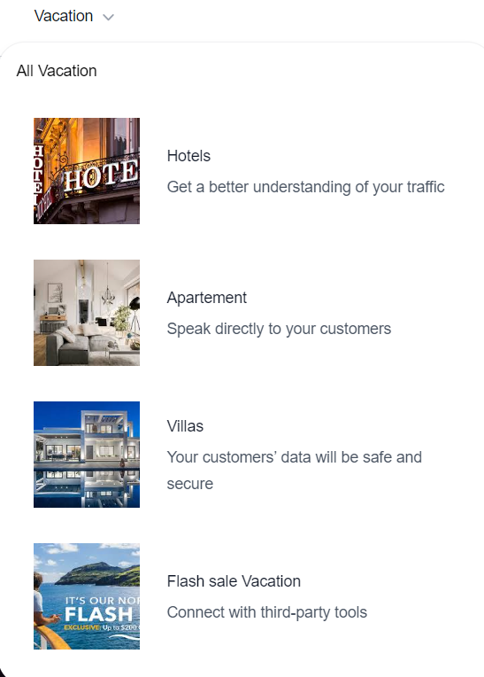

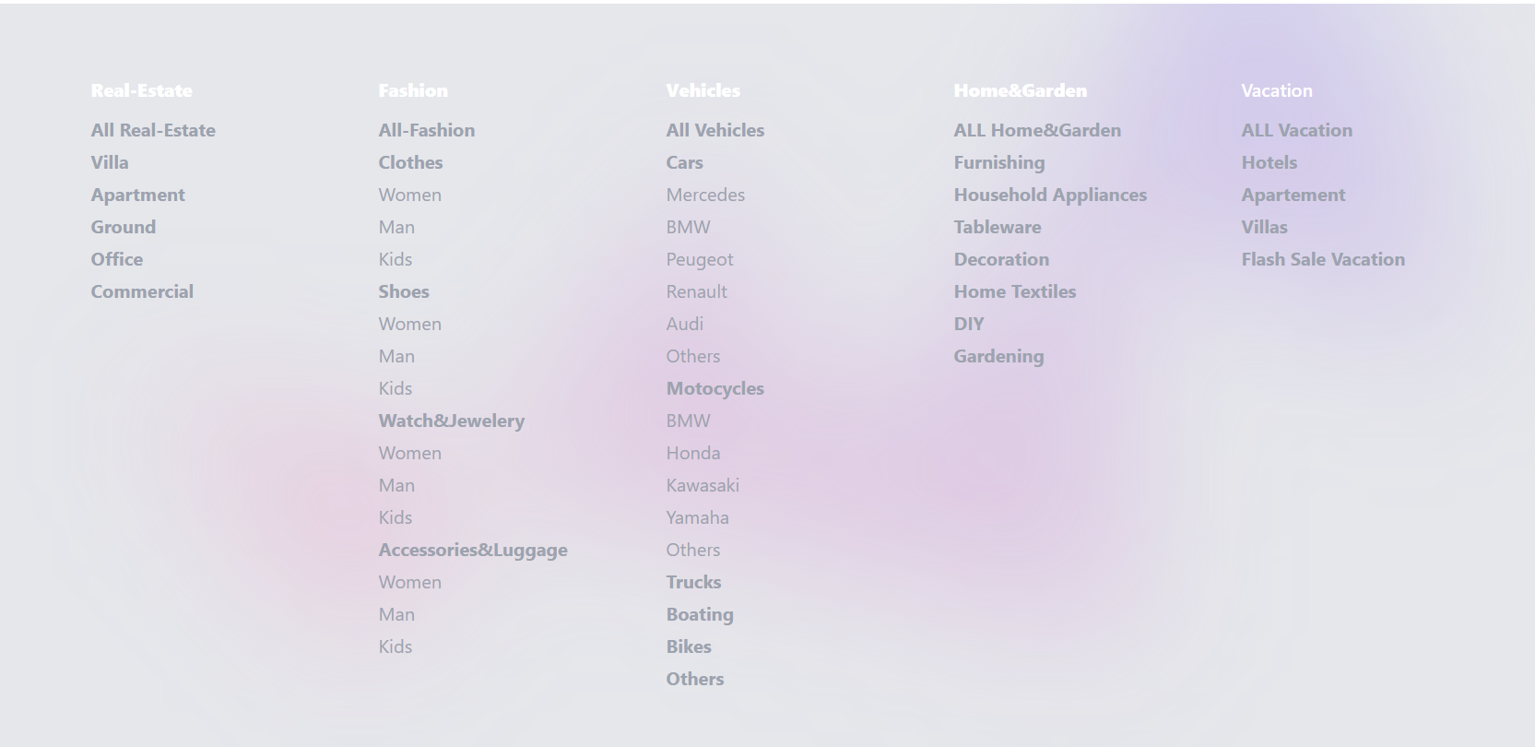
Features
Users can consult products by category and subcategory within the navbar, promo section and the footer

Slide 6
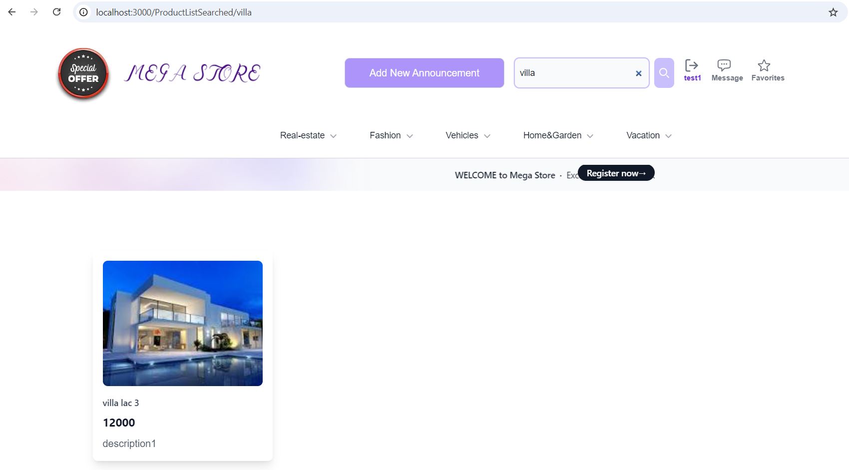
Features
Users can search products by name in the search bar

Slide 7
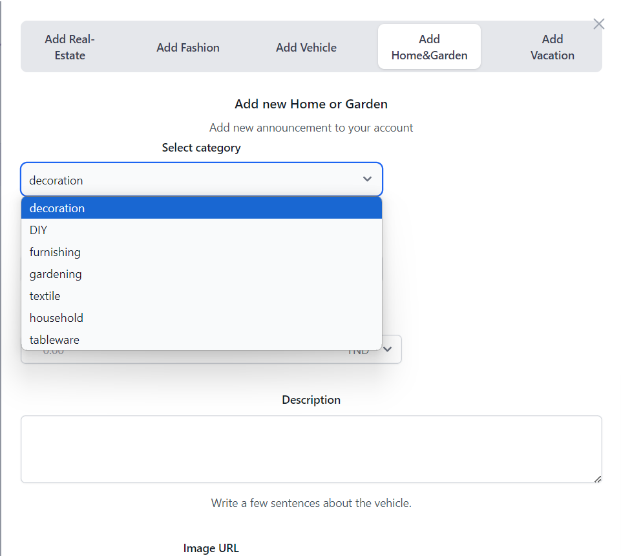
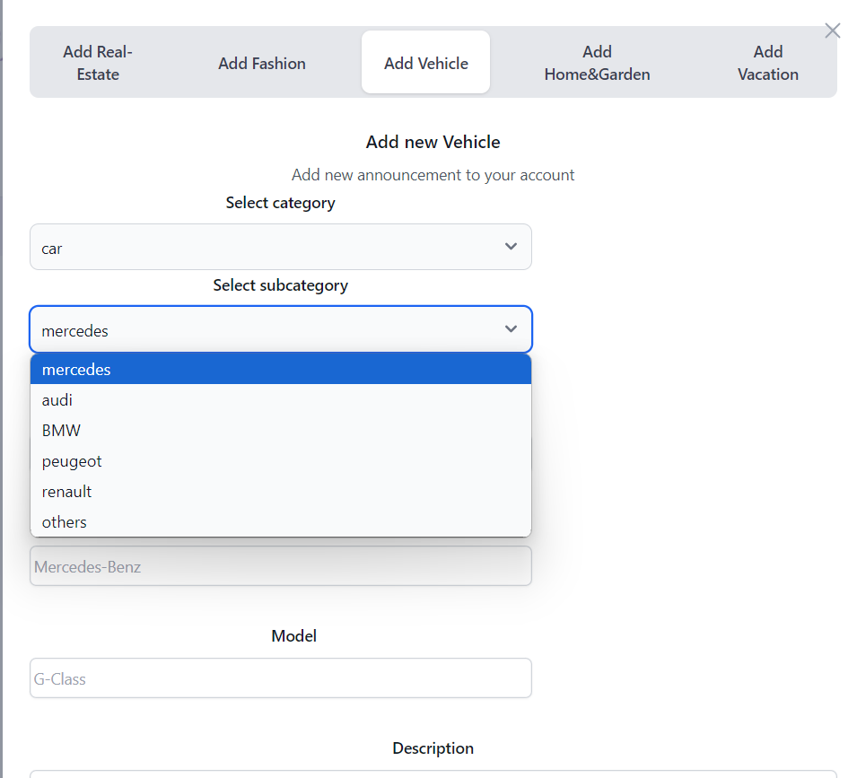
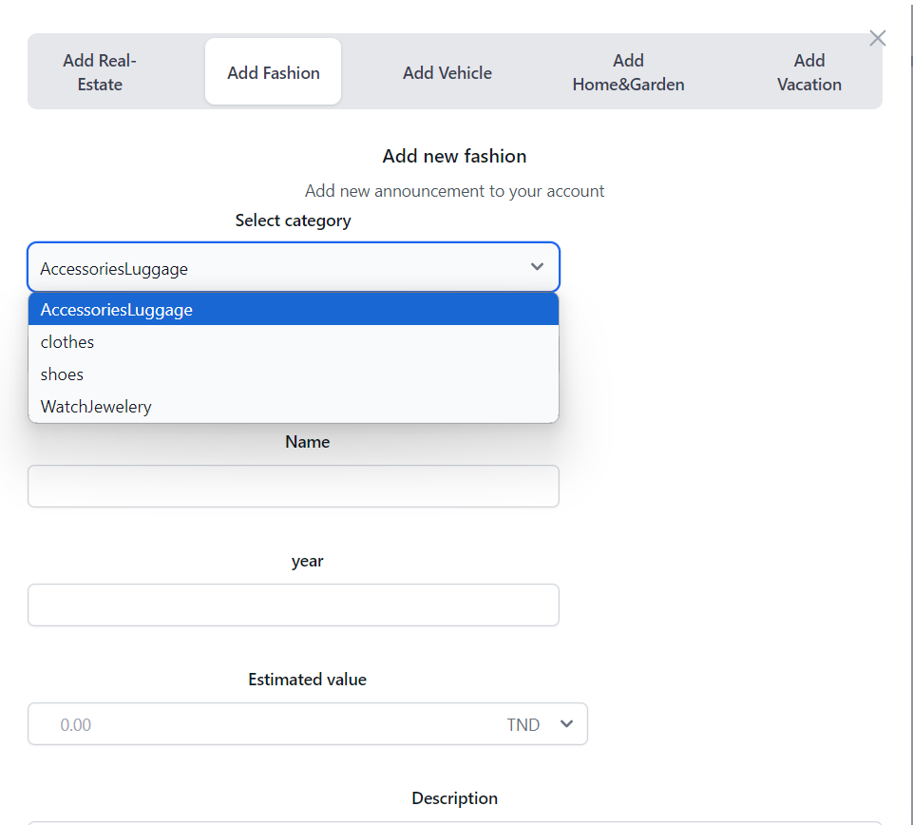
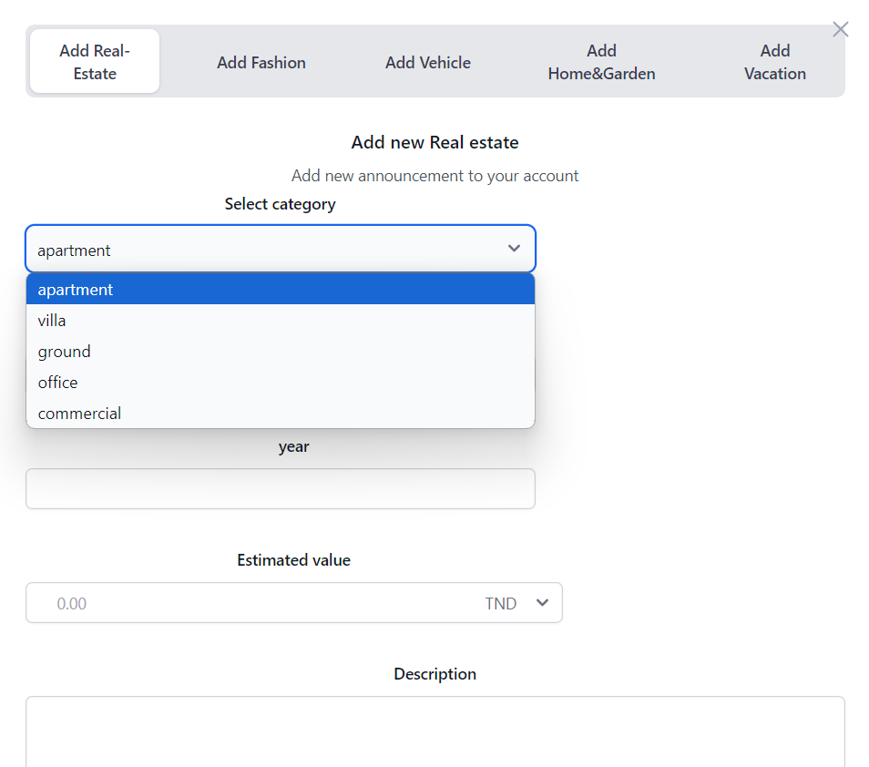
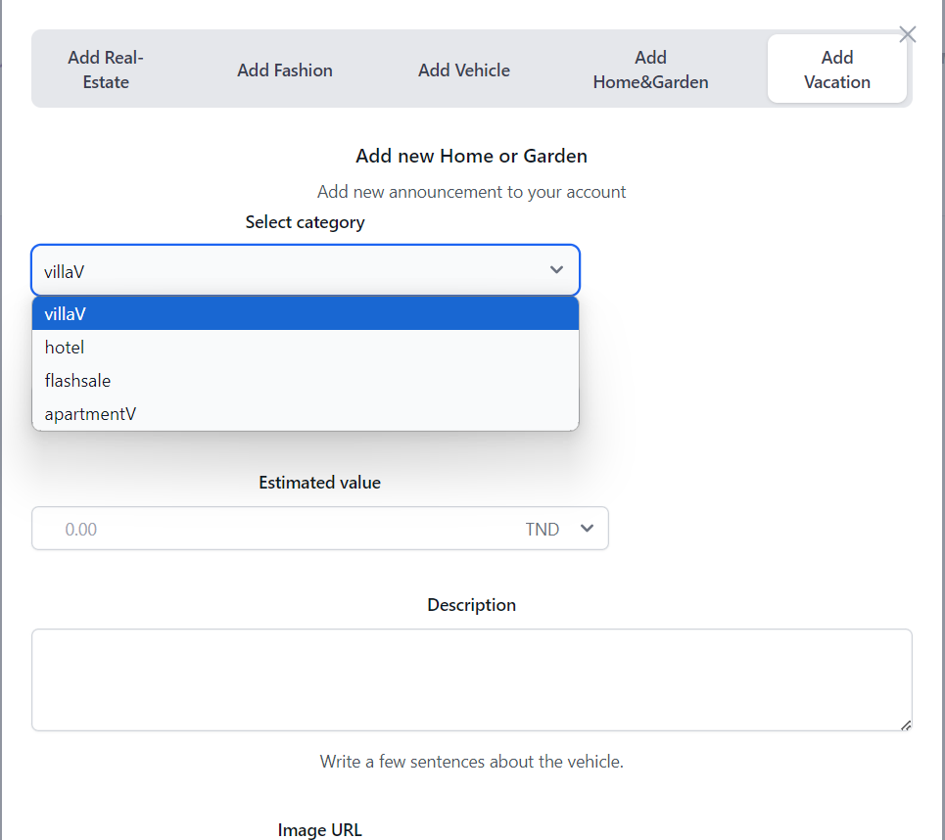
Features
Post new product according to category and sub category

Slide 8
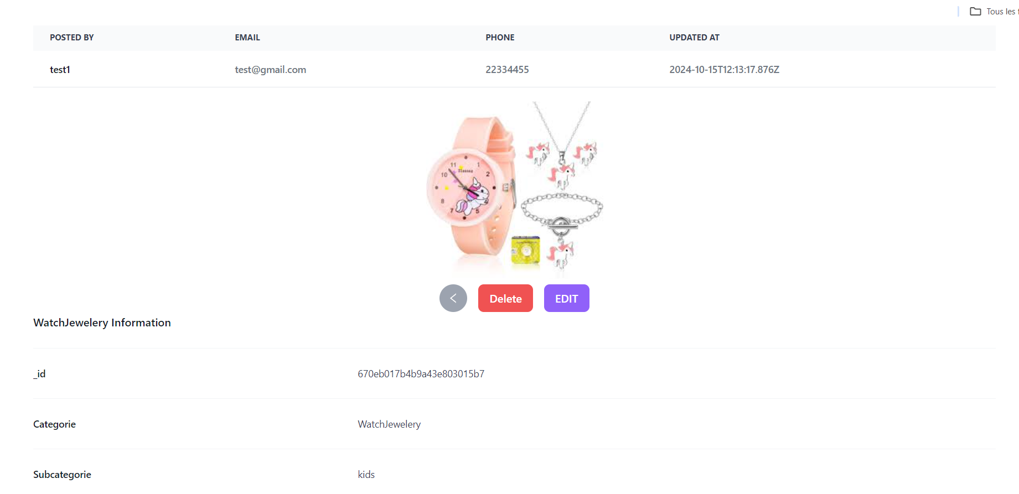
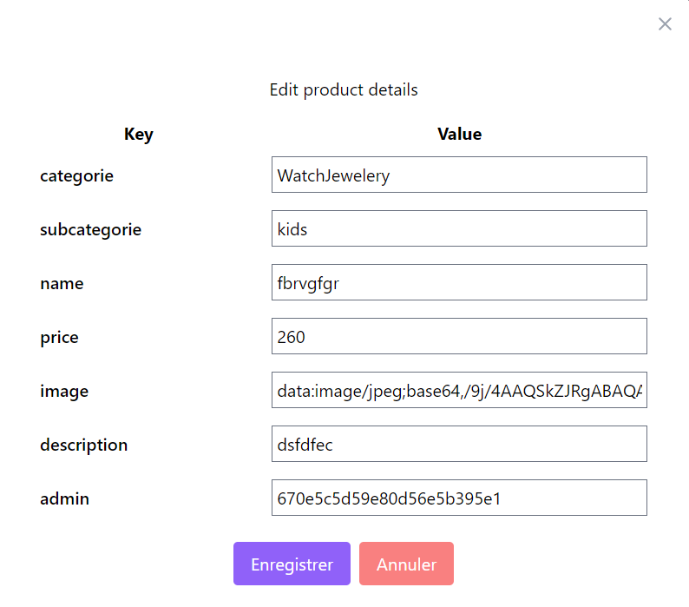
Features
The product can be edited and deleted only by the announcement owner

Slide 9
Enhancement Possible:
Adding more categories/products.
Scaling up to handle more users.
Enhancing the admin dashboard.
Improving UX/UI design.

