Slide 1

TWITTER SENTIMENT ANALYSIS
SUPERVISOR : DR. A.K.ASHFAUK AHAMAD ASSISTANT PROFESSOR (SR. GR.)
STUDENT NAME : ABDUL RAHMAN J
RRN : 230282601003
DEPARTMENT OF COMPUTER APPLICATIONS

Slide 2
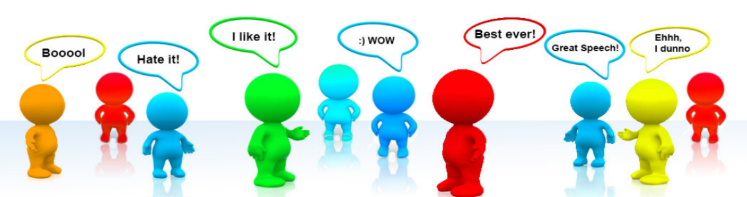
WHAT IS SENTIMENT ANALYSIS?
Sentiment analysis is a computational technique used to determine the emotional tone or sentiment expressed in a piece of text.
It involves the use of natural language processing (NLP), machine learning, and text analysis to classify text data into different categories of sentiment, such as positive, negative, or neutral.
DEPARTMENT OF COMPUTER APPLICATIONS

Slide 3
WHY SENTIMENT ANALYSIS?
Advent of various social media platforms
Given netizen the liberty to openly express their views and opinions
Large volume of data to get these information
Knowing “what people think”
Studies of SA deals:
Product and services reviews,
Celebrities,
Government policies,
Event,
and many more…
DEPARTMENT OF COMPUTER APPLICATIONS

Slide 4
OBJECTIVE
Analyze Public Opinion:
To assess and analyze public sentiment regarding specific topics, products, or brands by extracting and evaluating sentiments expressed in Twitter data.
Understand Consumer Feedback:
To gather insights from customer tweets to understand their experiences, preferences, and sentiments towards products or services.
Monitor Brand Reputation:
To track real-time sentiment changes and trends related to a brand, enabling proactive management of brand reputation and customer relationships.
Identify Key Trends:
To identify and analyze trending topics or sentiments on Twitter that may influence market dynamics or public opinion.
Enhance Decision-Making:
To provide actionable insights derived from sentiment analysis to support data-driven decision-making in marketing strategies and product development.
Improve User Engagement:
To develop strategies for increasing user engagement by understanding sentiments and emotions expressed by the audience.
DEPARTMENT OF COMPUTER APPLICATIONS

Slide 5
LIST OF MODULES
Data Collection
Data Preprocessing
Feature Extraction
Sentiment Classification
Result Aggregation & Visualization
DEPARTMENT OF COMPUTER APPLICATIONS

Slide 6
ABSTRACT
Twitter sentiment analysis is the process of using natural language processing (NLP) techniques to determine the sentiment behind tweets. As Twitter is a widely used social media platform where users express opinions on various topics in real-time, it serves as a rich source of data for analyzing public sentiment.
The analysis typically classifies tweets into categories such as positive, negative, or neutral, enabling organizations and researchers to understand public opinions, monitor brand reputation, assess customer satisfaction, and predict trends.
By leveraging machine learning, deep learning models, or lexicon-based approaches, Twitter sentiment analysis provides valuable insights that can drive data-driven decision-making in areas like marketing, politics, and customer service.
DEPARTMENT OF COMPUTER APPLICATIONS

Slide 7
DATASET INFORMATION
‘train_tweet.csv’ contains the tweets made in Twitter 2022, the dates of the tweets, and the labels as -1, 0 and 1 within the scope of the emotion contained in the tweets. 'tweets_21.csv' contains tweets from 2021.
train_tweet.csv
Size of the dataset : 31962 rows and 3 columns
test_tweet.csv
Size of the dataset : 17197 rows and 2 columns
DEPARTMENT OF COMPUTER APPLICATIONS

Slide 8
TOOLS & LIBRARIES
Python Libraries:
NumPy: Often used for handling large datasets and performing mathematical operations efficiently.
Pandas: Ideal for data cleaning, preprocessing, and analysis. It allows for easy handling of missing data, filtering, and aggregating data.
Matplotlib & Seaborn: Used for generating a wide variety of plots (e.g., line plots, bar charts, histograms) to visualize data insights effectively.
Tools:
Jupyter Notebook: For writing and executing Python code interactively.
DEPARTMENT OF COMPUTER APPLICATIONS

Slide 9
DATA PREPROCESSING
Data Cleaning
Eliminate any web links present in the tweets, as they do not contribute to sentiment analysis.
Remove hashtags or consider whether to keep them as they can contain sentiment (e.g., #happy).
Tokenization
Split the tweet text into individual words or tokens. This is essential for further analysis and modeling.
Removing Duplicates
Check for and remove duplicate tweets to ensure that the dataset is not biased by repeated entries.
Handling Emojis and Special Characters
Decide whether to remove or convert emojis and emoticons to their textual representation, as they can convey sentiment (e.g., 😊, 😢).
Text Normalization
Apply normalization techniques, such as correcting common misspellings and expanding contractions (e.g., "don't" to "do not").
DEPARTMENT OF COMPUTER APPLICATIONS

Slide 10
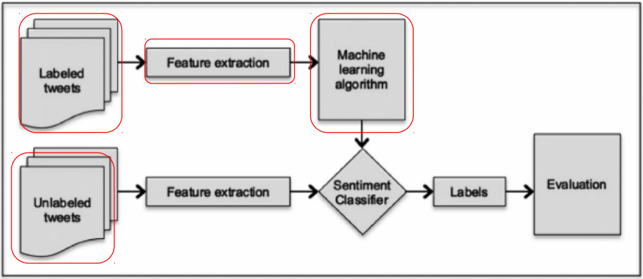
DEPARTMENT OF COMPUTER APPLICATIONS

Slide 11
FEATURE EXTRACTION
Objective: It transforms the preprocessed text data into a numerical format that machine learning algorithms can understand.
Description: Transforms tweets into numerical representations using methods like TF-IDF, Bag-of-Words, or word embeddings (e.g., Word2Vec, GloVe).
Tools: scikit-learn
Feature extraction with scikit-learn is a straightforward process that allows you to convert text data into a numerical format suitable for machine learning models. Below are the common methods for feature extraction using scikit-learn, specifically focusing on CountVectorizer, TfidfVectorizer, and n-grams.
DEPARTMENT OF COMPUTER APPLICATIONS

Slide 12
ACTION PLAN
WORK COMPLETED & TO BE COMPLETED
WORK COMPLETED:
Module 1 – Data Collection
Module 2 – Data Preprocessing
Module 3 – Feature Extraction
WORK TO BE COMPLETED:
Module 4 - Sentiment Classification
Module 5 - Result Aggregation & Visualization
DEPARTMENT OF COMPUTER APPLICATIONS

Slide 13
BASE PAPER
"Twitter Sentiment Analysis: A Comprehensive Study“
Authors: R. Agerri and M. D. L. S. Alvares
Publication Year: 2018
Summary: This paper provides an extensive review of sentiment analysis techniques applied to Twitter data. It discusses different methodologies, datasets, and the challenges faced in accurately classifying sentiments in tweets.
"Sentiment Analysis of Twitter Data: A Survey“
Authors: A. Go, J. S. P. Bhayani, and L. Huang
Publication Year: 2009
Summary: This is one of the early works in Twitter sentiment analysis, focusing on the classification of tweets as positive or negative. It discusses the use of various machine learning algorithms and feature extraction techniques.
3. "Sentiment Analysis of Twitter Data using Machine Learning Techniques"
Authors: A. T. O. E. E. Adediran and others
Publication Year: 2019
Overview: This paper presents an empirical study of various machine learning techniques applied to Twitter sentiment analysis. It evaluates the performance of different classifiers and discusses feature extraction methods.
DEPARTMENT OF COMPUTER APPLICATIONS

Slide 14

DEPARTMENT OF COMPUTER APPLICATIONS

