Slide 1


Calculator using Logic Gates
BY
Abdul Rahman, Furqan Bari, M. Noman, Sami Ullah Laang

Slide 2
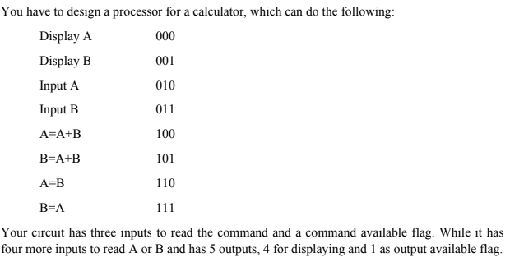
Problem Statement:
Inputs:
Clock Pulse CP
Command Available CA
Command C0...C2
Input Data A0...A3
Output:
Output Available OA
Output Data D0...D3

Slide 3
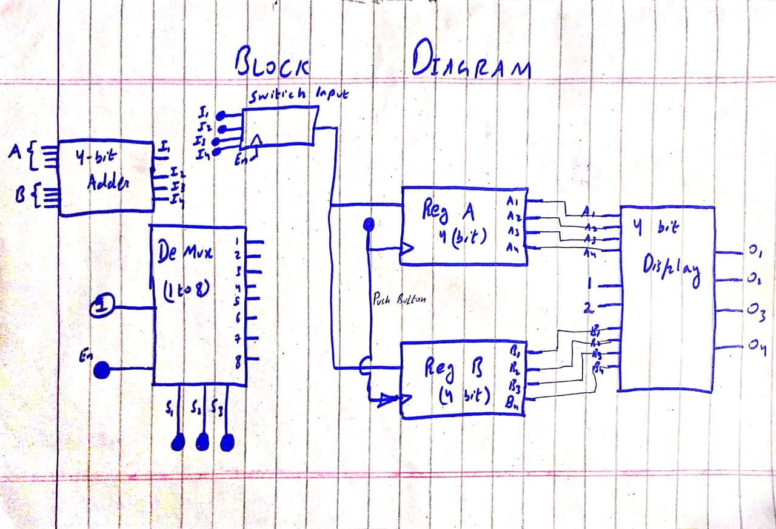
Block Diagram:

Slide 4


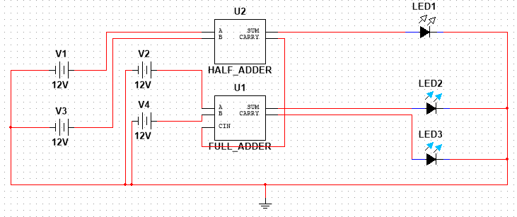


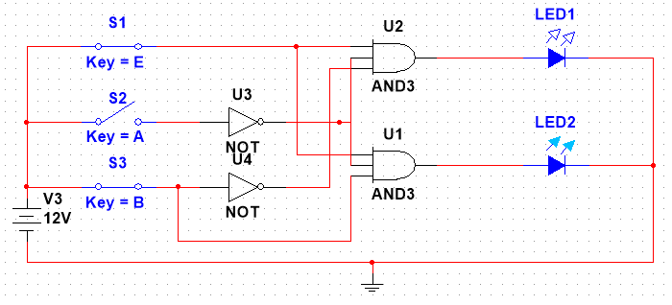

Multisim Circuit OF Main Function:
Full Bit Adder
For Adding two inputs coming from registers A and B.
DE-Multiplexer
For Performing following function:
Display A And B
Input A and B
Add A and B, and save it to A or B
A=B, B=A

Slide 5
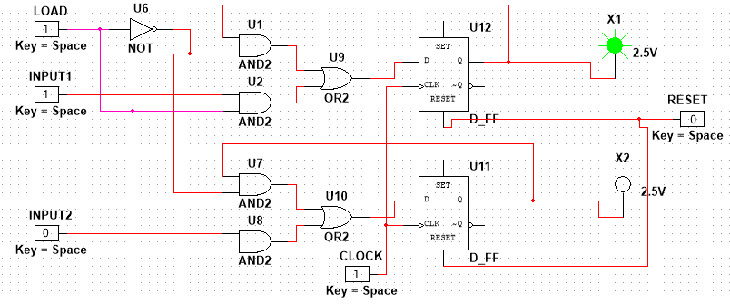
Main Functions:
3- Registers ( PIPO ):
4-bit Parallel Load Registers to store 4 inputs.

Slide 6
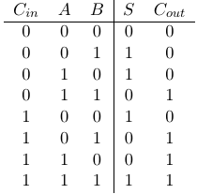
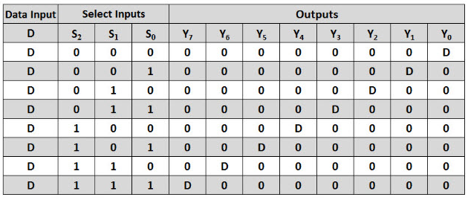
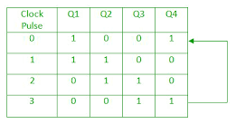
Truth Table
4-bit Full Adder
1to 8 DE -multiplexer.
4-bit Registers.

Slide 7
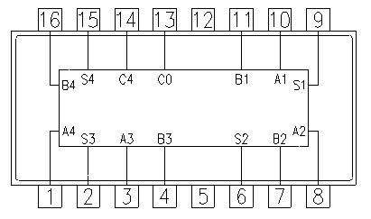
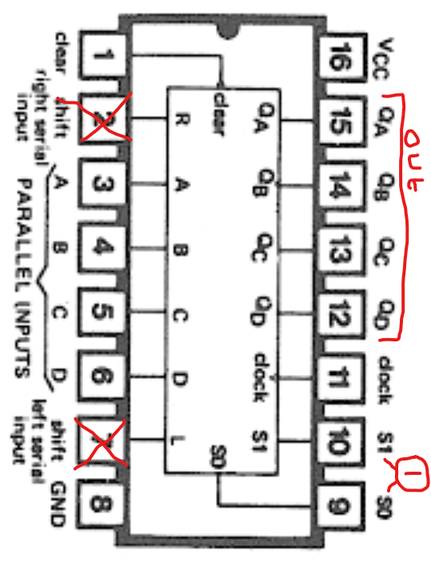
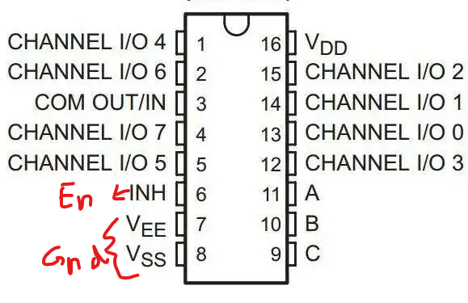
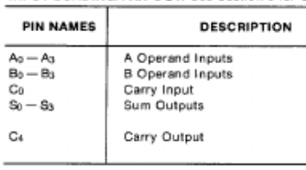
IC’S
74LS194 ( UNIVERSAL REGISTER )
7483 ( 4-BIT ADDER )
CD4051B ( 1-8 Mux/DE- Mux )

Slide 8

Thank You!
Fila's!
References: https://www.alldatasheet.com/

