Slide 1

Improve samples and documentation for SDR representation (SDR to Bitmap)
Khan Mushfiqur Rahman (1347995)
Md Tanzeem Hasan Mahmud (1364198)

Slide 2
Outline: 1. Introduction 2. SDR 3. Bitmap 4. DrawBitmap method 5. SDR into Bitmap 6. SDR examples with encoders 7. DrawBitmap examples with different encoders 8. Bitmap representation using spatial pooler 9. Conclusion

Slide 3
Introduction
This presentation outlines the method for visualizing Sparse Distributed Representations (SDRs) as bitmap images using the DrawBitmap method.
Visualizing SDRs can significantly aid in understanding the patterns and information encoded within them, especially when dealing with complex encoders or spatial pooling processes.
This method provides a tangible way to assess and interpret the activity and structure of SDRs, facilitating a deeper understanding of their functionality in various applications.

Slide 4
What is SDR?
Sparse Distributed Representation (SDR) is a computer concept inspired by how our brains process information.
Imagine it like storing data where most of it is 'off' (0), and only a few bits are 'on' (1).
This method helps handle lots of different information efficiently and reliably, just like how our brains work with neurons.

Slide 5
What is Bitmap?
A bitmap is a type of file format used to store images.
It's basically like a map made up of tiny dots, where each dot can be either 'on' or 'off’.
When representing Sparse Distributed Representations (SDRs) as bitmaps, we start by taking the output from encoders and using it as input for the Spatial Pooler (SP).

Slide 6
The DrawBitmap Method
The DrawBitmap method is a flexible tool for visually representing Sparse Distributed Representations (SDRs).
It allows us to see the patterns and behaviors within the data by converting SDRs into bitmap images.
This helps us understand how the information is encoded and processed. This guide shows how to use the DrawBitmap method in various situations, demonstrating its application with both simple SDR examples and those generated by encoders.

Slide 7
Turning an SDR into a visual bitmap
Setting the Scene:
Determine the width and height for the bitmap, scaling the image to fit your needs.
Choose colors for the active and inactive cells to make the SDR's structure clear.
Calculating the Scale:
A scale factor is calculated based on the ratio of the bitmap's width to the SDR array's width. This helps adjust the cell sizes in the bitmap to fit the entire SDR.
Drawing the Bitmap:
Go through each cell in the SDR:
1. Color it with the active cell color if it's active (1).
2. Use the inactive cell color if it's inactive (0).
The scale factor ensures each cell in the bitmap represents the SDR accurately.
Saving the drawn bitmaps:
Once every cell is colored, the bitmap is saved to the location specified in filePath.

Slide 8
Basic SDR Examples with binary encoders
This simple example will help understand the visualization process. So, for this we can take a simple value say 40148. Now we need SDR encode this data to visualize.
Then we can make this result 2D as we need two dimension for drawing the bitmap.
Now we can draw this data in the DrawBitMap method.

Slide 9

Basic SDR Examples with binary encoders
We can get the below image from the DrawBitMap method

Slide 10
DrawBitMap example with Binary Encoder 1D image
We can also use DrawBitMap method for generating 1D images by getting the binary encoded value from our input.
Now we can create a method which can generate Images from the 1D sdrs from the binary encoder and make the data suitable for the DrawBitMap method to generate a 1D Image.
Here is the output image:

Slide 11

DrawBitmap example for DateTime Encoder
For this example, we can take "08/03/2024 21:58:07" and send it through datetime encoder to get SDR.
Now we can get the result from here and make it a 2D array for DrawBitMap method.
Now wee send the transposed 2D data in DrawBitMap method.
The generated image is this:

Slide 12
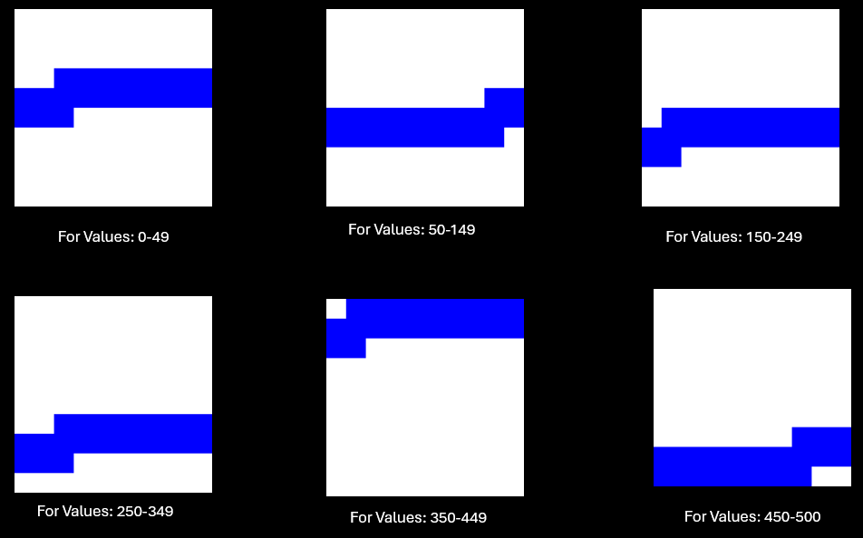
Drawing AQI Values with Scalar Encoder
The Scalar Encoder converts AQI levels into SDRs, capturing the essence of air quality in a binary format.
Now have to convert to 2D array and then transpose that and finally drawing the Bitmap to utilize DrawBitmap for visual representation, the generated bitmaps:

Slide 13
DrawBitmap sample for Geospatial Encoder
Encoding Process for Geographical Coordinates To encode and visualize geographical coordinates, we set the encoder parameters as follows, aiming to cover a specific range of latitude and longitude.
Generating Bitmaps from Encoded Geospatial Data:
Initialization: The geographical coordinates within the range of 48.75 to 51.86 are encoded using the configured encoder. This process converts each coordinate into a 1-Dimensional SDR.
Transformation to 2-D Array: The resulting 1-D SDR is then mapped to a 2-Dimensional array, preparing it for bitmap visualization.
The transposed 2-D array is passed to the DrawBitmap method along with visualization parameters such as dimensions (1024x1024 pixels), file path, and colors for active and inactive cells (Active: Black, Inactive: LightSeaGreen):

Slide 14


DrawBitmap sample for Geospatial Encoder
The bitmap generated are as follows:
The bitmap images generated for geographical coordinates offer a unique view of the spatial patterns encoded within the SDRs. Now if we change the encoder settings and provide the below settings:
encoderSettings.Add("W", 21);
encoderSettings.Add("N", 40);
The output will be different for the same value. The bitmaps generated in this case are:

Slide 15
Bitmap representation of Image using Spatial Pooler
In Hierarchical Temporal Memory (HTM) theory, the Spatial Pooler (SP) is vital for converting input data into Sparse Distributed Representations (SDRs). These representations highlight structural and semantic similarities in the data. By representing SDRs as bitmaps, we visually grasp the transformation process and SP's output, deepening our understanding of HTM's processing abilities.
Generating Inputs for Image Generation and Training in Spatial Pooler.

Slide 16
Bitmap representation of Image using Spatial Pooler
The Image we have used for training is these:
Before being used as input for the Spatial Pooler, each image undergoes a binarization process.
With the binary representation of images ready, the Spatial Pooler computes the Sparse Distributed Representation (SDR) for each binarized image.
Converting the SDRs back into a two-dimensional array format suitable for generating bitmap images.

Slide 17

Bitmap representation of Image using Spatial Pooler
The DrawBitmaps utility function generates bitmap images that visually represent the active columns as a result of the SP's processing. The generated Images looks like this:
On the right side we can see the images generated from the binarized file of the input training image, on the left we have the sdr representation by SpatialPooler after feeding the training image.

Slide 18
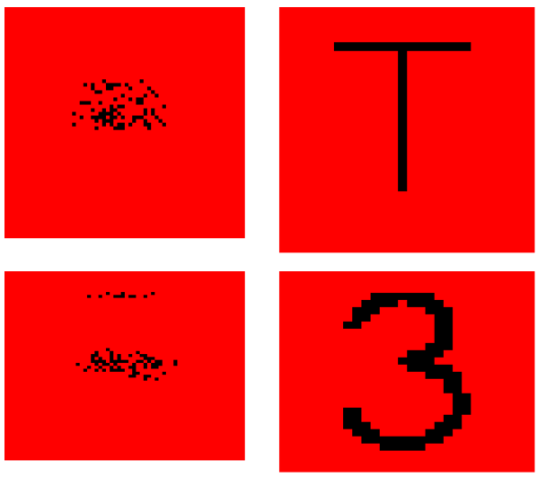
Example representing Overlap(Intersection),Difference and Union for Alphabet T and Numeric 3 in Bitmap after computing in spatial pooler:
Here we can see the Alphabet T and Numeric 3:

Slide 19
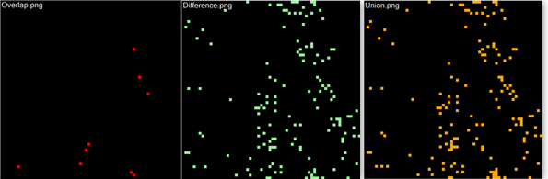
Example representing Overlap(Intersection),Difference and Union for Alphabet T and 3 in Bitmap after computing in spatial pooler
Below are the representation for Overlap, Difference and Union:
Two SDRs are compared with the help of UnionSDRFun(), DiffSDRFun() and OverlapSDRFun() functions. The overlap.png shows very few intersections as the SDRs are very different from each other. Basically, the combination of Overlap and Difference gives us Union.

Slide 20
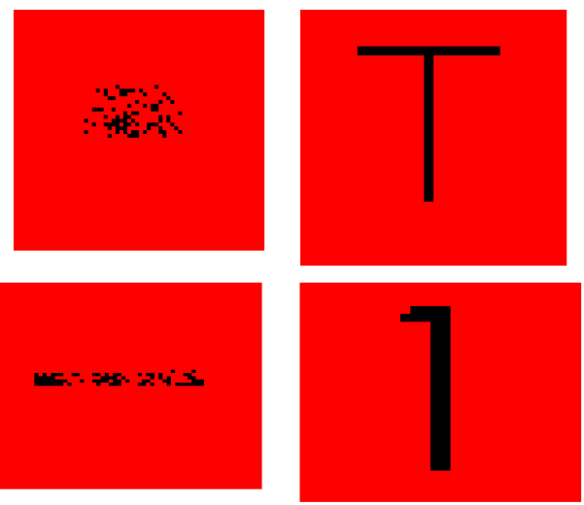
Example representing Overlap(Intersection),Difference and Union for Alphabet T and Numeric 1 in Bitmap after computing in spatial pooler:
Generated Bitmap representation of T and 1 is shown below:

Slide 21
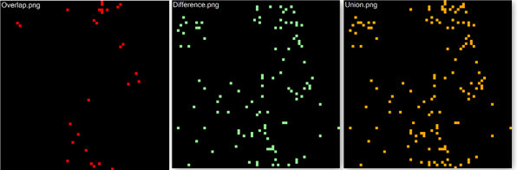
Example representing Overlap(Intersection),Difference and Union for Alphabet T and Numeric 1 in Bitmap after computing in spatial pooler:
Below are the representation for Overlap, Difference and Union:
On comparison between two SDRs, the overlap.png shows more overlaps/intersections in comparison to the above example. SDRs are similar to each other.

Slide 22
Conclusion:
In our study, we've effectively utilized bitmap images to visually represent encoded Sparse Distributed Representations (SDRs), showcasing various data types such as numbers, geographical coordinates, and temporal information. Through the DrawBitmap method, we've highlighted active and inactive bits within SDRs, shedding light on the encoding mechanisms of Hierarchical Temporal Memory (HTM) models.
Additionally, we've explored visualizing SDRs generated by spatial pooling, revealing how input patterns are captured and represented in the model. Overall, visualizing SDRs as bitmap images provides a robust method for understanding the intricate patterns encoded in HTM systems.
This approach not only aids in model analysis but also holds potential for developing more intuitive interfaces for interacting with these models. Our project offers new examples and guidance for utilizing bitmap generation of SDRs, whether in one-dimensional or two-dimensional contexts.

Slide 23

Thank you

