Slide 1
Telomerase Reverse Transcriptase (TERT)
Bioserver project.

Slide 2
CONTENTS OF THIS Presentation
1.Team Member.
2. what is Telomerase Reverse Transcriptase?
3.Database Schema.
4.Implemented biological functions.
5. Website

Slide 3
Team Members
Name | ID
Rahma Samy | 20198035
Doha Khaled | 20198126
Ghada Mamdouh | 20198063
Yasmeen Maroof | 20198099
Rania Ismail | 20198032

Slide 4
Telomerase Reverse Transcriptase (TERT)
TERT(Telomerase Reverse Transcriptase) is a protein coding gene diseases associated with TERT include Dyskeratosis Congenita, Autosomal Dominant 2 and Pulmonary Fibrosis or Bone Marrow Failure ,Telomere-Related, 1.Among its related pathways are Chromosome Maintenance and Signaling by WNT.
Gene Ontology(GO) annotations related to this gene include protein homodimerization activity and tRNA binding

Slide 5
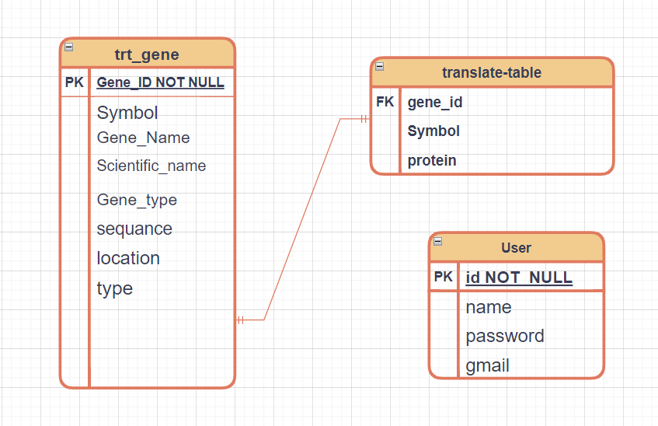
3.Database Schema

Slide 6
4.Biological Functions
. Lenght
.GC-content
.CpG Ratio
.N-Bases
.Complement
.Reverse

Slide 7
Length Function
This function Takes the sequance of
DNA and returns number of nuclotides in it

Slide 8
GC-Content (or guanine-cytosine content)
This Function takes the sequance of DNA as an input and returns the percentage of nitrogenous bases in molecule that are either guanine (G) or cytosine (C)
using Rule:Count (G+C)/Count(A+C+G+T)*100

Slide 9
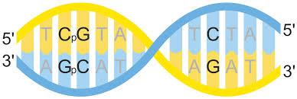
CpG island
The CpG sites or CG sitesare regions of DNA where a cytosine nucleotide is followed by a guanine nucleotide in the linear sequence of bases
This function takes sequance as an input and returns CpG Ratio
Using Rule: (number of C *number of G)/ Length of sequance

Slide 10
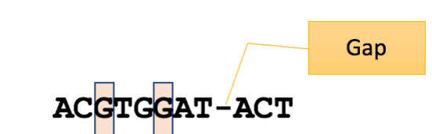
N-Bases
The N-bases indicate the persence of GAB in the sequance
The function takes the sequance of DNA and returns number N -bases in it
Using Rule: number of N bases/Length of sequance

Slide 11
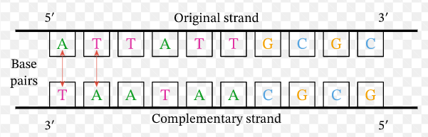
Complement
The function takes the orignal sequance of DNA as a input and returns complementary sequance of DNA after
converting each “T” nuclotide into “A” nuclotide and converting each “C” nuclotide into “G” nuclotide and vice verse.

Slide 12
Reverse
The function takes the orignal sequance of DNA as a input and returns sequance of DNA after being reversed
orignal sequance A C G T T T A
Reversed sequance A T T T G C A

Slide 13
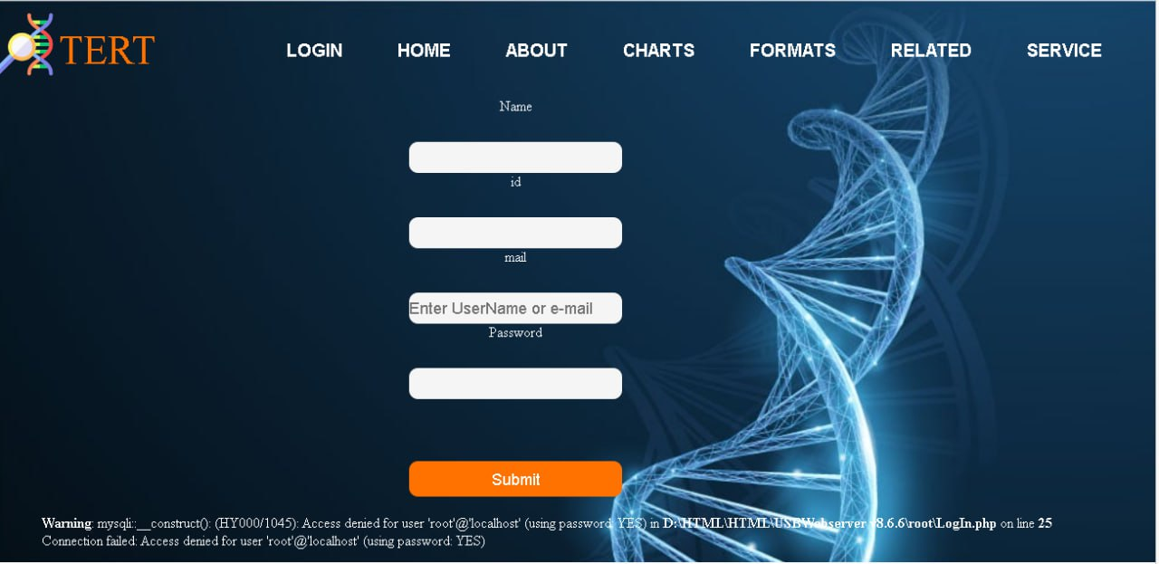
5.Websit

Slide 14
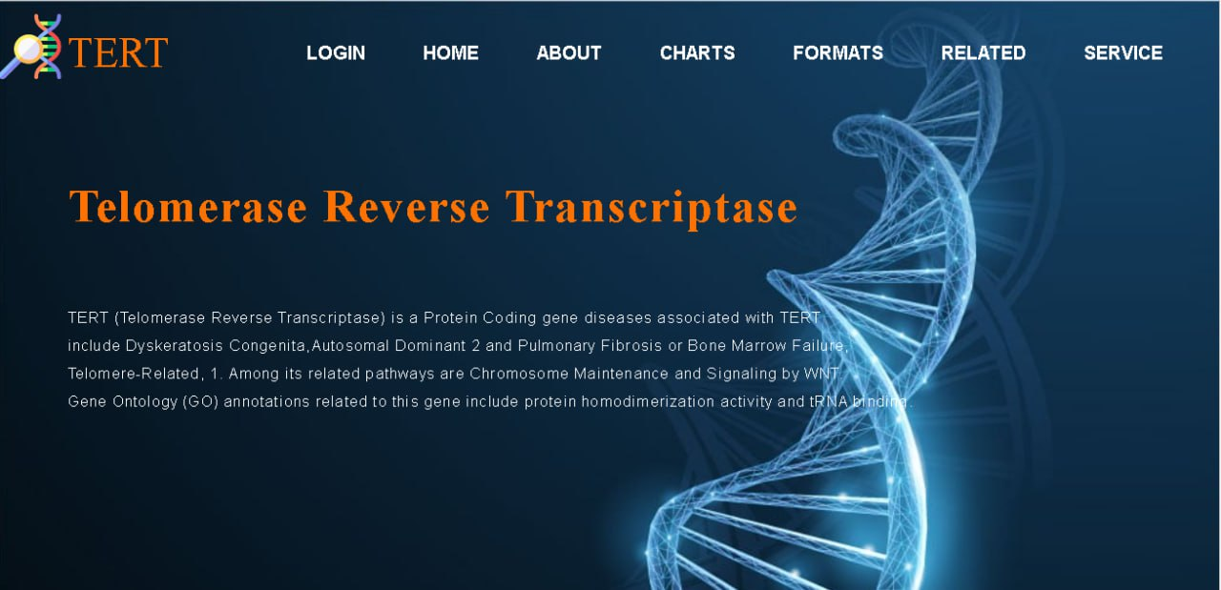

Slide 15
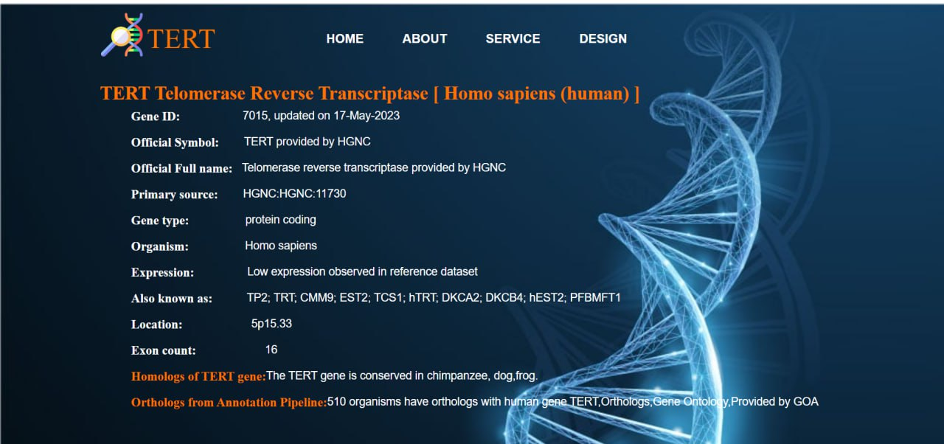

Slide 16
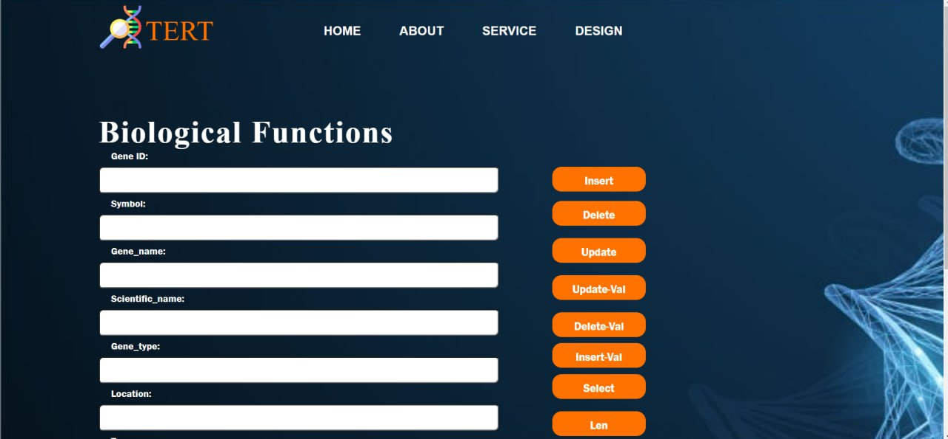

Slide 17
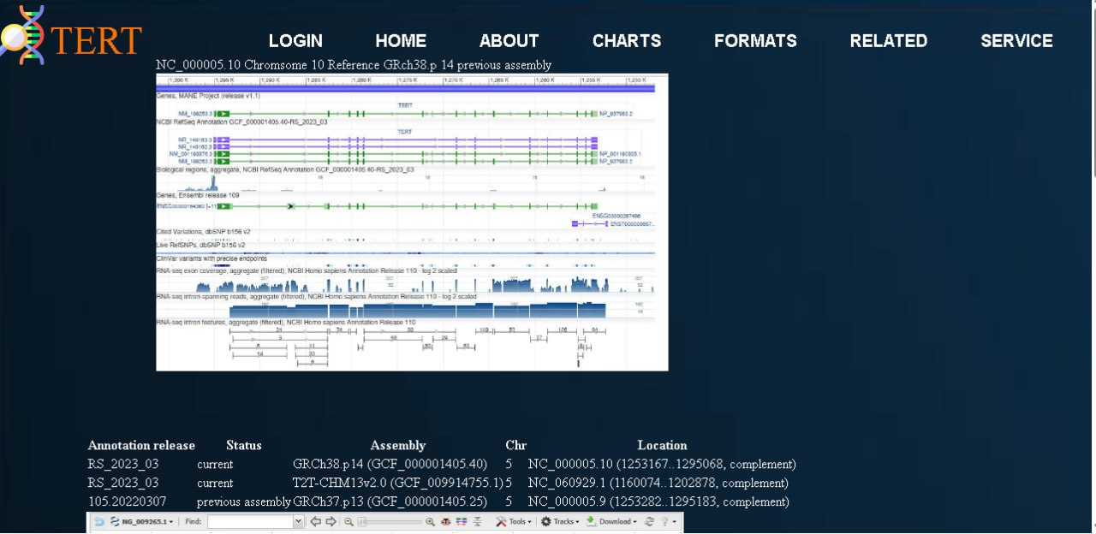

Slide 18
THANKS!

