Slide 1

CDR Infantry Supply Station

Slide 2
Introduction
Size and limitation of the supply station Supply station size : 1m*1m*1m Specs of bullets: 2.6 g (±5%), plastic, 17 mm (-3% to 0%) in diameter Total number of bullets: 800

Slide 3
Brief structure of the supply station

Slide 4
Components for supply station 12V motors: 12V 100RPM high torque DC Motor MCU: Arduino Uno Rev3 Motor Driver: Pololu Simple High-Power Motor Controller 18v15 Detect Sensor: QSD122A4R0-ND & QED123-ND Power source: NIMH Battery 12.0V 2300MAH

Slide 5
Objective
Be fully automatic
Minimize the filling time
Follow restrictions of the competition
Prevent any jamming of bullets in the station

Slide 6
Photo Interrupter
Transmission-type photo sensor
A light emitting elements
A light receiving elements
Acting as an optical switch
Infantry Robots Detector
Signal triggers after infantry robots block infrared light
Bullets will release from the second stage
Components:
QED123--- Plastic Infrared Light Emitting Diode
QSD122--- Plastic Silicon Infrared Phototransistor

Slide 7
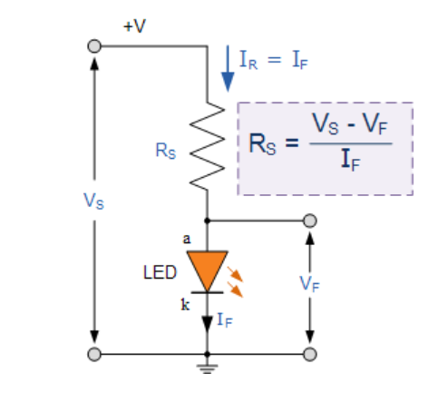
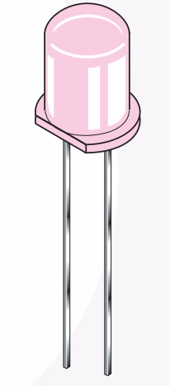
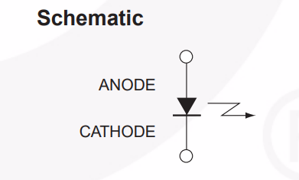
Photo Interrupter Con’t
QED123 : (Emitter)

Slide 8
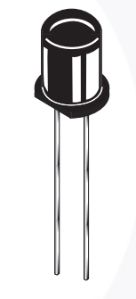
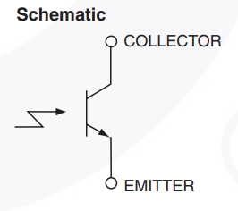
Photo Interrupter Con’t
QSD122: (Detector)
The base is left disconnected
Light is used to enable the current flow through the phototransistor.

Slide 9
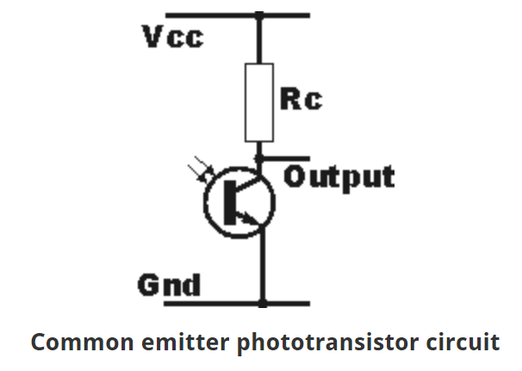
Photo Interrupter Con’t
Phototransistor Circuit:
1. Common Emitter phototransistor circuit:
Light is detected
The output moves from a high-voltage state to a low-voltage state.

Slide 10
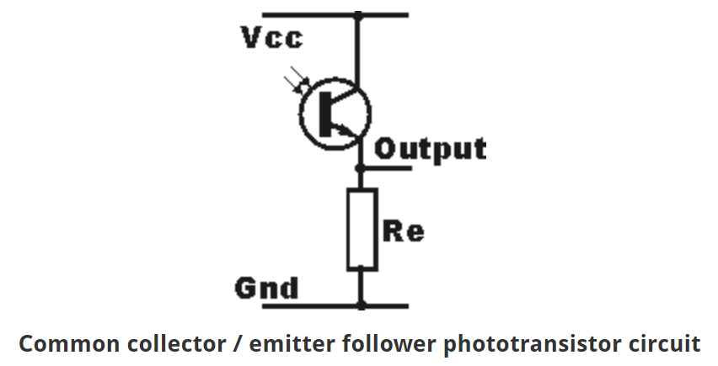
Photo Interrupter Con’t
Phototransistor Circuit:
2. Common Collector phototransistor circuit:
The output that moves from the low- state
to a high-state when light is detected.

