Slide 1
Data Base Check Point RDBMS
Done by Rahmouni Ferdaous

Slide 2

What’s MySQL?
MySQL is an open-source relational database management system (RDBMS).Its name is a combination of "My", the name of co-founder Michael Widenius's daughter, and "SQL", the abbreviation for Structured Query Language.
SQL which is used for adding, removing, and modifying information in the database. Standard SQL commands, such as ADD, DROP, INSERT, and UPDATE can be used with MySQL.

Slide 3

What’s Postgre SQL ?
PostgreSQL known as Postgres, is a free and open-source relational database management system (RDBMS) emphasizing extensibility and SQL compliance. It was originally named POSTGRES, referring to its origins as a successor to the Ingres database developed at the University of California, Berkeley. In 1996, the project was renamed to PostgreSQL to reflect its support for SQL.
Commonly supported objects include views, stored procedures, indexes, triggers and object-defined data types, in addition to general RDBMS features such as primary keys, foreign key relationships and atomicity.

Slide 4

What’s SQL server?
Microsoft SQL Server is a relational database management system developed by Microsoft. As a database server, it is a software product with the primary function of storing and retrieving data as requested by other software applications—which may run either on the same computer or on another computer across a network (including the Internet). Microsoft markets at least a dozen different editions of Microsoft SQL Server, aimed at different audiences and for workloads ranging from small single-machine applications to large Internet-facing applications with many concurrent users.

Slide 5
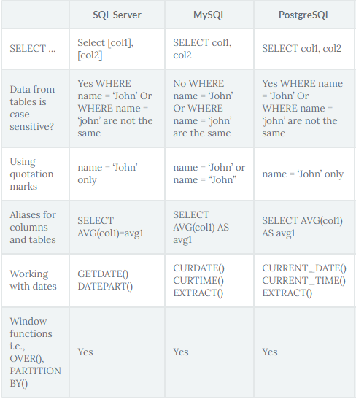
Comparison between the three RDBMS
Notes:
https://jelvix.com/wp-content/uploads/2020/07/infographic-01-scaled.jpg

