Slide 1



PetStore_Report
View in Power BI
Last data refresh:
1/21/2025 6:29:31 PM UTC
Downloaded at:
1/21/2025 7:13:12 PM UTC

Slide 2
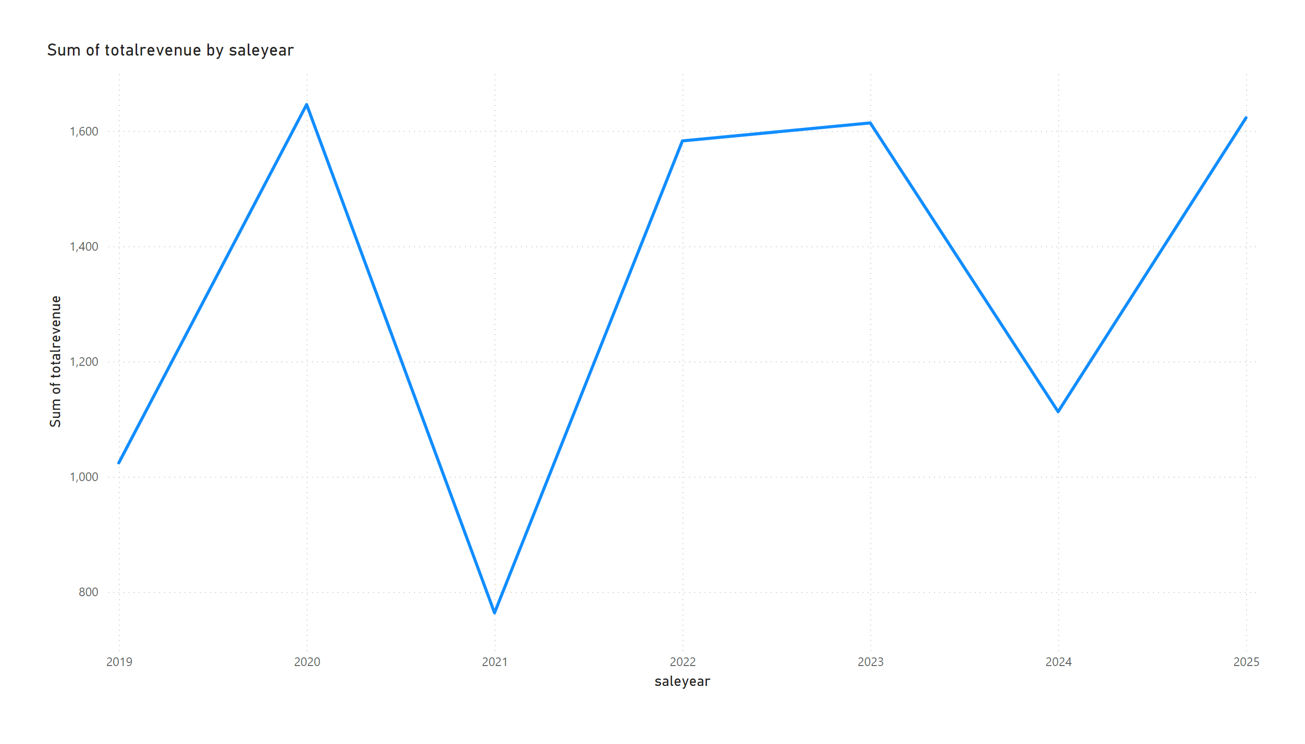
Page 1
Notes:
lineChart
No alt text provided

Slide 3
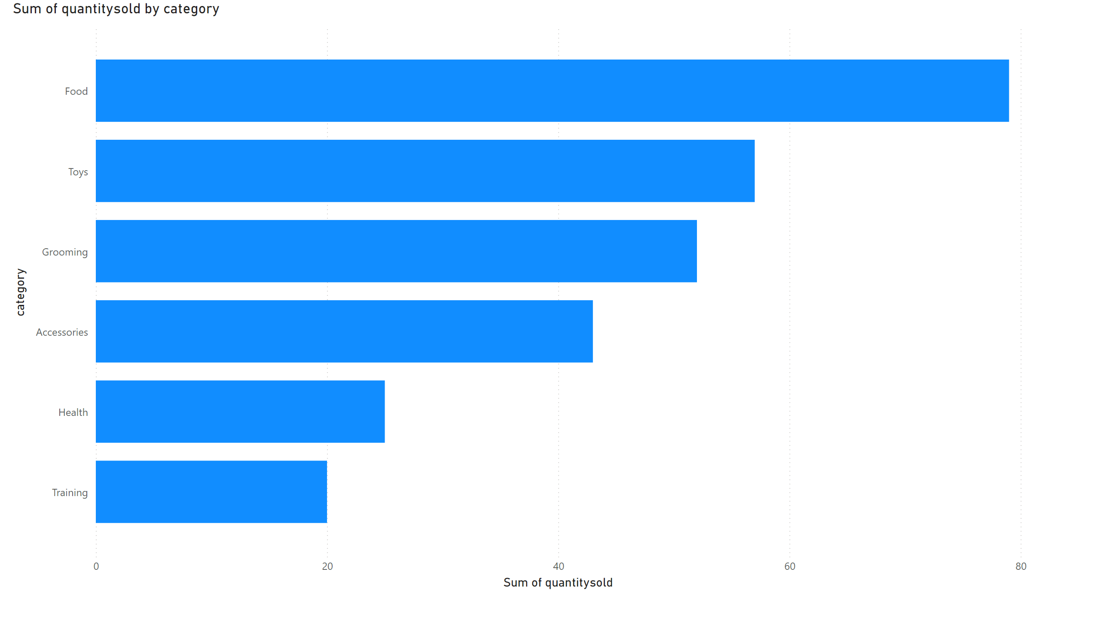
Page 2
Notes:
clusteredBarChart
No alt text provided

Slide 4
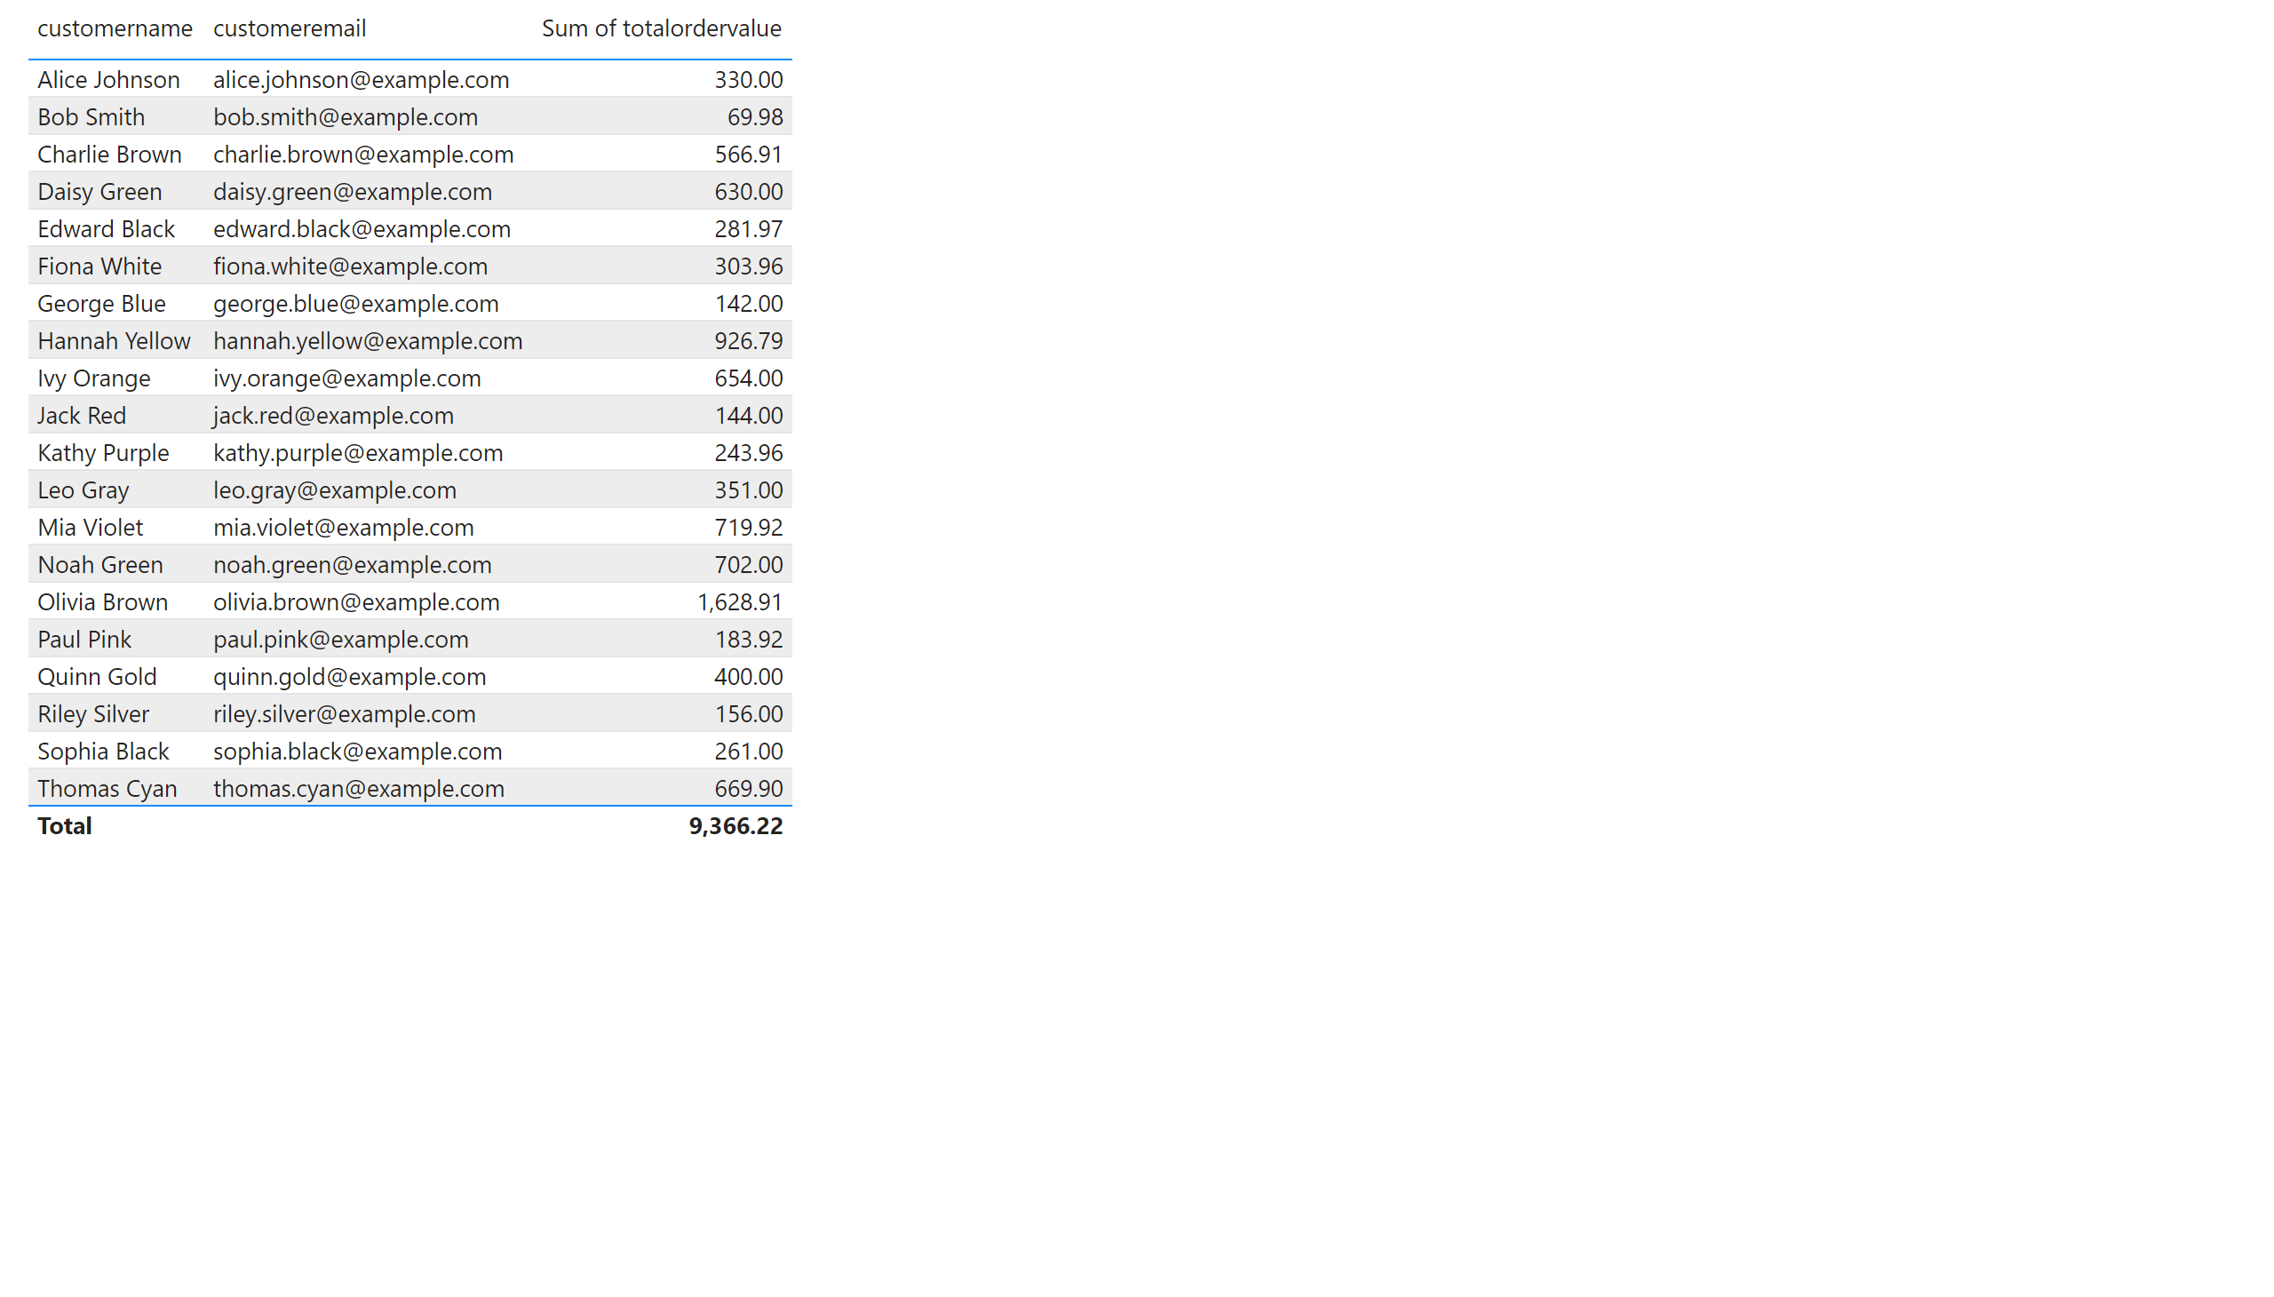
Page 3
Notes:
tableEx
No alt text provided

Slide 5
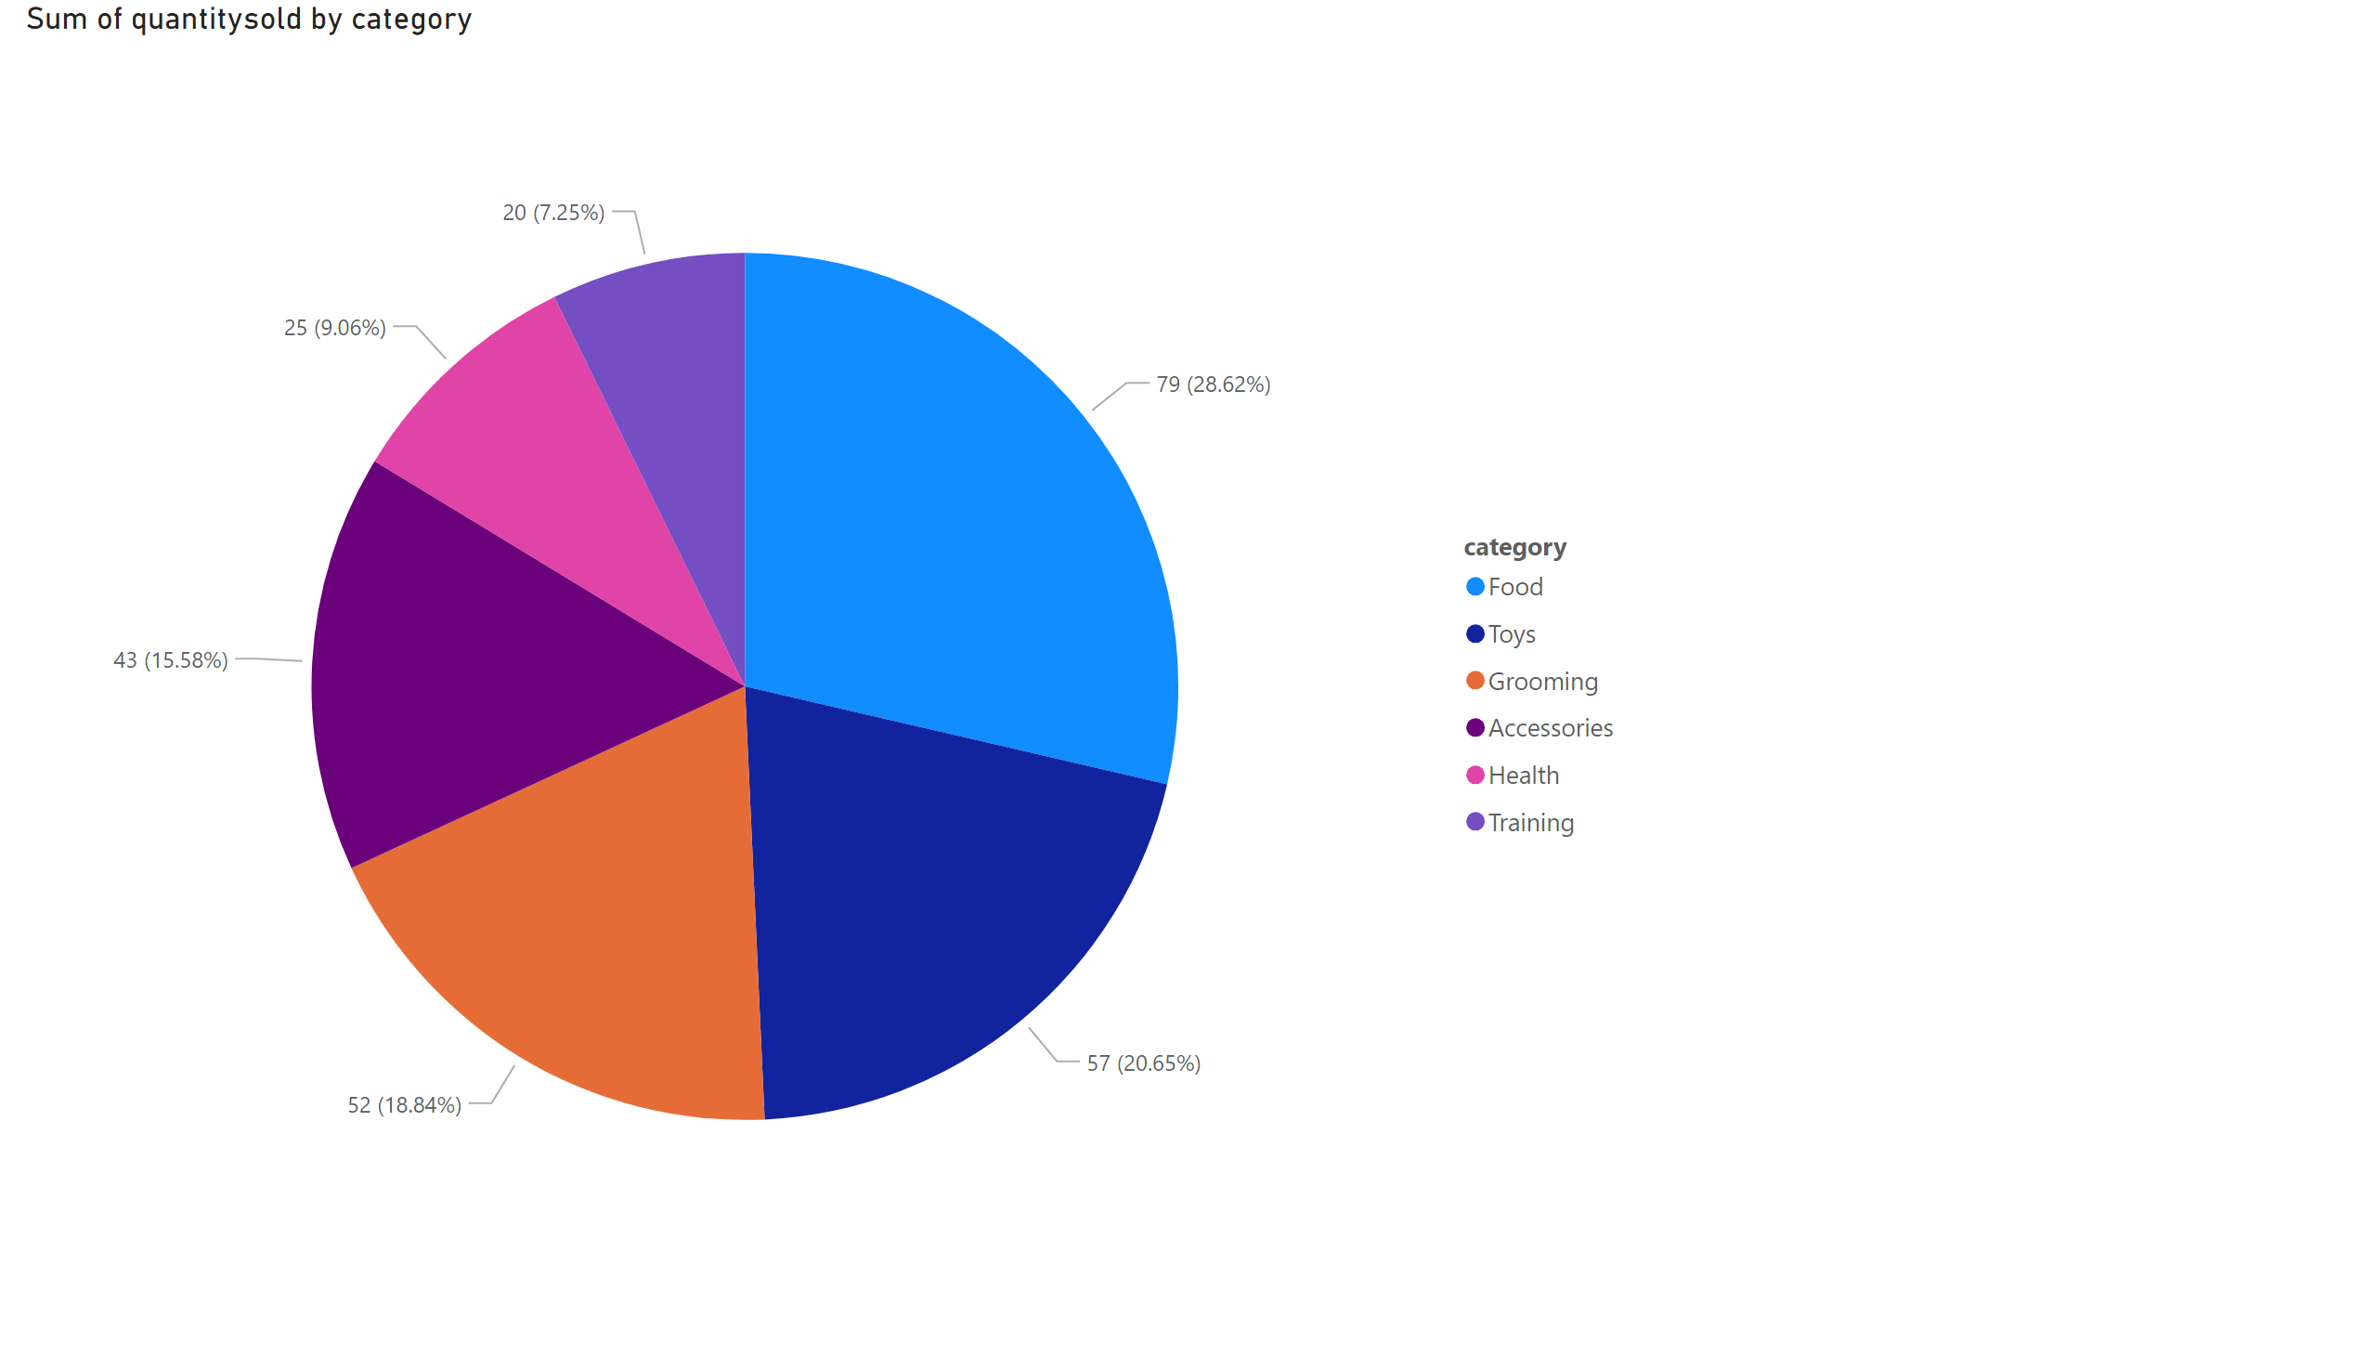
Page 4
Notes:
pieChart
No alt text provided

Slide 6
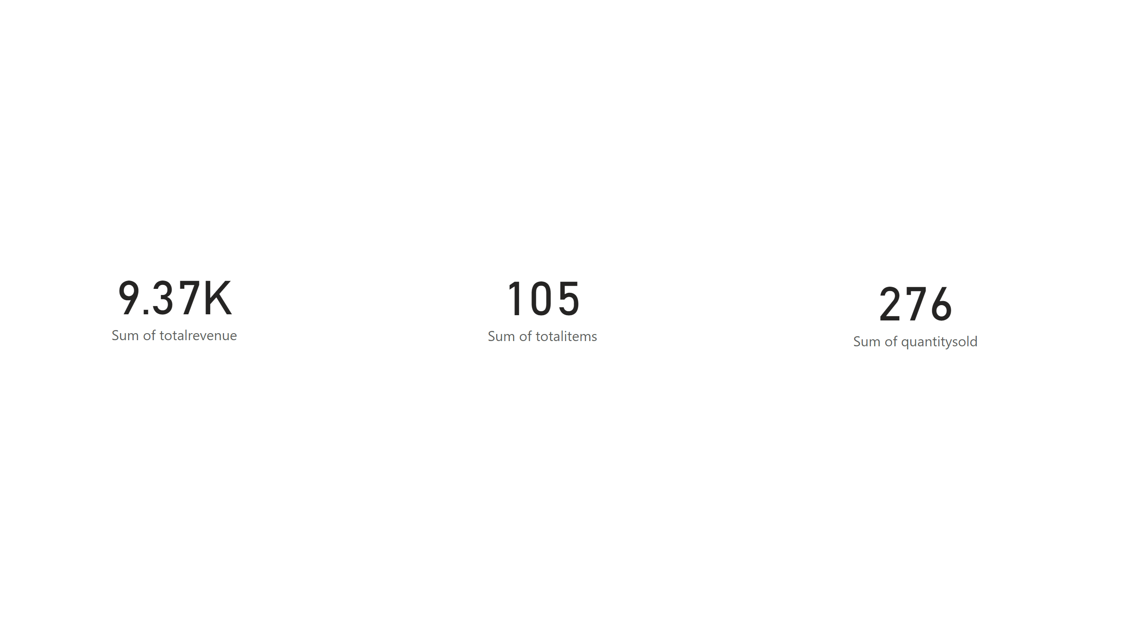
Page 5
Notes:
card
No alt text provided
card
No alt text provided
card
No alt text provided

