Slide 1



E-COMMERCE WEBSITE
GROUP 4
Rahool Singh
Sneha Bhamare
Shravani Sangle
Akash Jadhav
Jayesh Patel
Jay Tripati

Slide 2
Table of contents
01
Introduction
05
GUI
02
Our Project
06
Conclusion
03
Aims
07
Reference
04
Implementation

Slide 3

Introduction
E-commerce refers to the buying and selling of goods and services over the internet. This includes online retail, marketplaces, and other electronic transactions. E-commerce has grown rapidly due to the convenience and accessibility it offers. It allows businesses to reach a wider audience and provides consumers with more options. As an intern, our primary role was to develop key features of an e-commerce platform. Our objectives included learning new technologies, improving coding skills, and contributing to real-world projects.

Slide 4

Our Project
The project involved creating an online store with features such as product listings, track order and a shopping cart. Key features included user registration, a product catalog and build routine, a shopping cart and track order process. The expected outcomes were to produce a fully functional demo of the e-commerce site and to improve our skills in web development and project management. HTML was used for structuring the web pages, CSS for styling and layout, and JavaScript for adding interactivity and handling the logic.

Slide 5

Implementation
HTML
CSS
JAVASCRIPT
HTML (Hypertext Markup Language) is the standard markup language used for creating and structuring web pages and web applications on the internet. It defines the structure and content of web pages using a set of tags and attributes.
CSS (Cascading Style Sheets) is a language used for describing the presentation and styling of web pages. It defines how elements are displayed, including layout, colors, fonts, and more, enhancing the visual appeal and usability of websites.
JavaScript (JS) is a versatile programming language primarily used for adding interactivity to web pages. It enables dynamic content updates and interactive features, enhancing user experience on websites.

Slide 6
Project Aims
User-friendly
Sales
Convenience
Reach
Services
User engagement
Security
Review

Slide 7
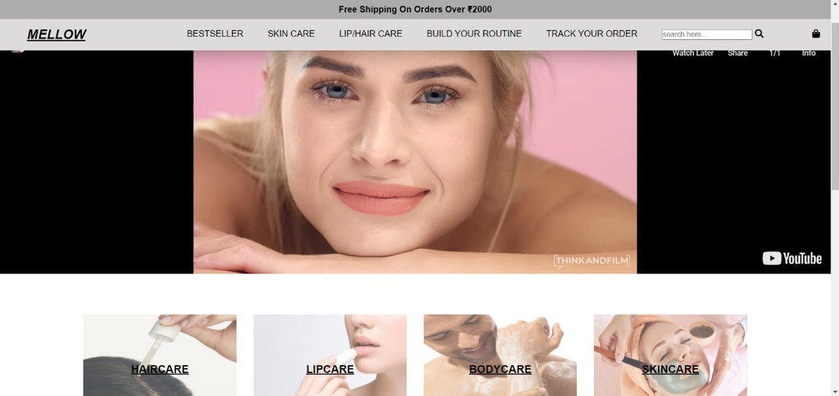
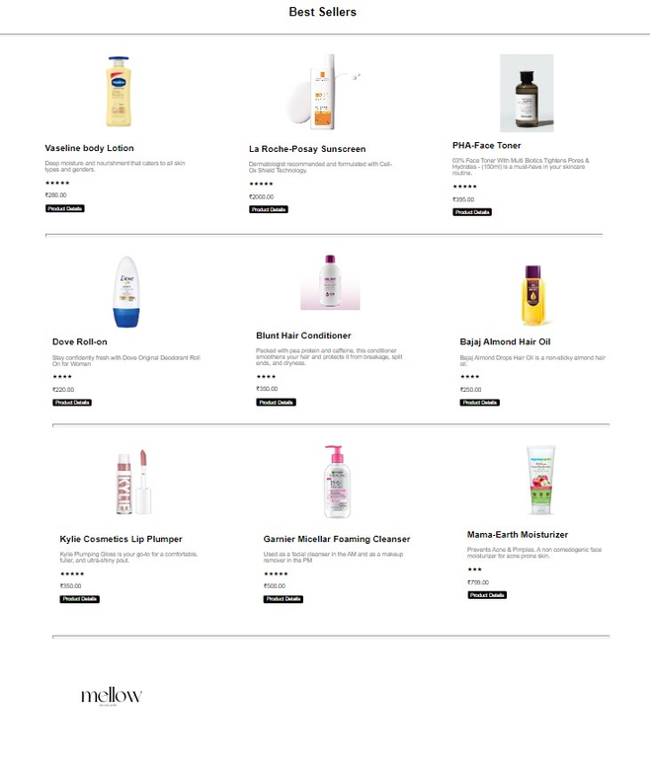
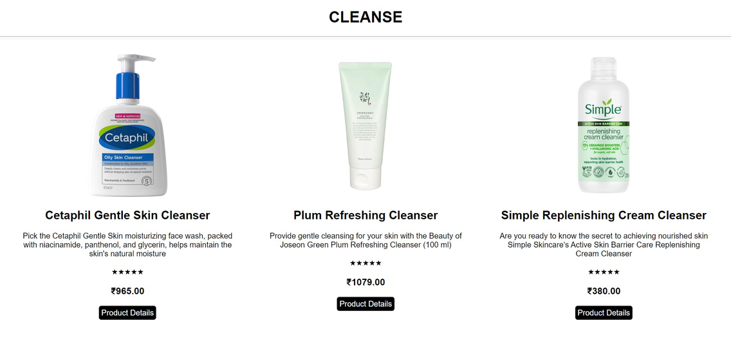
Graphical User Interface
Best Seller Page
Home Page
Product
Page

Slide 8
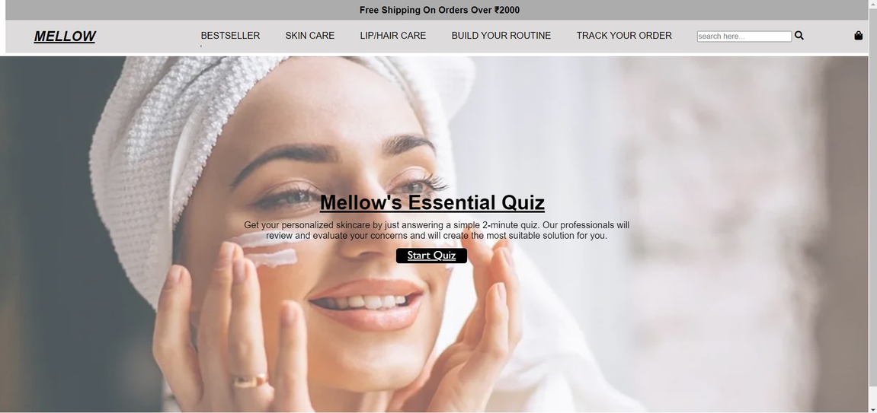
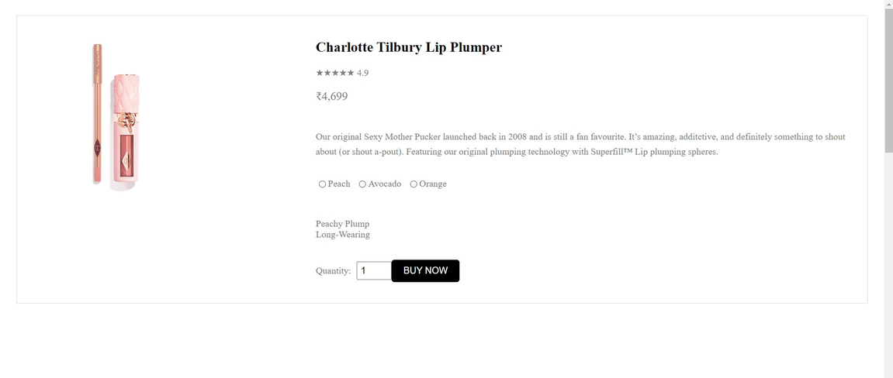
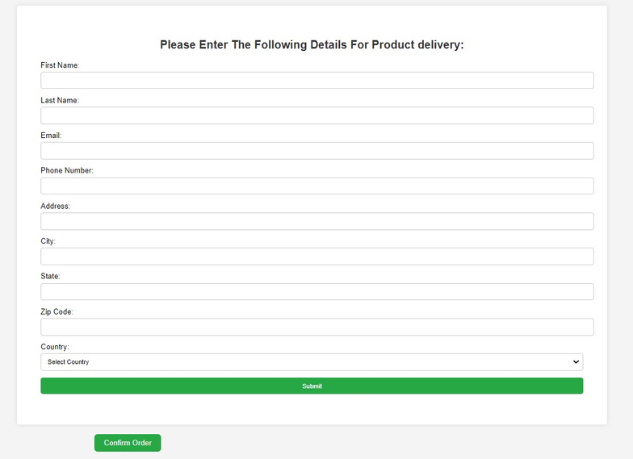
Graphical User Interface
Checkout Page
Product Detail Page
Build Your Routine

Slide 9
Conclusion
In summary, we developed a functional e-commerce website with key features such as user registration, product catalog, and shopping cart. Through this project, we gained hands-on experience with technologies like HTML, CSS and Javascript and overcame challenges in integrating third-party APIs. For future improvements, we plan to add more advanced features such as database management and improve the site's performance and scalability. This internship has significantly enhanced our problem-solving skills and coding proficiency, providing valuable insights into real-world web development.

Slide 10
References
https://www.w3schools.com/bootstrap/bootstrap_ref_comp_glyphs.asp
https://www.youtube.com/watch?v=HcOc7P5BMi4&t=5301s
https://www.w3schools.com/bootstrap/bootstrap_get_started.asp
https://www.youtube.com/watch?v=ESnrn1kAD4E&t=21136s

Slide 11
Thankyou !

