Slide 1

GitHub
SOCIAL CODING
Rahul Mohite 16 Oct 2020

Slide 2







Slide 3
What is GitHub?
What is Git?

Slide 4

Git
a distributed revision control system
Notes:
with an emphasis on speed.

Slide 5
Git
a distributed revision control system
Local
Centralized
Distributed
Notes:
版本控制系統是一個能夠記錄一個或一組檔案在某一段時間的變更，使得讀者以後能取回特定版本的系統。

Slide 6
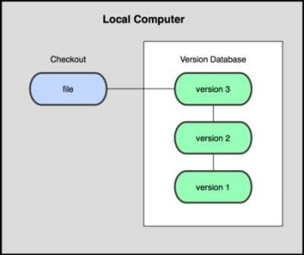
Revision Control System
Local
Ex. RCS
Image source : http://ascc.sinica.edu.tw/iascc/articals.php?_section=2.4&_op=?articalID:4811
Notes:
使用者將檔案複製到本機端其他目錄下，方法很簡單，但也很容易出現人為操作錯誤而發生問題。使用者容易忘記複製哪個目錄，或者寫入錯誤的檔案內。
缺點是無法共同協作 also if local computer breakdown -> gg

Slide 7

Revision Control System
Centralized
Ex. CVS, SVN
Image source : http://ascc.sinica.edu.tw/iascc/articals.php?_section=2.4&_op=?articalID:4811
Notes:
However, many large projects require multiple people to collaborate on development and editing. To solve this problem, a centralized version control system appeared.
This type of version control system has a single server that records all file changes. Project members or clients can also obtain files from the server. This version control system has many advantages over the local version control system. This type of board control allows all project-related personnel to know all the changes in the file and have a relative degree of understanding of what changes are made to the project. Administrators can also set permissions for all users and limit the actions that each member can perform. It is also easier for managers to maintain centralized archives than to maintain versions of archives scattered everywhere。

Slide 8
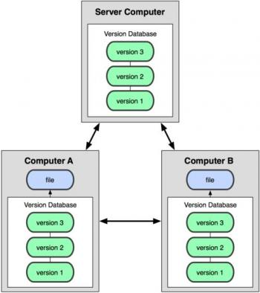
Revision Control System
Distributed
Ex. Mercurial, Bazaar, Darcs
Image source : http://ascc.sinica.edu.tw/iascc/articals.php?_section=2.4&_op=?articalID:4811
Notes:
The client is not only the latest version, but also the entire database content is copied. Even if the computer commonly used by developers is damaged, any user's previous content can be copied and restored. Every time you obtain the change file data, you copy all the database contents.

Slide 9
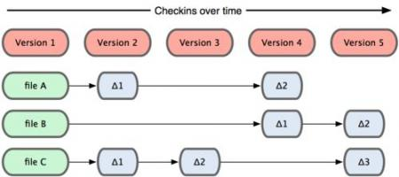
Git
Image source : http://ascc.sinica.edu.tw/iascc/articals.php?_section=2.4&_op=?articalID:4811
Notes:
Git originated from the development of Linus Torvalds and the Linux kernel. Linux kernel is a complex and large-scale project. The first project used BitKeeper for version control, but after a break with BitKeeper's company, Linus Torvalds used BitKeeper's experience to design a board control system that meets the following five points. (2005)
fast
Simple design
Full support for non-linear development
Completely distributed system
Can effectively handle images like
Linux kernel scale project

Slide 10
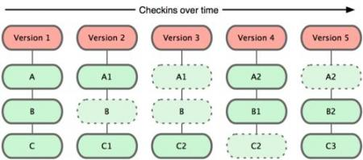
Git
Image source : http://ascc.sinica.edu.tw/iascc/articals.php?_section=2.4&_op=?articalID:4811
Notes:
Git originated from the development of Linus Torvalds and the Linux kernel. Linux kernel is a complex and large-scale project. The first project used BitKeeper for version control, but after a break with BitKeeper's company, Linus Torvalds used BitKeeper's experience to design a board control system that meets the following five points. (2005)
fast
Simple design
Full support for non-linear development
Completely distributed system
Can effectively handle images like
Linux kernel scale project

Slide 11
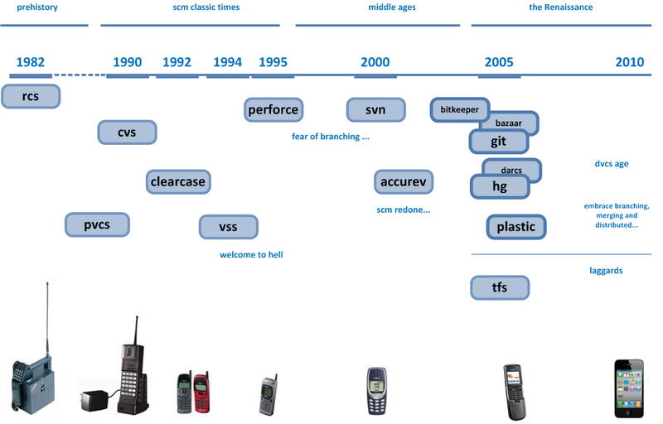
Fun Facts
Design Criteria:
Take CVS as an example of what not to do; if in doubt, make the exact opposite decision.
Support a distributed, BitKeeper-like workflow.
Very strong safeguards against corruption, either accidental or malicious.
Notes:
Git originated from the development of Linus Torvalds and the Linux kernel. Linux kernel is a complex and large-scale project. The first project used BitKeeper for version control, but after a break with BitKeeper's company, Linus Torvalds used BitKeeper's experience to design a board control system that meets the following five points. (2005)
fast
Simple design
Full support for non-linear development
Completely distributed system
Can effectively handle images like
Linux kernel scale project

Slide 12
History of version system
https://www.lynda.com/ALMTFS-tutorials/history-version-control/106788/115979-4.html

Slide 13
Fun Facts
Design Criteria:
Take CVS as an example of what not to do; if in doubt, make the exact opposite decision.
Support a distributed, BitKeeper-like workflow.
Very strong safeguards against corruption, either accidental or malicious.
Notes:
Git originated from the development of Linus Torvalds and the Linux kernel. Linux kernel is a complex and large-scale project. The first project used BitKeeper for version control, but after a break with BitKeeper's company, Linus Torvalds used BitKeeper's experience to design a board control system that meets the following five points. (2005)
fast
Simple design
Full support for non-linear development
Completely distributed system
Can effectively handle images like
Linux kernel scale project

Slide 14
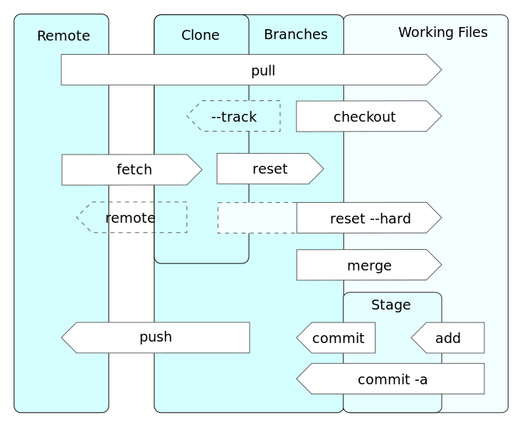
Operations

Slide 15
Operations

Slide 16
Operations
git repository

Slide 17
Operations

Slide 18
Operations

Slide 19
Operations
clone

Slide 20
Operations
checkout

Slide 21
Operations
pull

Slide 22
Operations
commit
add
commit -a

Slide 23
Operations
push

Slide 24

What is GitHub?
A web-based hosting service for software development projects that used Git revision control system.
Provides social networking functionality
Notes:
Launched in 2008, became the the most popular code repository site for open source projects by 2011.
2. functionality such as feeds, followers and the social network graph to display how developers work on their versions of a repository.
3. Offer paid plans for private repositories, and free accounts for open source projects.

Slide 25

Projects on GitHub
Linux Mint
Perl
PHP
Prey
Prototype JavaScript
Ruby
Ruby on Rails

Slide 26

Reference
http://en.wikipedia.org/wiki/Git_(software)
http://ascc.sinica.edu.tw/iascc/articals.php?_section=2.4&_op=?articalID:4811
http://coolshell.cn/articles/3288.html
http://en.wikipedia.org/wiki/Revision_control
http://billy3321.blogspot.tw/2009/02/github-howto.html

