Slide 1


Introduction to Git and Github
Joshua Gall
@SirkleZero
imtraum.com
Notes:
How to think like Git
Not going to go over anything that is really specific to .NET (language and platform independent)
Give some resources

Slide 2
Introduction to Git and Github
An overview of Git
Getting started on Windows
Using Git from the Command Line
Creating Repositories
Working with code
Working with Remotes
A simple development workflow
Some GitHub stuff

Slide 3

Git is…
“A pubescent kid who thinks it’s totally cool to act like a moron on the internet, only because no one can actually reach through the screen and punch their lights out.” – Urban Dictionary
Notes:
Was written to manage the linux kernel
Built to handle very large projects
Sucks at large binary management

Slide 4
Git is…
Git is an open source distributed version control system designed for speed and efficiency.
Notes:
Was written to manage the linux kernel
Built to handle very large projects
Sucks at large binary management

Slide 5
Git is…
Git is an open source distributed version control system designed for speed and efficiency.
Git is DISTRIBUTED (but mostly local)
Git is FAST
Git is COOL
Notes:
Was written to manage the linux kernel
Built to handle very large projects
Sucks at large binary management

Slide 6
Git Isn’t
like TFS, VSS or Subversion
hard to learn
great at versioning large binary files (media for example)
Notes:
Was written to manage the linux kernel
Built to handle very large projects
Sucks at large binary management

Slide 7
Why Git?
Working with Git will change how you develop concurrent software.
Work local by default, work with server when needed
It’s fast, Ferreals fast
Branches are Easy, not Scary
Merges are Trivial (Reintegration Merges == ERMAHGERD)
Cryptographically verifiable
Every repository is a backup in some form
Scriptable
Notes:
Reintegration merges – once a branch is merged to master (trunk), you can continue doing work in that branch. Let that sink in for a moment.

Slide 8
Why Git?
Git doesn’t store files as deltas
Git does store the entire file as a blob
Referenced by the SHA1 file checksum
A recursive manifest of SHA pointers for structure and renames
Renames are heuristic (default 50%, configurable)
Git database is immutable, though you can re-write history
Git branches aren’t just another folder
Git has a single workspace
Notes:
Each commit creates a recursive manifest of pointers

Slide 9
Gitting Started on Windows
Install msysgit from www.git-scm.org
Choose (and install) a Git Interface
GitHub for Windows (Phil Haack)
TortoiseGIT
Git Extensions
Command Line (Powershell)
Many others available
Set your name and email address
Via Gui
Via Command Line
git config –global user.name “Joshua Gall”
git config –global user.email “josh@imtraum.com”

Slide 10
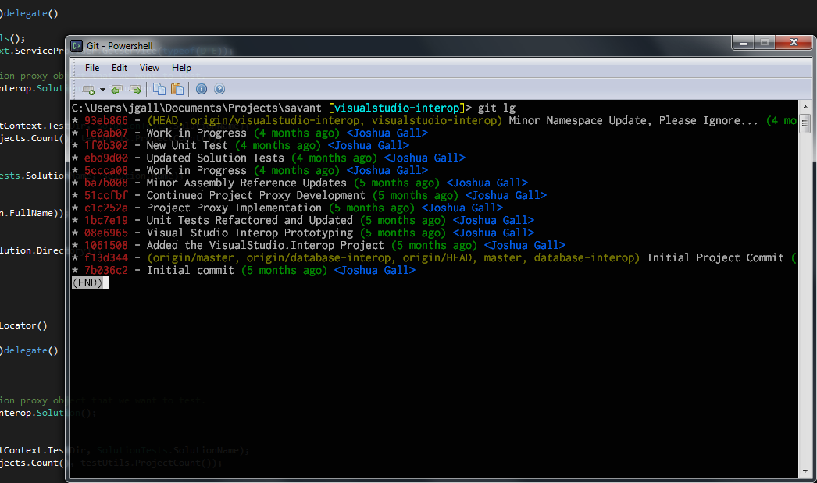
My Git Environment
I prefer a command line environment based on
msysgit
Powershell
Console2
Posh-Git
Sublime Text 2
DiffMerge
Using Git via command line will help you adjust to the differences between Git and other SCM’s.
demo

Slide 11
Everyday Git Commands
Create Repository
init
clone
Snap Shots
add
status
diff
commit
reset
rm, mv
stash
Branching and Merging
branch
merge
checkout
log
tag
Sharing
fetch
push
remote
Inspection
log, diff

Slide 12
Remotes
Remotes are what make Git Distributed and Confusing
Remotes are just a URL that’s been aliased
Commands
remote
push
fetch (or pull)
merge
Git protocols
Local – read/write a file system (local, share, friends computer)
Git – generally read-only
SSH – Git protocol over SSH
HTTP/S
Notes:
- intro here about how after knowing how to work with git local, working with a remote only involves a few more commands
- note that you can have many remotes

Slide 13
Cool GitHub Stuff
GitHub hosts repositories – a remote for your local repo
GitHub hosts Wiki’s versioned by Git
GitHub has simple defect tracking
Pull Requests – Code Review and Collaboration
Numerous ways to navigate your code
demo

Slide 14
A Simple Git Workflow
To work on something new, create a descriptively named branch off of master. This is a topic branch.
Commit to that branch locally and regularly push your work to the same named branch on the server.
Keep your topic branch up to date with master.
When you need feedback or help, or you think the branch is ready for merging, open a pull request
After someone else has reviewed and signed off on your new feature, merge it into master.
Once deployed to master, you can and should deploy immediately.

Slide 15
Introduction to Git and Github
Helpful Git Resources
git-scm.com – Git Documentation
github.com – Repository Hosting
gitref.org – Reference Materials
progit.org – Downloadable Book
try.github.com – Git Tutorial
Follow me @SirkleZero
imtraum.com

