Slide 1
R RAHUL
Generative AI for Engineering (E2324)
IBM-EDUNET FOUNDATION
Email:rahulkarna321@gmail.com
Reg No: 211521243124
Department of AI & DS
Panimalar Institute of Technology, Chennai
3/28/2024

Slide 2
PROJECT TITLE
"FACE RECOGNITION ATTENDANCE SYSTEM"

Slide 3

AGENDA
Problem Statement
Proposed System/Solution
System Development Approach
Algorithm & Deployment
Result
Conclusion
Future Scope
References

Slide 4
PROBLEM STATEMENT
problem statement:Traditional attendance systems often suffer from inaccuracies, inefficiencies, and susceptibility to manipulation. To address these shortcomings, there is a growing demand for the implementation of advanced biometric technologies such as face recognition for attendance tracking in various organizations, institutions, and workplaces. However, developing a robust and reliable Face Recognition Attendance System poses several challenges that need to be addressed

Slide 5
PROPOSED SYSTEM
key features
face deletion and recognition
real time processing
adaptive learning
user friendly interface
security and privacy
scalability and integration
benefits
conclusion
5

Slide 6
SYSTEM DEVELOPMENT APPROACH
Introduction:
Brief overview of the importance of attendance tracking and the role of face recognition technology.
Objective: To outline the development process of a face recognition attendance system.
Overview of System Development Approach:
Explanation of the systematic approach involving key steps.
Steps include Requirement Analysis, Technology Selection, Data Collection, Model Training, Integration, Testing & Evaluation, Deployment, Maintenance, and Continuous Improvement.
Requirement Analysis:
Importance of understanding user needs, hardware resources, security, and integration requirements.
Technology Selection:
Discussion of different face recognition technologies.
Factors considered: accuracy, speed, compatibility.
Data Collection and Preprocessing:
Importance of gathering a diverse dataset.
Preprocessing steps: standardization of lighting, facial expressions, and pose.

Slide 7
ALGORITHM & DEVELOPMENT
Data Collection and Preprocessing:
Gather a dataset of facial images representing all individuals who will be enrolled in the system.
Preprocess the images to standardize factors like lighting conditions, facial expressions, and pose variations to improve model accuracy. Common preprocessing techniques include normalization, resizing, and histogram equalization.
Feature Extraction:
Utilize a pre-trained deep learning model (such as a Convolutional Neural Network - CNN) to extract features from the preprocessed facial images. Features may include facial landmarks, texture, and spatial relationships.
Model Training:
Train a face recognition model using the extracted features. Popular algorithms include DeepFace, VGG-Face, and FaceNet.
Split the dataset into training and validation sets, and utilize techniques like cross-validation to tune hyperparameters and prevent overfitting.
Face Enrollment:
Implement a user interface for administrators to enroll individuals into the system.
Capture facial images of individuals, preprocess them, and extract features using the trained model.
Store the extracted features along with the corresponding user IDs in a database.
Face Recognition:
Implement the face recognition algorithm to identify individuals from live or recorded video streams.
Preprocess incoming facial images and extract features using the trained model.
Compare the extracted features with the features stored in the database to identify the individual.
Utilize distance metrics such as Euclidean distance or cosine similarity to measure the similarity between feature vectors.

Slide 8
ALGORITHM & DEVELOPMENT
Attendance Marking:
Upon successful recognition of an individual, mark their attendance by recording the timestamp.
Maintain a record of attendance for each individual, which can be stored in a database or exported to a spreadsheet for further analysis.
User Interface:
Develop a user-friendly interface for both administrators and users.
Administrators should have access to features such as user enrollment, system configuration, and attendance reporting.
Users should be able to view their attendance records and receive notifications of attendance status.
Integration and Deployment:
Integrate the face recognition attendance system with existing attendance management systems or HR software if required.
Deploy the system in the intended environment, ensuring compatibility with hardware and network infrastructure.
Testing and Evaluation:
Conduct extensive testing to evaluate the system's accuracy, speed, and robustness under various conditions.
Collect feedback from users and stakeholders to identify areas for improvement.
Maintenance and Updates:
Regularly update the system to incorporate improvements in face recognition algorithms and address security vulnerabilities.
Provide technical support and maintenance to ensure the system's smooth operation over time.

Slide 9
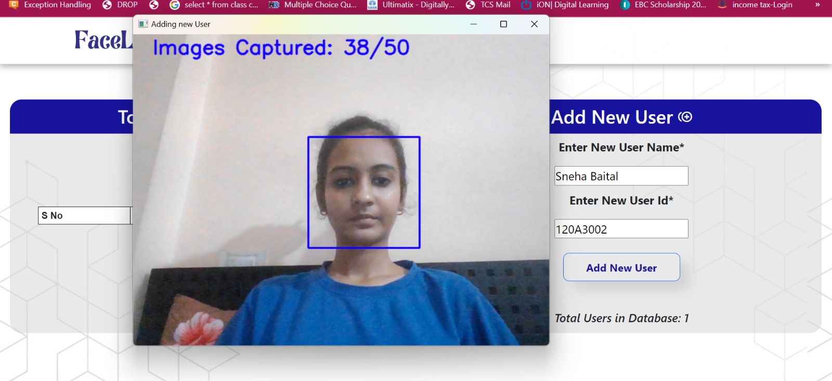
RESULT
*
9

Slide 10
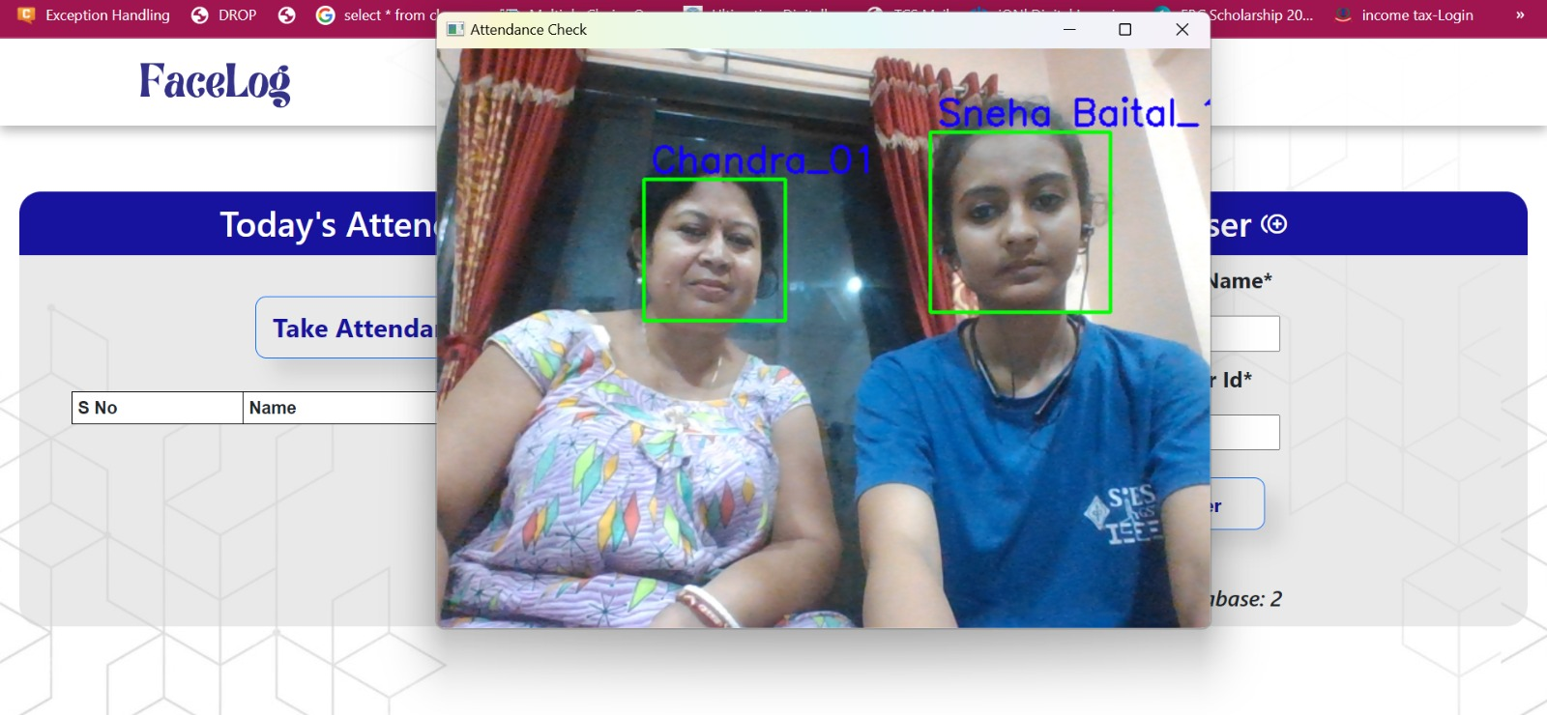
RESULT
10

Slide 11
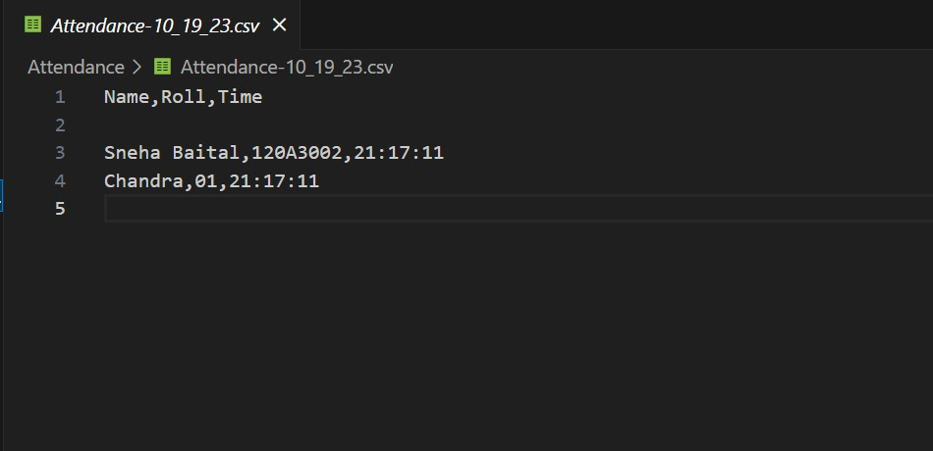
RESULT
11

Slide 12
CONCLUSION
Accurate Prediction: The LSTM model demonstrated strong performance in classifying heart disease presence based on clinical parameters.
Insights into Performance: Confusion matrix analysis and visualization of learning curves provided clear understanding of model performance and areas for improvement.
Clinical Applications: The model offers potential for aiding healthcare professionals in risk assessment, leading to timely interventions and better patient outcomes.
Future Directions: Refinement of model architecture, integration of diverse data sources, and addressing ethical considerations are key for enhancing predictive accuracy and applicability.
Ethical Considerations: Ensuring transparency, privacy, and interpretability are vital for responsible deployment of predictive analytics tools in healthcare.
The Coding of the project is uploaded in GitHub, click below button to see the code :)
https://github.com/Rahu2003/Naan-Mudhalvan.git
12

Slide 13
“ANOTHER FORM OF MODERNIZATION IS CONSERVING ENERGY FOR THE FUTURE”
THANK YOU!

