Slide 1
Mobile price prediction machine learning project
Present by : Rahul Makwana

Slide 2
Introduction :-
Objective : this is machine learning project objective is discover new data insights and
patterns , or to predict output value from given set of input variables
Example : to predict mobile phone prices using machine learning technique based on
features like RAM , battery , camera and other.
Problem statement : price comparison is crucial for customers when choosing the best
smartphone

Slide 3
Step of build machine learning model :-
The basic steps of machine learning are :
Understand the business problem
Understand what data is needed
Collect and preprocessing data
Choose a model
train the model
Evaluate the model
Deploy the model

Slide 4
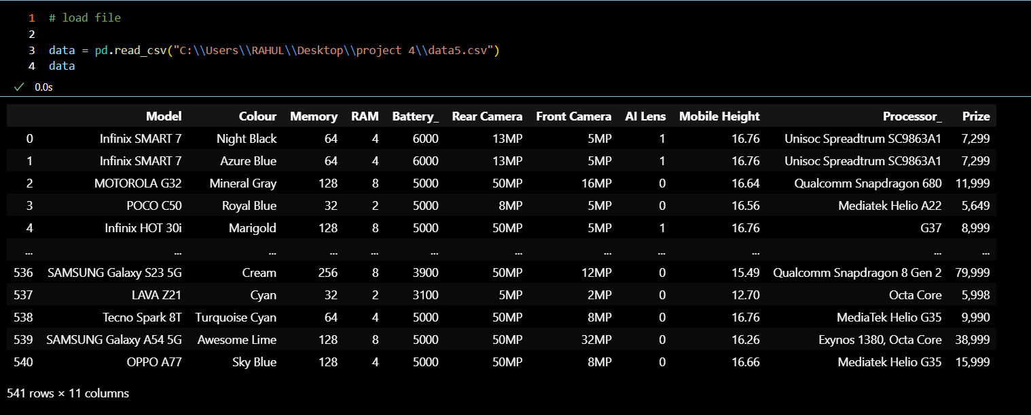
Data collection : -
Data set information:
Data set example :
No. rows = 541
No. columns = 11
Examples of features = model ,colour , memory , RAM , rear camera , front camera etc..

Slide 5
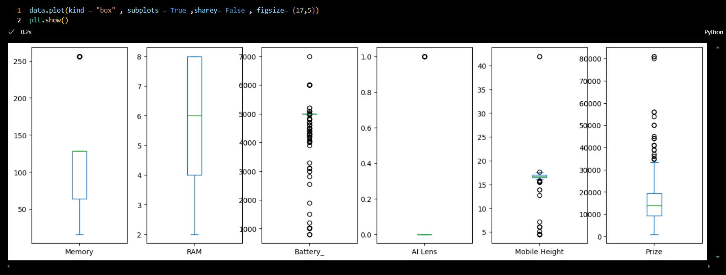
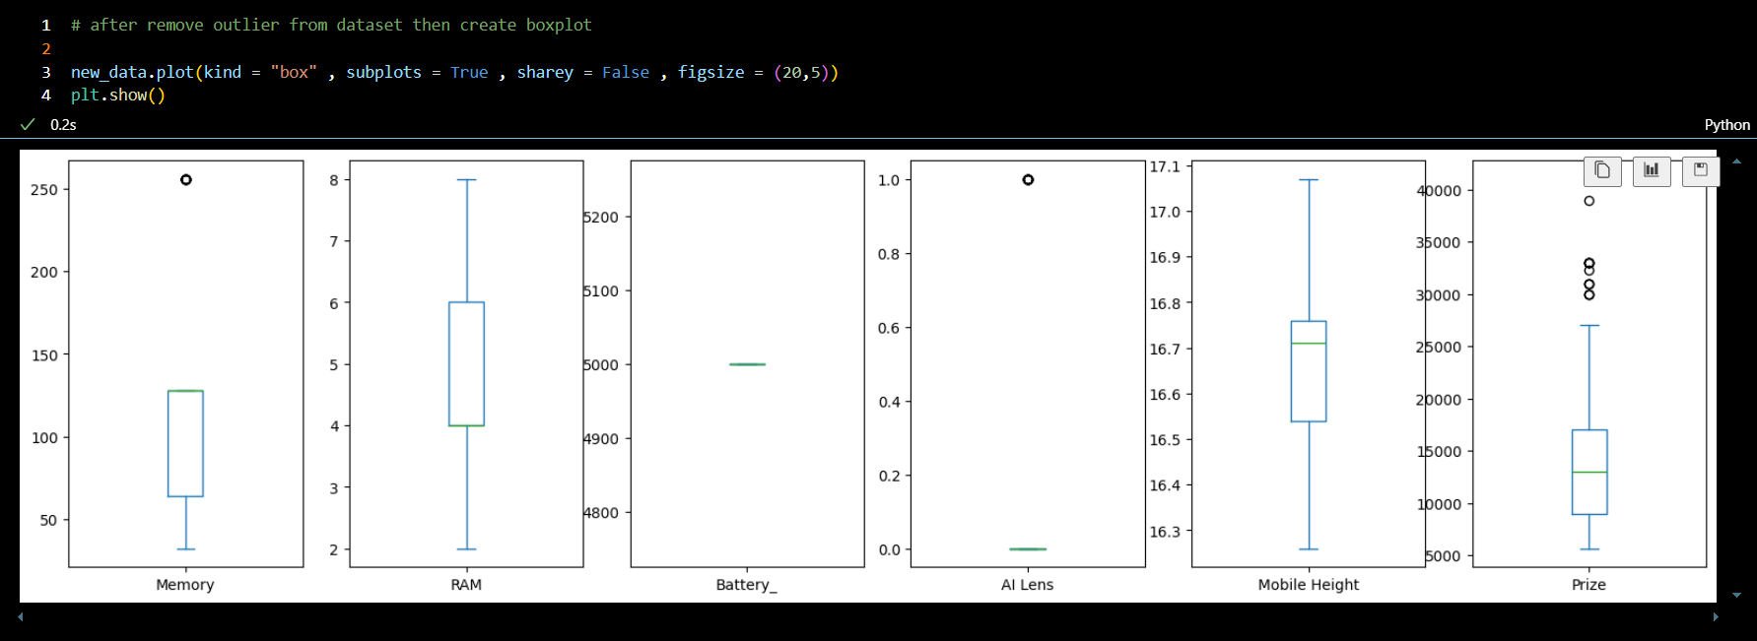
Handling missing values in dataset :-
Outlier present In dataset :
Apply IQR method and remove outlier in dataset :

Slide 6
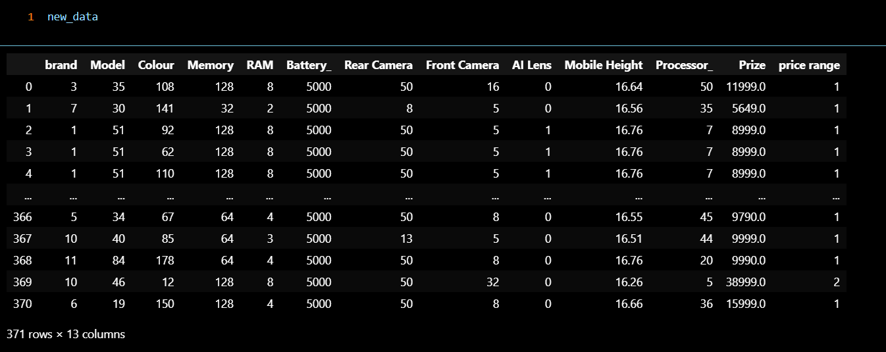
Encoding categorical data :-
In dataset apply label encoding and convert into int

Slide 7
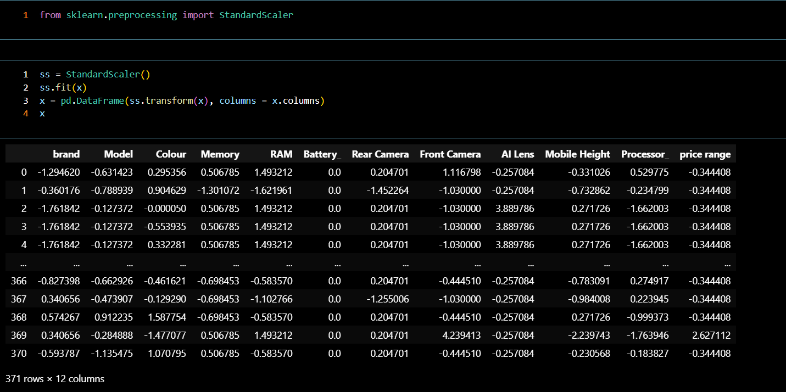
Feature scaling in dataset :-

Slide 8
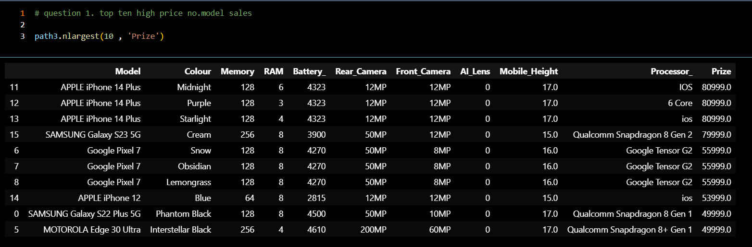
Exploratory data analysis visualizations :-
In top ten high price selling mobile :
Key insight from the data :
in dataset top ten high price selling mobiles
In show dataset same company like apple giving in less features in mobile but price will be high observed in other mobile company.

Slide 9
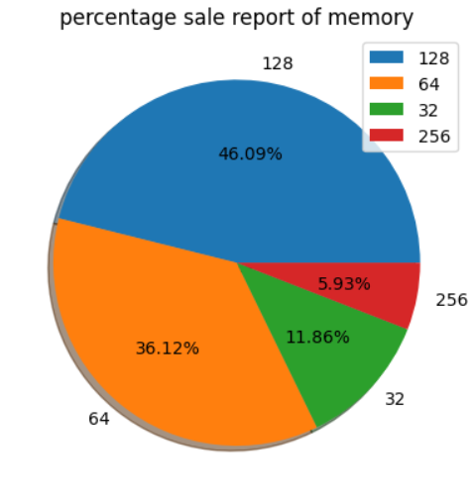
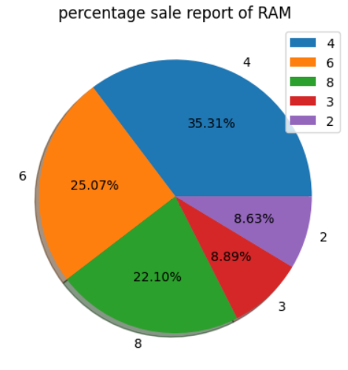
Percentage sale report of memory and RAM :-
Show in percentage sale report of memory :
Show in percentage sale report of RAM :

Slide 10
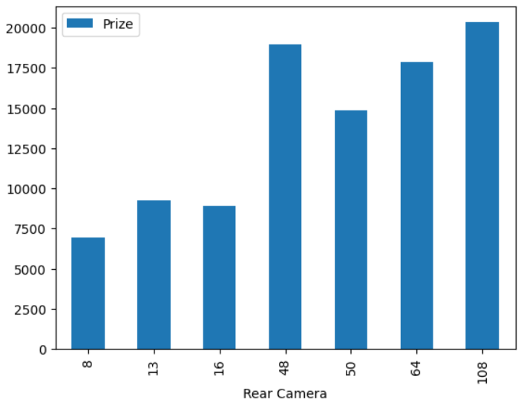
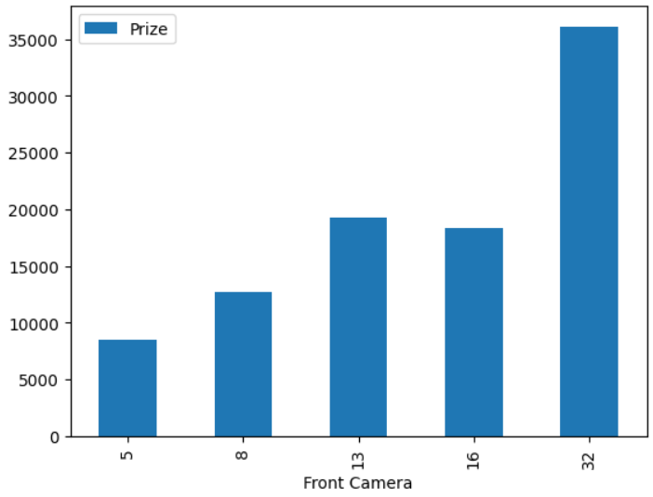
Sale report of camera :-
Bar plot is rear camera :
Bar plot is front camera :

Slide 11
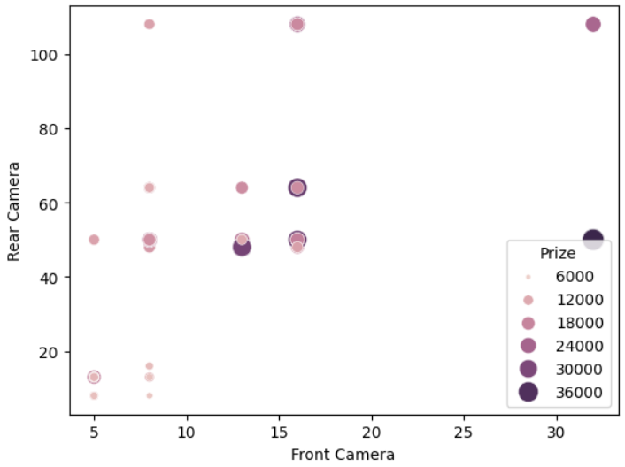
Scatter plot camera vs price :-
Prize distribution of using scatter plot :
Insight found in scatter plot :
in No. of mobile due to mobile company like Vivo, poco, Redmi are giving average features and less price so more No. of mobile sale.
Which mobile front camera less than 20MP and rear camera more less than 80MP so No. Mobile is more sell.

Slide 12
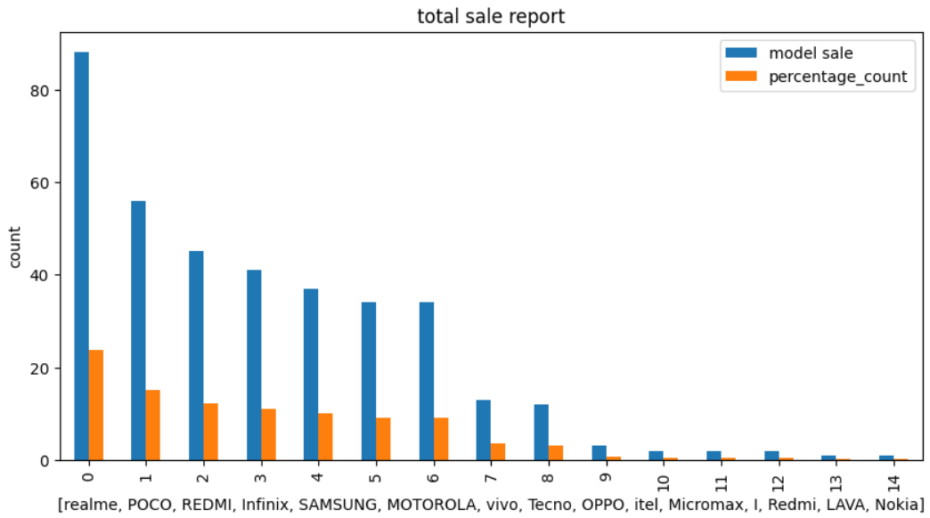
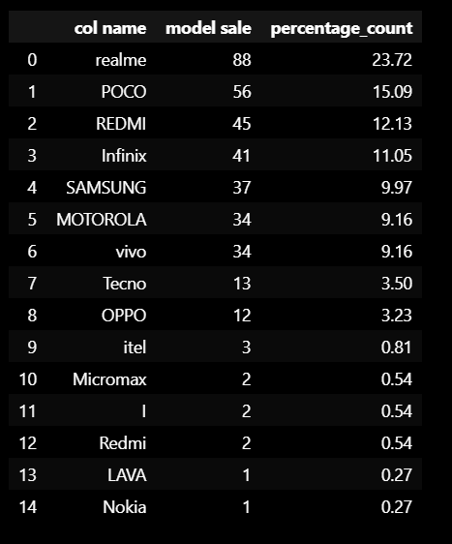
Total sale report :-
Bar plot of total sale report :
Data Frame :

Slide 13
Accuracy Comperation of different models :-
Accuracy comperation of different machine learning models :
Machine learning algorithms | Train accuracy | Test accuracy
Linear regression | 85.6675 | 83.8415
Lasso regression | 85.6668 | 83.7873
Ridge regression | 85.6675 | 83.8381
Decision tree regression | 94.6864 | 93.0206
Random forest regression | 98.7213 | 94.4901
Support vector algorithms | -3.8889 | -9.9173
KNeighborsRegressor | 99.9211 | 97.2125

Slide 14
Conclusion :-
Best fit model our dataset is KNN due to Accuracy high observed in different machine learning models.
Check confusion metrics of regression mean squared error , mean absolute error , r2 score also find less error observed in different machine learning models confusion metrics.
Also, price predict efficiently with new data.
The model can help businesses or individuals make informed decisions in pricing strategies or investments.
I am learning about this project is how to apply machine learning algorithms and built model so solve business problem.

Slide 15
Thank you

